Slide 1


Slide 2

Unit
6
1
Unit
FAMILY LIFE
GENDER EQUALITY
LESSON 1
GETTING STARTED
Equal job opportunities

Slide 3

Unit
1
1
FAMILY LIFE
Family Life
Unit
OBJECTIVES
Gain an overview about the topic Gender Equality
Identify and use words and phrases related to the topic Gender Equality
Identify and use the passive voice with modals

Slide 4
LESSON 1
GETTING STARTED
Unit
GETTING STARTED
WARM-UP
Game: Charades!
PRESENTATION
Vocabulary
Task 1: Listen and read.
Task 2: Read the conversation again and tick (✔) T (True) or F (False).
Task 3: Match the words to make meaningful phrases
Task 4: Complete the summary.
PRACTICE
CONSOLIDATION
Wrap-up
Home work

Slide 5
LESSON 1
GETTING STARTED
Unit
WARM-UP
Game: Charades!

Slide 6
WARM-UP
Charades – Rules:
Play in two teams.
Each team sends one student to the board, facing the class. They MUST NOT turn around!
When a word appears on the screen: Everyone must describe the word to the guesser of your team. No talking!
Whoever guesses the word faster wins 1 point.
Both teams change the guesser after each word.

Slide 7
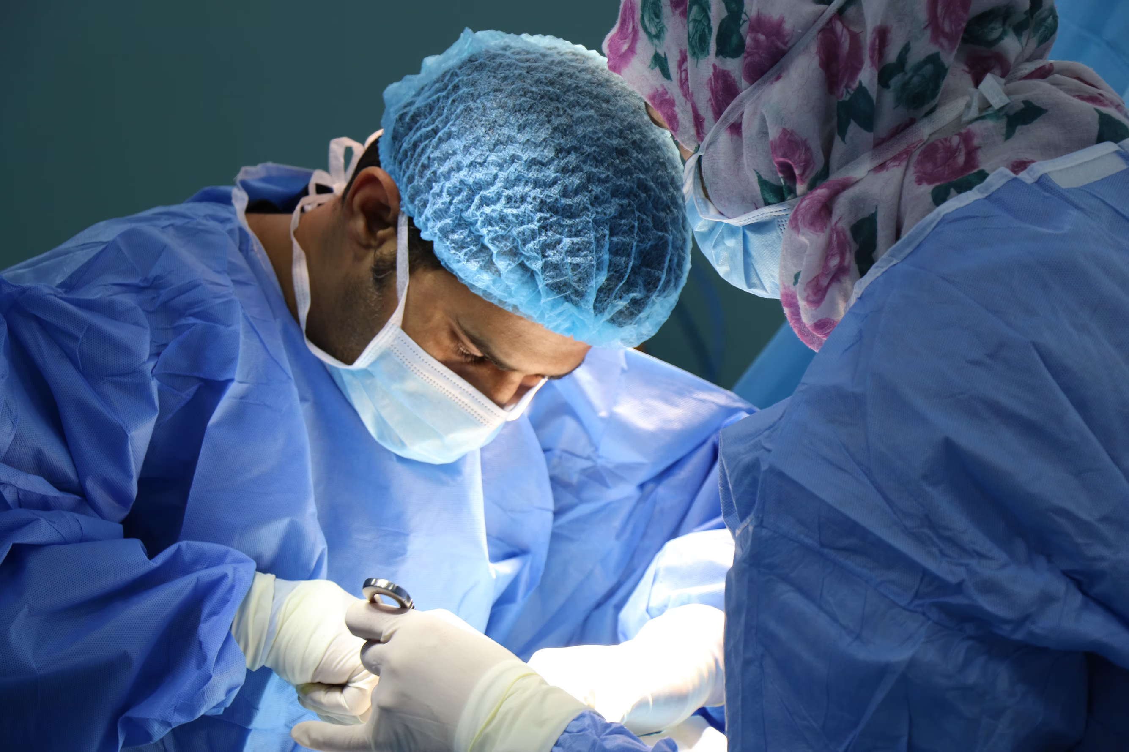
Surgeon

Slide 8
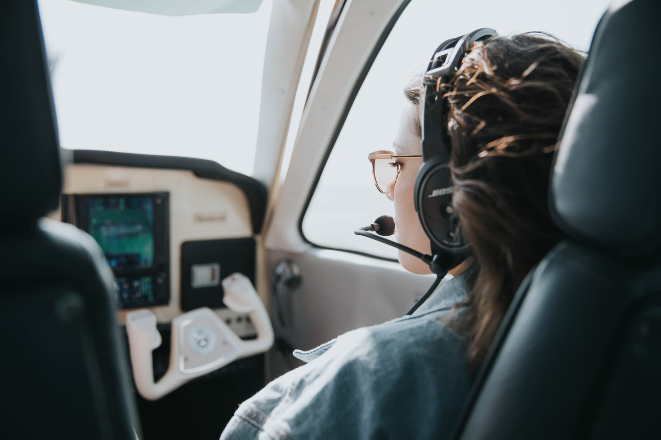
Pilot

Slide 9
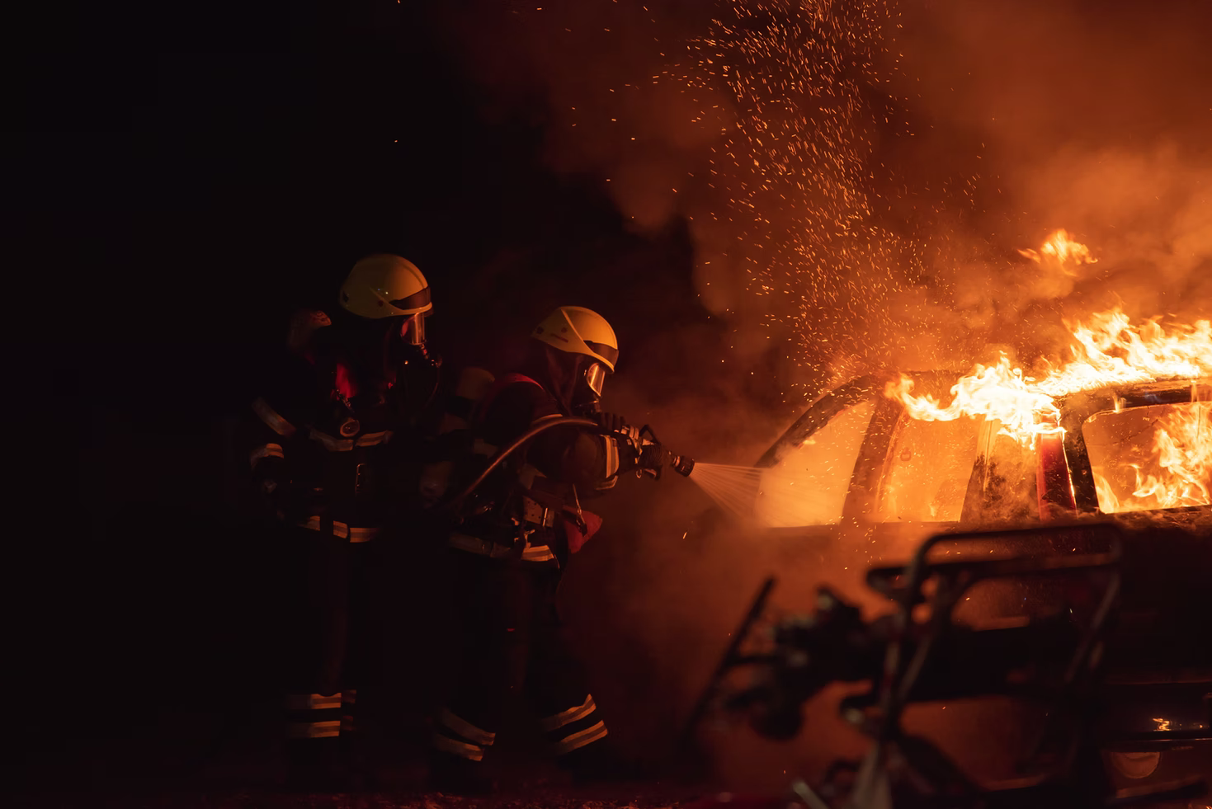
Firefighter

Slide 10

Nurse

Slide 11
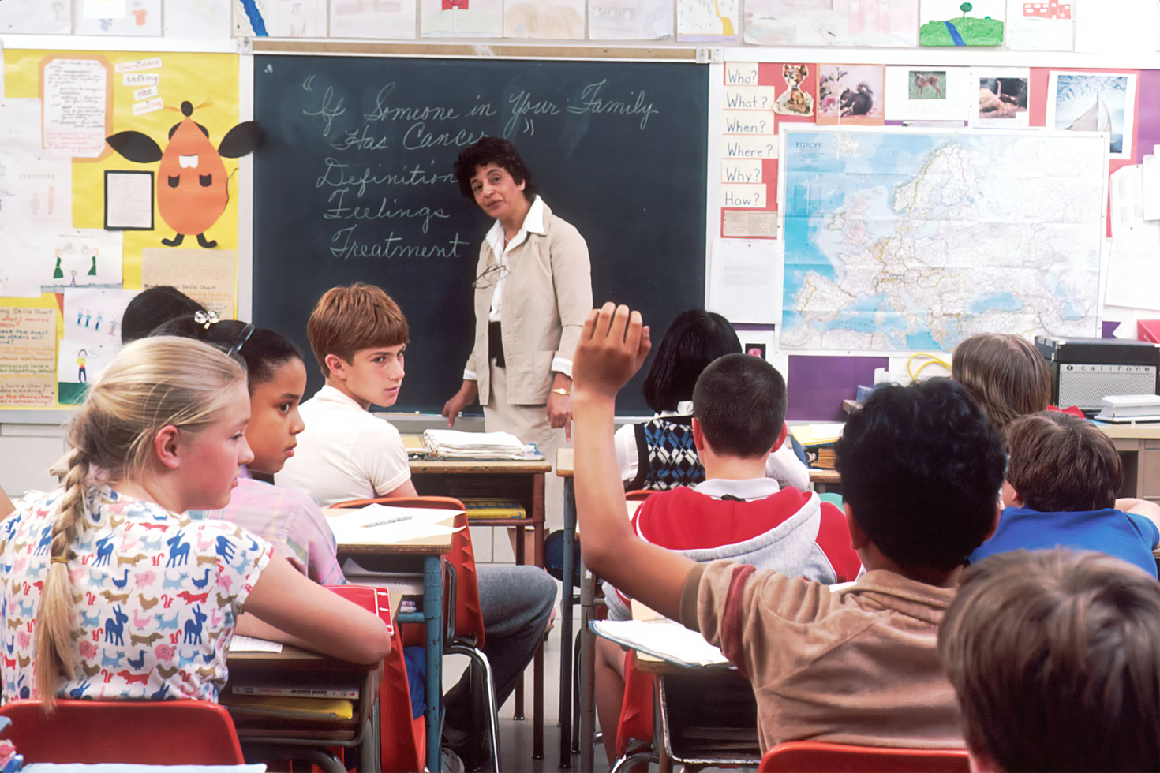
Teacher

Slide 12
LESSON 1
GETTING STARTED
Unit
WARM-UP
Game: Charades!
PRESENTATION
Vocabulary

Slide 13
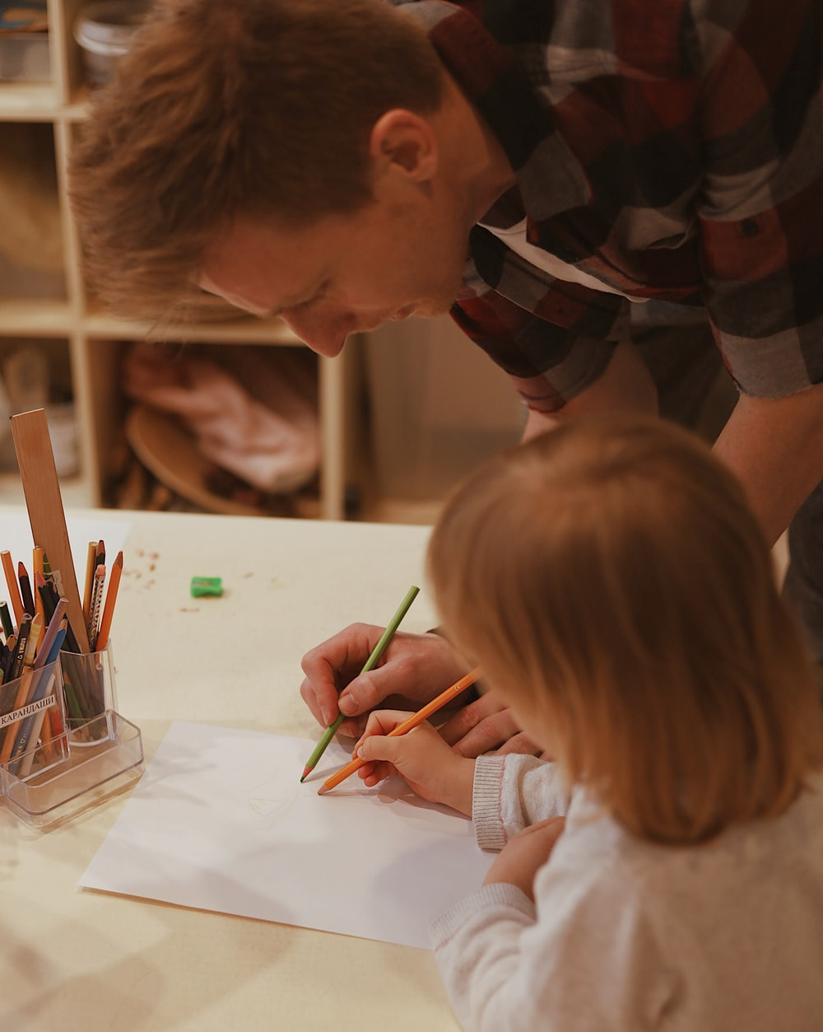

PRESENTATION
kindergarten (n)
/ˈkɪndəɡɑː(r)tn/
a school for children between the ages of about three and five

Slide 14
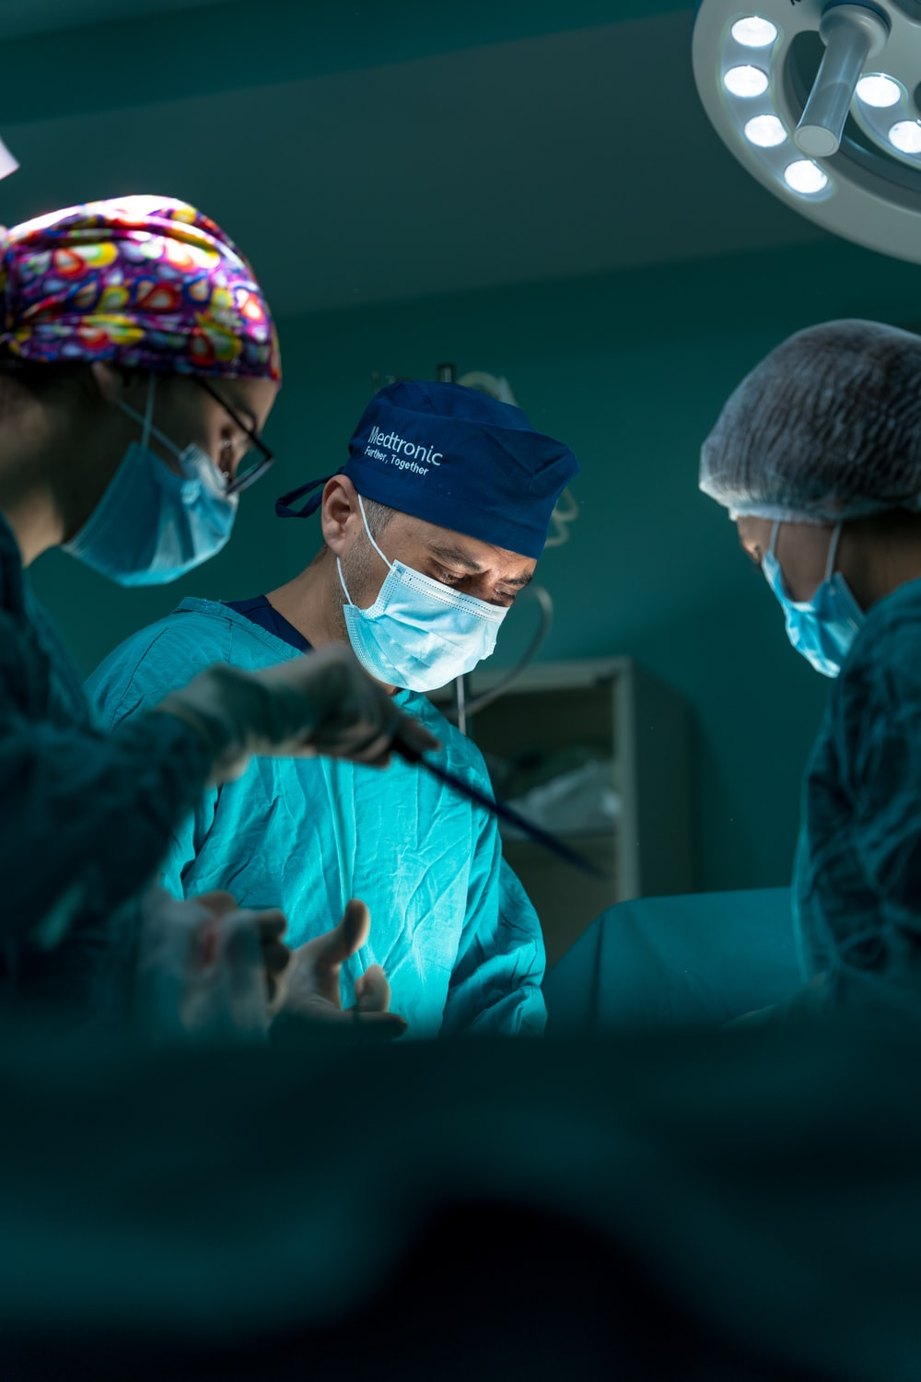
PRESENTATION
surgeon (n)
/ˈsɜː(r)dʒən/
a doctor who is trained to perform surgery

Slide 15
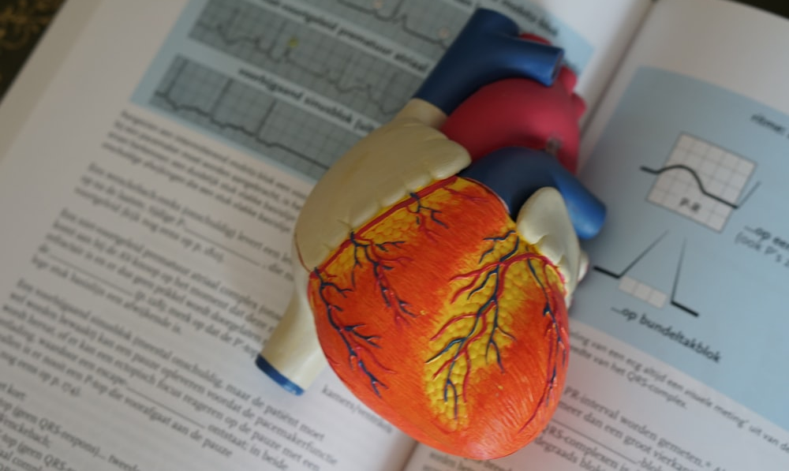
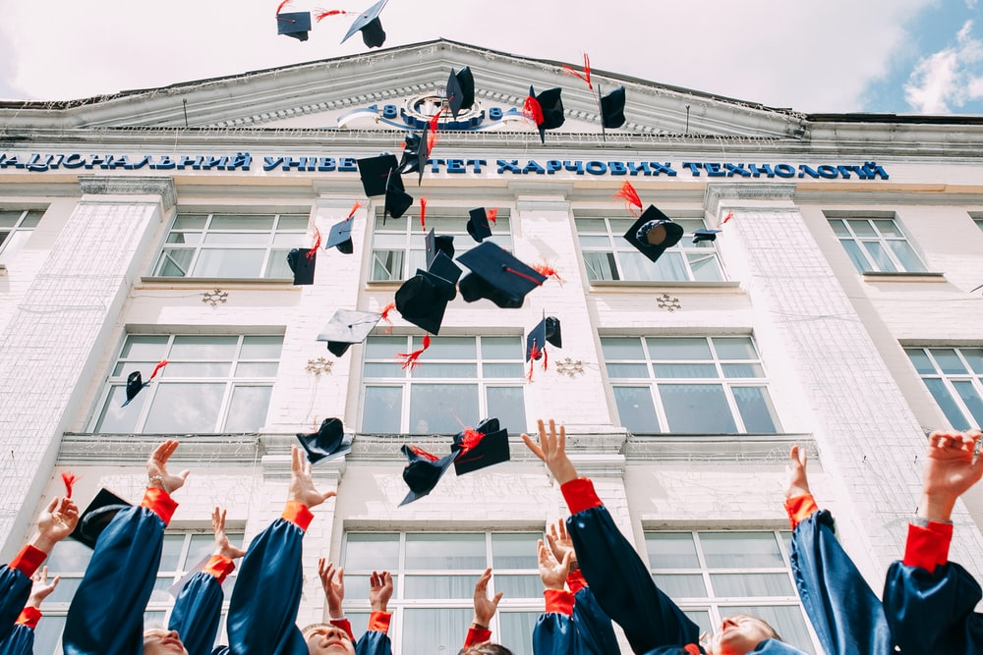
PRESENTATION
medical school (n)
/ˈmedɪkl skuːl/
a college or a department of a university where students study to obtain a degree in medicine

Slide 16
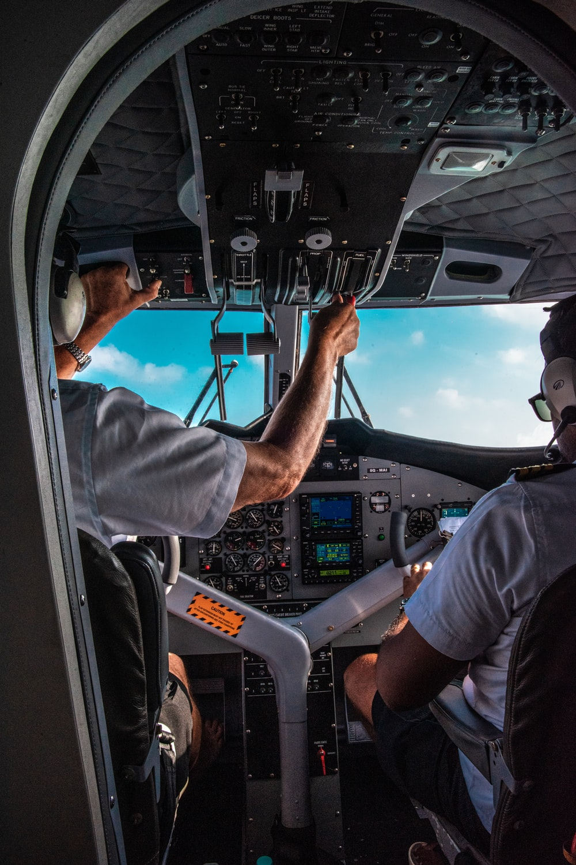
PRESENTATION
pilot (n)
/ˈpaɪlət/
a person who operates the controls of an aircraft, especially as a job

Slide 17
PRESENTATION
New words | Pronunciation | Meaning
kindergarten (n) | /ˈkɪndəɡɑː(r)tn/ | a school for children between the ages of about two and five
surgeon (n) | /ˈsɜː(r)dʒən/ | a doctor who is trained to perform surgery
medical school (n) | /ˈmedɪkl skuːl/ | a college or a department of a university where students study to obtain a degree in medicine
pilot (n) | /ˈpaɪlət/ | a person who operates the controls of an aircraft, especially as a job

Slide 18
LESSON 1
GETTING STARTED
Unit
GETTING STARTED
WARM-UP
Game: Charades!
PRESENTATION
Vocabulary
Task 1: Listen and read.
Task 2: Read the conversation again and tick (✔) T (True) or F (False).
Task 3: Match the words to make meaningful phrases
Task 4: Complete the summary.
PRACTICE

Slide 19
PRACTICE
1
Listen and read.
Equal job opportunities
At an international summer camp: Lan is talking with Mark and Linda about jobs.
Lan: It’s great to have another week full of activities and trips at the camp.
Mark: Oh, yeah. I like the trip to the kindergarten most. The kids were adorable and the teachers were great. I think I’ll be a kindergarten teacher.
Lan: That’s fantastic. My cousin works at a kindergarten and the children love being in his class. By the way, what do you want to be in the future, Linda?
Linda: Oh, I’ve always wanted to be a surgeon, so I’ll go to medical school. What about you, Lan?

Slide 20


PRACTICE
1
Listen and read.
Equal job opportunities
Lan: Me? My dream is to become an airline pilot. That’s why I’m focusing on maths and physics, and exercising more to improve my fitness.
Linda: Cool! I hope your dream will come true. In some countries girls may not be allowed to be pilots.
Lan: That’s true, Linda. We’re lucky to live in a country where boys and girls are encouraged to do the jobs they want.
Mark: I couldn’t agree more. Girls mustn’t be kept home in today’s world. Boys and girls should be treated equally and given the same job opportunities.

Slide 21
PRACTICE
PRACTICE
2
Read the conversation again and tick () T (True) or F (False).
 |  | T | F
1. | Linda would like to be a kindergarten teacher.
2. | Lan wants to be a teacher of maths and physics in the future.
3. | Mark says that girls mustn’t be kept home in today’s world.
✓
✓
✓

Slide 22
PRACTICE
3
Match the words to make meaningful phrases in activity 1.
Column A
treated
medical
job
Column B
school
opportunities
equally

Slide 23
PRACTICE
4
Complete the summary below. Use the verb phrases from the conversation in activity 1.
Three students are talking about future jobs. While Mark wants to work as a kindergarten teacher, Linda wants to be a surgeon. Lan dreams to be an airline pilot. Linda says that in some countries girls (1)______________ to be pilots. Mark thinks girls (2)___________ home in today’s world. He says that boys and girls (3) _____________ equally and given the same job opportunities.
may not be allowed
mustn’t be kept
should be treated

Slide 24
LESSON 1
GETTING STARTED
Unit
GETTING STARTED
WARM-UP
Game: Charades!
PRESENTATION
Vocabulary
Task 1: Listen and read.
Task 2: Read the conversation again and tick (✔) T (True) or F (False).
Task 3: Match the words to make meaningful phrases
Task 4: Complete the summary.
PRACTICE
CONSOLIDATION
Wrap-up
Home work

Slide 25
CONSOLIDATION
1
Wrap-up
Some words and phrases related to Gender Equality
Reading for specific information
Scanning skills

Slide 26
CONSOLIDATION
2
Homework
Do exercises in the workbook
Project preparation

Slide 27


