Slide 1

UNIT 7: INVENTIONS
Lesson 3.1 – Listening & Reading
Page 62

Slide 2



Lesson 3.1
LESSON OUTLINE
Consolidation

Slide 3

By the end of this lesson,
students will be able to …
practice listening and reading for gist and specific information.
talk about useful inventions.

Slide 4



Slide 5

Work in pairs.
Can you think of three useful inventions in your house?
Why are they useful?

Slide 6



Slide 7
Pre-Listening
a. Listen to a lecture about the internet.
What is the main topic of the lecture?
Underline the key words/phrases.
1. The history of the internet
2. The invention that became the internet

Slide 8
Underline the key words/phrases.
b. Listen twice and circle the correct answers.
1. When did the idea of the internet come about?
a. in the 1960s b. in the 1990s
2. In which country was the first long-distance network created?
a. the UK b. the USA

Slide 9
3. What was the first message sent over the network?
a. "hello" b. "login"
4. What is an internet protocol?
a. a set of rules b. a message between two computers
5. What did Tim Berners-Lee invent?
a. the World Wide Web b. a messaging software

Slide 10

While-Listening
a. Listen to a lecture about the internet.
What is the main topic of the lecture?
First time
1. The history of the internet
2. The invention that became the internet
→ 1. The history of the internet

Slide 11
b. Listen twice and circle the correct answers.
1. When did the idea of the internet come about?
a. in the 1960s b. in the 1990s
2. In which country was the first long-distance network created?
a. the UK b. the USA

Slide 12
3. What was the first message sent over the network?
a. "hello" b. "login"
4. What is an internet protocol?
a. a set of rules b. a message between two computers
5. What did Tim Berners-Lee invent?
a. the World Wide Web b. a messaging software

Slide 13

Scripts
W: Throughout history, humans have invented many things to make our lives easier. We invented computers to help us do complicated tasks. Later, the internet was invented to help connect people more easily. Originally, the idea of creating the internet came about in the 1960s. In 1969, two research teams at the University of California and Stanford Research Institute in the USA created a long-distance network between two computers. A message saying "login" was sent from one computer to the other. It wasn't a total success. Only the letters "i" and "o" were sent, and then the system crashed. An hour later, however, they tried again, and the full message was sent successfully. In 1974, American scientists, Vinton Cerf and Bob Kahn, developed the frst internet protocol, which is a set of rules that allow computers to communicate with each other. This was the basis for the internet as we know it today. In 1989, British scientist Tim Berners-Lee
invented the World Wide Web or WWW. This allowed everyone to share information easily on the internet. When you use the internet, it's very likely that you're using his invention to access the information.

Slide 14
Pre- Listening
a. Listen to someone talking about artificial intelligence (AI). Why are they talking about it?
Extra Practice
WB, page 42
Underline the key words/phrases.
1. It's an interview. 2. It's a presentation.

Slide 15
While-Listening
a. Listen to someone talking about artificial intelligence (AI). Why are they talking about it?
First time
Underline the key words/phrases.
1. It's an interview. 2. It's a presentation.
→ 2. It's a presentation.

Slide 16
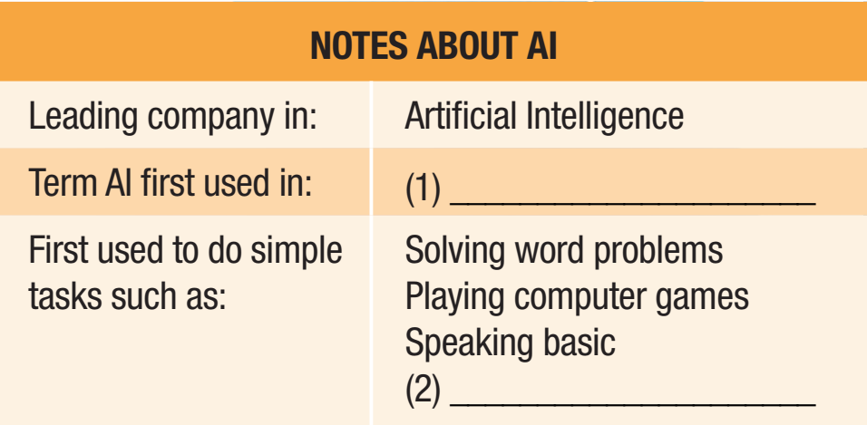
b. Listen twice and complete the notes.
1956
English

Slide 17
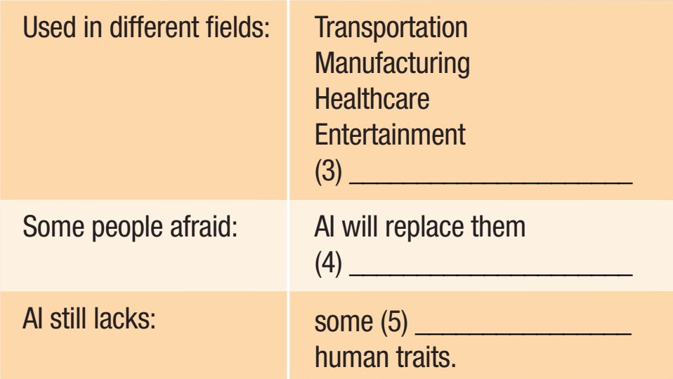
Sports
at work
important

Slide 18
Scripts
M: Hello, everyone and welcome to AlphaTech. We are the leading company in Artificial Intelligence and today I'm going to introduce you to our latest member of staff, Sophia. She is the first human-like robot and can communicate and show emotions. Before you meet her, let me give you a brief history of AI and how it has developed in recent years.
The term Artificial Intelligence, or AI, was first introduced in 1956. At first, AI was only used to do simple tasks, such as playing computer games, solving word problems, and speaking basic English. However, over the years, AI has become much more like the human brain and can do complex tasks. We now use it in many major fields, such as transportation, manufacturing, healthcare, entertainment, and sports. For example, people can contact an AI-powered chatbot instead of an actual person when they need to find information. Social media platforms use AI for photo tagging suggestions, newsfeeds, and advertisements. Because of the many uses of AI, some people are afraid that AI-run machines will replace humans at work. However, AI still lacks some important human traits so there's no need to worry... yet. Right, it's time to meet Sophia. Here she is, everyone. Sophia, would you like to introduce...

Slide 19
Post-Listening
Work in pairs.
Do you often use the internet?
What do you use the internet for?
Talk about some AI devices you have known.

Slide 20



Slide 21
Pre-Reading
a. Read Tâm's essay and choose the main idea
Underline the key words/phrases.
1. The negative impacts of the internet
2. How the internet has changed our lives

Slide 22
Pre-Reading
a. Read Tâm's essay and choose the main idea
Underline the key words/phrases.
Many inventions have been created throughout history. Many of them have changed our lives. In my opinion, the most important invention is the internet.
I think the internet is important because it has changed our lives in many ways. For example, the way we communicate has changed significantly. We can communicate with each other instantly using the internet.

Slide 23
Many people even spend more time connecting with other people on the internet than in real life. If you go to a busy café today, you will probably see most people are communicating with their phones and laptops instead of talking to the person next to them.

Slide 24
The internet has also allowed us to work together in a way that was impossible before, such as working from home and working with people from other countries.
This is okay. Both ways of working are becoming more popular. By connecting their computer to the internet, people can access the same resources wherever they are in the world.

Slide 25
Today, people from all over the globe can work together closely without ever meeting face-to-face.
Although the internet is quite a new invention, it now plays an important role in our lives. Without it, things would be very different.

Slide 26
While-Reading
a. Read Tâm's essay and choose the main idea
Skim the essay to choose the main idea
1. The negative impacts of the internet
2. How the internet has changed our lives
→ 2. How the internet has changed our lives

Slide 27
b. Now, read the essay again and answer the questions.
Scan the essay to answer the questions
What do people do differently because of the internet?
2. What is common to see at a café these days?
Communicate
People communicating with phones and laptops
While-Reading

Slide 28
3. What is becoming more common because of the internet?
4. What would happen if we didn't have the internet?
Working from home and with people from other countries.
Things would be very different.

Slide 29


Post-Reading
Work in pairs.
Has the internet made people's lives better or worse? Why?

Slide 30

Consolidation

Slide 31
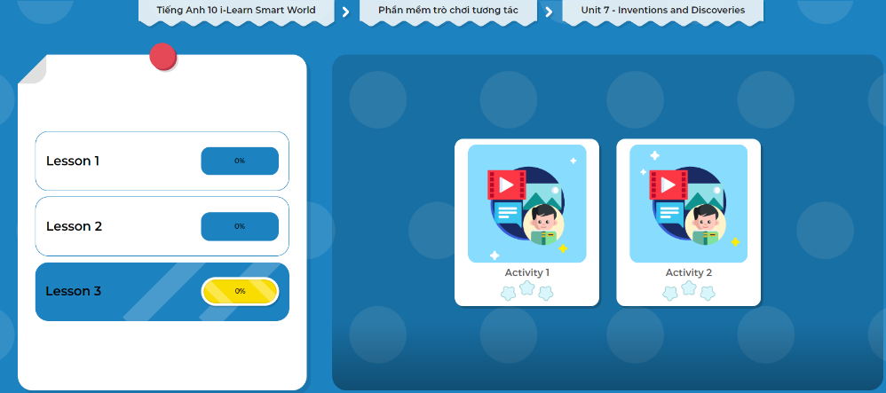
Extra Practice
DHA on Eduhome
Let’s Play!
Click here to play the games.

Slide 32

WRAP-UP

Slide 33
Today’s lesson
Reading & Listening: for gist and specific information
Speaking: talk about useful inventions, especially the Internet

Slide 34

Do the exercises in WB on page 42 (Reading).
Do the exercises in Tiếng Anh 10 i-Learn Smart World Notebook on page 42.
Prepare the next lesson - Writing on page 63 in SB.
Play the consolidation games in Tiếng Anh 10 i-Learn Smart World DHA App on www.eduhome.com.vn

