Slide 1
Unit 18: At the shopping centre
Lesson 3-Period 5

Slide 2
Table of contents
Activity 1
01
Warm up
02
03
Activity 2
04
Activity 3
Listen and repeat
Listen and circle
Let’s chant

Slide 3
01
Warm-up

Slide 4
Gift shop
Sports shop
Pet
shop
Clothes shop
Bookshop
Bakery
Supermarket
Food shop
Look and remember

Slide 5
The clothes shop is …………….. the bakery.
A. opposite
B. behind
C. between
D. near

Slide 6
The gift shop is …………….. the clothes shop and the pet shop.
A. opposite
B. behind
C. between
D. near

Slide 7
The pet shop is …………….. the clothes shop and the bookshop.
A. opposite
B. behind
C. between
D. near

Slide 8
The bookshop is …………….. the gift shop.
A. opposite
B. behind
C. between
D. near

Slide 9
02
Activity 1

Slide 10
Listen and clap. Which syllable is stressed?

Slide 11
campsite
‘campsite

Slide 12
shopping
‘shopping

Slide 13
‘bookshop
bookshop

Slide 14
centre
‘centre

Slide 15
be’hind
behind

Slide 16
between
bet’ween
bet’ween

Slide 17
The stress is on the second syllable
be’hind
bet’ween

Slide 18
Listen and repeat

Slide 19
03
Activity 2

Slide 20
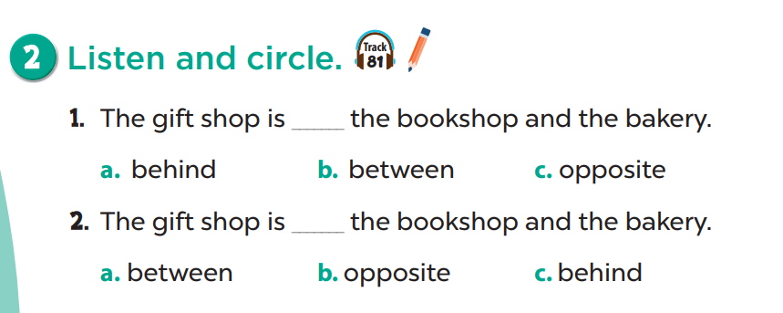
Look and read
Listen and circle

Slide 21
04
Activity 3

Slide 22
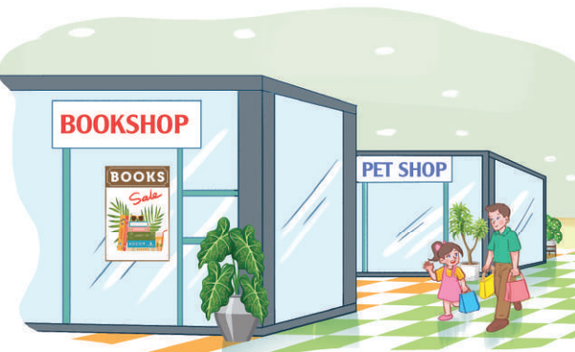
Where is the pet shop?
It’s behind the bookshop.

Slide 23
Clap and chant
Listen and repeat
Look and read

Slide 24
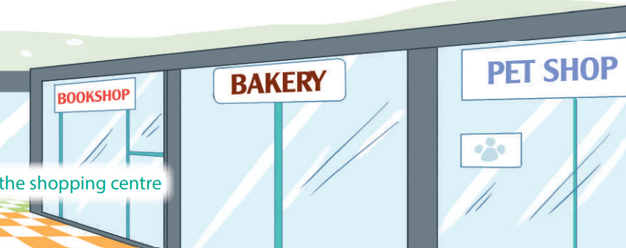
Where is the bakery?
It’s between the bookshop and the pet shop.

Slide 25
Clap and chant
Listen and repeat
Look and read

Slide 26
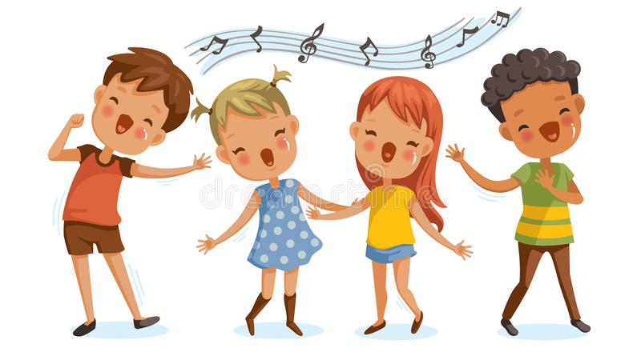
Let’s have fun

Slide 27
Let's chant like a robot!

Slide 28
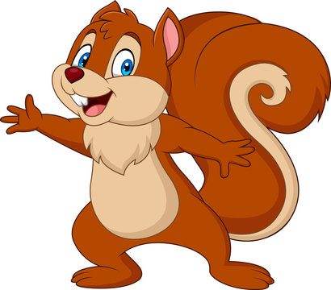
Let's chant like a chipmunk!

Slide 29
Let's chant like a robot and a chipmunk!

