Slide 1

UNIT 5: GENDER EQUALITY
Lesson 2 – Vocabulary & Reading
Page 41

Slide 2



LESSSON OUTLINE
Consolidation

Slide 3

By the end of this lesson,
students will be able to:
- use adjectives of attitude.
- read the interview about racing car driver for main ideas and specific information.

Slide 4
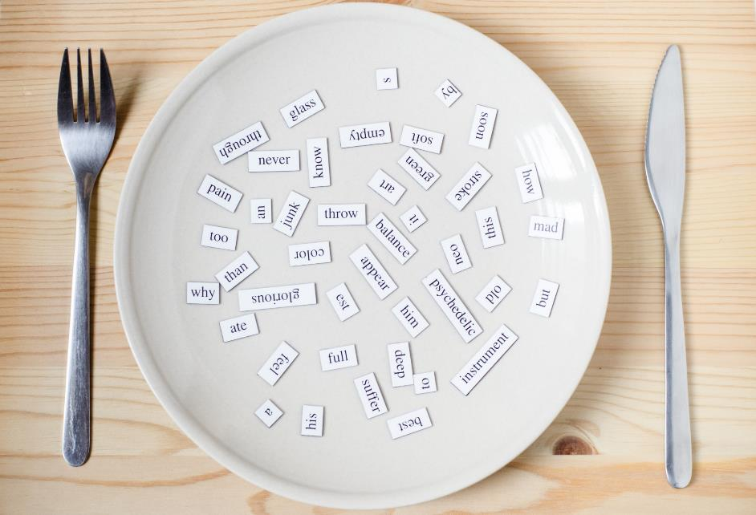

determined
grateful
passionate
proud
delighted
exhausted

Slide 5



Slide 6
Make a list of 3 adjectives to show your feeling after a day learning so hard at school.
...
tired
happy

Slide 7



Slide 8


Listen and repeat. Click on each word to hear the sound.
determined (adj) /dɪˈtɝːmɪnd/ quyết tâm, kiên quyết
grateful (adj) /ˈɡreɪtfəl/ biết ơn
passionate (adj) /ˈpæʃənət/ thích, đam mê
proud (adj) /praʊd/ tự hào
delighted (adj) /dɪˈlaɪt̬ɪd/ vui vẻ
exhausted (adj) /ɪɡˈzɑːstɪd/ mệt lả

Slide 9

a. Match the underlined words to their definitions.
1. I failed my exam last year but this time I’m determined to pass. I studied really hard.

Slide 10
a. Match the underlined words to their definitions.
2. Max was really grateful for Alice’s help with his project. He bought her a gift to say thank you.

Slide 11

a. Match the underlined words to their definitions.
3. I’m really passionate about soccer. I watch all the games on TV and play every day at school.

Slide 12

a. Match the underlined words to their definitions.
4. Ben’s partents were so proud of him because he passed all his exams. His mom couldn’t stop smiling.

Slide 13

a. Match the underlined words to their definitions.
5. Sue’s dog was missing for two weeks, so she was delighted when she finally found him.

Slide 14

a. Match the underlined words to their definitions.
6. The runners were exhausted when they crossed the finish line. The ten-thousand-meter race is not easy.

Slide 15
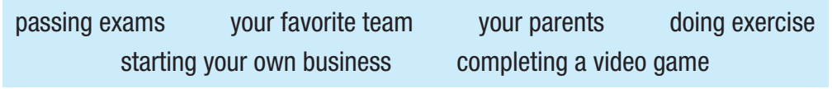
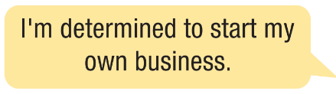

Work in pairs.
b. Discuss the ideas below using the new words.

Slide 16


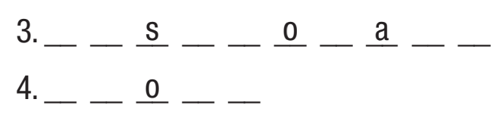
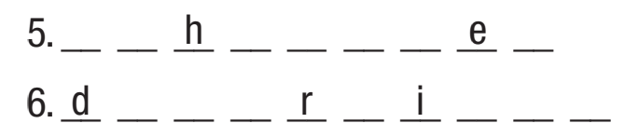
Extra Practice
WB, page 28
a. Fill in the missing letters.
r
a
e
f
u
l
d
l
i
h
e
d
p
a
s
i
n
t
e
p
r
u
d
e
x
a
u
s
t
d
e
t
e
m
n
e
d

Slide 17
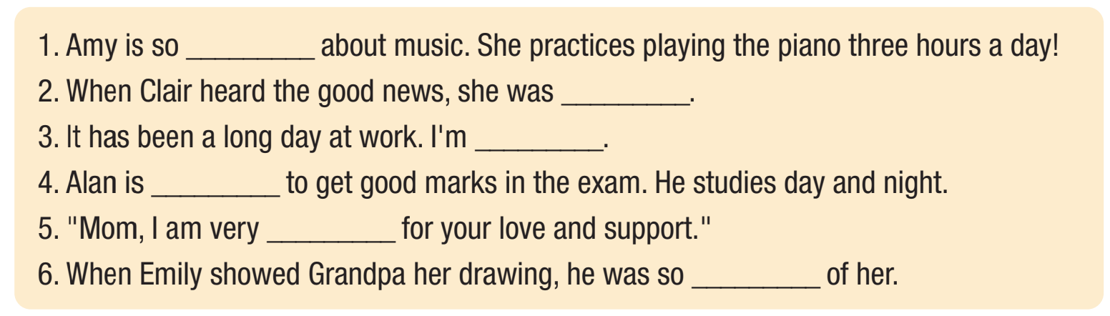
Extra Practice
WB, page 28
b. Fill in the blanks with correct words from Task a.
passionate
delighted
exhausted
determined
grateful
proud

Slide 18



Slide 19
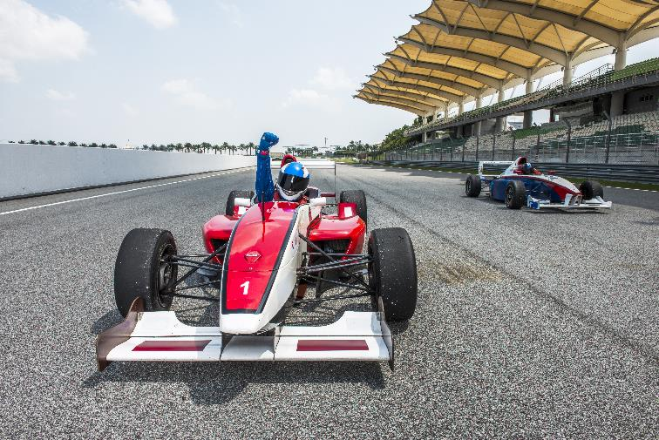

Pre-Reading
What do you know about racing cars and racing car drivers?

Slide 20
Pre-Reading
Before reading the texts on page 41, read the all the questions, underline the key words.

Slide 21
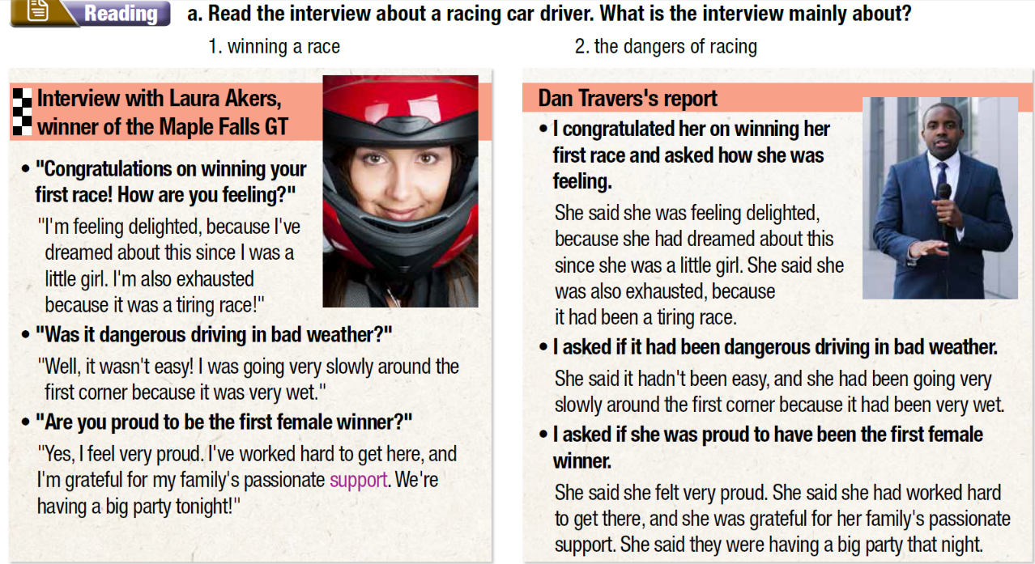

Slide 22
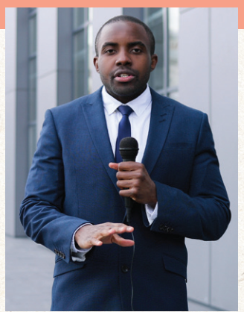
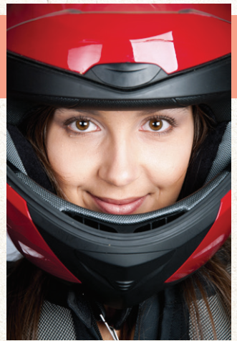
Read the interview about a racing car driver.
What is the interview mainly about?
While-Reading
1. winning a race
2. the dangers of racing

Slide 23
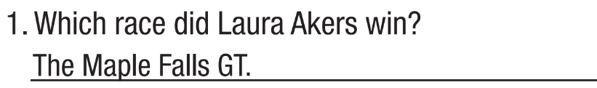

While-Reading
b. Now, read and answer the questions.

Slide 24
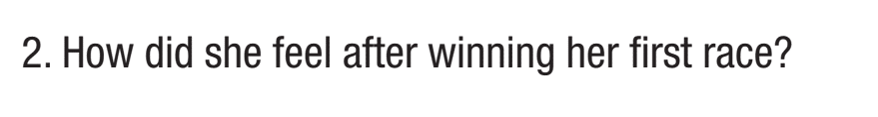


While-Reading
b. Now, read and answer the questions.

Slide 25
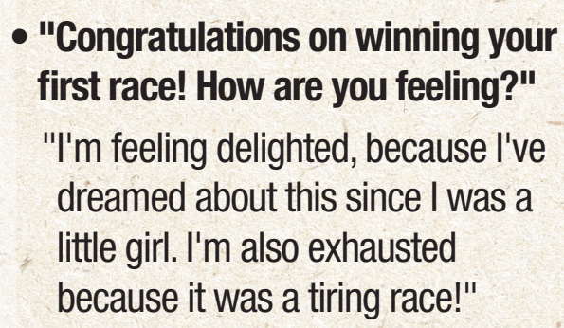
While-Reading

Slide 26
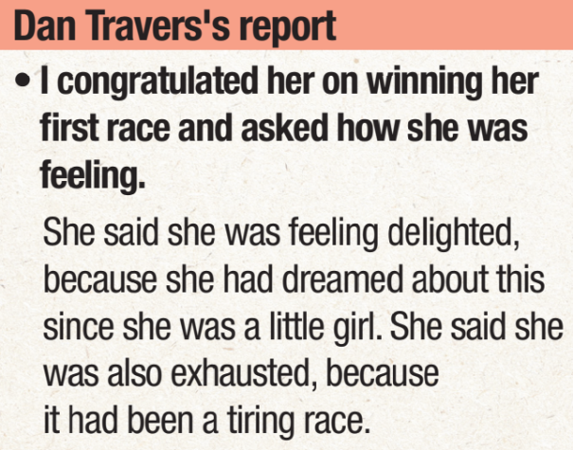
While-Reading

Slide 27
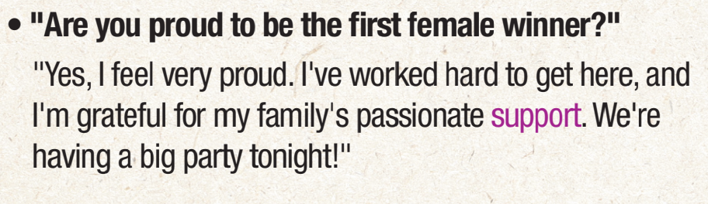
While-Reading

Slide 28

Post-Reading
Work in pairs.
c. Discuss this question with your partner.
Would you like to drive a racing car? Why (not)?

Slide 29

Consolidation

Slide 30
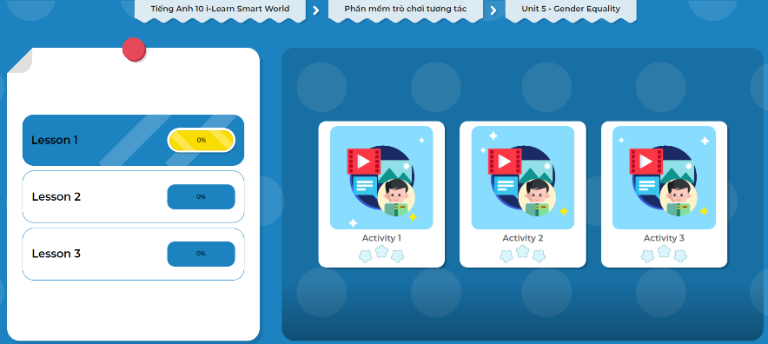
Let’s play!
Click here to play the games!

Slide 31
Consolidation
Today’s lesson
Vocabulary: Adjectives of attitudes
Reading: Reading for main ideas and specific information about the interview with a racing car driver.

Slide 32

Make sentences using the adjectives of attitudes learned today.
Practice more reading on page 28 in WB
Prepare the next lesson - Grammar on page 42 in SB.
Play consolidation games in Tiếng anh 10 i-Learn Smart World DHA App on www.eduhome.com.vn
Do the exercise in Tiếng anh 10 i-Learn Smart World Notebook (page 28)

Slide 33

Have a nice day!

