Slide 1


Slide 2

Unit
5
1
Unit
FAMILY LIFE
INVENTIONS
LESSON 6
WRITING
Writing about the benefits of an invention

Slide 3

Unit
1
1
FAMILY LIFE
Family Life
Unit
OBJECTIVES
Write about the benefits of an invention

Slide 4
LESSON 6
WRITING
Unit
GD
WARM-UP
Game: Hot seat
PRE-WRITING
Task 1: Draw an diagram.
Task 2: Rewrite the sentences.
WHILE-WRITING
Task 3: Write a paragraph to describe benefits of the invention.
POST-WRITING
Feedback
CONSOLIDATION
Wrap-up
Homework

Slide 5
LESSON 6
WRITING
Unit
WARM-UP
Game: Hot seat

Slide 6

GAME: HOT SEAT
Work in groups.
A representative of each group sits on a chair, facing the class.
Others from each group look at the picture shown on the slide and give hints about it.
The representative of each group says out loud the word.

Slide 7

Electric light

Slide 8

Airplane

Slide 9
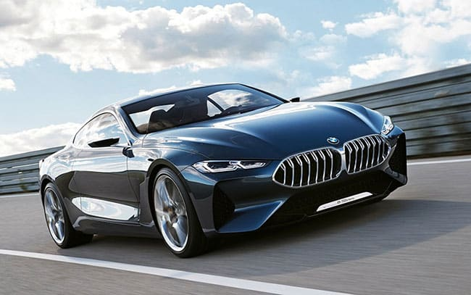
Automobile

Slide 10
LESSON 6
WRITING
Unit
TED
WARM-UP
Game: Hot seat
PRE-WRITING
Task 1: Draw an diagram.
Task 2: Rewrite the sentences.

Slide 11
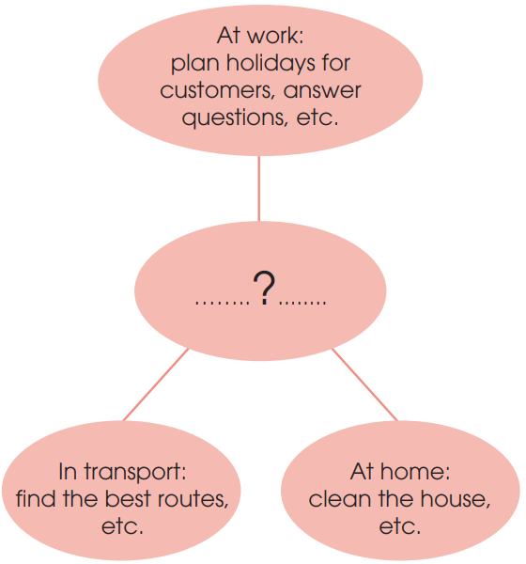
PRE-WRITING
1
Draw a diagram.
Choose an invention from the unit,
keep it secret.
Draw a diagram in a notebook or on a piece of paper, listing some benefits or uses of the invention.
Work in groups, swap the diagrams with others.
Take turns reading the diagrams and guessing the inventions.

Slide 12
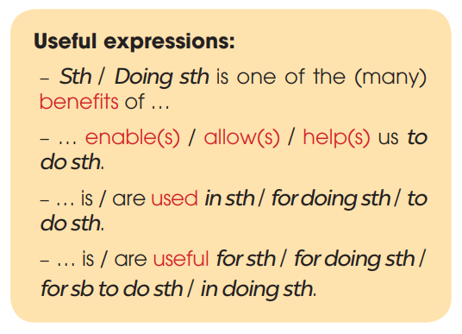
PRE-WRITING

Slide 13
PRE-WRITING
2
Rewrite the sentences.
1. AI helps drivers to find the best routes in transport.
→ Helping drivers to find the best routes is one of the benefits of AI in transport.
2. Vacuum cleaners allow us to clean the house quickly.
→ Vacuum cleaners are useful for cleaning / in cleaning the house quickly.
3. Smartphones are used for learning languages.
→ Smartphones help us to learn languages.
4. Telephones are useful in communicating over long distances.
→ Telephones are used to communicate / for communication / for communicating over long distances.

Slide 14
LESSON 6
WRITING
Unit
GE
WARM-UP
Game: Hot seat
PRE-WRITING
Task 1: Draw an diagram.
Task 2: Rewrite the sentences.
WHILE-WRITING
Task 3: Write a paragraph to describe benefits of the invention.

Slide 15
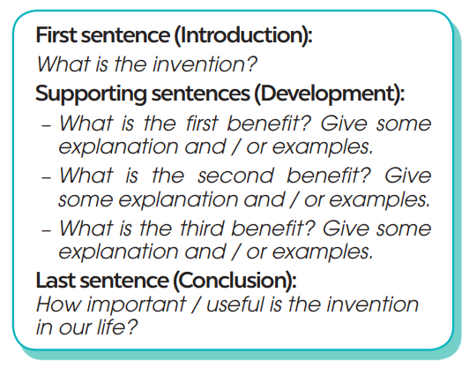
WHILE-WRITING
3
Write a paragraph (120 - 150 words) to describe benefits of the invention.

Slide 16
WHILE-WRITING
3
Write a paragraph (120 - 150 words) to describe benefits of the invention.
Sample:
Electricity is one of the great inventions of the past, because it has brought many benefits for people. First, electricity can be used to light our houses and streets. Without it, the world will be dark and dangerous. Second, electricity is also useful in heating. For example, in cold areas, electric heaters can keep us warm and healthy in long winters. Finally, the most important use of electricity is to run machines. Without electricity, factories, schools and hospitals cannot run normally. Everyone and everything will stop working. Other inventions, such as TVs, computers and robots will become useless without electricity. In conclusion, electricity plays a very important part in our life today and we cannot live without it.

Slide 17
LESSON 6
WRITING
Unit
WARM-UP
Game: Hot seat
PRE-WRITING
Task 1: Draw an diagram.
Task 2: Rewrite the sentences.
WHILE-WRITING
Task 3: Write a paragraph to describe benefits of the invention.
POST-WRITING
Feedback

Slide 18


POST-WRITING
Peer review
Teacher’s feedback

Slide 19
LESSON 6
WRITING
Unit
WARM-UP
Game: Hot seat
PRE-WRITING
Task 1: Draw an diagram.
Task 2: Rewrite the sentences.
WHILE-WRITING
Task 3: Write a paragraph to describe benefits of the invention.
POST-WRITING
Feedback
CONSOLIDATION
Wrap-up
Homework

Slide 20
CONSOLIDATION
1
Wrap-up
Write about the benefits of an invention.

Slide 21
CONSOLIDATION
2
Homework
Prepare for the next lesson: Unit 5 – Communication and culture/ CLIL.
2. Do exercises in the workbook

Slide 22

Website: hoclieu.vn
Fanpage: facebook.com/www.tienganhglobalsuccess.vn

