Slide 1
WELCOME TO OUR CLASS 9
Unit 1: LOCAL ENVIRONMENT
Communication

Slide 2
UNIT 1: LOCAL ENVIRONMENT LESSON 4: COMMUNICATION
*.Vocabulary:
team-building (adj):
xây dựng đội ngũ
turn up (ph.v) :
xuất hiện, đến
set of (ph.v) :
khởi hành

Slide 3
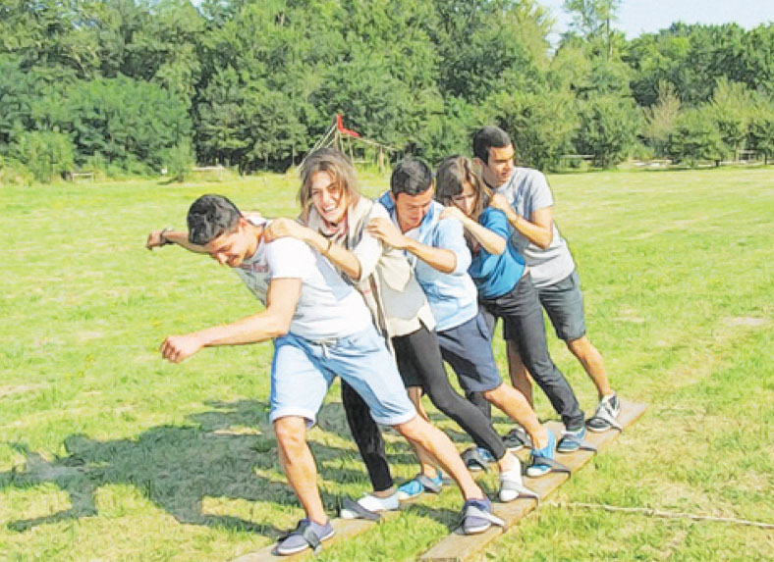
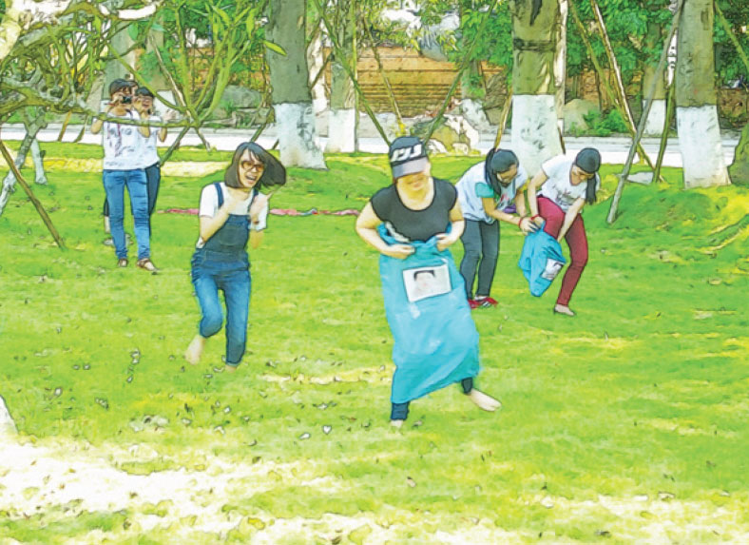
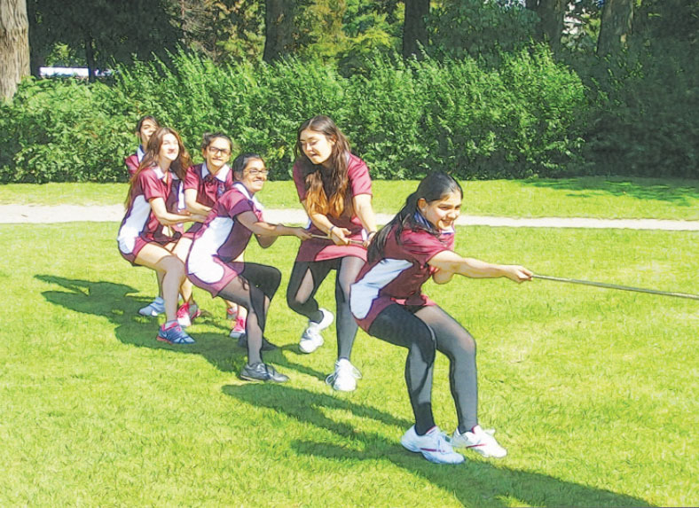
1. Nick, Mi , Duong and Mai are playing a day out to a place of interest for their class. Listen to the conversation and complete their plan..

Slide 4
1. Nick, Mi , Duong and Mai are playing a day out to a place of interest for their class. Listen to the conversation and complete their plan..
 | Details | Who to prepare
Place | (1)
Means of transport | (2)
Time to set off | (3) | Mai: stick a notice
Food | (4) bring
Drinks | For everyone | Nga: buy in (5)
Activities | Morning: (6) …………………..games and quizzes Lunch: 11.30 Afternoon: go to traditional (8) ………………… at .30; (9)…………………. their own paintings | Nick: prepare games Thanh: prepare (7)
Time to come back | (10)
Green Park
bus
8 a.m.
own lunch
team-building
supermarket
painting village
make
quizzes
5 p.m

Slide 5
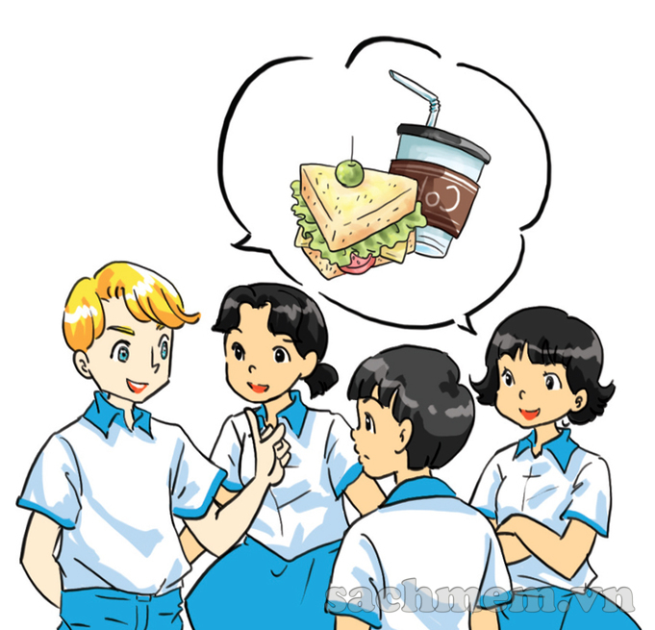
2. Imagine that your class is going to a place of interest in your area
Work in groups to discuss the plan for this day out. Make the note in the table
A DAY OUT
Details | Who to prepare
Place
Means of transport
Time to set off
Food
Drinks
Activities
Time to come back

Slide 6
3. Pesent your plan to the class. Which group has the best plan?

Slide 7
homework
- Learn by heart vocabulary - Prepare: Skills 1

