Slide 1


Slide 2

Unit
4
1
Unit
FAMILY LIFE
FOR A BETTER COMMUNITY
LESSON 3
READING
Teenagers and voluntary work

Slide 3

Unit
1
1
FAMILY LIFE
Family Life
Unit
OBJECTIVES
Develop reading skill for specific information about teenagers and voluntary work.

Slide 4
LESSON 3
READING
Unit
GETTING STARTED
WARM-UP
Lucky number
Task 1: Complete the mind map with popular volunteering activities for teenagers.
* Vocabulary
PRE-READING
Task 2: Read the text and choose the main idea.
Task 3: Match the highlighted words in the text with their meanings.
Task 4: Decide whether the following statements are true (T) or false (F).
WHILE-READING
POST-READING
Task 5: Discuss the question.
CONSOLIDATION
Wrap-up
Homework

Slide 5
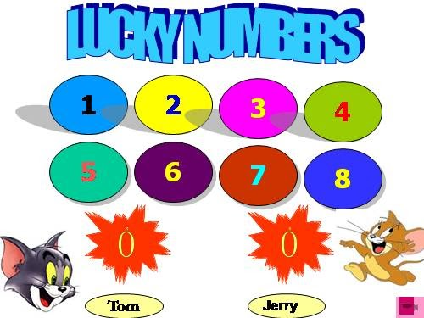
LESSON 3
READING
Unit
WARM-UP
Lucky number
Work in 2 teams.
Choose a number.
Answer the question in each number and get the point.
With LUCKY NUMBER, you get the point without answering the question.

Slide 6
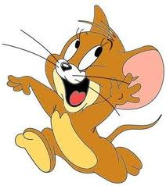

LUCKY NUMBERS
1
2
3
4
5
6
4
3
2
1
6
5
4
3
2
1
0
6
7
0
7
5
Tom
Jerry

Slide 7

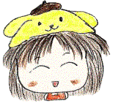
lucky number

Slide 8

1.
When do we use the past simple?

Slide 9
2.
When do we use the past continuous?

Slide 10
3.
Name some words/phrases used as signals of the past simple.

Slide 11
4.
Give the correct form of the verbs in brackets:
While I (listen)_______to music, my sister (knock)_______the door.

Slide 12
Name two volunteering activities.
5.

Slide 13
LESSON 3
READING
Unit
GETTING STARTED
WARM-UP
Lucky number
PRE-READING
Task 1: Complete the mind map with popular volunteering activities for teenagers.
* Vocabulary

Slide 14
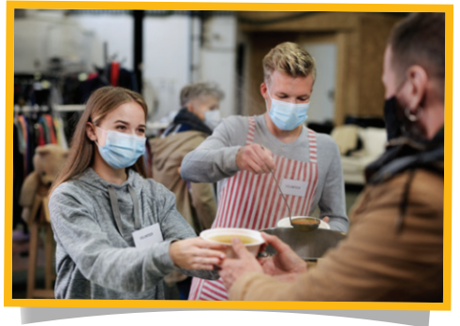


PRE-READING
1
Complete the mind map with popular volunteering activities for teenagers.
helping at a food bank
selling handmade items
raising money for charity
Volunteering activities
…
…

Slide 15


VOCABULARY
donation (n)
/dəʊˈneɪʃn/
something that is given to a person or an organization such as a charity, in order to help them; the act of giving something in this way

Slide 16
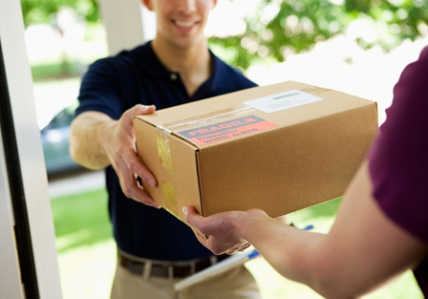
VOCABULARY
deliver (v)
/dɪˈlɪvə(r)/
to take goods, letters, etc. to the person or people they have been sent to

Slide 17
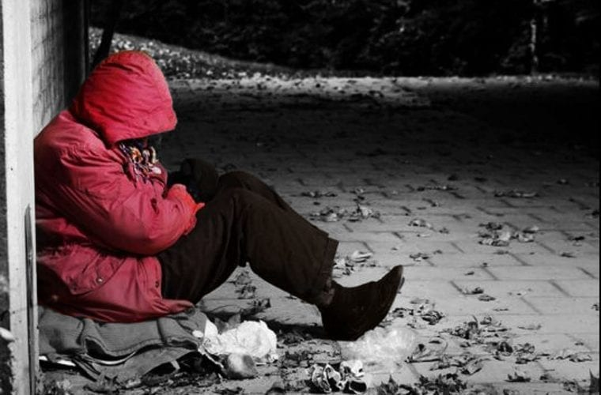
VOCABULARY
hardship (n)
/ˈhɑːdʃɪp/
a situation that is difficult and unpleasant because you do not have enough money, food, clothes, etc.

Slide 18
VOCABULARY
Form | Pronunciation | Meaning
donation (n) | /dəʊˈneɪʃn/ | something that is given to a person or an organization such as a charity, in order to help them; the act of giving something in this way
deliver (v) | /dɪˈlɪvə(r)/ | to take goods, letters, etc. to the person or people they have been sent to
hardship (n) | /ˈhɑːdʃɪp/ | a situation that is difficult and unpleasant because you do not have enough money, food, clothes, etc.

Slide 19
LESSON 3
READING
Unit
GETTING STARTED
WARM-UP
Lucky number
PRE-READING
Task 1: Complete the mind map with popular volunteering activities for teenagers.
* Vocabulary
Task 2: Read the text and choose the main idea.
Task 3: Match the highlighted words in the text with their meanings.
Task 4: Decide whether the following statements are true (T) or false (F).
WHILE-READING

Slide 20
WHILE-READING
2
Read the text and choose the main idea.
A. The writer’s secondary school has a long and interesting history.
B. The Volunteer Club was set up 15 years ago to help teens gain work experience.
C. The club organises many volunteering activities that benefit both community and the students.

Slide 21
WHILE-READING
2
Read the text and choose the main idea.
I joined the Volunteer Club when I started secondary school. The club formed fifteen years ago, shortly after the school was set up. Since then, it has organised various volunteering activities for all students to participate.
One of the most popular activities of our club is selling handmade items to raise money for the local orphanage and homeless old people. Last year, we also raised over one hundred million VND to help people in flooded areas. The money was used to buy warm clothes, blankets, food and clean water.
Our club welcomes different types of donations: clothes, picture books, unused notebooks, and other unwanted items. At the end of each month, we take the donations to the community centre. Our club also organises afterschool games for orphanage and concerts for the old people at the centre. In addition, it offers other volunteering activities, such as helping at a food bank or delivering free meals to poor families.
Volunteering has helped my gain life experiences and find my sense of purpose in life. When I see suffering and hardships, I feel thankful for what I have. What is more, these activities provide opportunities for me to meet other teenagers with similar interests and help me build essential life skills.

Slide 22
WHILE-READING
2
Read the text and choose the main idea.
A. The writer’s secondary school has a long and interesting history.
B. The Volunteer Club was set up 15 years ago to help teens gain work experience.
C. The club organises many volunteering activities that benefit both community and the students.

Slide 23
WHILE-READING
PRACTICE
3
Match the highlighted words in the text with their meanings
1. various
a. objects or things
2. participate
b. taking things to someone
3. items
c. several different
4. raised
d. to take part in an activity
5. delivering
e. collected money

Slide 24
WHILE-READING
PRACTICE
4
Decide whether the following statements are true (T) or false (F)
 | T | F
1. The Volunteer Club was set up long after the school was opened.
2. All students can join different volunteering activities.
3. The money collected from selling handmade items is used to build a local centre for orphans and homeless old people.
4. Students can volunteer at the orphanage or the community centre.
5. Club members can also help cook free meals for poor families.
✓
✓
✓
✓
✓

Slide 25
LESSON 3
READING
Unit
GETTING STARTED
WARM-UP
Lucky number
PRE-READING
Task 1: Complete the mind map with popular volunteering activities for teenagers.
* Vocabulary
Task 2: Read the text and choose the main idea.
Task 3: Match the highlighted words in the text with their meanings.
Task 4: Decide whether the following statements are true (T) or false (F).
WHILE-READING
POST-READING
Task 5: Discuss the question.

Slide 26

POST-READING
5
Work in pairs. Discuss the following question.
If you were a member of the Volunteer Club, what could you do to help?

Slide 27
LESSON 3
READING
Unit
GETTING STARTED
WARM-UP
Lucky number
PRE-READING
Task 1: Complete the mind map with popular volunteering activities for teenagers.
* Vocabulary
Task 2: Read the text and choose the main idea.
Task 3: Match the highlighted words in the text with their meanings.
Task 4: Decide whether the following statements are true (T) or false (F).
WHILE-READING
POST-READING
Task 5: Discuss the question.
Wrap-up
Homework
CONSOLIDATION

Slide 28
CONSOLIDATION
1
Wrap-up
Reading for general and specific information about teenagers and voluntary work.

Slide 29
CONSOLIDATION
2
Homework
Prepare for the next lesson: Unit 4: Speaking
2. Do exercises in the workbook

Slide 30

Website: hoclieu.vn
Fanpage: facebook.com/www.tienganhglobalsuccess.vn

