Slide 1

THẢO CHI

Slide 2
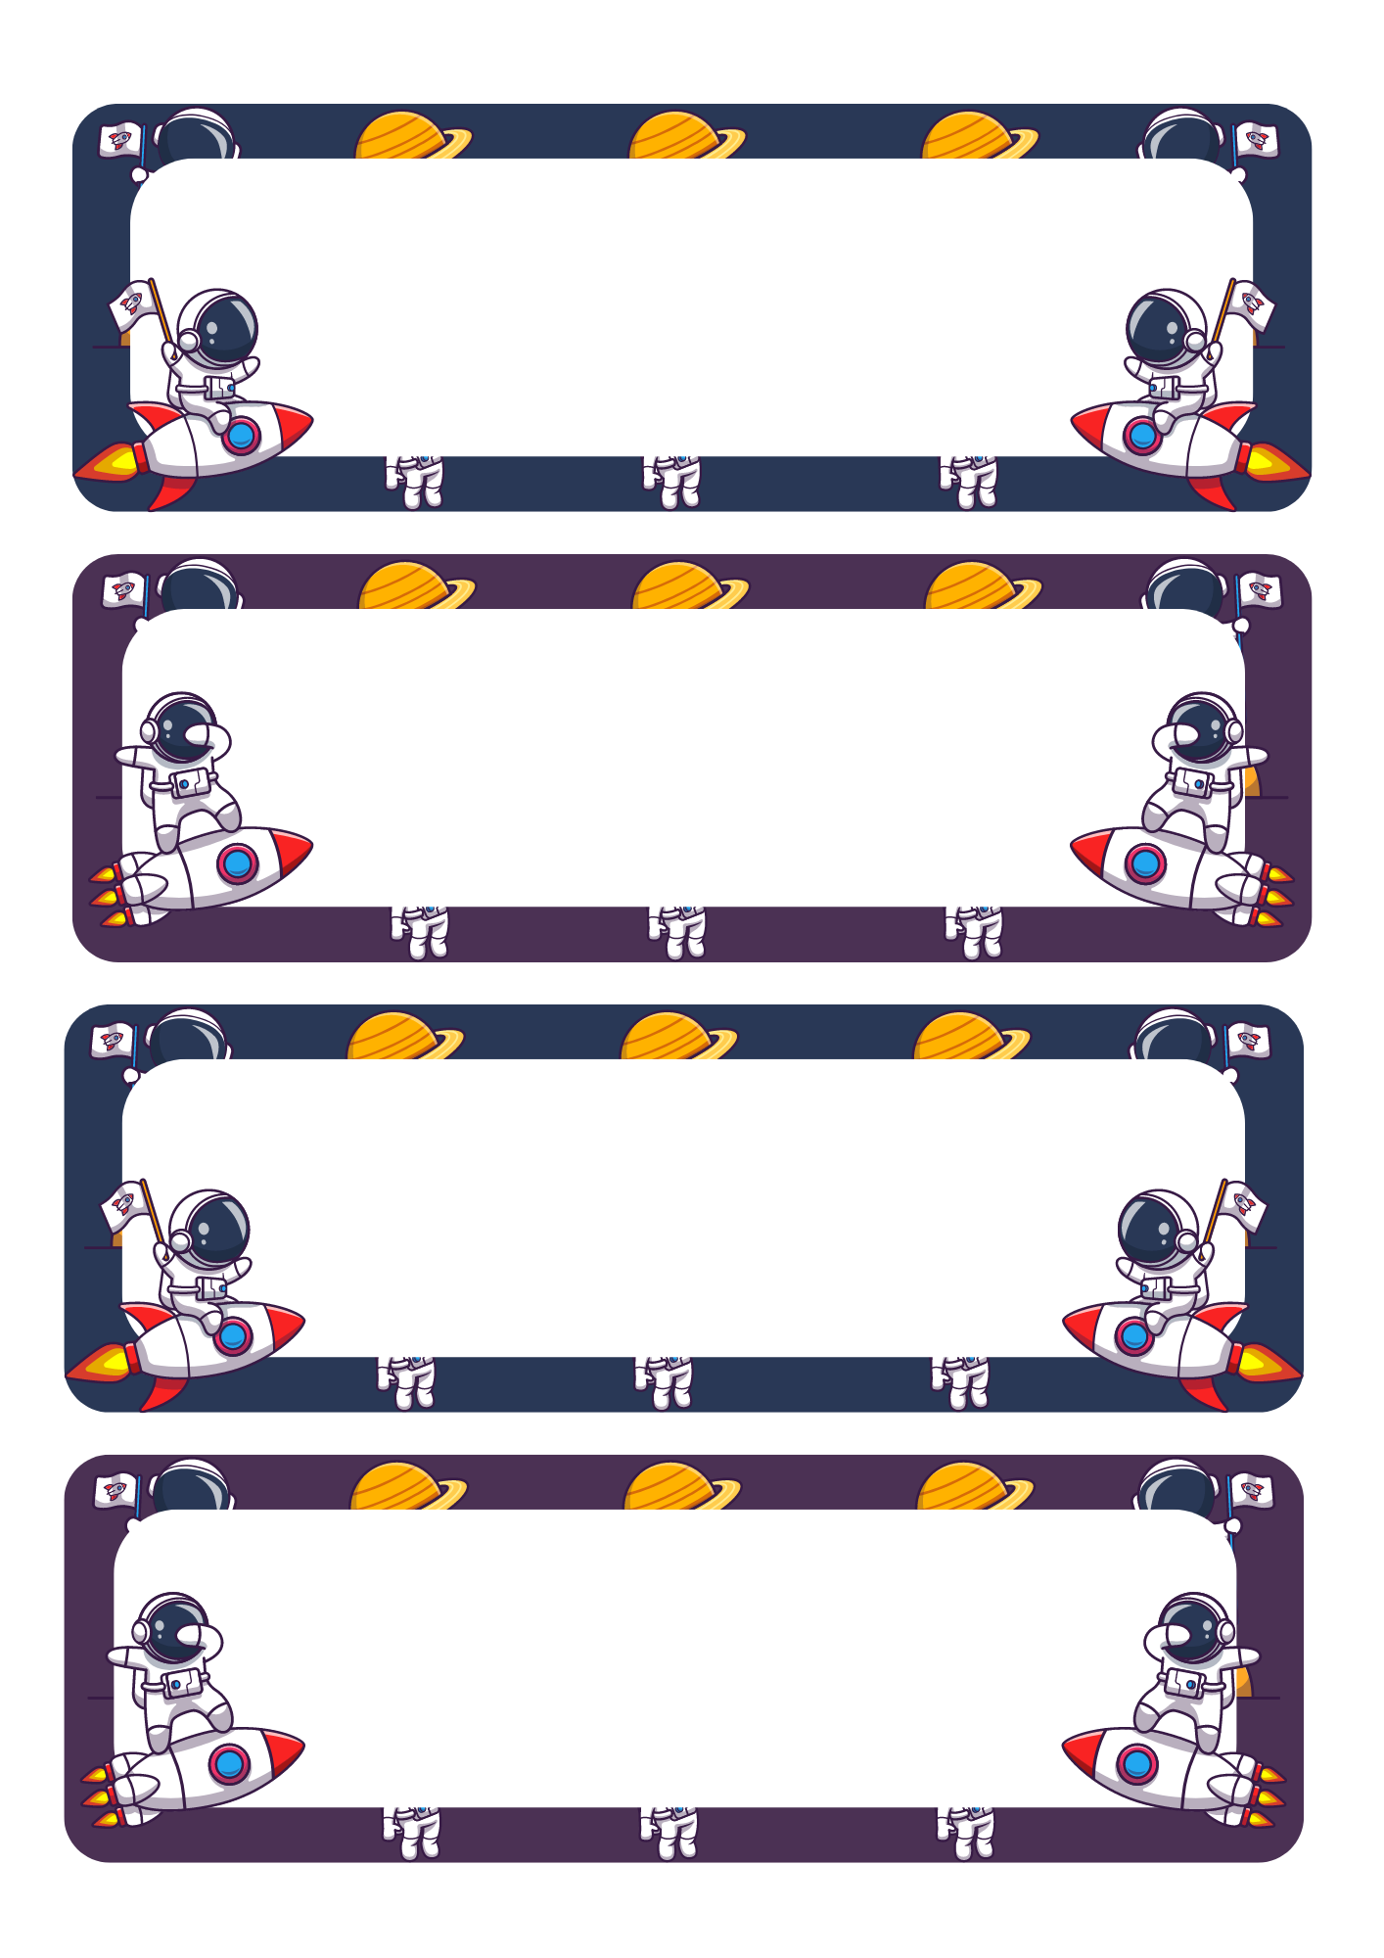
SƠN TÙNG

Slide 3
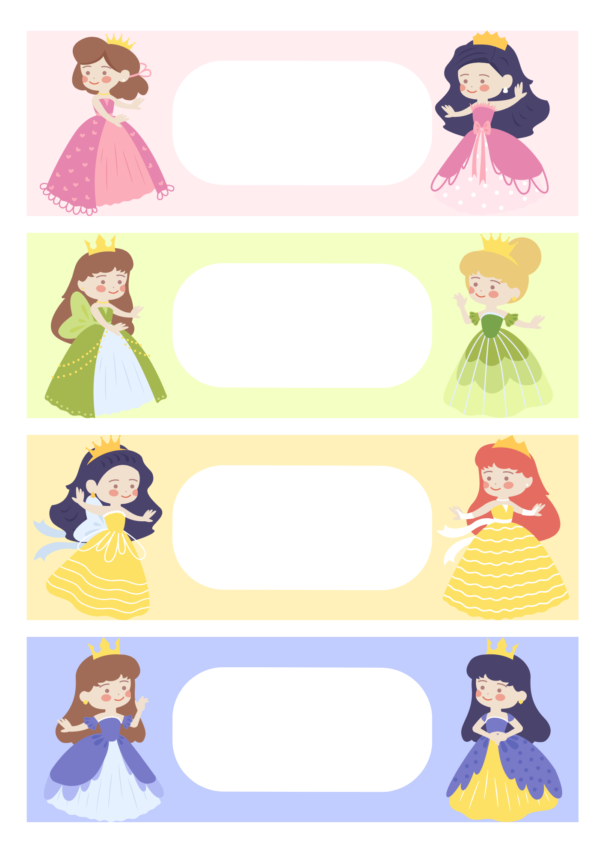
MỸ HẠNH

Slide 4

Con:………………………… Gửi: …………………………
……………………………………………………………………………………………………………………………………………………………....
From: …………………………
……………………………………………………………………………………………………………………………………………………………....
From: …………………………
……………………………………………………………………………………………………………………………………………………………....
From: …………………………
……………………………………………………………………………………………………………………………………………………………....

Slide 5

From: …………………………
……………………………………………………………………………………………………………………………………………………....
From: …………………………
……………………………………………………………………………………………………………………………………………………....
From: …………………………
……………………………………………………………………………………………………………………………………………………....
From: …………………………
……………………………………………………………………………………………………………………………………………………....

