Slide 1


Slide 2




Unit
11
TRAVELLING IN THE FUTURE
LESSON 4: COMMUNICATION
Unit
HOBBIES

Slide 3

OBJECTIVES
By the end of the lesson, students will be able to:
learn how to how to make predictions
practise using some grammar points and vocabulary related to the topic

Slide 4
LESSON 4: COMMUNICATION
WARM-UP
Chatting
Making predictions
Task 1: Listen and read the conversation.
Task 2: Make similar conversation.
EVERYDAY ENGLISH
Task 3: Complete the conversation between Mark and Lan with the questions and answers from the box.
Task 4: Choose one means of transport below and make a similar conversation as in 3.
Task 5: Choose one means of transport that you would like to use to travel to school. Give reasons.
HOW WILL CHILDREN GO TO SCHOOL?
CONSOLIDATION
Wrap-up
Homework

Slide 5

WARM-UP
Make sentences using:
the future simple or possessive pronouns

Slide 6
EVERYDAY ENGLISH
  MAKING PREDICTIONS
- We certainly will/ won’t …
→ if you are sure about your predictions.
- It probably won’t/ will …
→ if you are not sure about your predictions.

Slide 7


EVERYDAY ENGLISH
1
Listen and read the conversations. Pay attention to the highlighted sentences.

Slide 8

EVERYDAY ENGLISH
2
Make similar conversations.
Situation 2: Travelling to other planets for holidays.
Situation 1: Travelling long distances by hyperloop.

Slide 9
HOW WILL CHILDREN GO TO SCHOOL?
3
Complete the conversation between Mark and Lan with the questions and answers from the box.
﻿Mark: So what means of transport will students use to go to school?
Lan: (1)
Mark: Walkcar? (2)
Lan: Four.
Mark: How will it work?
Lan: You stand on it then turn on the switch and drive away.
Mark: (3)
Lan: Electricity.
Mark: Won’t riders fall off it? It sounds dangerous.
Lan: No, they won’t. (4)
Mark: I can’t wait to get one.
B. I think they will go by walkcar.
A. How many wheels will a walkcar have?
D. What will it run on?
C. It is self-balancing.

Slide 10
HOW WILL CHILDREN GO TO SCHOOL?
4
Choose one means of transport below and make a similar conversation as in 3.

Slide 11
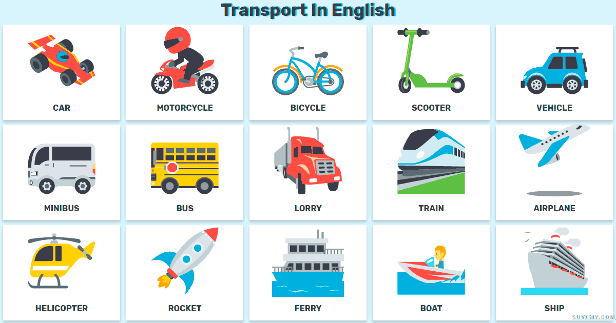
HOW WILL CHILDREN GO TO SCHOOL?
5
Choose one means of transport that you would like to use to travel to school.
Give reasons.

Slide 12

CONSOLIDATION
1
WRAP-UP
In this lesson, we have learnt to:
make predictions
practise using some grammar points and vocabulary related to the topic

Slide 13

CONSOLIDATION
2
HOMEWORK
Do exercises in the workbook.

Slide 14

Website: hoclieu.vn
Fanpage: facebook.com/www.tienganhglobalsuccess.vn/

