Slide 2




REVIEW
2
PART 2 - SKILLS
1

Slide 3
PART 2 – SKILLS
LESSON 1: GETTING STARTED
WARM-UP
Warm-up: Chatting
Reading
Task 1: Read the passage and choose the correct answer A, B, C or D.
PRESENTATION
Speaking
Task 2: Work in groups. Choose ONE of the things below and discuss it, using the cues. Then present it to your class.
PRACTICE
Listening
Task 3: Listen to a talk about entertainment for Vietnamese children in the past and complete each sentence with ONE word.
PRODUCTION
Writing
Task 4: Make complete sentences from the clues. Make any changes and add more words if necessary.
CONSOLIDATION
Wrap-up
Homework

Slide 4
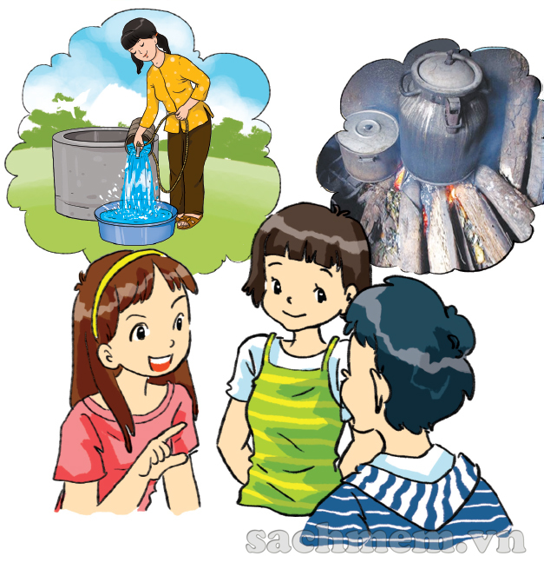
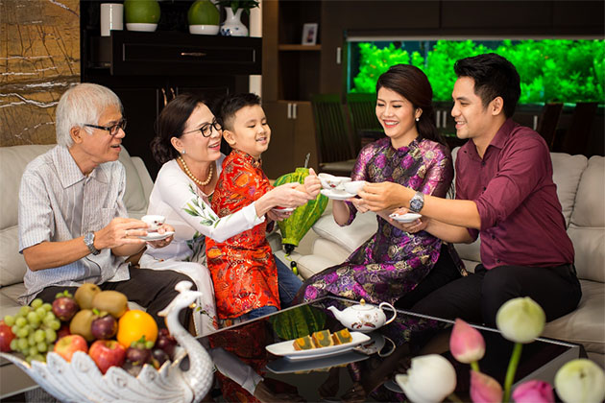
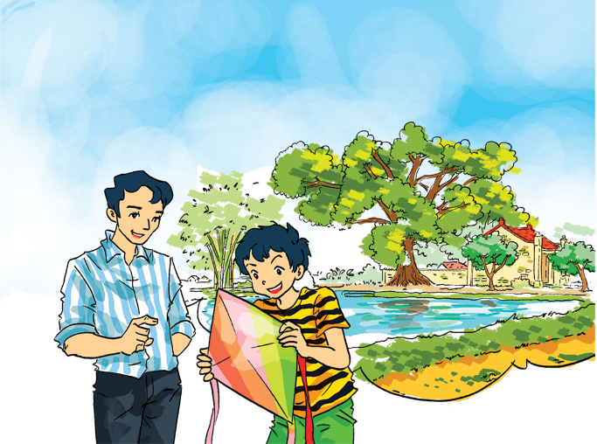
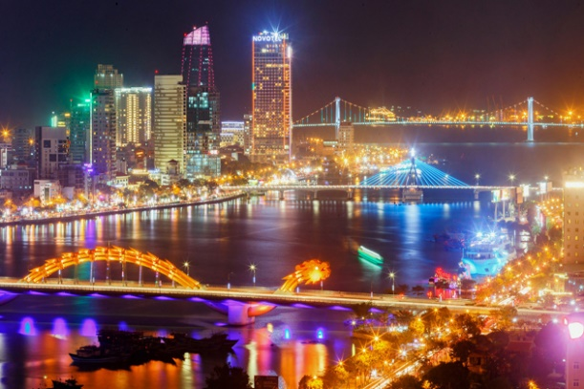
WARM-UP
The differences between life
in the past and
at present?

Slide 5
PRACTICE - READING
1
Read the passage and choose the correct answer A, B, C, or D.
Not long ago, open-air markets played an important part in the lives of the Vietnamese. Wherever there was open space, the local people could start their own market. There, you could find almost everything from local home-made and home-grown products to those that the sellers bought wholesale from somewhere and resold them for a profit. Since the locals went there nearly every day, they knew one another, and the sellers even remembered the customers’ preferences. Then supermarkets came and soon became popular. There are many reasons to explain their popularity. First, they offer a cool and large shopping site. Shoppers can spend hours in them without worrying about heat or rain. Second, they provide shoppers with a wide range of goods, from foods and kitchenware to cosmetics and pet care products. People do not have to move from shop to shop to collect all the things they need. Nowadays, many supermarkets even offer home-delivery service and online shopping, which makes shopping even easier.

Slide 6
PRACTICE - READING
1
Read the passage and choose the correct answer A, B, C, or D.
Not long ago, open-air markets played an important part in the lives of the Vietnamese. Wherever there was open space, the local people could start their own market. There, you could find almost everything from local home-made and home-grown products to those that the sellers bought wholesale from somewhere and resold them for a profit. Since the locals went there nearly every day, they knew one another, and the sellers even remembered the customers’ preferences. Then supermarkets came and soon became popular. There are many reasons to explain their popularity. First, they offer a cool and large shopping site. Shoppers can spend hours in them without worrying about heat or rain. Second, they provide shoppers with a wide range of goods, from foods and kitchenware to cosmetics and pet care products. People do not have to move from shop to shop to collect all the things they need. Nowadays, many supermarkets even offer home-delivery service and online shopping, which makes shopping even easier.
1. In the past, the local people could start an open-air market when ______.
A. they paid the rent
B. they found a spacious spot
C. they had products to sell
D. they didn’t want to shop elsewhere

Slide 7
PRACTICE - READING
1
Read the passage and choose the correct answer A, B, C, or D.
Not long ago, open-air markets played an important part in the lives of the Vietnamese. Wherever there was open space, the local people could start their own market. There, you could find almost everything from local home-made and home-grown products to those that the sellers bought wholesale from somewhere and resold them for a profit. Since the locals went there nearly every day, they knew one another, and the sellers even remembered the customers’ preferences. Then supermarkets came and soon became popular. There are many reasons to explain their popularity. First, they offer a cool and large shopping site. Shoppers can spend hours in them without worrying about heat or rain. Second, they provide shoppers with a wide range of goods, from foods and kitchenware to cosmetics and pet care products. People do not have to move from shop to shop to collect all the things they need. Nowadays, many supermarkets even offer home-delivery service and online shopping, which makes shopping even easier.
2. The relationship between the sellers and the market-goers at an open-air market was ______.
A. healthy
B. distant
C. formal
D. close

Slide 8
PRACTICE - READING
1
Read the passage and choose the correct answer A, B, C, or D.
Not long ago, open-air markets played an important part in the lives of the Vietnamese. Wherever there was open space, the local people could start their own market. There, you could find almost everything from local home-made and home-grown products to those that the sellers bought wholesale from somewhere and resold them for a profit. Since the locals went there nearly every day, they knew one another, and the sellers even remembered the customers’ preferences. Then supermarkets came and soon became popular. There are many reasons to explain their popularity. First, they offer a cool and large shopping site. Shoppers can spend hours in them without worrying about heat or rain. Second, they provide shoppers with a wide range of goods, from foods and kitchenware to cosmetics and pet care products. People do not have to move from shop to shop to collect all the things they need. Nowadays, many supermarkets even offer home-delivery service and online shopping, which makes shopping even easier.
3. The writer mentions two ______ the supermarket.
A. of his experiences with
B. types of goods in
C. benefits of
D. types of shoppers in

Slide 9
PRACTICE - READING
1
Read the passage and choose the correct answer A, B, C, or D.
Not long ago, open-air markets played an important part in the lives of the Vietnamese. Wherever there was open space, the local people could start their own market. There, you could find almost everything from local home-made and home-grown products to those that the sellers bought wholesale from somewhere and resold them for a profit. Since the locals went there nearly every day, they knew one another, and the sellers even remembered the customers’ preferences. Then supermarkets came and soon became popular. There are many reasons to explain their popularity. First, they offer a cool and large shopping site. Shoppers can spend hours in them without worrying about heat or rain. Second, they provide shoppers with a wide range of goods, from foods and kitchenware to cosmetics and pet care products. People do not have to move from shop to shop to collect all the things they need. Nowadays, many supermarkets even offer home-delivery service and online shopping, which makes shopping even easier.
4. The supermarket also offers ______.
A. pet food
B. pets
C. pet shops
D. pet vets

Slide 10
PRACTICE - READING
1
Read the passage and choose the correct answer A, B, C, or D.
Not long ago, open-air markets played an important part in the lives of the Vietnamese. Wherever there was open space, the local people could start their own market. There, you could find almost everything from local home-made and home-grown products to those that the sellers bought wholesale from somewhere and resold them for a profit. Since the locals went there nearly every day, they knew one another, and the sellers even remembered the customers’ preferences. Then supermarkets came and soon became popular. There are many reasons to explain their popularity. First, they offer a cool and large shopping site. Shoppers can spend hours in them without worrying about heat or rain. Second, they provide shoppers with a wide range of goods, from foods and kitchenware to cosmetics and pet care products. People do not have to move from shop to shop to collect all the things they need. Nowadays, many supermarkets even offer home-delivery service and online shopping, which makes shopping even easier.
5. Which statement is true according to the information in this passage?
A. Now you can find open-air markets in the countryside only.
B. Every supermarket offers home-delivery service.
C. It’s more convenient to shop in a supermarket than in an open-air market.
D. Supermarkets offer everything we need.

Slide 11
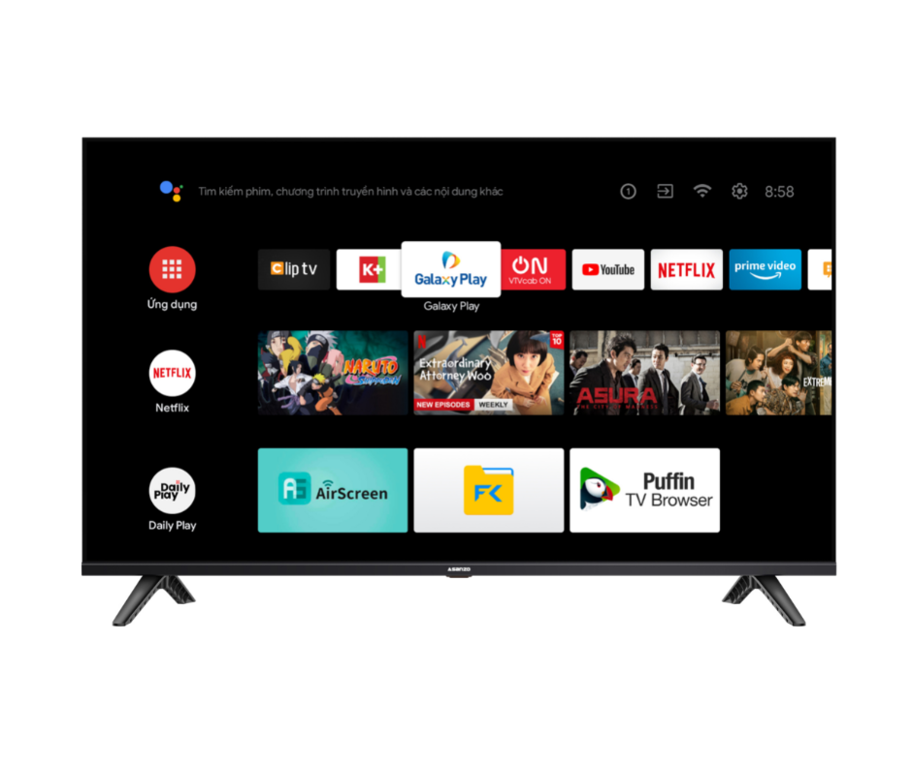
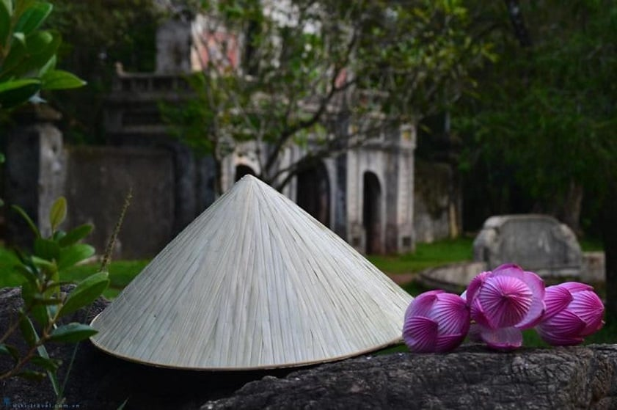
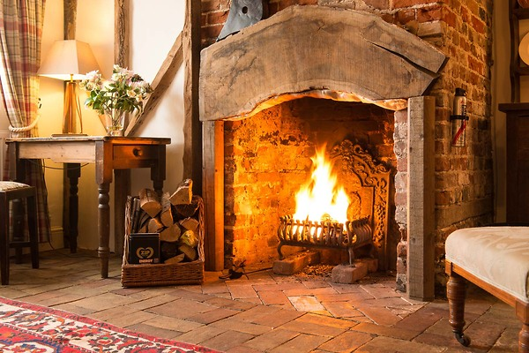
PRACTICE - SPEAKING
2
Work in groups. Choose ONE of the things below and discuss it, using the cues. Then present it to your class.
1. conical hat
2. smart TV
3. open wood fire

Slide 12

PRACTICE - LISTENING
3
Listen to a talk about entertainment for Vietnamese children in the past and complete each sentence with ONE word.
1. Games in the past required little ___________.
2. We floated paper boats on imagined ‘rivers’ formed from __________.
3. Thanks to making our own toys, we became ________.
4. We played most games in _______ outdoors.
5. Team games helped develop _______ bonds among us.
equipment
rainwater
creative
groups
strong

Slide 13
PRACTICE - WRITING
4
Make complete sentences from the clues. Make any changes and add more words if necessary.
1. I / wish / I can / attend / traditional festivals / minority people / Viet Nam.
→ I wish I could attend some traditional festivals of minority people in Viet Nam.
2. When we / arrive / fair, / rice-cooking competition / taking place.
→ When we arrived at the fair, the rice-cooking competition was taking place.
3. He promise / help me / PowerPoint presentation / but he / not.
→ He promised to help me with my PowerPoint presentation but he didn’t.

Slide 14
PRACTICE - WRITING
4
Make complete sentences from the clues. Make any changes and add more words if necessary.
4. We / never see / sight / as beautiful as / mountain at sunset.
→ We have never seen a sight as beautiful as the mountain at sunset.
5. he / fancy / become / fashion designer / when / he / child?
→ Did he fancy becoming a fashion designer when he was a child?

Slide 15

CONSOLIDATION
1
Wrap-up
What have we learnt in this lesson?
Reading?
Speaking?
Listening?
Writing?

Slide 16

CONSOLIDATION
2
Homework
- Do exercises in the workbook;
- Prepare for Unit 7 – Getting started.

Slide 17
Website: hoclieu.vn
Fanpage: facebook.com/www.tienganhglobalsuccess.vn/

