Slide 1
CHRISTMAS CROSSWORD
1
1
C
A
N
D
L
E
S
2
2
S
L
E
I
G
H
3
3
P
R
E
S
E
N
T
4
4
P
I
E
5
5
S
I
N
G
6
6
G
I
F
T
7
7
H
A
M
8
8
B
A
B
Y
9
9
S
L
E
D
6. It is opened on christmas
5. What carolers do
1. Used light tower
2. Santa’s ride
4. Pumpkin or minceat
3. Alternative word to 17 across
7. Christmas dinner centerpiece
8. Newborn
9. Snow glider
Keyword

Slide 2
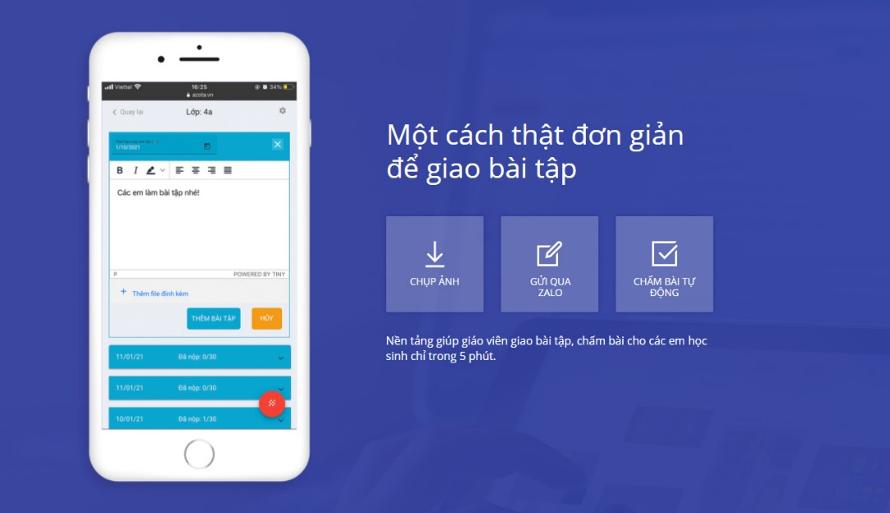
gioithieu.azota.vn

