Slide 1


Slide 2

Unit
9
1
Unit
FAMILY LIFE
Protecting the environment
LESSON 7
COMMUNICATION AND CULTURE/ CLIL

Slide 3

Unit
1
1
FAMILY LIFE
Family Life
Unit
OBJECTIVES
To review expressions for making and responding to apologies.
To help students learn about Earth Hour through CLIL (Environmental studies) and learn some content vocabulary.
To give Ss an opportunity to personalize the CLIL topic.

Slide 4
LESSON 7
COMMUNICATION AND CULTURE/ CLIL
Video watching
WARM-UP
EVERYDAY ENGLISH
Task 1: Listen and complete the conversations.
Task 2: Make similar conversations.
CLIL
Task 1: Answer the questions.
Task 2: Read the text and complete the fact file.
Task 3: Discussion.
EXTRA ACTIVITY
Talk about Earth Hour.
CONSOLIDATION
Wrap-up
Home work

Slide 5
LESSON 7
COMMUNICATION AND CULTURE/ CLIL
Video watching
WARM-UP

Slide 6

Video watching
In this video, Paul says sorry for making Noelia fall over. Watch the video and:
- Complete the conversation with the correct information.
- Listen and repeat at the end of the clip.
Notes:
Video link: https://learnenglish.britishcouncil.org/skills/speaking/pre-intermediate-a2/apologising

Slide 7
Video watching
Paul: Noelia! I am so (1) ! Are you OK?
Noelia: I think so. That was lucky.
Paul: I'm (2) sorry! I didn't see you!
Noelia: That's (3) . I shouldn't have been running.
Paul: No, no, I should have been (4) .
Noelia: And they teach you (5) inside at school!
Paul: Still, it was my (6) and I'm sorry.
Noelia: I'm sorry (7) . It was both of us. Honestly, (8) .I'm fine. Don't (9) about it. Hey, I saved the laptop though!
Bob: Yeah, I'll be there in …
Noelia: Oh no!
Bob: Uh oh!
Paul: Ahhhh …
sorry
really
all right
paying attention
not to run
fault
too
it's fine
worry

Slide 8
LESSON 7
COMMUNICATION AND CULTURE/ CLIL
Video watching
WARM-UP
EVERYDAY ENGLISH
Task 1: Listen and complete the conversations.
Task 2: Make similar conversations.

Slide 9

EVERYDAY ENGLISH
1
Listen and complete the conversations with the expressions in the box. Then practise them in pairs.
Never mind
I’d like to apologise for
That’s all right
I’m sorry to
1
Mai: (1) ________ submitting my assignment late. I‘m sorry, but my laptop was broken.
Mr Ha: (2) ________. Next time you should finish it earlier and have a back-up copy in case you have any technical problems.
B
C
2
Nam: (3) ________ keep you waiting for so long. The talk was longer than expected.
Mai: (4) ________. We still have enough time for dinner before the show.
D
A

Slide 10
EVERYDAY ENGLISH
PRACTICE
2
Work in pairs. Make similar conversations making and responding to apologies. Use the expressions below to help you
Useful expressions
Making apologies | Responding to apologies
(I hope you’ll) excuse me for… | Don’t mention it.
Sorry for … I am sorry to … | Never mind.
I’d like to apologise for … | That’s all right.
Please accept my apology for… | Don’t worry about it.

Slide 11
LESSON 7
COMMUNICATION AND CULTURE/ CLIL
Video watching
WARM-UP
EVERYDAY ENGLISH
Task 1: Listen and complete the conversations.
Task 2: Make similar conversations.
CLIL
Task 1: Answer the questions.
Task 2: Read the text and complete the fact file.
Task 3: Discussion.

Slide 12
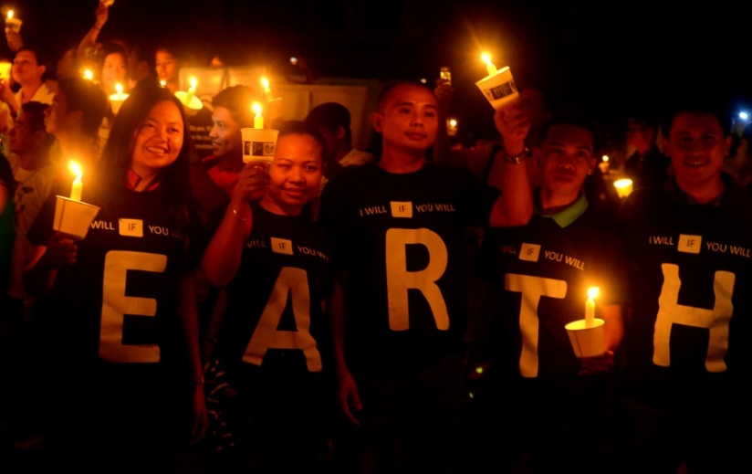

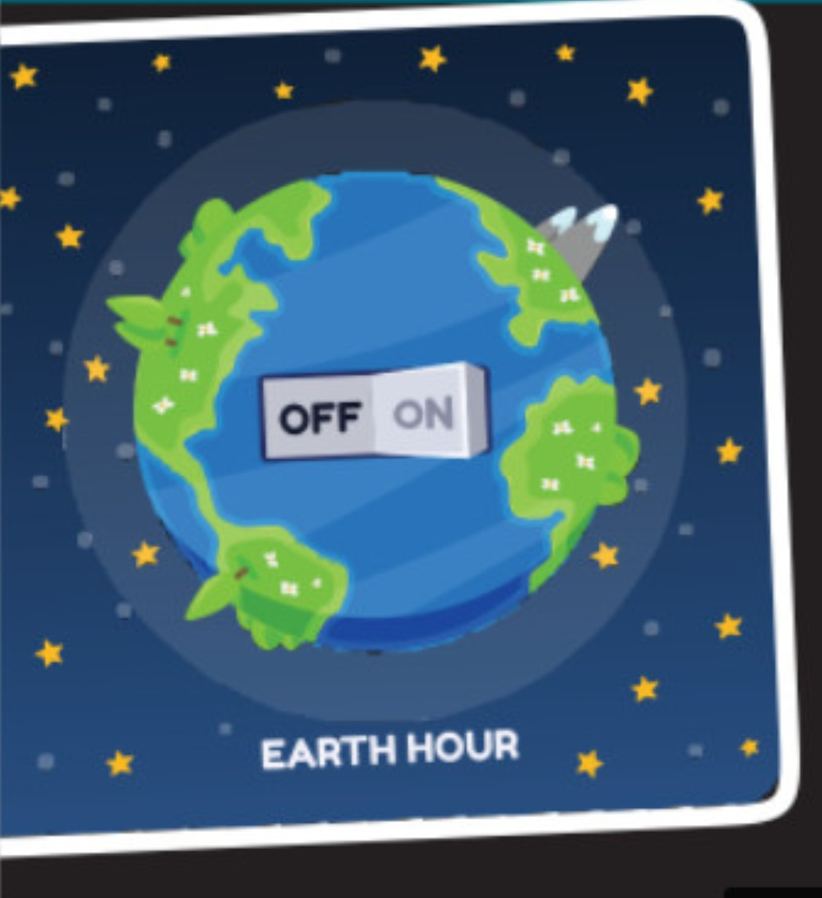
CLIL
PRACTICE
1
Look at the pictures and answer the question:
What do you know about Earth Hour?

Slide 13
CLIL
2
Read the text and complete each blank about Earth Hour with ONE word.
EARTH HOUR
Organised by | World Wide Fund for Nature
Held from | 8.30 p.m. – 9.30 p.m. on the last (1)………………….of March.
Started in | Sydney, Australia, in 2007
Aims | - to show the public (2)………….....for protecting the environment and saving the planet - to draw attention to (3)……..........change and global energy issues - to promote green (4) ………………worldwide
First held in Viet Nam in | (5) ……………….with a variety of activities nationwide.
Saturday
support
climate
activities
2009

Slide 14

CLIL
3
Watch a video about Earth Hour. Work in pairs. Discuss the following questions.
1. Do you want to take part in this lights-out event in Viet Nam? Why or why not?
2. If you have a chance to take part in the event, what would you do?
Notes:
https://www.youtube.com/watch?v=mDM1piwvGCQ&t=24s

Slide 15

EXTRA ACTIVITY
TALK ABOUT EARTH HOUR
2

Slide 16
LESSON 7
COMMUNICATION AND CULTURE/ CLIL
Video watching
WARM-UP
EVERYDAY ENGLISH
Task 1: Listen and complete the conversations.
Task 2: Make similar conversations.
CLIL
Task 1: Answer the questions.
Task 2: Read the text and complete the fact file.
Task 3: Discussion.
EXTRA ACTIVITY
Talk about Earth Hour.
CONSOLIDATION
Wrap-up
Home work

Slide 17
CONSOLIDATION
1
Wrap-up
To review expressions for making and responding to apologies.
To help Ss learn about Earth Hour through environmental studies and learn some content vocabulary.
To give Ss an opportunity to personalise the CLIL topic.

Slide 18
CONSOLIDATION
2
Homework
Do exercises in the workbook.

Slide 19

Website: hoclieu.vn
Fanpage: facebook.com/tienganhglobalsuccess.vn/

