Slide 1

UNIT 9: TRAVEL AND TOURISM
Lesson 2.1 – Vocabulary & Listening
Page 77

Slide 2




Lesson 2.1
LESSSON OUTLINE
Consolidation

Slide 3
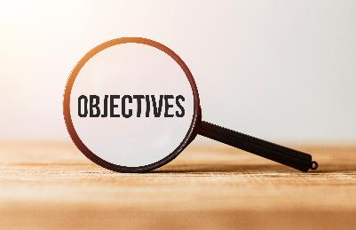
By the end of this lesson,
students will be able to:
- practice and learn vocab. about problems on Vacations: steal, food poisoning, delay, break down, fire alarm.
- practice listening for specific information.
- improve listening skill.

Slide 4



Slide 5

WATCHING VIDEO
Watch the video and answer these questions.
1. What were the man’s problems?
2. Why did he feel wonderful?
Link mở video: https://www.youtube.com/watch?v=FG0USQaru8o

Slide 6
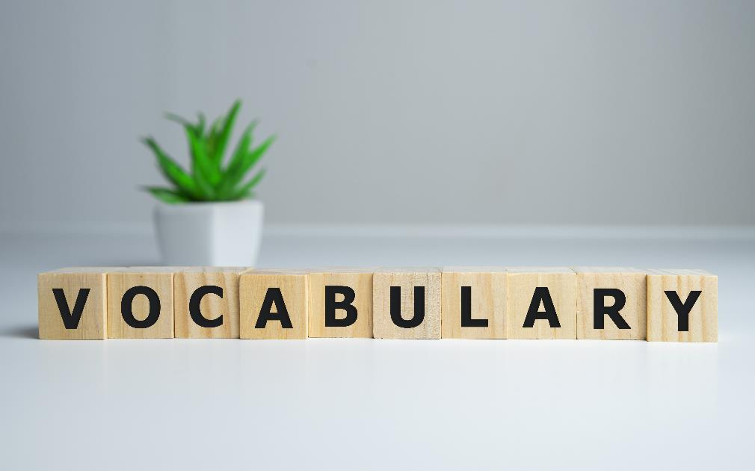


Slide 7


a. Fill in the blanks using the words from the box. You might need to use the past form of the verbs. Listen and repeat.
steal food poisoning delay break down fire alarm
1. I missed my flight because the taxi ___________ on the way to the airport. We had to wait for a mechanic.
2. I ate some seafood last night and felt really sick. I think I had
______________.
3. Someone ______ my suitcase when I was traveling on vacation. I had to buy new clothes because all my clothes were taken.
broke down
food poisoning
stole
4. Because of the storm, our flight was ________ by two hours.
5. The __________ rang at 2 a.m. last night. We were scared, but luckily, everyone was safe.
delayed
fire alarm

Slide 8

Listen and repeat.
1. steal (v) /stiːl/ → stole (v₂ ) /stoʊl/ ăn cắp, ăn trộm
2. food poisoning (n) /ˈfuːd pɔɪzənɪŋ/ sự ngộ độc thực phẩm
3. delay(ed) (v) / dɪˈleɪ/ làm chậm trễ, hoãn
4.(break) broke down (v) /(breɪk) broʊk daʊn / bị hư, bị hỏng
5. fire alarm (n) /ˈfaɪr əˈlɑːrm/ chuông báo cháy
Notes:
Please, click on each phrase to hear the sound

Slide 9
More Practice
WB, P. 52
a. make someone or something late
b. sickness caused by bad food
c. a bell or other device that gives people warning of a fire in a building
d. take something from a person or shop without permission
e. (of a machine or vehicle) stop working
1.food poisoning
2.steal
3.break down
4.fire alarm
5.delay
Notes:
Taken from TA 10 i-Learn Smart World WB, page 52, New Words, activity a

Slide 10
More Practice
WB, P. 52
b. Fill in the blanks with the words from Task a. Make changes to the verb form if needed.
1. The plane had a problem, so our flight was ________ until midnight.
2. Don't eat those shrimp. They'll give you ______________.
3. When you hear the _________, exit using the stairs. Do not use the elevator.
4. Can I borrow your money? Someone _____ my wallet last night.
5. My motorbike ___________, so I had to walk to work.
delayed
food poisoning
fire alarm
stole
broke down
Notes:
Taken from TA 10 i-Learn Smart World WB, page 52, New Words, activity b

Slide 11

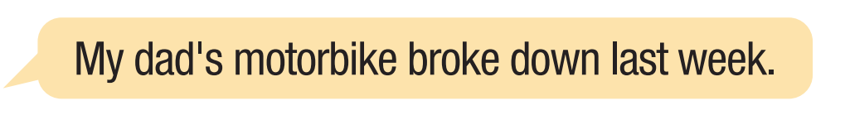
b. In pairs: Have you had similar experiences to the previous problems in task b?
Talk with your partner.
Example:

Slide 12
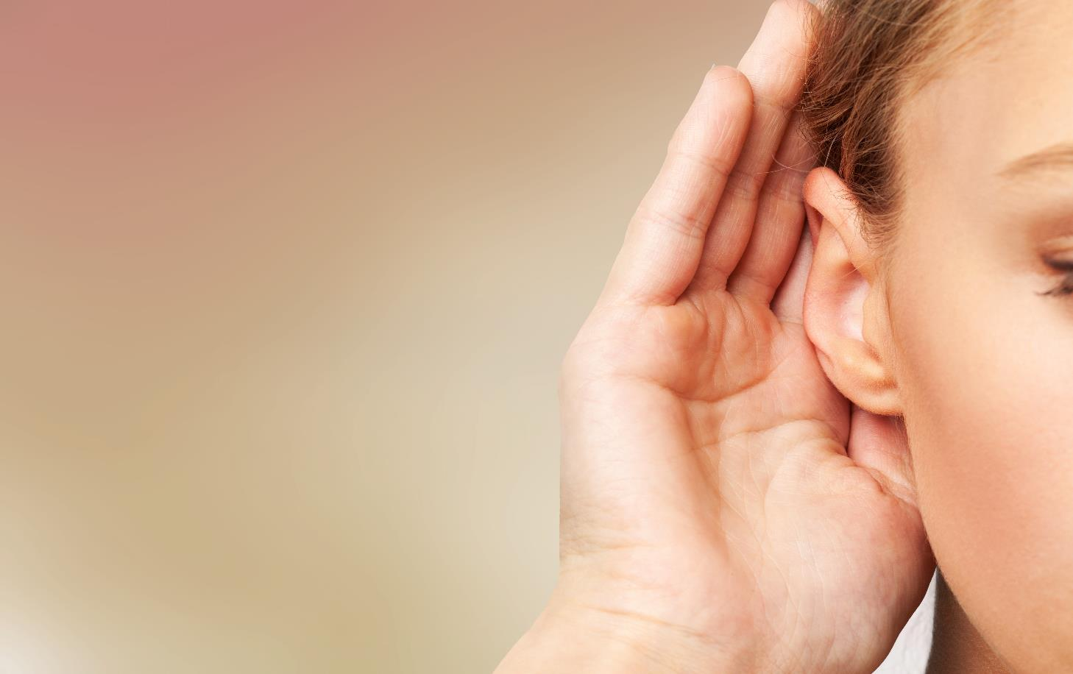


Slide 13
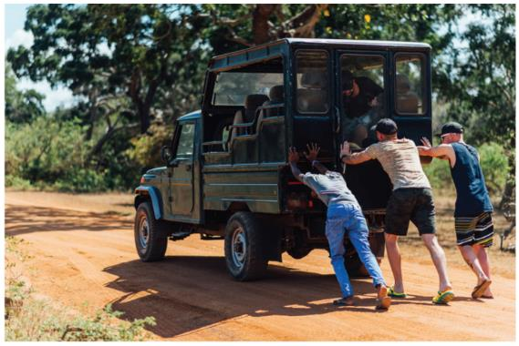
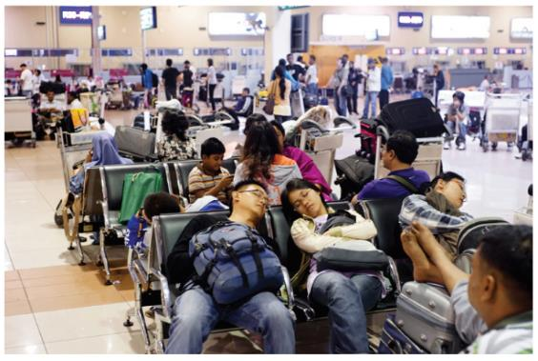
Pre - Listening
Listen to Simon talking to Jackie about his vacation.
How was his vacation?
a. fantastic b. terrible c. boring

Slide 14
Pre - Listening
Listen to Simon talking to Jackie about his vacation.
How was his vacation?
a. fantastic b. terrible c. boring
What are you going to listen?
→ Listen to Simon talking to Jackie about his vacation
What are some key words in the question?
→ How, vacation, fantastic, terrible, boring ?

Slide 15
While-Listening
Listen to Simon talking to Jackie about his vacation.
How was his vacation?
a. fantastic b. terrible c. boring

Slide 16
Pre-Listening
b. Now, listen and answer the questions.
1. What happened on the way to the hotel?
2. What was wrong with the man's room?
3. What happened after dinner?
4. What was Simon doing when his bag was stolen?

Slide 17
While-Listening
b. Now, listen and answer the questions.
1. What happened on the way to the hotel?
2. What was wrong with the man's room?
3. What happened after dinner?
4. What was Simon doing when his bag was stolen?
→ The bus broke down
→ The toilet was broken and there was a bad smell
→ They got food poisoning
→ He was taking photos

Slide 18
Audio Scripts
Jackie: Hi, Simon. How was your vacation?
Simon: Oh you wouldn't believe what happened.
Jackie: What?
Simon: Well, we were driving to our hotel when the bus broke down.
Jackie: Really?
Simon: We had to wait for three hours for it to be fixed.
Jackie: Oh dear.
Simon: We didn't get to the hotel until 11 p.m. While we were checking in, we heard a guest complaining about his broken toilet and a bad smell.
Jackie: Eww.
Simon: And our rooms were next to his!
Jackie: Did they fix it?
Simon: Not until the last day.
Jackie: That's terrible.
Simon: Wait, it gets worse. The next evening, we were eating dinner when the man behind us found a dead fly from his food.
Jackie: Ew!
Simon: That night, we all got food poisoning.
Jackie: I'm so sorry.
Simon: We went sightseeing the next day. While we were taking photos, someone stole my bag!
Jackie: Oh no! What happened next?
Simon: We couldn't catch him. Luckily, I had my wallet with me so he didn't get anything but some snacks and a jacket.
Jackie: Haha.
Simon: But that wasn't the end. We were waiting for our flight home when it started snowing. Our flight was delayed and we had to wait for ten hours.
Jackie: What a nightmare!
Simon: I know. It was the worst vacation ever.

Slide 19

Pre-Listening
a. Aiden is talking to Emma about his Christmas vacation.
Did he enjoy the trip?
More Practice
WB, P. 52
What are you going to listen?
→ Aiden is talking to Emma about his Christmas
What are you going to do?
→ Answer the question
Notes:
Taken from TA 10 i-Learn Smart World WB, page 52

Slide 20
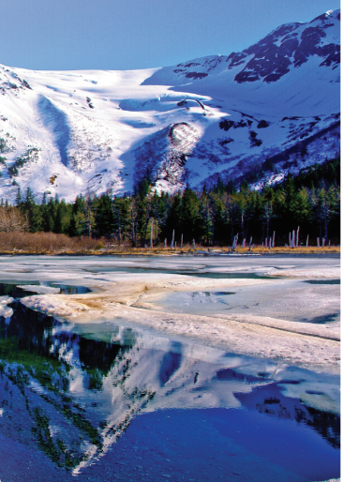
While-Listening
Aiden is talking to Emma about his Christmas vacation.
Did he enjoy the trip?
→ No, he didn’t
More Practice
WB, P. 52
Notes:
Taken from TA 10 i-Learn Smart World WB, page 52

Slide 21
While-Listening
More Practice
WB, P. 52
b. Now, listen and answer the questions.
1. What happened to Aiden's wife?
2. What did Ben hurt when he fell down the stairs?
3. What was stolen while Ben and Aiden were in the hospital?
4. Where did their car break down?
5. How long was the plane delayed?
→ She got food poisoning.
→ his arm
→ a laptop, camera, and TV
→ in a forest
→ for six hours
Notes:
Taken from TA 10 i-Learn Smart World WB, page 52

Slide 22
Audio Scripts
Emma: Hi, Aiden. How was your trip to Alaska?
Aiden: Erm...It didn't go very well.
Emma: Really? What happened?
Aiden: On Christmas Eve, my wife got food poisoning. I had to drive her to a hospital twenty kilometers away during a snow storm. She had to stay there for two days, so Christmas was ruined.
Emma: Oh, no! I'm so sorry.
Aiden: Then my son Ben fell down the stairs and hurt his arm. Luckily, it wasn't broken.
Emma: Oh, poor Ben.
Aiden: On Christmas Day, while we were visiting my wife at the hospital, someone broke into our rental home and stole my laptop, Ben's camera, and the TV. The police were called in, but there wasn't much that they could do.
Emma: What about your money and passports?
Aiden: Fortunately, I had those with me. But that wasn't the end of it. While we were driving back to the airport, our car broke down in a forest. We had to leave it there and walk five kilometers to the next gas station to ask for help.
Emma: What happened next? Did you miss your flight back?
Aiden: Well...The flight was delayed for six hours because of the heavy snow, so in the end we were lucky, I guess.

Slide 23
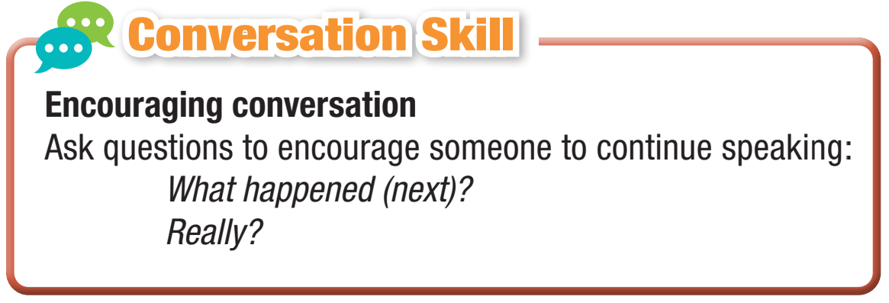
Post-Listening
c. Read the Conversation Skill box and listen to Task b. audio again. Number the phrases in the Conversation Skill box in the order you hear them.
2
1

Slide 24

Post-Listening
d. Listen and repeat.

Slide 25

Post-Listening
e. In pairs:
Have you had any similar problems to Simon on your vacations?
What did you do?

Slide 26

Consolidation

Slide 27
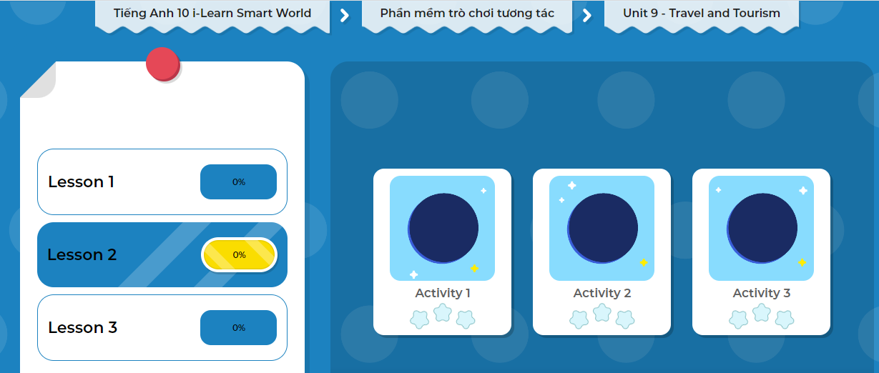
LET’S PLAY!
Click here to play the game!

Slide 28
Wrap-up
Today’s lesson
Vocabulary: about problems on Vacations: steal, food poisoning, delay, break down, fire alarm.
Listening: for main ideas and specific information.
Speaking: talk about problems on vacation.

Slide 29
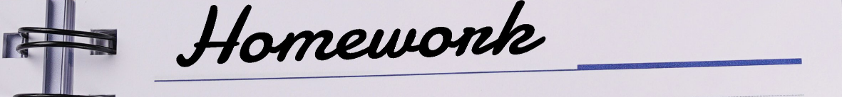
Write a short list about problems that travelers of have on their vacations.
Do the exercises in Tiếng Anh 10 i-Learn Smart World Notebook on page 52.
Prepare the next lesson: Lesson 2.2 - Grammar, (page 78).

