Slide 1

UNIT 1: FAMILY LIFE
Lesson 1.1 – Vocabulary & Listening
Page 4

Slide 2



Lesson .
LESSSON OUTLINE
Consolidation

Slide 3

By the end of this lesson,
students will be able to:
- use vocabulary about household chores.
- listen for a gist and specific information.
- talk about doing chores.

Slide 4
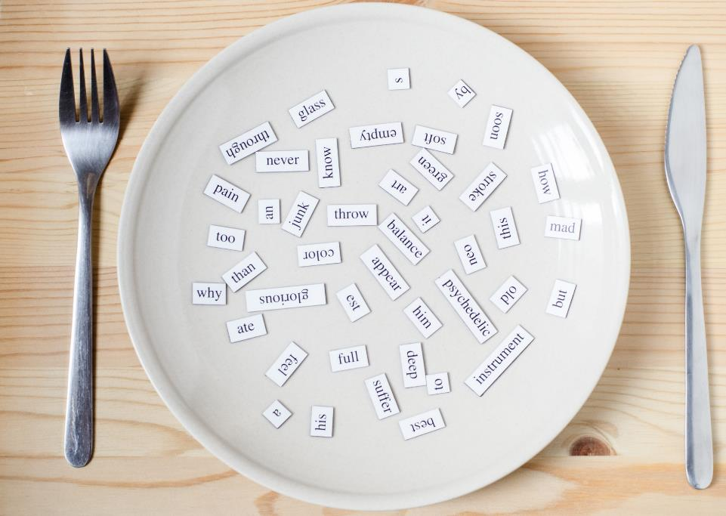
New words
mop the living room
sweep the floor
dust the furniture
tidy my room
vacuum the sofa
put away the clothes
clean the bathroom
wash/do the dishes

Slide 5



Slide 6

Work in pairs.
What chores do you do at home?

Slide 7
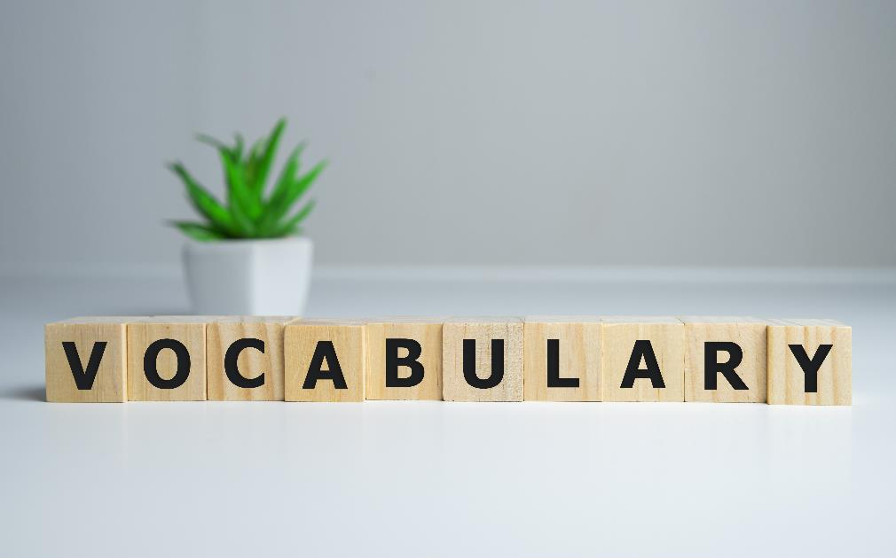


Slide 8

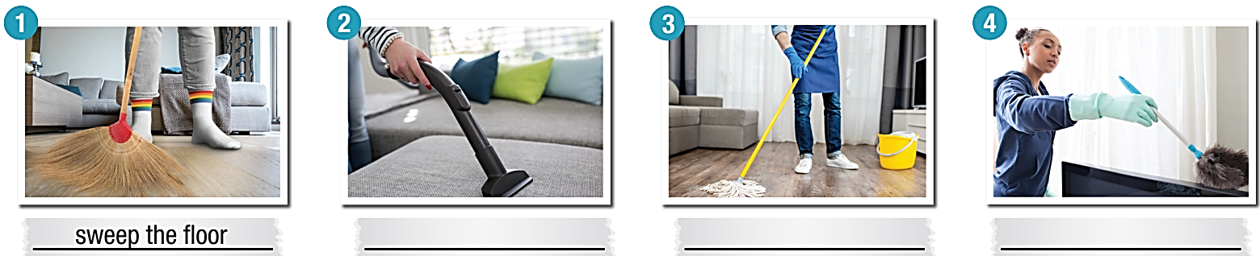
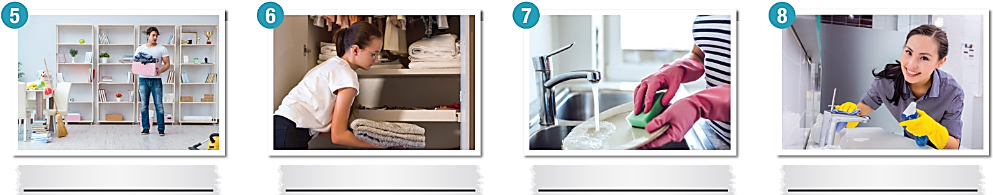


mop the living room sweep the floor dust the furniture clean the bathroom
vacuum the sofa tidy my room put away the clothes wash/do the dishes
sweep the floor
vacuum the sofa
mop the living room
dust the furniture
____________________
tidy my room
put away the clothes
wash/do the dishes
clean the bathroom
Click the ‘Check Answers’ button.
Notes:
Please, click on each phrase to hear the sound

Slide 9
Listen and repeat.
chore (n) / tʃɔːr / việc vặt
mop the living room (v phr) / mɑːp ðə ˈlɪvɪŋ ruːm / lau phòng khách
sweep the floor (v phr) / swiːp ðə flɔːr / quét nhà
dust the furniture (v phr) / dʌst ðə ˈfəːrnɪtʃər / phủi bụi nội thất
clean the bathroom (v phr) / kliːn ðə ˈbæθ ruːm / lau chùi phòng tắm
vacuum the sofa (v phr) / ˈvækjuːm ðə ˈsoufə / hút bụi sofa
put away the clothes (v phr) / pʊt əˈweɪ ðə kloʊðz / dẹp quần áo
wash/do the dishes (v phr) / wɑːʃ/duː ðə dɪʃɪz / rửa chén
tidy my room (v phr) / ˈtaɪdi maɪ ruːm / dọn phòng

Slide 10
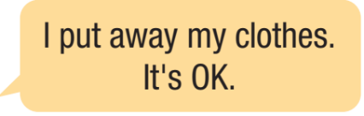
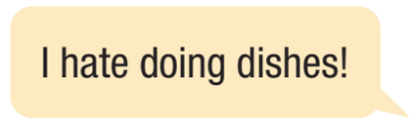

Slide 11


Slide 12
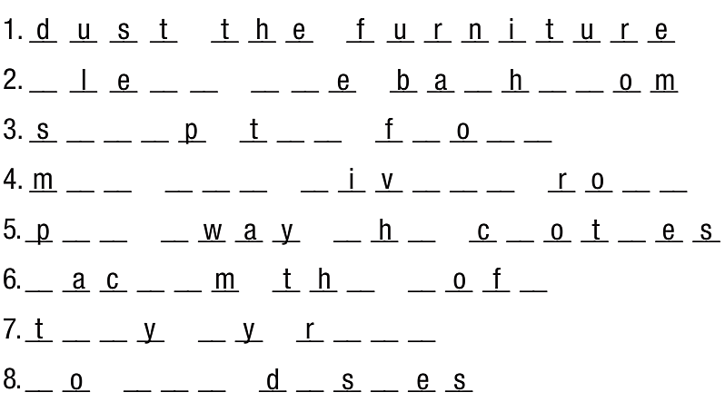
Extra Practice, WB page 2.
dust the furniture
clean the bathroom
sweep the floor
mop the living room
put away the clothes
vacuum the sofa
tidy my room
wash/do the dishes
Click the ‘Check Answers’ button.

Slide 13
Extra Practice, WB page 2.
1. I ___________________ in the living room once a week, including the TV.
2. Please _________________ before you mop it. The broom is in the cupboard.
3. Tonight I need to ___________________. It's really messy.
4. After Mom does the laundry, I __________________.
5. Once a week I ___________________, including the sink and shower.
6. Can you ___________________ floor? Remember to use hot water.
7. After we finish dinner, I'll _________________. You can put them away later.
8. I ___________________ on Fridays. I always find potato chips behind the cushions. My little brother is so messy!
dust the furniture
sweep the floor
tidy my room
put away the clothes
clean the bathroom
mop the living room
wash/do the dishes
vacuum the sofa
Click the ‘Check Answers’ button.

Slide 14



Slide 15

Pre- listening
Work in pairs.
Share ideas.
mop the living room
sweep the floor
dust the furniture
clean the bathroom
vacuum the sofa
tidy my room
put away the clothes
wash/do the dishes
How often do you ________?

Slide 16




While- listening

Click the ‘Check Answers’ button.

Slide 17

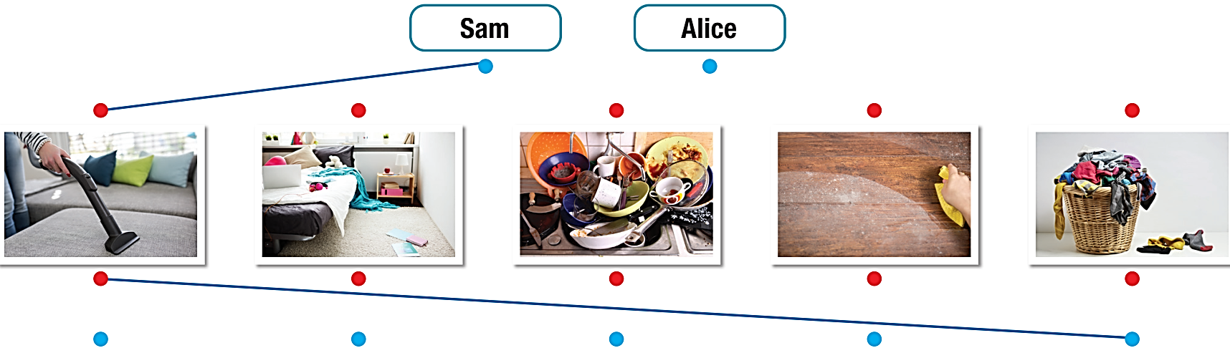
While- listening
b. Now, listen and draw lines from Sam and his sister
to the chores they do and how often they do them.


Slide 18
While- listening
Share ideas with a new partner. What chores does
Sam/Alice do? And how often? Then check the answers.

Click the ‘Check Answers’ button.

Slide 19
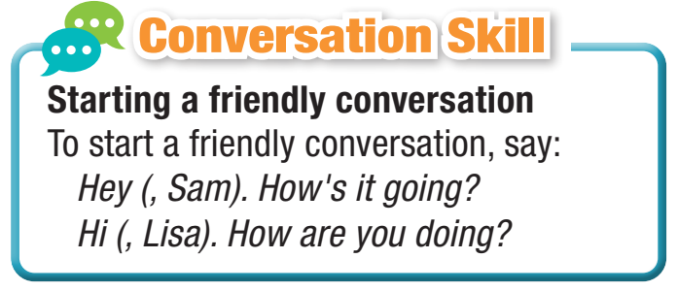

Read the Conversation Skill box:




Slide 20
Read the Conversation Skill box and listen to Task b. audio again.
Number the phrases in the Conversation Skill box in the order you hear them.

1
2
Click the ‘Check Answers’ button.

Slide 21
Post- listening
Look and listen to the conversation. Then practice with a partner.

Slide 22
Lisa: Hey, Sam. How's it going?
Sam: Hi, Lisa. I'm great. How are you doing?
Lisa: I'm fine. Hey, what's that?
Sam: Oh, my mom makes me a schedule
every week with all the chores I have to do.
Lisa: Why?
Sam: Well, she's pretty busy. She cooks, and
my dad does the shopping. So, my sister and
I try to help out around the house.
Lisa: Oh, that's so nice! What chores do you do?
Sam: I vacuum the living room, and I do the dishes.
Lisa: How often do you vacuum the living room?
Sam: Three times a week.
Lisa: And how often do you do the dishes?
Sam: Every morning, after breakfast.
Lisa: Do you do anything else?
Sam: Oh, yeah. I put away my clothes when
my mom does the laundry. That's twice a week
on Wednesdays and Saturdays.
Lisa: What chores does your sister do?
Sam: Alice tidies her bedroom every day.
She's very messy.
Lisa: Oh, is that all?
Sam: Well, sometimes she dusts the furniture.
Maybe once or twice a month. She hates doing
chores.
Lisa: How about you? Do you like doing chores?
Sam: Not really, but it's good to help my mom.

Slide 23

Post- listening

Slide 24

Consolidation

Slide 25

Chores
Work in pairs:
Student A: Take turns saying a chore to your partner.
Student B: Make a sentence with each chore given.

Slide 26
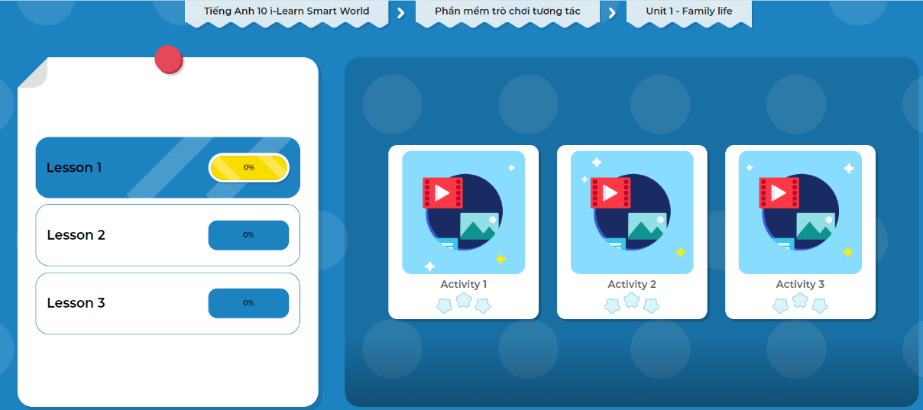
Click the picture below to play the games.

Slide 27
Today’s lesson
Wrap-up
Vocabulary: about household chores.
Listening: for a gist and specific information.
Speaking: about doing chores.

Slide 28
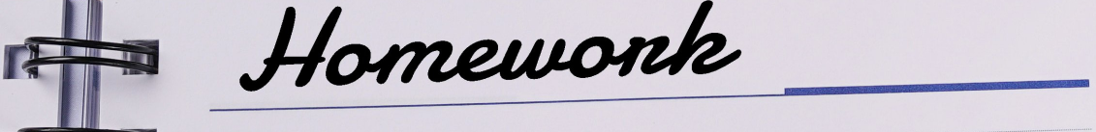
Finish the Listening exercise on page 2, WB.
Do the exercises in Tiếng Anh 10 i-Learn Smart World Notebook on page 2.
Prepare the next lesson on page 5, SB.
Play the consolidation games in Tiếng Anh 10 i-Learn Smart World DHA App on www.eduhome.com.vn

Slide 29

Have a nice day!

