Slide 1

Unit 1: My World
Lesson 1e: Grammar
Page 20

Slide 2
Lesson Outline
Warm-up
Grammar
Consolidation
Wrap-up

Slide 3
Objectives
By the end of this lesson, students will be able to…
- revise, practice, and use Present Continuous.

Slide 4

WARM-UP

Slide 5
Choose the word whose main stress is placed differently from the others.
1. A. discipline B. describe C. develop D. discover
/ˈdɪsəplɪn/ /dɪˈskraɪb/ /dɪˈveləp/ /dɪˈskʌvər/
2. A. clever B. dangerous C. casual D. especial
/ˈklevər/ /ˈdeɪndʒərəs/ /ˈkæʒjuəl/ /ɪˈspeʃəl/
3. A. gymnastics B. appliance C. balcony D. museum
/dʒɪmˈnæstɪks/ /əˈplaɪəns/ /ˈbælkəni/ /mjuːˈziːəm/

Slide 6
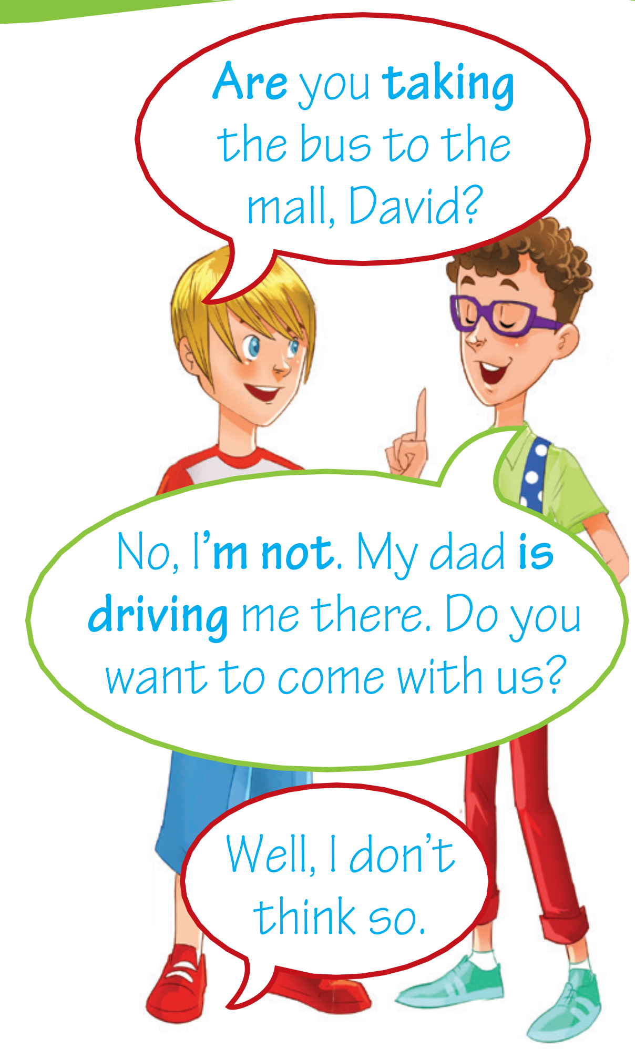
Look at the conversation. Pay attention to the verbs. Which tense do people use?
Present Continuous

Slide 7

It’s time to learn …

Slide 8

Presentation

Slide 9

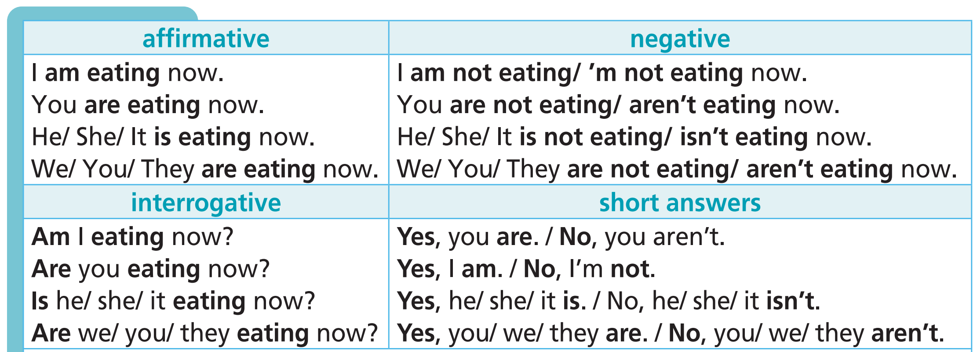
Form
Affirmative: S + am/is/are + V-ing
Negative: S + am/is/are + not + V-ing
Interrogative: Am/Is/Are + S + V-ing…?

Slide 10
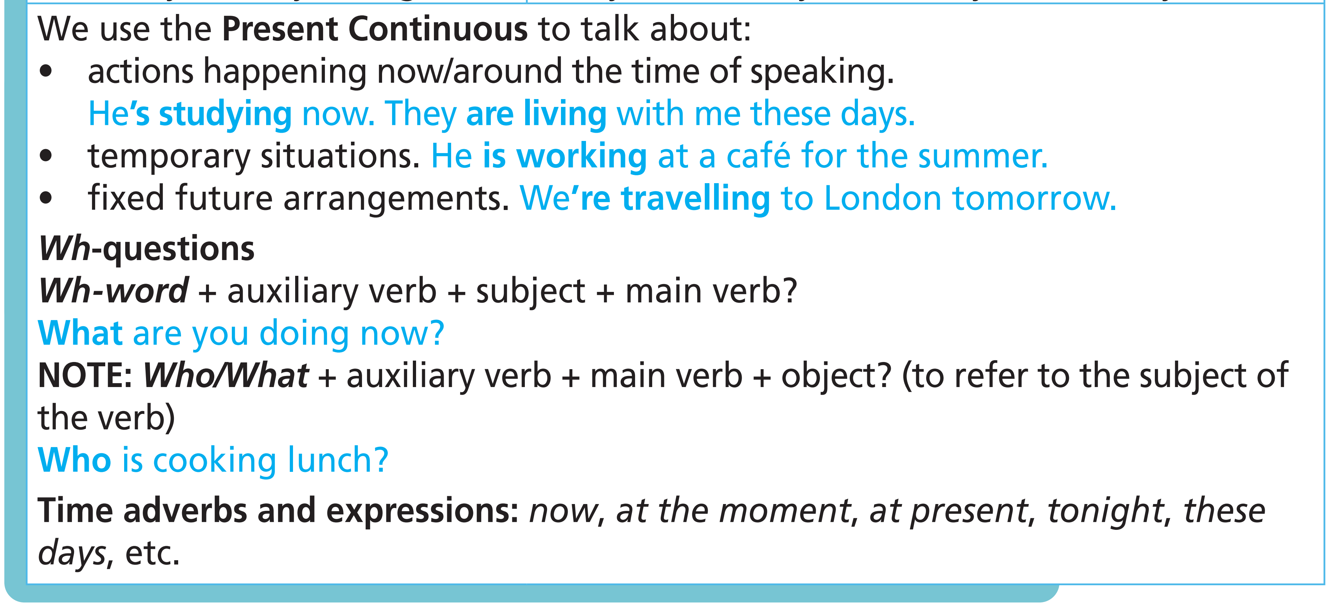
Usages

Slide 11

-ing ending
• most verbs: + -ing
talk ➝ talking
• verbs ending in consonant + -e: -e + -ing
come ➝ coming
• verbs ending in consonant + vowel +-l: double the final -l + -ing
travel ➝ travelling
• verbs ending in -ie: drop -ie and add -y + -ing
lie ➝ lying
• verbs ending in a stressed vowel between two consonants: double the last consonant + -ing
run ➝ running

Slide 12
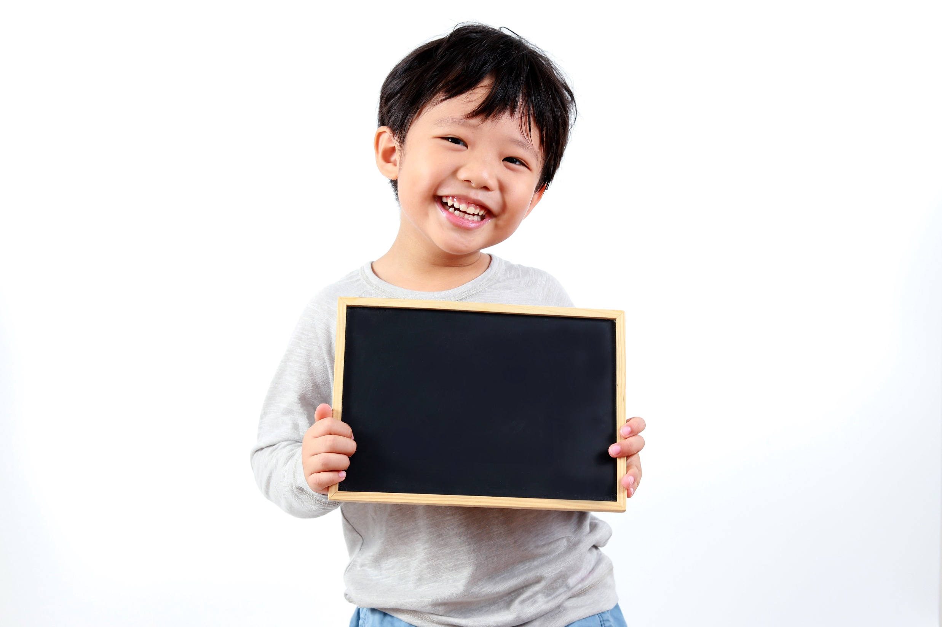
Practice

Slide 13

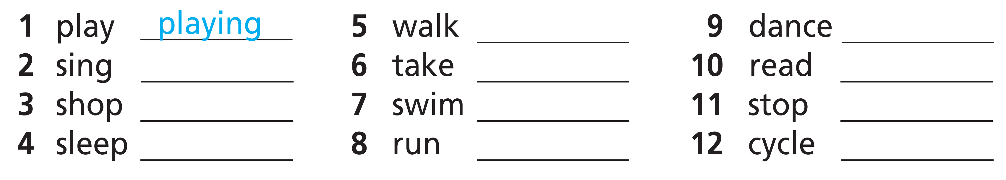
walking
dancing
singing
taking
reading
shopping
swimming
stopping
sleeping
running
cycling

Slide 14
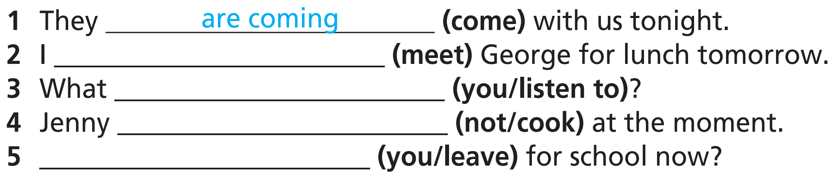
am meeting
are you listening to
isn’t cooking
Are you leaving

Slide 15
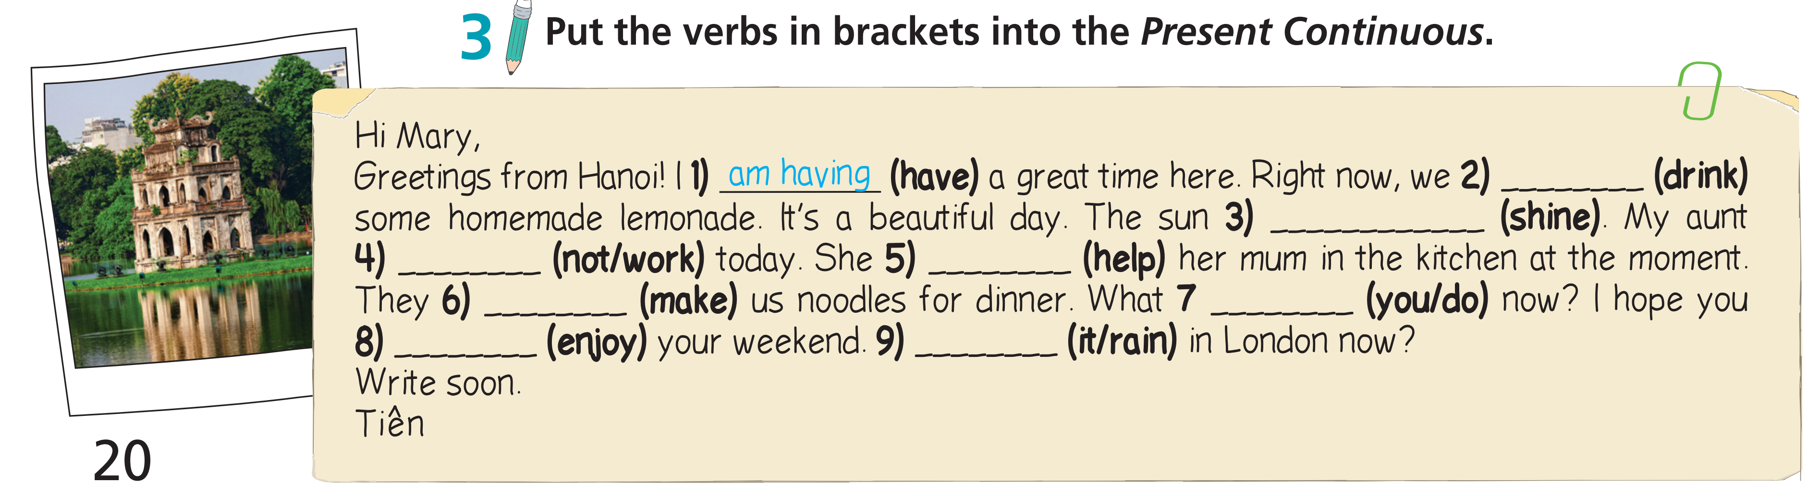
Hi Mary,
Greetings from Hanoi! I 1) am having (have) a great time here. Right now, we 2) _______________ (drink) some homemade lemonade. It’s a beautiful day. The sun 3) _______________ (shine). My aunt 4) ______________ (not/work) today. She 5) _______________ (help) her mum in the kitchen at the moment. They 6) ______________ (make) us noodles for dinner. What 7 _____________ (you/do) now? I hope you 8) ________________ (enjoy) your weekend. 9) ___________________ (it/rain) in London now?
Write soon.
Tiên
are drinking
is shining
isn’t working
is helping
are making
are you doing
are enjoying
Is it raining

Slide 16
Extra Practice
WB, page 14
1. Put the verbs in brackets into the Present Continuous.
are you going
1. Where __________________ (you/go) now?
2. Lisa __________________ (do) her science project at the moment.
3. I __________________ (not/use) the computer right now – you can use it.
4. We __________________ (not/visit) the amusement park tomorrow.
5. What __________________ (you/wear) to Tom’s party tonight?
is doing
am not using
aren’t visiting
are you wearing

Slide 17
19 ★ Put the verbs in brackets into the Present Continuous.
1 ___________________ (Adam/come) to the cinema with us tonight?
2 Dad ___________________ (cook) dinner right now.
3 Toby ___________________ (practise) the piano at the moment.
4 Beth ___________________ (not/talk) on the phone now.
5 We ___________________ (not/visit) our cousins tomorrow.
6 ___________________ (you/take) an English course this summer?
Is Adam coming
is cooking
is practising
is not talking
are not visiting
Are you taking
Extra Practice
WB, page 64

Slide 18
20 ★ Complete the sentences with the verbs in the list in the Present Continuous.
• study • brush • swim
• wait • have • use
1 Mum _________________ lunch with Grandma now.
2 We _________________ for the bus at the moment.
3 Jenny _________________ a lot these days.
4 I _________________ the computer at the moment.
5 Dad can’t come to the phone right now; he ______________ his teeth.
6 My brothers _____________ in the sea. Can you see them?
Extra Practice
WB, page 64
is having
are waiting
is studying
am using
is brushing
are swimming

Slide 19
21 ★ Put the verbs in brackets into the Present Continuous.
1 A: _____________ (you/go) to football practice this afternoon?
B: No, I’ve got a lot of homework, but I _______________ (play) in the match on Saturday.
2 A: _______________ (Ben/do) his homework now?
B: No, he _______________ (chat) to his friends online.
3 A: ____________________ (Mrs Bright/teach) you about British culture these days?
B: No, we ________________ (learn) about Australian culture.
4 A: _______________________ (your parents/ fly) to Spain tomorrow?
B: Yes, but my dad ________________ (not/look) forward to it – he hates flying!
5 A: We ________________ (not/wait) for the bus.
B: What _________________ (you/ do) here, then?
Are you going
am playing
Is Ben doing
is chatting
Is Mrs Bright teaching
are learning
Are your parents flying
is not looking
are not waiting
are you doing
Extra Practice
WB, page 64

Slide 20
22 ★★ Use the prompts to write questions in the Present Continuous. Then answer them.
1 Bruce / listen to music? (✗ read a book) Is Bruce listening to music? No, he isn’t. He is reading a book.
2 Karen and Sue / watch TV? (✗ surf the Net) _________________________________________________________________
3 James / chat online? (✗ play football) _________________________________________________________________
4 they / go to the theatre? (✗ go to the cinema) _________________________________________________________________
5 your parents / sleep / at the moment? (✗ work) _________________________________________________________________
Are Karen and Sue watching TV? - No, they aren’t. They’re surfing the Net.
Is James chatting online? - No, he isn’t. He’s playing football.
Are they going to the theatre? - No, they aren’t. They’re going to the cinema.
Are your parents sleeping at the moment? - No, they aren’t. They’re working.

Slide 21

Production

Slide 22
Work in pairs. Using the Present Continuous to make questions with the verbs do, study, think. Ask and answer those questions.

Slide 23

CONSOLIDATION

Slide 24
Make five sentences about yourself and your family, using the Present Continuous.

Slide 25

WRAP-UP

Slide 26
Today’s lesson
Grammar
Present Continuous

Slide 27
Homework
Practise the grammar point and make sentences using it.
Do the exercises in TA 7 Right on WB (page 14)
Prepare the next lesson (page 21 SB)
Complete the grammar notes in TA 7 Right on Notebook (page 8)

Slide 28
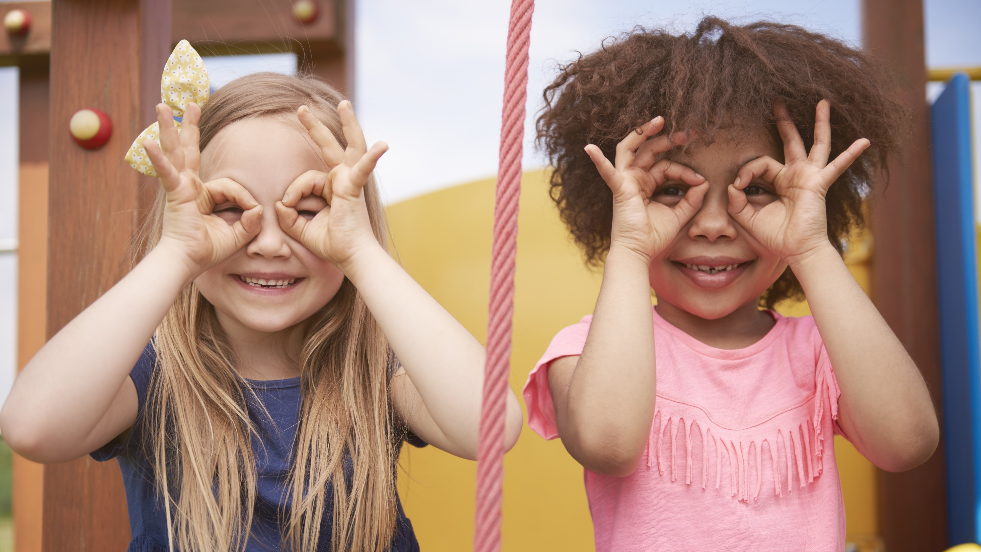
Enjoy your day!

