Slide 1


Slide 2

Unit
7
1
FAMILY LIFE
Unit
VIETNAM AND INTERNATIONAL ORGANISATIONS
LESSON 2
LANGUAGE STARTED

Slide 3

Unit
1
1
FAMILY LIFE
Family Life
Unit
OBJECTIVES
Knowledge
Use lexical items related to international organisations
Pronounce more than three-syllable words correct stress
Use comparative and superlative adjectives
Core competence
Access and consolidate information from a variety of sources
Be collaborative and supportive in pair work and teamwork
Actively join in class activities
Personal qualities
Develop an awareness of international organisations

Slide 4
LESSON 2
LANGUAGE
Unit
GETTING STARTED
WARM-UP
Game: I dare you!
PRONUNCIATION
Task 1: Listen and repeat.
Task 2: Listen and mark the primary stress in the words in bold. Then practise saying the sentences.
PRONUNCIATION
VOCABULARY
Task 1: Match the words with their meanings.
Task 2: Complete the sentences using the words or phrases in Task 1
VOCABULARY
GRAMMAR
GRAMMAR
Task 1: Choose the correct answer
Task 2: Write another sentence using the word in brackets
CONSOLIDATION
Wrap-up
Home work

Slide 5
LESSON 2
LANGUAGE
Unit
GETTING STARTED
WARM-UP
Game: I dare you!

Slide 6

WARM-UP
Game: I dare you!
Click to roll
Play in two teams.
Each round: One team rolls a dice and gets a number (1-6).
The opposing team will find a word with that number of syllables (in the dictionary, on the Internet…) and “dare” Team 1 to guess the correct stress position.
1 correct answer = 1 point
After 3 minutes: The team with most points wins!

Slide 7
LESSON 2
LANGUAGE
Unit
GETTING STARTED
WARM-UP
Game: I dare you!
PRONUNCIATION
Task 1: Listen and repeat.
Task 2: Listen and mark the primary stress in the words in bold. Then practise saying the sentences.
PRONUNCIATION

Slide 8
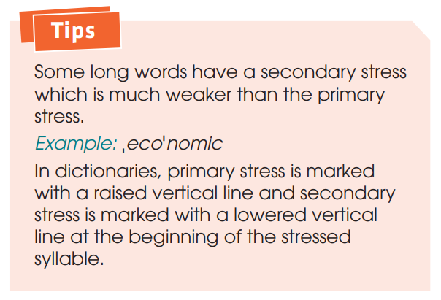
PRONUNCIATION
Read the Tips box and watch this tutorial video:
https://www.youtube.com/watch?v=65wx9_zmuqQ

Slide 9

PRONUNCIATION
1
Listen and repeat. Pay attention to the syllable with the primary stress.
More than three syllables words
ˌappliˈcation | ˌpopuˈlation
comˌmuniˈcation | ˌindeˈpendent
ˌecoˈnomic | ˌpossiˈbility
ˌexplaˈnation | parˌticiˈpation

Slide 10
PRONUNCIATION
2
Listen and mark the primary stress in the words in bold. Then practise saying the sentences.
1. Viet Nam is a member of different international organisations.
2. Our responsibility is to help the most disadvantaged children.
3. This organisation aims to promote environmental protection.
4. UNICEF aims to create educational opportunities for all children.

Slide 11
PRONUNCIATION
2
Listen and mark the stressed syllables in the words in bold.
1. Viet Nam is a member of different ,inter'national ,organi'sations.
2. Our re,sponsi'bility is to help the most ,disad'vantaged children.
3. This ,organi'sation aims to promote en,viron'mental protection.
4. UNICEF aims to create ,edu'cational ,oppor'tunities for all children.

Slide 12
LESSON 2
LANGUAGE
Unit
GETTING STARTED
WARM-UP
Game: I dare you!
PRONUNCIATION
Task 1: Listen and repeat.
Task 2: Listen and mark the primary stress in the words in bold. Then practise saying the sentences.
PRONUNCIATION
VOCABULARY
Task 1: Match the words with their meanings.
Task 2: Complete the sentences using the words or phrases in Task 1
VOCABULARY

Slide 13
VOCABULARY
1
Match the words with their meanings.
WORDS
1. Enter
2. Promote
3. Aims
4. Committed
5. Welcomes
MEANINGS
A. intends
B. is pleased to accept
C. go into
D. encourage
E. promised

Slide 14
VOCABULARY
2
Complete the following sentences,using the correct forms of the words in bold in 1.
1. Joining the WTO has helped Viet Nam _________ its economic growth.
2. Viet Nam _________ foreign investors in various parts of the economy.
3. We _________ to use the donations effectively. We have signed an agreement on this.
4. This environmental organisation __________ to protect local forests. It has a detailed plan to achieve this.
5. We need to improve the quality of goods and services so that they can _________ new markets.

Slide 15
VOCABULARY
2
Complete the following sentences, using the correct forms of the words in bold in 1.
1. Joining the WTO has helped Viet Nam promote its economic growth.
2. Viet Nam welcomes foreign investors in various parts of the economy.
3. We commits to use the donations effectively. We have signed an agreement on this.
4. This environmental organisation aims to protect local forests. It has a detailed plan to achieve this.
5. We need to improve the quality of goods and services so that they can enter new markets.

Slide 16
LESSON 2
LANGUAGE
Unit
GETTING STARTED
WARM-UP
Game: I dare you!
PRONUNCIATION
Task 1: Listen and repeat.
Task 2: Listen and mark the primary stress in the words in bold. Then practise saying the sentences.
PRONUNCIATION
VOCABULARY
Task 1: Match the words with their meanings.
Task 2: Complete the sentences using the words or phrases in Task 1
VOCABULARY
GRAMMAR
GRAMMAR
Task 1: Choose the correct answer
Task 2: Write another sentence using the word in brackets

Slide 17
GRAMMAR
Remember!
 | Use | Example
comparative adjectives | To compare a person or thing with another person or thing. To show changes | The European markets are usually more competitive than the Asian markets. The Asian markets are less competitive than the European markets. Since then, our country has become more active.
superlative adjectives | to compare a person or thing with the whole group of which that person or thing is a member | This trade organisation includes two of the largest economies in the world: the United States and China. UNICEF supports the most disadvantaged children all over the world.

Slide 18
GRAMMAR
1
Choose the correct answers.
1. WTO rules make trade the easiest / easier for smaller member countries.
2. This job offer is more attractive / the most attractive than the previous one.
3. Because of poorly designed packaging, our products are less competitive / the least competitive than foreign products.
4. Over the past few years, Viet Nam has become one of more popular / the most popular destinations for foreign visitors in Southeast Asia.

Slide 19
GRAMMAR
1
Choose the correct answers.
1. WTO rules make trade easier for smaller member countries.
2. This job offer is more attractive than the previous one.
3. Because of poorly designed packaging, our products are less competitive than foreign products.
4. Over the past few years, Viet Nam has become one of the most popular destinations for foreign visitors in Southeast Asia.

Slide 20
GRAMMAR
2
Write another word using the word in brackets. Make sure it has the same meaning as the previous one.
1. No place is more popular with foreign visitors than this city. (the most popular)
2. In many supermarkets, imported goods are not as expensive as locally produced goods. (cheaper)
3. No international organisation is larger than the United Nations. (the largest)
4. In the past, our country wasn’t as active on the international stage as it is today. (more active)

Slide 21
GRAMMAR
2
Write another word using the word in brackets. Make sure it has the same meaning as the previous one.
1. No place is more popular with foreign visitors than this city. (the most popular)
This city is the most popular place for foreign visitors.
2. In many supermarkets, imported goods are not as expensive as locally produced goods. (cheaper)
In many supermarkets, imported goods are cheaper than locally produced goods.
3. No international organisation is larger than the United Nations. (the largest)
The United Nations is the largest international organization.
4. In the past, our country wasn’t as active on the international stage as it is today. (more active)
Our country is more active on the international stage today than it was in the past.

Slide 22
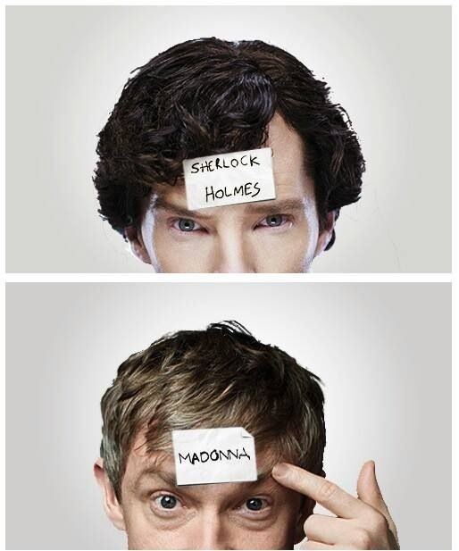
GAME: 20 QUESTIONS
Write the name of a country/international organisation on a piece of paper.
Form pairs and stick your piece of paper on your partner’s head.
Ask them 20 questions (maximum) as clues to find out which country/international organisation name is written on your head.
Bonus point if you use comparative/ superlative adjectives and learned vocabulary about international organisations!
(Eg. + Is it smaller or bigger than Vietnam?
+ Does it support the most disadvantaged children all over the world?)

Slide 23
LESSON 2
LANGUAGE
Unit
GETTING STARTED
WARM-UP
Game: I dare you!
PRONUNCIATION
Task 1: Listen and repeat.
Task 2: Listen and mark the primary stress in the words in bold. Then practise saying the sentences.
PRONUNCIATION
VOCABULARY
Task 1: Match the words with their meanings.
Task 2: Complete the sentences using the words or phrases in Task 1
VOCABULARY
GRAMMAR
GRAMMAR
Task 1: Choose the correct answer
Task 2: Write another sentence using the word in brackets
CONSOLIDATION
Wrap-up
Home work

Slide 24
CONSOLIDATION
1
Wrap-up
Lexical items related to the topic International Organisations
Pronunciation: more than three-syllable words correct stress
Grammar: Comparative and Superlative Adjectives

Slide 25
CONSOLIDATION
2
Homework
Do exercises in the workbook.
Prepare for the Project.

Slide 26


