Slide 2
REVIEW 1
LESSON 3
Skills (2)
Reading & Writing

Slide 3
LESSON 3
SKILLS (2)
WARM-UP
Game: Guess who
READING
- Task 1. Reading comprehension: Alexandre Yersin
- Task 2. Read the following passage about Ton That Tung and choose the correct word that best fits each blank.
WRITING
Write a biography.
Wrap-up
Homework
CONSOLIDATION

Slide 4
WARM-UP
GUESS WHO
- There are four clues related to a famous person.
- Each clue is shown one by one.
- If you can get the correct key word after the 1st clue ➔ 40 points.
- If you can get the correct key word after the 2nd clue ➔ 30 points.
- If you can get the correct key word after the 3rd clue ➔ 20 points.
- If you can get the correct key word after the last clue ➔ 10 points.

Slide 5
WARM-UP
CLUE 1
This person is a Swiss-French physician and bacteriologist.

Slide 6
WARM-UP
CLUE 2
On 8 January 1902, this person was accredited to be the first Headmaster of Hanoi Medical University by the Governor-General of French Indochina.

Slide 7
WARM-UP
CLUE 3
This person died at his home in Nha Trang, in 1943.

Slide 8
WARM-UP
CLUE 4
This person is well remembered in Vietnam, where he was affectionately called Ông Năm (Mr. Nam/ Fifth) by the people.

Slide 9
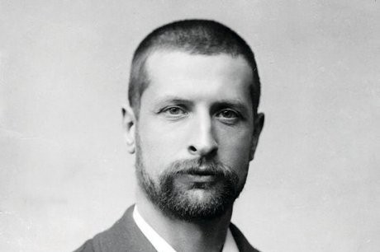
WARM-UP
Alexandre Yersin (1863 – 1943)

Slide 10
READING
1
Read the text about Alexandre Yersin. Mark the letter A, B, C, or D to indicate the correct answer to each of the following questions. (p.47)
1. Which of the following can be the best title for the text?
A. The story of a remarkable life
B. Yersin’s research and exploration in Indochina
C. Yersin’s contributions to medicine in Viet Nam
D. Yersin’s childhood in Viet Nam
2. The word ‘fund’ in paragraph 3 is closest in meaning to ________.
A. introduce B. grow C. discover D. finance

Slide 11
READING
1
Read the text about Alexandre Yersin. Mark the letter A, B, C, or D to indicate the correct answer to each of the following questions (p.47)
3. The word ‛it’ in paragraph 3 refers to ________.
A. cattle B. laboratory C. coffee D. rubber tree
4. According to the text, which of the following information is true about Yersin?
A. He started living in Ha Noi in 1890.
B. He opened a university by himself.
C. He could find an effective method for treating malaria.
D. He had a house in Nha Trang, which was turned into a pharmacy.

Slide 12
READING
Read the following passage about Ton That Tung’s contributions to the medicine in Viet Nam. Mark the letter A, B, C, or D to indicate the correct word that best fits each blank. (p.47)
2
Ton That Tung was a famous surgeon (1) ________ made great contributions to the medicine in Viet Nam. From 1935 to 1939, he performed operations on over 200 livers of dead bodies and analysed them when he (2) ________ the Indochina School of Medicine and Pharmacy. After the Revolution in August (1945), he worked as a private doctor to take care (3) ________ Uncle Ho. A few years later, he became the director of Phu Doan Hospital (Viet Duc Hospital today). In 1958, he was the first doctor to (4) ________ heart surgery in Viet Nam. Later, in 1960s, he found a new surgery method to reduce bleeding (5) ________ shorten the time for the operation down to only four to eight minutes.

Slide 13
READING
Read the following passage about Ton That Tung’s contributions to the medicine in Viet Nam. Mark the letter A, B, C, or D to indicate the correct word that best fits each blank. (p.47)
2
1. A. whose B. who C. which D. whom
2. A. made B. took C. attended D. discovered
3. A. in B. for C. about D. of
4. A. perform B. prevent C. change D. treat
5. A. but B. and C. so D. for

Slide 14
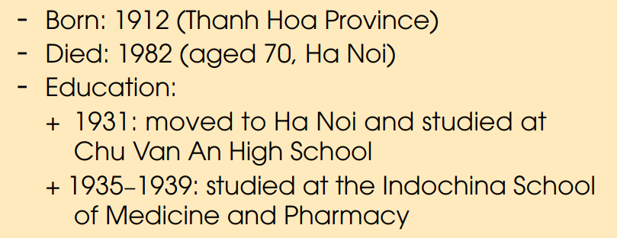
WRITING
Use the information about Ton That Tung below and details from 2 in Reading above to write a biography (180 words) about Ton That Tung. (p.46)

Slide 15
WRITING
Use the information about Ton That Tung below and details from 2 in Reading above to write a biography (180 words) about Ton That Tung. (p.46)
Sample answer:
Ton That Tung was born in 1912 in Thanh Hoa province in Vietnam, and passed away at the age of 70 in Hanoi. He was a famous surgeon who had impressive achievements in the medicine of Vietnam. In 1931, he moved to Hanoi and studied at Buoi school, which is Chu Van An high school today. From 1935 to 1939, when he attended the Indochina School of Medicine and Pharmacy, he performed operations on over 200 livers of dead bodies and analysed them. Later, he started working as a private doctor for Uncle Ho in August, 1945. Until 1958, he carried out the first heart surgery in Vietnam. In the late 1960s, he found a new surgery method to reduce bleeding and shorten the time for the operation down to only four to eight minutes. His impressive achievements were admired by many doctors and other people in Vietnam. The Government also introduced an award named after him, and many streets in various local areas are now named after him.

Slide 16
CONSOLIDATION
CONSOLIDATION
1
Wrap-up
What have you learnt today?
Practise reading for main ideas and specific information about the Alexandre Yersin and Ton That Tung;
Write a biography of Doctor Ton That Tung.

Slide 17
CONSOLIDATION
2
Homework
Do exercises in the workbook.
Prepare for the next lesson.

Slide 18
Website: hoclieu.vn
Fanpage: facebook.com/www.tienganhglobalsuccess.vn

