Slide 1


Slide 2

Unit
12
LIFE ON OTHER PLANETS
LESSON 3: A CLOSER LOOK 2
GRAMMAR
Reported speech (questions)
1

Slide 3
LESSON 3: A CLOSER LOOK 2
WARM-UP
Video watching
PRESENTATION
Reported speech (questions)
Task 1: Underline the correct word or phrase for each sentence.
Task 2: Put the words and phrases in the correct order to make reported questions.
Task 3: Change the following questions into reported questions.
Task 4: Report the conversation between An and Mai.
PRACTICE
PRODUCTION
Task 5: Work in pairs.
Wrap-up: Game: What did they ask you?
Homework
CONSOLIDATION

Slide 4

WARM-UP
Watch a video.
Notes:
Video link: https://www.youtube.com/watch?v=g2C7-nLkZ8I

Slide 5
WARM-UP
How do we use reported speech
for questions?

Slide 6
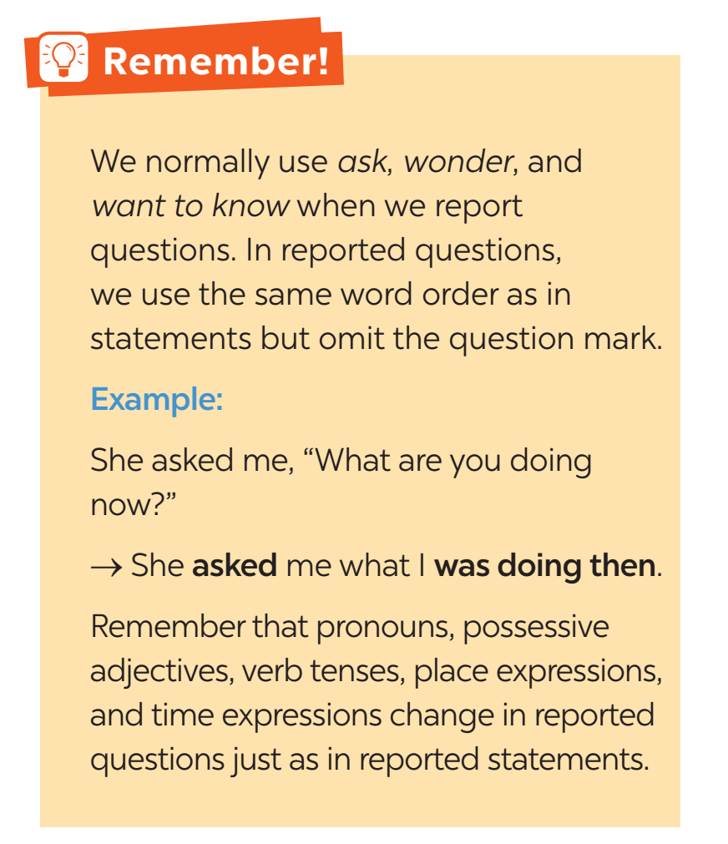
WARM-UP

Slide 7
PRESENTATION
Structure:
S + ask/wonder/want to know + question word + clause.
Example:
“What time does the train leave?”
 He asked me what time the train left.
“Where did he go?”
 She wanted to know where he had gone.
“When could you get this done by?”
 He wondered when we could get it done by.

Slide 8
PRESENTATION
1
Underline the correct word or phrase for each sentence.
1. He phoned to ask his mother what she was doing now / then.
2. Ann wondered what plants Vietnamese people grow / grew for food.
3. Peter phoned the shop to ask what specialities they are selling there / here.
4. The student asked his professor what forms of life can / could exist on Mars.
5. He wanted to know how many planets there were / were there in our solar system.

Slide 9
PRACTICE
2
Put the words and phrases in the correct order to make reported questions.
1. how many moons / My little brother / asked me / had / Venus / .
 My little brother asked me how many moons Venus had.
2. which / She / planet / the closest / wanted to know / was / to the sun / .
 She wanted to know which planet was the closest to the sun.
3. asked the scientists / The journalist / what / for / were using / telescopes / in space / they / .
 The journalist asked the scientists what they were using telescopes in space for.

Slide 10
PRACTICE
2
Put the words and phrases in the correct order to make reported questions.
4. wanted to know / when / The scientists / travel to Mars / would be able to / humans / .
 The scientists wanted to know when humans would be able to travel to Mars.
5. He / what / were / asked the professor / to have life / for a planet / the conditions / on it / .
 He asked the professor what the conditions for a planet to have life on it were.

Slide 11
PRACTICE
3
Change the following questions into reported questions.
1. “Who will be the first to step on Mars?” Mary asked the scientist.
 Mary asked the scientist who would be the first to step on Mars.
2. “How fast can a UFO travel?” I asked my father.
 I asked my father how fast a UFO could travel.
3. The student asked his friend, “How many craters does the moon have?”
 The student asked his friend how many craters the moon had.

Slide 12
PRACTICE
3
Change the following questions into reported questions.
4. The pupils asked the teacher, “Where can we find information about the solar system?”
 The pupils asked the teacher where they could find information about the solar system.
5. “What is the weather on Mars like?” I asked my teacher.
 I asked my teacher what the weather on Mars was like.

Slide 13
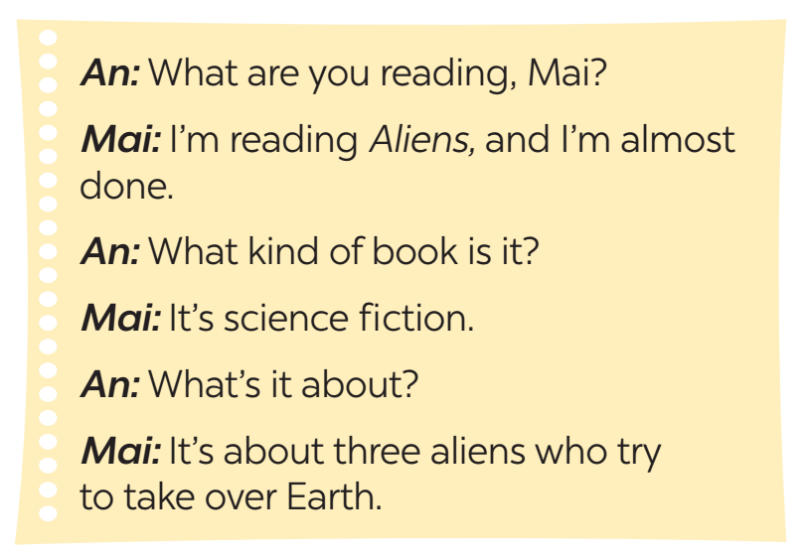
PRACTICE
4
Report the conversation between An and Mai.
Suggested answers:
An asked Mai what she was reading. Mai told An that she was reading Aliens, and she was almost done. Next, An asked Mai what kind of book it was. Mai said to An that it was science fiction. And An asked Mai what it was about. Mai told An that it was about three aliens who tried to take over Earth.

Slide 14

PRACTICE
5
Work in pairs. Ask your partner five questions about his / her daily routine and make notes of his / her answers. Then report your questions and your partner’s answers to the class.
Example:
I asked ... what time he/ she got up in the morning and he told me (that) he got up at ...

Slide 15

CONSOLIDATION
1
Wrap-up
Game: What did they ask you?
- Make a list of people who might ask you questions and what those questions might be: a police officer, your mother/ father, a teacher, a taxi driver, etc.,
- Report something that he/she asked, without revealing
who he/she was:
+ This person asked me if I had my driver’s license.
- Other Ss guess that was the police officer: The police officer asked you if you had your driver’s license.

Slide 16

CONSOLIDATION
2
Homework
- Make 5 sentences by using reported speech (questions).
- Do the exercises in the workbook.

Slide 17

Website: hoclieu.vn
Fanpage: facebook.com/tienganhglobalsuccess.vn/

