Slide 1

Unit 7: Transportation
Lesson 1.1: Vocabulary & Listening
Page 52

Slide 2



LESSON OUTLINE
Consolidation

Slide 3
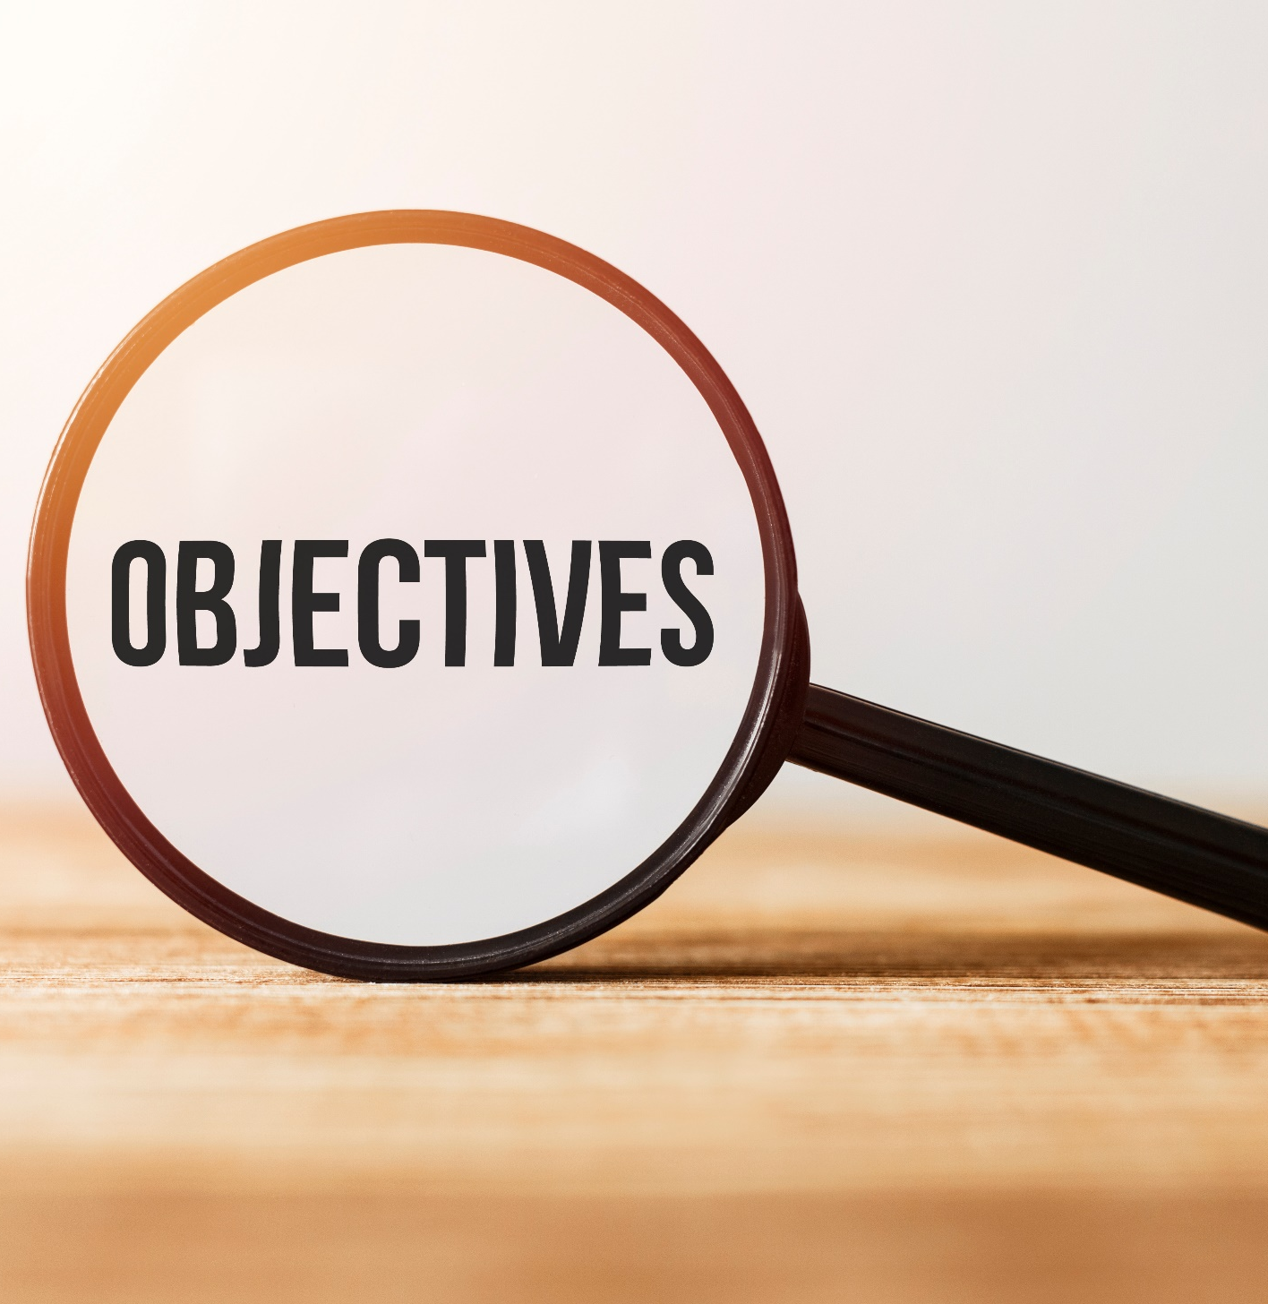
By the end of this lesson, students will be able to…
Describe and identify personal belongings.
Use possessive pronouns and adjectives in order.
Practice listening and speaking about asking for confirmation.

Slide 4

New words
• boarding pass
• passport
• customs
• baggage claim
• suitcase
• backpack
• luggage

Slide 5
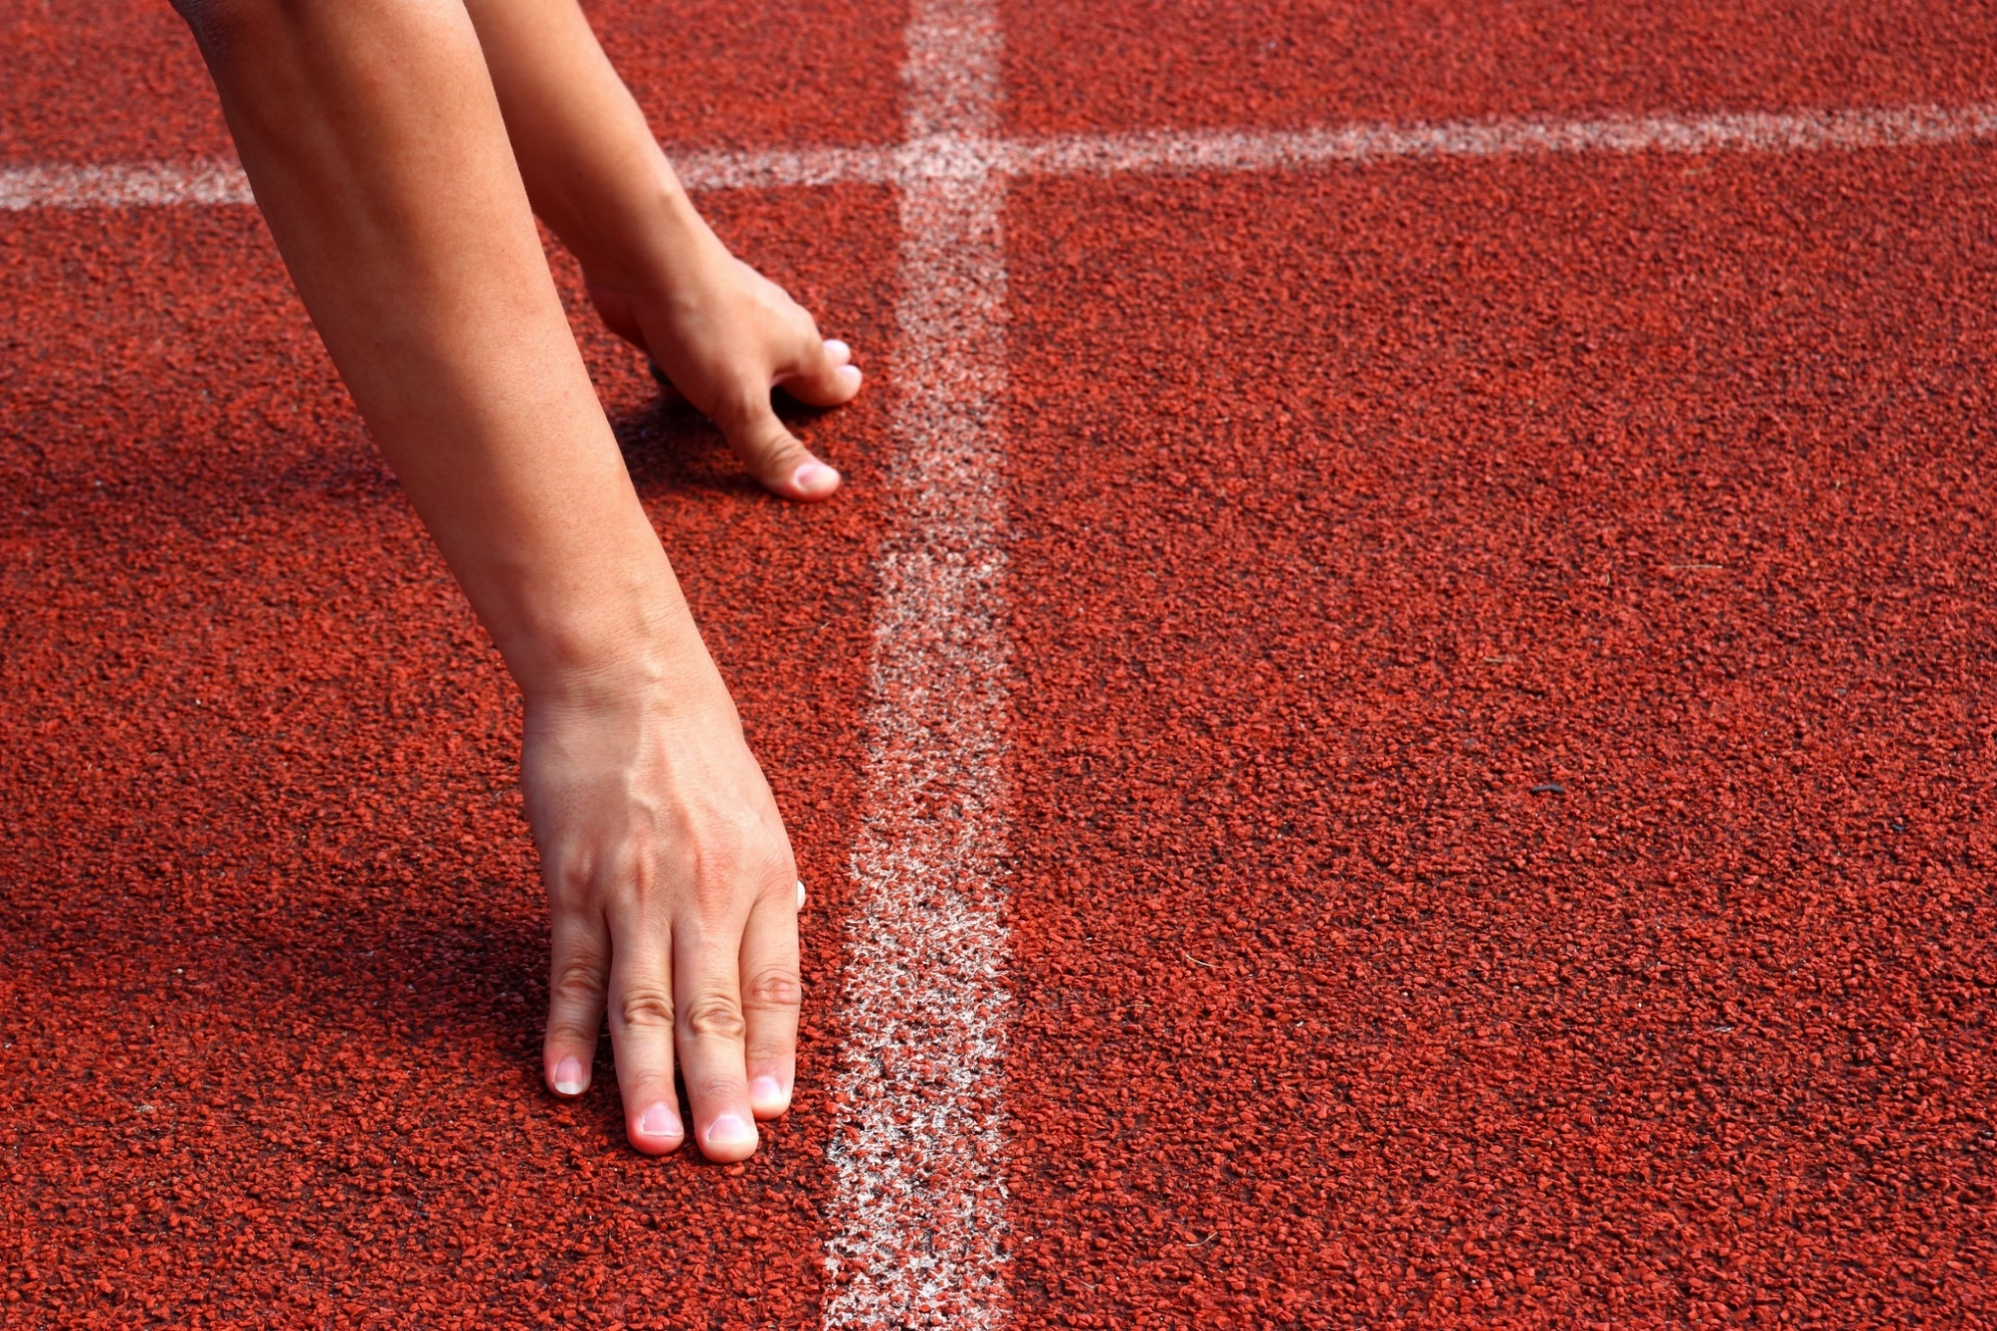
WARM UP

Slide 6

Work in pairs
1. How do you like to go on vacation?
By car
By plane
By train
By coach
2. What do you take with you when you travel by plane?

Slide 7
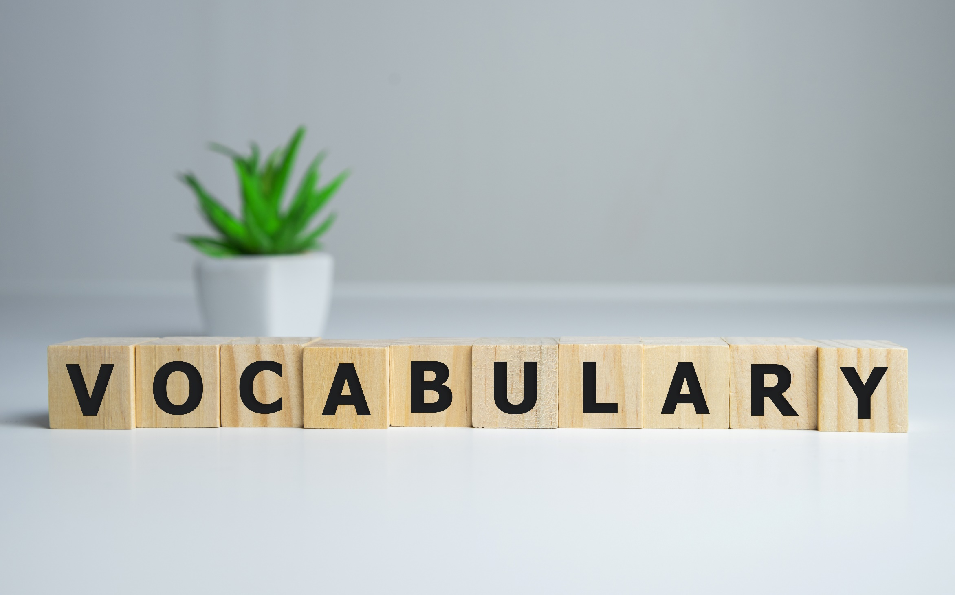


Slide 8

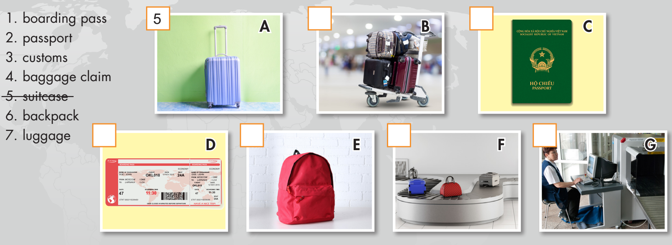
Work in pairs. a. Number the pictures.

Slide 9

b. Listen, check and repeat.
5
7
2
1
6
4
3

Slide 10
Listen and repeat. Click each phrase to hear the sound.
boarding pass (n) /ˈbɔːrdɪŋ pæs/ thẻ lên máy bay/tàu
passport (n) /ˈpæspɔːrt/ hộ chiếu
customs (n) /ˈkʌstəmz/ hải quan
baggage claim (n) /ˈbæɡɪdʒ kleɪm/ khu vực lấy hành lý (ở sân bay)
suitcase (n) / ˈsuːt.keɪs / va-li
backpack (n) / 'bækpæk/ ba lô
luggage (n) / 'lʌgiʤ / hành lý
Notes:
GV click vào từng cụm nghe âm thanh

Slide 11
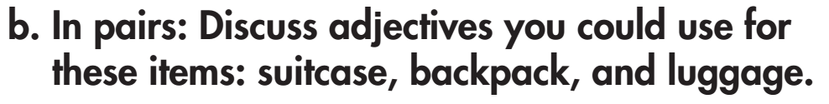
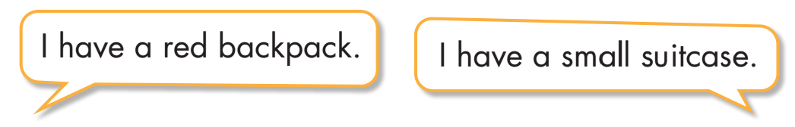
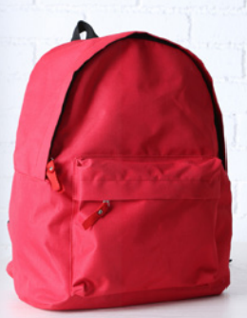
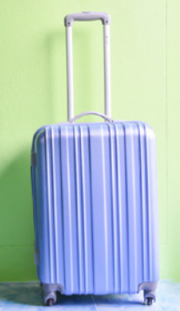

Slide 12
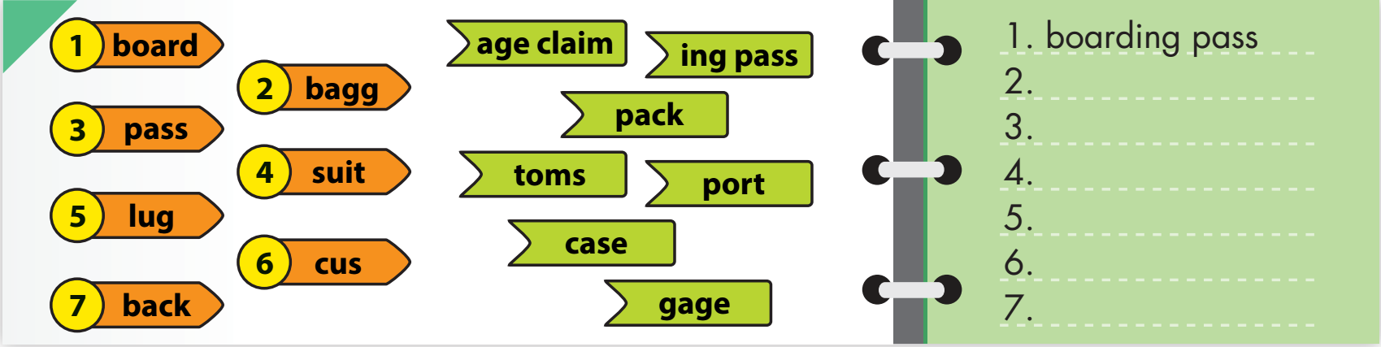
Extra Practice
WB, page 38
a. Find the matching parts of the words and write them on the lines.
baggage claim
passport
suitcase
luggage
customs
backpack

Slide 13
Extra Practice
WB, page 38
b. Write the words in Task a. next to the correct descriptions.
boarding pass
1. __________ A. a card that people have to show before they get on an airplane
2. __________ B. a place at an airport where someone checks your luggage
when you come into a country
3. __________ C. a place at an airport where you get your luggage back after arriving
4. __________ D. a small book with your picture that you have to show the officers when you leave or enter a country
5. __________ E. a large case which people put their clothes in when they’re
traveling
6. __________ F. bags or suitcases that people usually take on their trip
7. __________ G. a bag that you carry on your back
customs
baggage claim
passport
suitcase
luggage
backpack

Slide 14
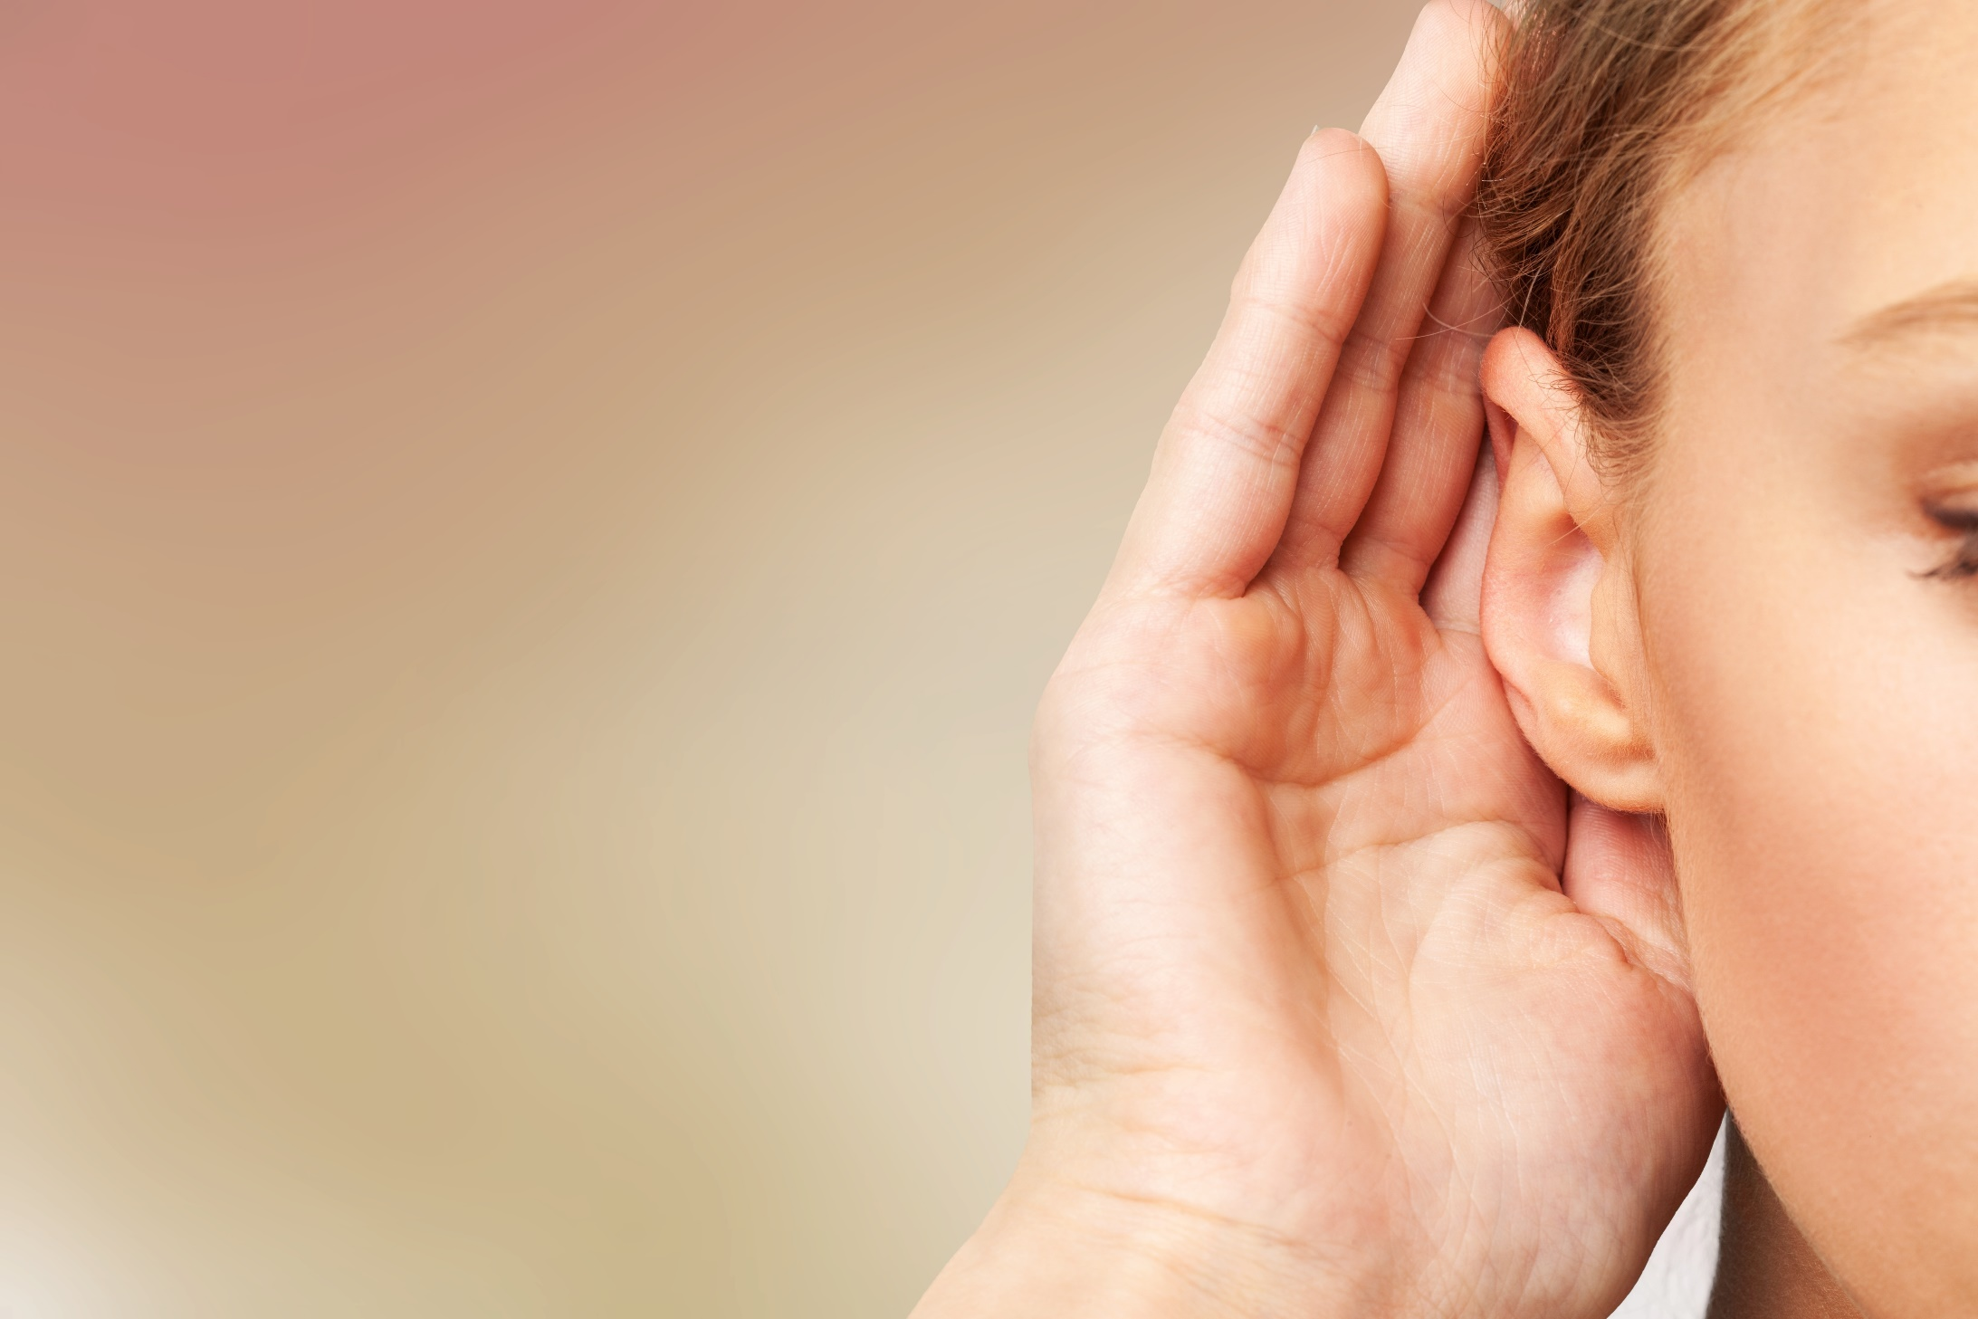

It’s listening time….

Slide 15
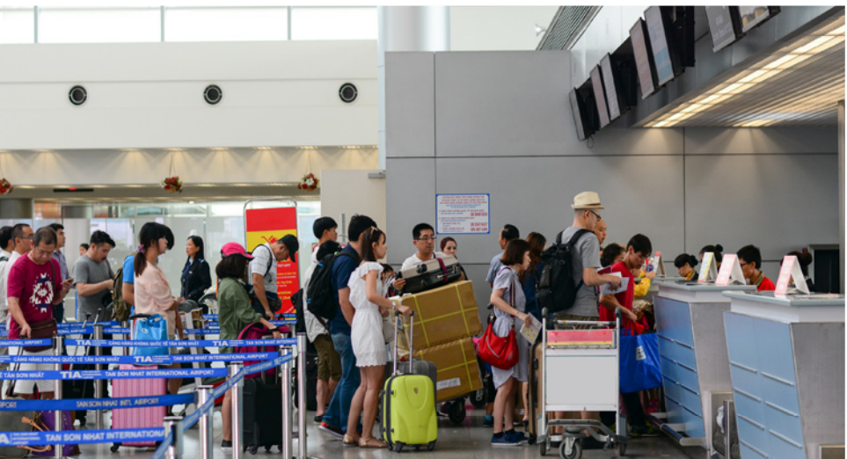
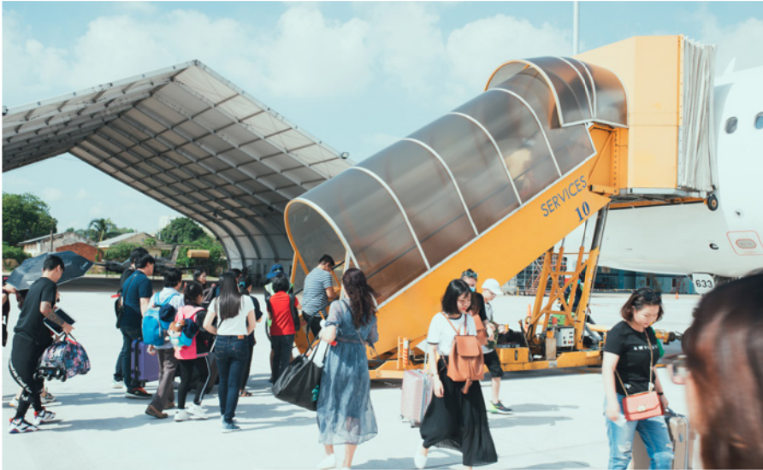
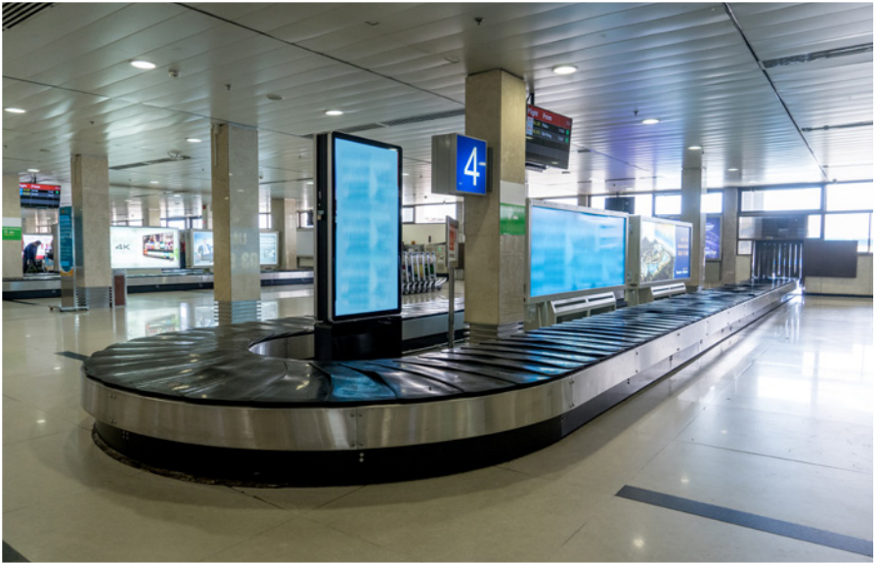
Pre - listening
Look at the pictures. What are these places?
Do you think these people are going on holiday or returning home after their holiday?

Slide 16
Pre - listening
Read the instruction quickly. Underline the key words. What are we going to do?
Listen and choose the correct answer.
a. Listen to Jenny and Fred at the airport. What are they doing?
1. They are going on holiday.
2. They are returning home after their holiday.

Slide 17
Pre - listening
Now listen and choose the correct answer.  FIRST TIME
a. Listen to Jenny and Fred at the airport. What are they doing?
1. They are going on holiday.
2. They are returning home after their holiday.
☞ YOUR ANSWER?
1. They are going on holiday.
☞ WHY?

Slide 18
While - listening
Now listen again and check.  SECOND TIME
While you are listening, focus on last sentences that Jenny and Fred talk to each other.
Jenny: Okay, let's go! I want to start on our holiday.
Fred: Yeah, I can't wait to see our hotel.
☞ THE ANSWER IS …
1. They are going on holiday.

Slide 19
Pre - listening
Read the instruction and questions quickly. Guess the missing words. Are they nouns or adjectives? What are we going to do?
Listen and fill in the blanks.
b. Now, listen and fill in the blanks.
Jenny has a small ______________ bag.
Lisa and Jake are in the ______________.
Jake has a new ______________ suitcase.
Jenny and Fred's _____________ are in Fred's bag.
(adjective – color)
(noun – place)
(adjective – color)
(noun – thing)

Slide 20
While - listening
Now listen and fill in the blanks.  FIRST TIME
b. Now, listen and fill in the blanks.
Jenny has a small _____________ bag.
Lisa and Jake are in the _____________.
Jake has a new _____________ suitcase.
Jenny and Fred's _____________ are in Fred's bag.
☞ WHAT ARE YOUR ANWERS?

Slide 21
While - listening
Now listen and fill in the blanks.  SECOND TIME
b. Now, listen and fill in the blanks.
Jenny has a small _____________ bag.
Lisa and Jake are in the _____________.
Jake has a new _____________ suitcase.
Jenny and Fred's _____________ are in Fred's bag.
purple
bathroom
orange
passports

Slide 22
Now listen to the conversation. Read and check.  THIRD TIME
Jenny: Let's get our luggage, Fred.
Fred: OK. There's mine – it's the big blue backpack.
Jenny: Can you see mine? Mine is a small purple bag.
Fred: Did you say a purple bag?
Jenny: Yes, that's right.
Fred: That's yours, Jenny, next to the black suitcase.
Jenny: Great! Hey, where are Lisa and Jake?
Fred: They're in the bathroom. We can find their luggage for them.
Jenny: OK. What luggage does Lisa have?
Fred: She has a small green backpack.

Slide 23
Now listen to the conversation. Read and check. THIRD TIME
Jenny: Is this hers?
Fred: No, hers is old.
Jenny: Is that hers over there?
Fred: Yes, it is!
Jenny: What luggage does Jake have?
Fred: His is a new orange suitcase.
Jenny: This one?
Fred: That's right. OK, let's go!
Jenny: Wait, where are the passports?
Fred: Ours are in my bag. Lisa and Jake have theirs.
Jenny: Okay, let's go! I want to start on our holiday.
Fred: Yeah, I can't wait to see our hotel.

Slide 24
Audio - Scripts
Practice the conversation with a partner.
Jenny: Can you see mine? Mine is a small purple bag.
Fred: Did you say a purple bag?
Jenny: Yes, that's right.
Fred: That's yours, Jenny, next to the black suitcase.
Jenny: Great! Hey, where are Lisa and Jake?
Fred: They're in the bathroom. We can find their luggage for them.
Jenny: OK. What luggage does Lisa have?
Fred: She has a small green backpack.
Jenny: Is this hers?
Fred: No, hers is old.

Slide 25
Audio - Scripts
Practice the conversation with a partner.
Jenny: Is that hers over there?
Fred: Yes, it is!
Jenny: What luggage does Jake have?
Fred: His is a new orange suitcase.
Jenny: This one?
Fred: That's right. OK, let's go!
Jenny: Wait, where are the passports?
Fred: Ours are in my bag. Lisa and Jake have theirs.
Jenny: Okay, let's go! I want to start on our holiday.
Fred: Yeah, I can't wait to see our hotel.

Slide 26

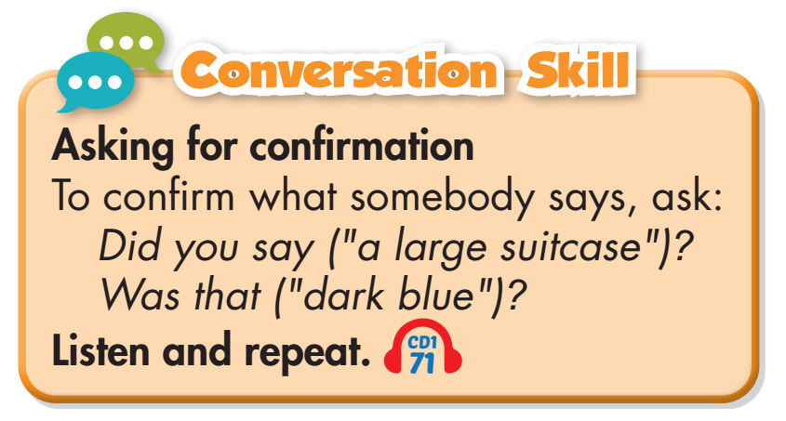
Work in pairs.
Post - listening
What type of luggage do you like to travel with? Why?

Slide 27

CONSOLIDATION

Slide 28
Write 5 sentences about what kind of luggage and things you take with you on vacation. Use the information from Listening Task c. Use the structures:
  I like traveling by ……………when I go on vacation.
  I often travel with my…………
  I usually take……,……..and……..with me.
  I always put………..in my…………..
  I like to stay in a…………….

Slide 29

WRAP-UP

Slide 30
Today’s lesson
Vocabularies
boarding pass
passport
customs
baggage claim
suitcase
backpack
luggage

Slide 31
Today’s lesson
Listening:
Listening for main ideas and specific information
Speaking:
Talking about types of luggage and things for a holiday
Asking for clarification

Slide 32
Homework
Learn by heart vocabularies and make sentences using them.
Do the Listening exercise on page 38 WB.
Do exercises in Tiếng Anh 7 i-Learn Smart World Notebook on page 42.
Play consolation games in Tiếng Anh 7 i-Learn Smart World DHA App on www.eduhome.com.vn
Prepare the next lesson (page 53 SB)

Slide 33
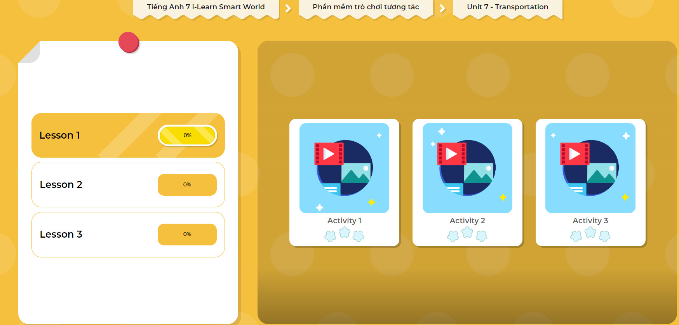
Click on the picture below to play the games.

Slide 34

Lesson 3
Stay positive and have a nice day!

