Slide 1


Slide 2

Unit
6
1
Unit
FAMILY LIFE
GENDER EQUALITY
LESSON 5
LISTENING

Slide 3

Unit
1
1
FAMILY LIFE
Family Life
Unit
OBJECTIVES
Knowledge
Listen for specific information in a talk about the first woman in space
Identify and use lexical items related to gender equality
Core competence
Develop communication skills and problem-solving skills
Be collaborative and supportive in pair work and teamwork
Actively join in class activities
Personal qualities
Develop an awareness of women’s achievements in their jobs
Be respectful towards all genders

Slide 4
LESSON 5
LISTENING
Video: A history of women in space
WARM-UP
Task 1: Work in pairs. Look at the picture and tell your partner what this woman's job is
PRE-READING
Task 2: Listen to a talk about Valentina Tereshkova. Choose the best answer to complete each sentence.
Task 3: Listen again and give short answers to the following questions.
WHILE-READING
POST-READING
Task 4: Work in groups. Discuss the following questions.
CONSOLIDATION
Wrap-up
Homework

Slide 5
LESSON 5
LISTENING
Unit
GETTING STARTED
WARM-UP
Video: A history of women in space

Slide 6
WARM-UP
Watch a video: https://www.youtube.com/watch?v=HIEach7rmDg
Write down as many names that you can hear as possible.
After watching: Which names have you already known and which names have you never heard of?

Slide 7
LESSON 3
LISTENING
Video: A history of women in space
WARM-UP
Task 1: Work in pairs. Look at the picture and tell your partner what this woman's job is
PRE-READING

Slide 8
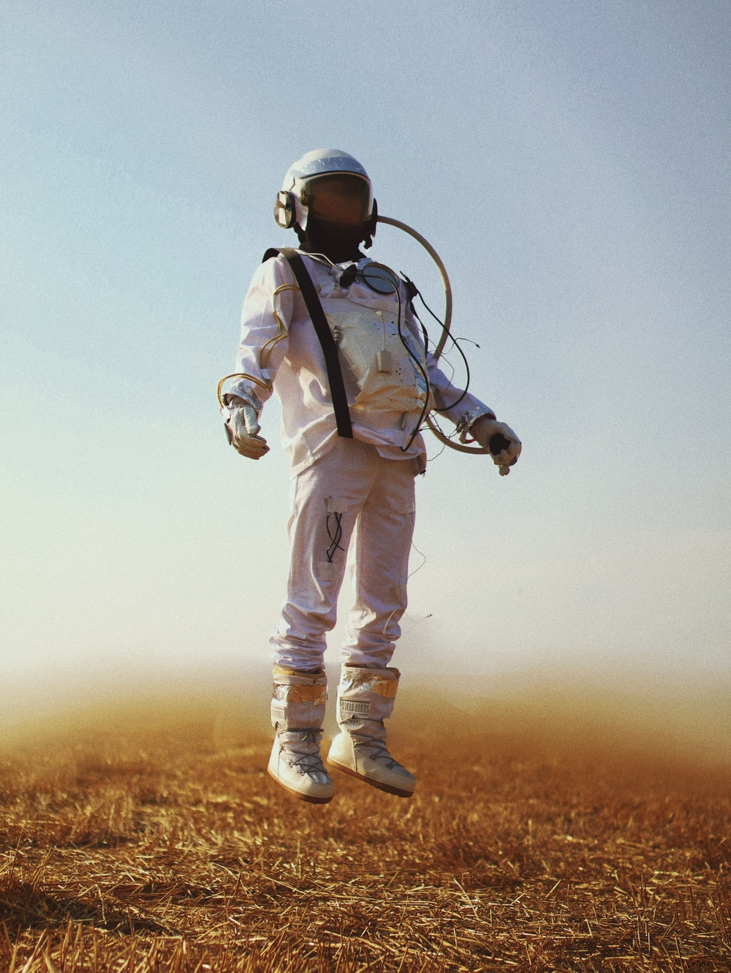

VOCABULARY
cosmonaut (n)
/ˈkɒzmənɔːt/
an astronaut from the former Soviet Union or Russia

Slide 9
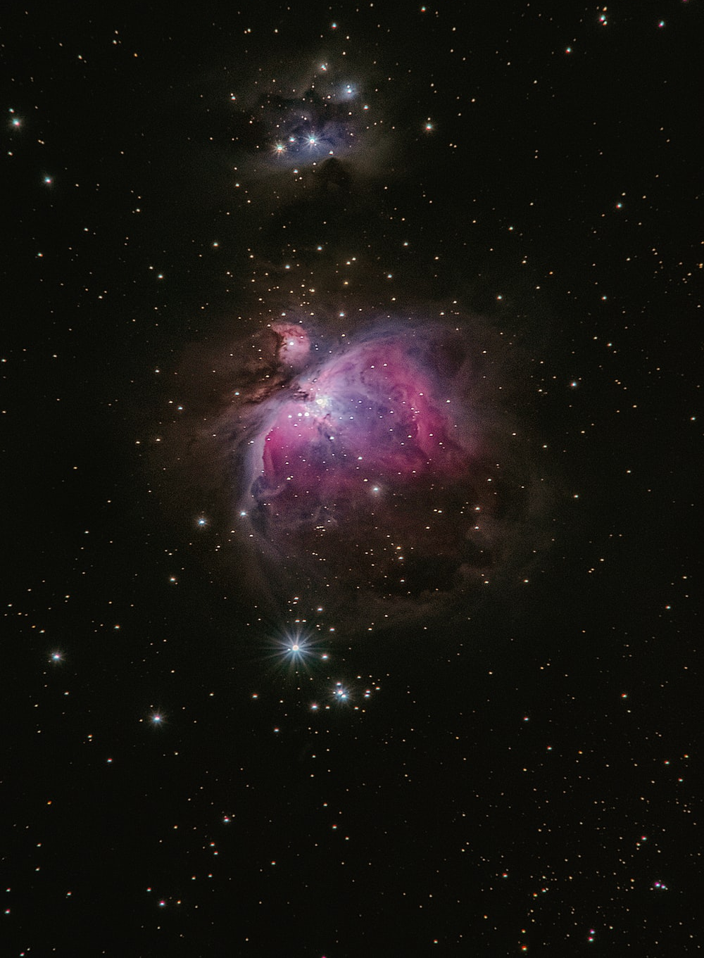
VOCABULARY
space (n)
/speɪs/
the area outside the earth’s atmosphere where all the other planets and stars are

Slide 10
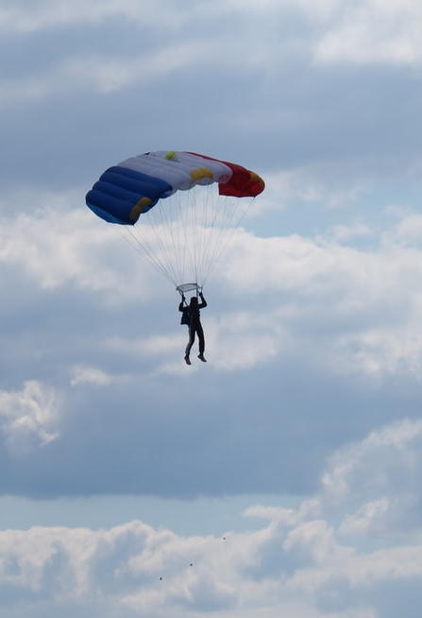
VOCABULARY
parachutist (n)
/ˈpærəʃuːtɪst/
a person who jumps from a plane using a parachute

Slide 11
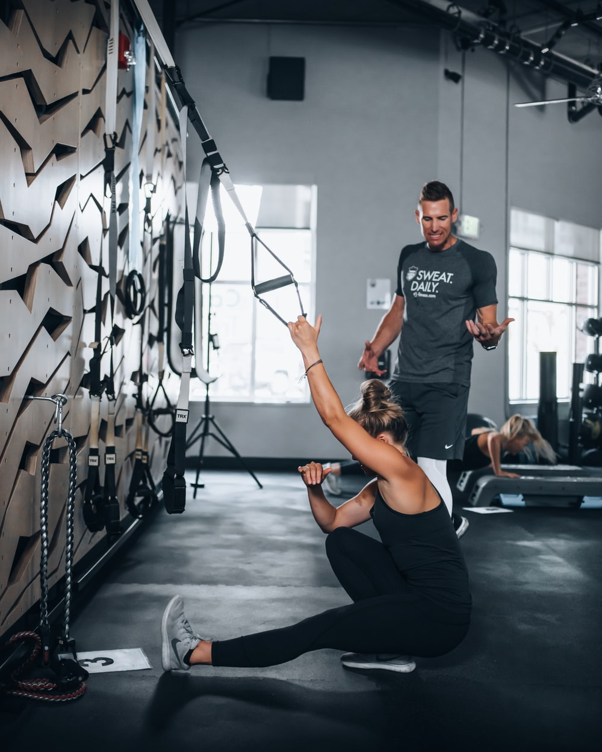
VOCABULARY
instructor (n)
/ɪnˈstrʌktə(r)/
a person whose job is to teach somebody a practical skill or sport

Slide 12
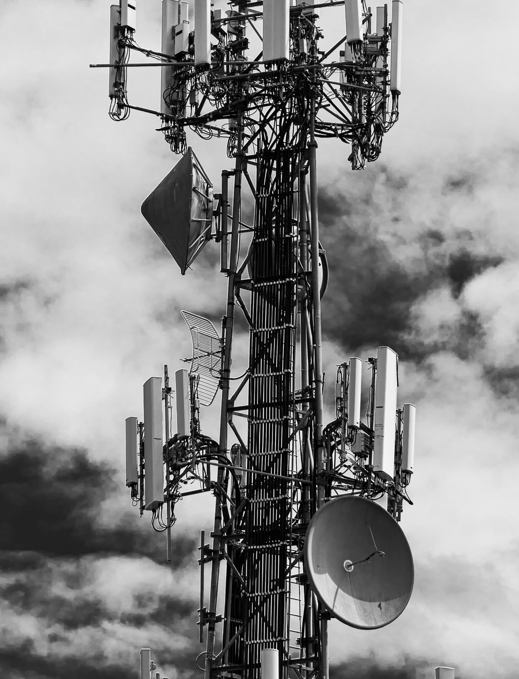
VOCABULARY
technical (adj)
/ˈteknɪkl/
connected with the practical use of machines, methods, etc. in science and industry

Slide 13

PRE-LISTENING
1
Work in pairs. Look at the picture and tell your partner what this woman’s job is.
She’s a cosmonaut.

Slide 14
LESSON 5
LISTENING
Video: A history of women in space
WARM-UP
Task 1: Work in pairs. Look at the picture and tell your partner what this woman's job is
PRE-READING
Task 2: Listen to a talk about Valentina Tereshkova. Choose the best answer to complete each sentence.
Task 3: Listen again and give short answers to the following questions.
WHILE-READING

Slide 15
LISTENING
2
Listen to a talk about Valentina Tereshkova. Choose the best answer to complete each sentence.
Valentina Tereshkova joined a local flying club and became a talented parachutist while she was _______.
Tereshkova and _______ other women were chosen for the Soviet space programme.
Tereshkova joined the Soviet Air Force and became _______ after completing her training and passing an examination.
She travelled into space in Vostok 6 and successfully returned to earth on _______.
After the flight, Tereshkova received many awards, and _______.

Slide 16
LISTENING
2
Listen to a talk about Valentina Tereshkova. Choose the best answer to complete each sentence.
Valentina Tereshkova joined a local flying club and became a talented parachutist while she was _A. working as a factory worker_____.
Tereshkova and __B. four______ other women were chosen for the Soviet space programme.
Tereshkova joined the Soviet Air Force and became _A. _an Air Force officer__ after completing her training and passing an examination.
She travelled into space in Vostok 6 and successfully returned to earth on __B. 19 June 1963______.
After the flight, Tereshkova received many awards, and _B. completed her university degree_______.

Slide 17
LISTENING
3
Listen again and give short answers to the following questions.
1. When was Tereshkova born?
- 1937
2. How old was she when she started working?
– 16
3. When did she join the Soviet space programe?
- 1962
4. At what age did she travel into space?
- 26
5. How many days did she spend in space?
– Three days/3 days

Slide 18
LESSON 5
LISTENING
Video: A history of women in space
WARM-UP
Task 1: Work in pairs. Look at the picture and tell your partner what this woman's job is
PRE-READING
Task 2: Listen to a talk about Valentina Tereshkova. Choose the best answer to complete each sentence.
Task 3: Listen again and give short answers to the following questions.
WHILE-READING
POST-READING
Task 4: Work in groups. Discuss the following questions.

Slide 19
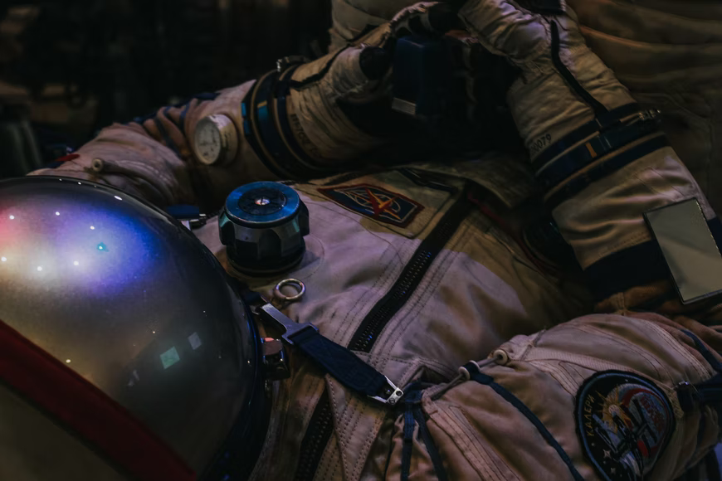
AFTER LISTENING
4
Work in groups. Discuss the following questions.
Do you want to be a cosmonaut? Why or why not?

Slide 20
LESSON 5
LISTENING
Video: A history of women in space
WARM-UP
Task 1: Work in pairs. Look at the picture and tell your partner what this woman's job is
PRE-READING
Task 2: Listen to a talk about Valentina Tereshkova. Choose the best answer to complete each sentence.
Task 3: Listen again and give short answers to the following questions.
WHILE-READING
POST-READING
Task 4: Work in groups. Discuss the following questions.
CONSOLIDATION
Wrap-up
Homework

Slide 21
CONSOLIDATION
1
Wrap-up
Lexical items about women in space
Listening for specific information

Slide 22
CONSOLIDATION
2
Homework
Do exercises in the workbook.
Prepare for the Project.

Slide 23


