Slide 1


Slide 2

1
Unit
FAMILY LIFE
REVIEW 2
LESSON 2
SKILLS (1)

Slide 3

Unit
1
1
FAMILY LIFE
Family Life
Unit
OBJECTIVES
1. Knowledge
Review the skills Listening and Speaking they have learnt in Unit 4-5.
2. Core competence
- Develop critical thinking skill;
- Be collaborative and supportive in pair work and team work;
- Actively join in class activities.
3. Personal qualities
- Develop self-study skills

Slide 4
LESSON 2
SKILLS
Unit
GETTING STARTED
WARM-UP
Game: HANGMAN
LISTENING
Activity 1: Listen and choose the best title for the talk.
Activity 2: Listen again and fill in each blank with one word.
Activity 3. Work in groups. Complete the sentences with as many words as possible.
SPEAKING
Activity 1. Brainstorming and mind mapping
Activity 2. Presentation
CONSOLIDATION
Wrap-up
Home work

Slide 5
LESSON 2
SKILLS
Unit
GETTING STARTED
WARM-UP
Game: HANGMAN

Slide 6

WARM-UP
HANGMAN
_ _ _ _ _ _ _ _ _
S
M
A
R
T
H
O
M
E
ABCDEFGHIJKLMN
OPQRSTUVWXYZ

Slide 7
LESSON 2
SKILLS
Unit
GETTING STARTED
WARM-UP
Game: HANGMAN
LISTENING
Activity 1: Listen and choose the best title for the talk
Activity 2: Listen again and fill in each blank with one word.
Activity 3. Work in groups. Complete the sentences with as many words as possible.

Slide 8


LISTENING
1
Listen and choose the best title for the talk (p.64)
Smart home technology
The popularity of smart homes
The future of smart homes

Slide 9
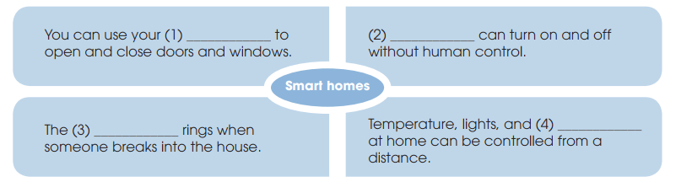
LISTENING
2
Listen again and fill in each blank with one word. (p.64)
voice
Lights
alarm
devices

Slide 10
LISTENING
3
Work in groups. Complete the sentences with as many words as possible.
Imagine living in a house where
from a distance.
1. _________________________ everything is controlled ____________
2. ________ turn on when ____________________________________.
3. _________________your house temperature, _____________________
___________________________________.
4. ____ that’s how technology ________________________________ _______________________________
The lights
you enter the room, and then turn off as you leave.
You can even control
lights and devices from a
mobile phone when you are far from home
And
can make your life more enjoyable and
enjoyable and comfortable than ever.

Slide 11
LESSON 2
SKILLS
Unit
GETTING STARTED
WARM-UP
Game: HANGMAN
LISTENING
Activity 1: Listen and choose the best title for the talk.
Activity 2: Listen again and fill in each blank with one word.
Activity 3. Work in groups. Complete the sentences with as many words as possible.
SPEAKING
Activity 1. Brainstorming and mind mapping
Activity 2. Presentation

Slide 12
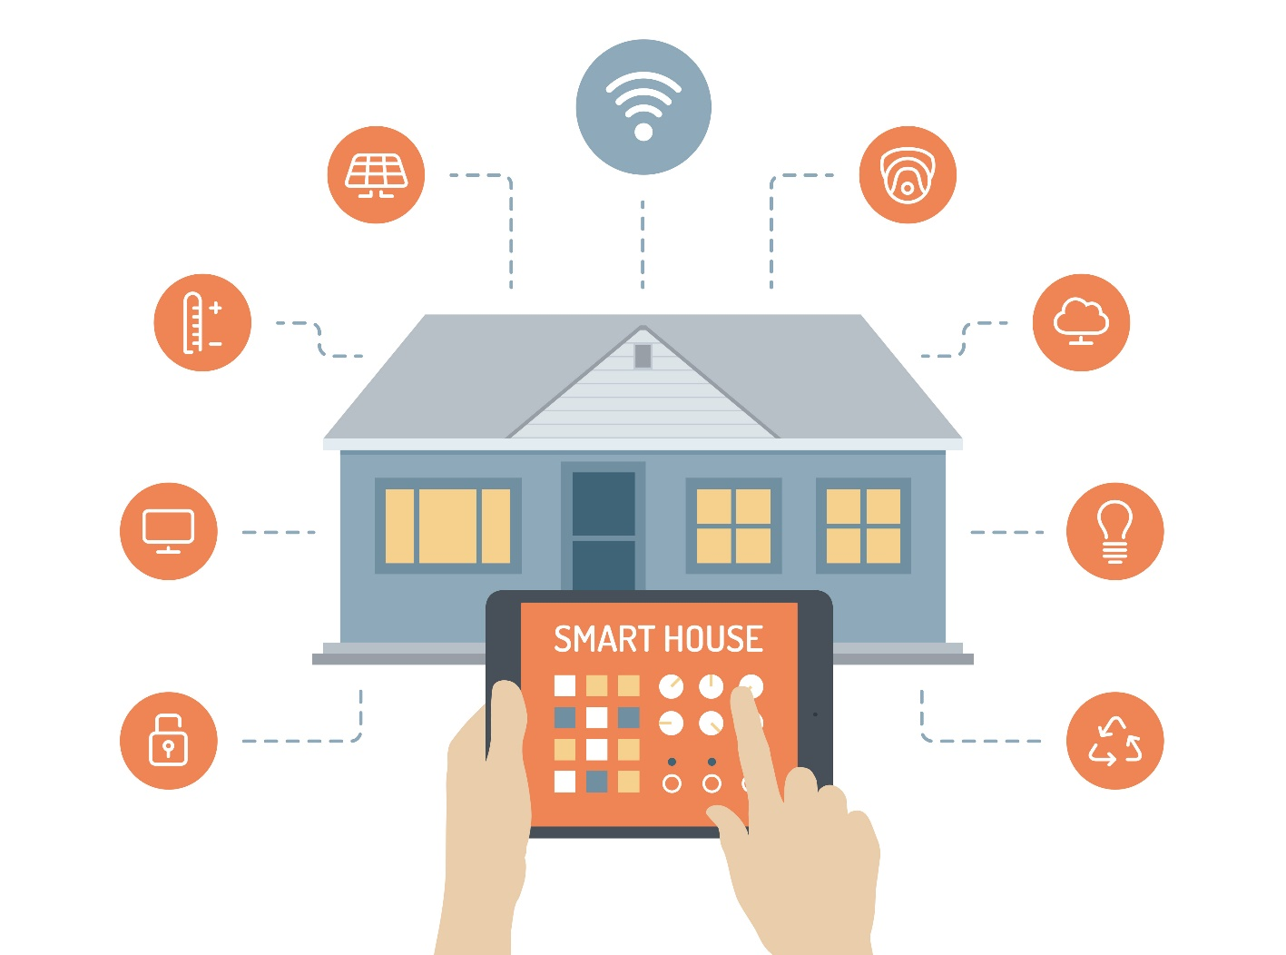
SPEAKING
BRAINSTORMING
Work in groups. What other features should a smart home have? How will they help us?

Slide 13
SPEAKING
Work in groups. What other features should a smart home have? How will they help us? Use the expressions you learnt in Unit 5 to help you. (p.64)
(will) help(s) / allow(s) / enable(s) us to do sth.
is/are used to do sth / for sth / for doing sth.
Example: I think a smart home should have a smart heating system that is controlled from a mobile phone. This will allow us to save energy and money.

Slide 14
LESSON 2
SKILLS
Unit
GETTING STARTED
WARM-UP
Game: HANGMAN
LISTENING
Activity 1: Listen and choose the best title for the talk.
Activity 2: Listen again and fill in each blank with one word.
Activity 3. Work in groups. Complete the sentences with as many words as possible.
SPEAKING
Activity 1. Brainstorming and mind mapping
Activity 2. Presentation
CONSOLIDATION
Wrap-up
Home work

Slide 15
CONSOLIDATION
1
Wrap-up
1. Knowledge
Review the skills Speaking and Listening they have learnt in Unit 4-5.
2. Core competence
- Develop critical thinking skill;
- Be collaborative and supportive in pair work and team work;
- Actively join in class activities.
3. Personal qualities
- Develop self-study skills

Slide 16
CONSOLIDATION
2
Homework
Do exercises in the workbook
Prepare for the next lesson:
Review 2. Lesson 3. Skills (2) Reading and Writing

Slide 17


