Slide 1


Slide 2


Unit
2
LIFE IN THE COUNTRYSIDE
LESSON 6: SKILLS 2

Slide 3
LESSON 6: SKILLS 2
WARM-UP
Miming game
Task 1: Work in pairs. Discuss the following question.
Task 2: Listen to three people talking about life in the countryside. Choose the opinion that each speaker expresses.
Task 3: Listen again and choose the correct answer A, B, or C.
LISTENING
Task 4: Work in groups. Discuss and write what you like or dislike about life in the countryside.
Task 5: Write a paragraph about what you like or dislike about life in the countryside.
WRITING
CONSOLIDATION
Wrap-up
Homework

Slide 4
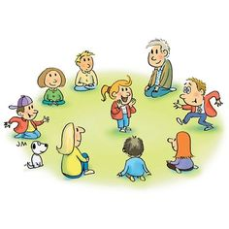
WARM-UP
MIMING GAME

Slide 5

LISTENING
1
1
Work in pairs. Discuss the following question.
What do you like or dislike about life
in the countryside?

Slide 6

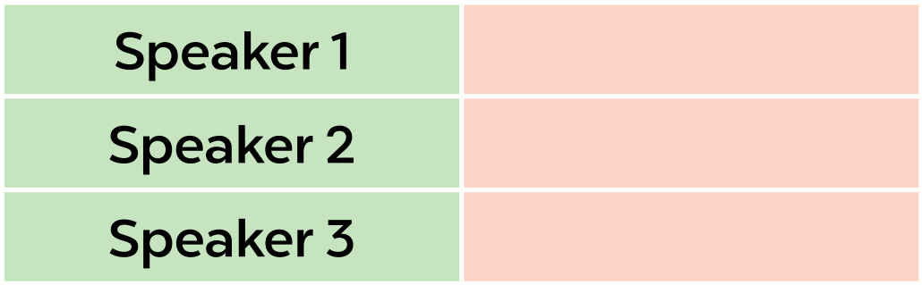
LISTENING
2
Listen to three people talking about life in the countryside. Choose the opinion (A - C) that each speaker (1 - 3) expresses.
B
A
C

Slide 7
LISTENING
3
Listen again and choose the correct answer A, B, or C.
1. According to speaker 1, there is a great sense of ______ in his village.
A. security B. duty C. community
2. Speaker 1 says that people in his village are very ______.
A. supportive B. unsociable C. well-trained
3. In speaker 2’s opinion, ______ is a big problem in the countryside.
A. the cost of living B. safety C. transportation
4. Speaker 2 says that they should ______ in the countryside.
A. improve the lives of people B. prevent crime C. protect nature
5. According to speaker 3, life in the countryside is peaceful and ______.
A. slow B. simple C. safe

Slide 8

WRITING
4
Work in groups. Discuss and write what you like or dislike about life in the countryside.
LIKE | DISLIKE
– low cost of living – many cheap things | – not many entertainment places, such as theatres, cinemas, etc. – poor means of transport ...

Slide 9
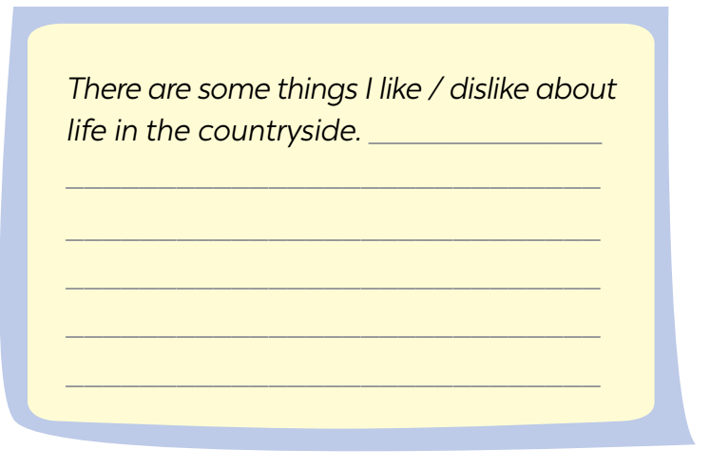
WRITING
5
Write a paragraph (80 - 100 words) about what you like or dislike about life in the countryside.
I live in Duong Lam. It’s an old village outside Ha Noi. It has ……...
…………………………………………………………………………………………………………………………………………………………………………………………………………………………….............................................

Slide 10

CONSOLIDATION
1
Wrap-up
What have we learnt in this lesson?
Listen to someone’s opinion about life in the countryside
Write a paragraph about what someone likes or dislikes about life in the countryside

Slide 11

CONSOLIDATION
2
Homework
Do exercises in the workbook.

Slide 12

Website: hoclieu.vn
Fanpage: facebook.com/www.tienganhglobalsuccess.vn/

