Slide 1


Slide 2
Unit
3
CITIES OF THE FUTURE
Unit
FAMILY LIFE
LESSON 8
LOOKING BACK AND PROJECT

Slide 3
LESSON 8
LOOKING BACK AND PROJECT
WARM-UP
Lucky number
- Pronunciation: Linking between the consonant and vowel sounds.
- Vocabulary: future cities
- Grammar: stative verbs in continuous form
LOOKING BACK
PROJECT
Ideal city posters
CONSOLIDATION
- Wrap up
- Homework

Slide 4
WARM-UP
LUCKY NUMBER
- Work in 2 teams
- There are 7 numbers, 2 of which are lucky ones
- Choose a lucky number ➔ 1 point without answering
- Other numbers ➔ Pick a piece of paper
- Use words or actions to describe the word (without saying it directly)
- Guess the word correctly ➔ 1 point
- The group having more points is the winner.

Slide 5
WARM-UP
Choose a number
1
2
3
4
5
6
7

Slide 6

WARM-UP

Slide 7
WARM-UP
Pick a word and explain it to your friends

Slide 8

LOOKING BACK
1
Listen and mark the consonant and vowel sounds that are linked. Then practise saying the sentences.
1. Many young people want to live in the city.
2. It’s a busy street with great shops and restaurants.
3. The government wants to build a smart city and the south of the country.
4. The apartment was expensive, but my parents could afford it.

Slide 9
LOOKING BACK
2
Complete the sentences. Use words and phrases you have learnt in this unit.
raffic
1. Improved road conditions may help reduce t________ j________ in the city.
2. My city was ranked as the most l________ city in the country thanks to its excellent facilities and clean air.
3. Cities in the future will have a lower carbon footprint and will be more s__________.
4. Smart technologies have made lives of c________ d________ more convenient.
ams
iveable
ustainable
ity
wellers

Slide 10
LOOKING BACK
3
Choose the correct words and phrases to complete these sentences.
1. Please don't talk I think/am thinking.
2. People living in crowded cities feel unhappily/unhappy.
3. You should try this soup. It tastes/is tasting delicious.
4. James seems an intelligent person/intelligently, but he sometimes asks silly questions.

Slide 11
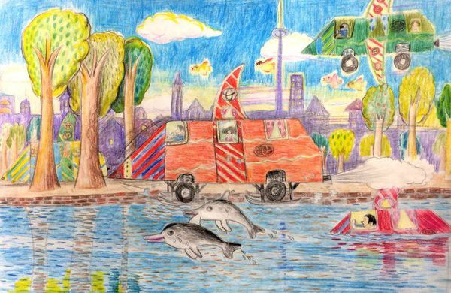
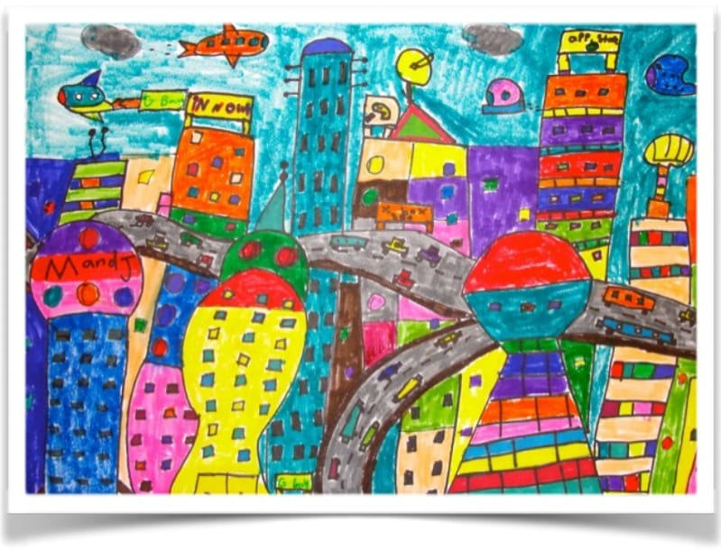
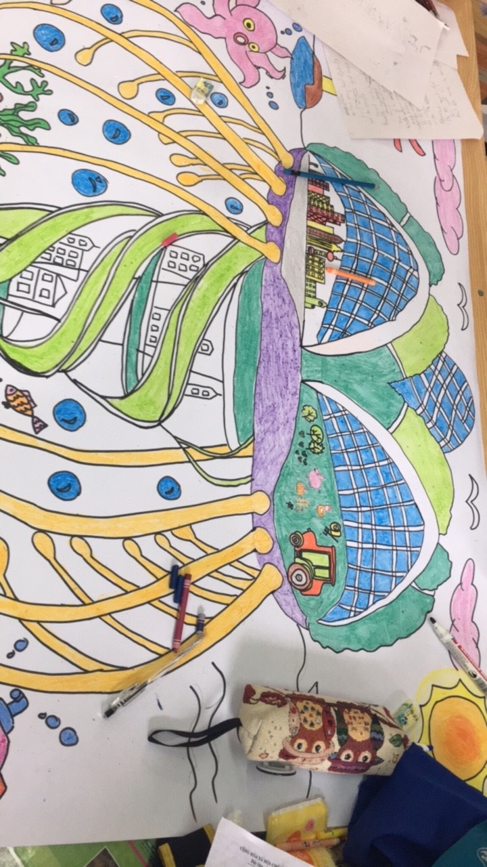
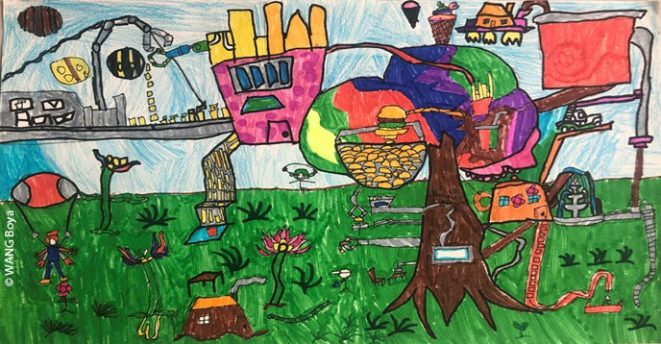
PROJECT
IDEAL CITY POSTERS

Slide 12
CONSOLIDATION
1
Wrap-up
What have you learnt today?
- Review the vocabulary and grammar of Unit 3;
- Apply what you have learnt (vocabulary and grammar) into practice through a project.

Slide 13
CONSOLIDATION
2
Homework
Do exercises in the workbook.
Prepare for Unit 4.

Slide 14

Website: hoclieu.vn
Fanpage: facebook.com/www.tienganhglobalsuccess.vn

