Slide 1

UNIT 4: INTERNATIONAL ORGANIZATIONS AND CHARITIES
Lesson 2.3 – Pronunciation & Speaking
Page 35

Slide 2




Lesson 2.3
LESSON OUTLINE
Consolidation

Slide 3

By the end of this lesson,
students will be able …
• to practice the sound change for have and has.
• to talk about how charities have helped.

Slide 4



Slide 5

Choose the word whose main stress is placed
differently from the others.
Work in pairs.
A. personal B. exhausted C. effective D. delighted
2. A. awareness B. customer C. family D. passenger
3. A. organize B. exercise C. deliver D. analyze
/ˈpɜ:sənəl/
/ɪɡˈzɑ:stɪd/
/əˈfektɪv/
/dɪˈlaɪtɪd/
/əˈwernəs/
/ˈkʌstəmə/
/ˈfæməli/
/ˈpæsəndʒə/
/ˈɔ:rɡənaɪz/
/ˈeksəsaɪz/
/dɪˈlɪvə/
/ˈænəlaɪz/

Slide 6
Work in pairs.
Choose the word whose underlined part is
pronounced differently from that of the other words.
A. provision B. resident C. quality D. uniform
2. A. raise B. pray C. say D. ask
3. A. defeated B. supported C. decided D. volunteered
/prəˈvɪʒən/
/ˈrezədənt/
/ˈkwɒ:ləti/
/ˈju:nəfɔ:rm/
/reɪz/
/preɪ/
/seɪ/
/æsk/
/dɪˈfi:tɪd/
/ səˈpɔ:rtɪd/
/dɪˈsaɪdɪd/
/ˌvɑ:lənˈtɪrd/

Slide 7
Go around the class and interview your classmates. Find someone who …
has studied English the longest.
How long have you studied English?
- I have studied English since I was 6.
- I have studied English for 8 years.
…
→ Lan has studied English the longest, since she was 6.
has had a cell phone the longest.
has used the same school bag the longest.
has had their current hair style the longest.
has used the same bike the longest.
has known their best friend the longest.

Slide 8



Slide 9

Sound change
"...have..." and "...has..." often sound like /əv/ and /əz/.
Notice the sound changes of the underlined words.
What has it done?
What have they done?

Slide 10
Sound change
c. Listen and cross out the one with the wrong sound changes.
How long has it helped poor people?
Their events have helped raise awareness about plastic pollution.
d. Read the sentences with the correct sound changes to a partner.

Slide 11
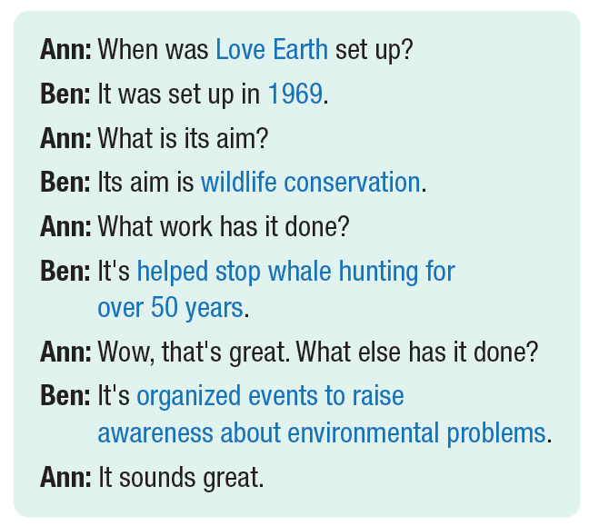

Slide 13



Slide 14
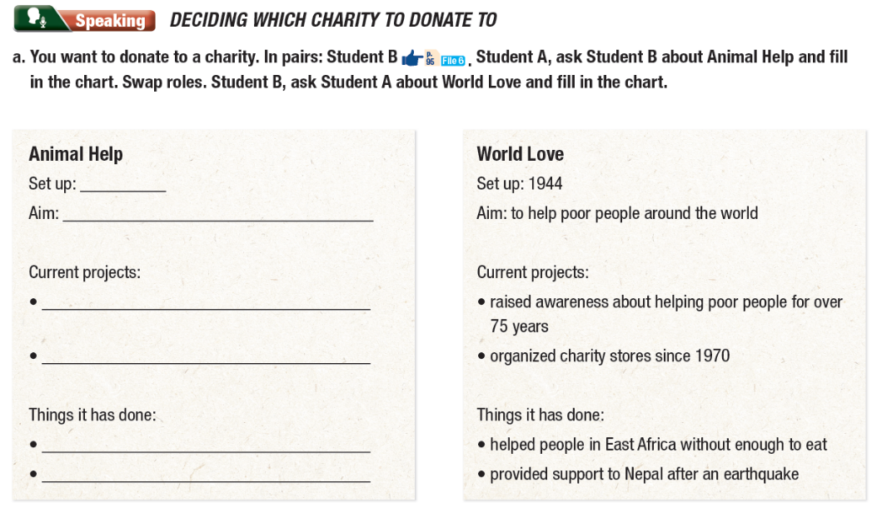

Slide 15

Consolidation

Slide 16

Work in pairs.
b. Which charities do you think is more important?
I think … is more important because …
I agree with you. I also think that …

Slide 17

WRAP-UP

Slide 18
Today’s lesson
Pronunciation: practice sound changes of have and has in a sentence
Speaking: exchange information about two charities

Slide 19

Practice pronunciation of sound changes of have and has
Prepare the next lesson – Lesson 3 on page 36 in SB.
Play the consolidation games in Tiếng Anh 10 i-Learn Smart World DHA App on www.education.com.vn
Review all the vocabulary and grammar points. Practice saying them.

