Slide 1
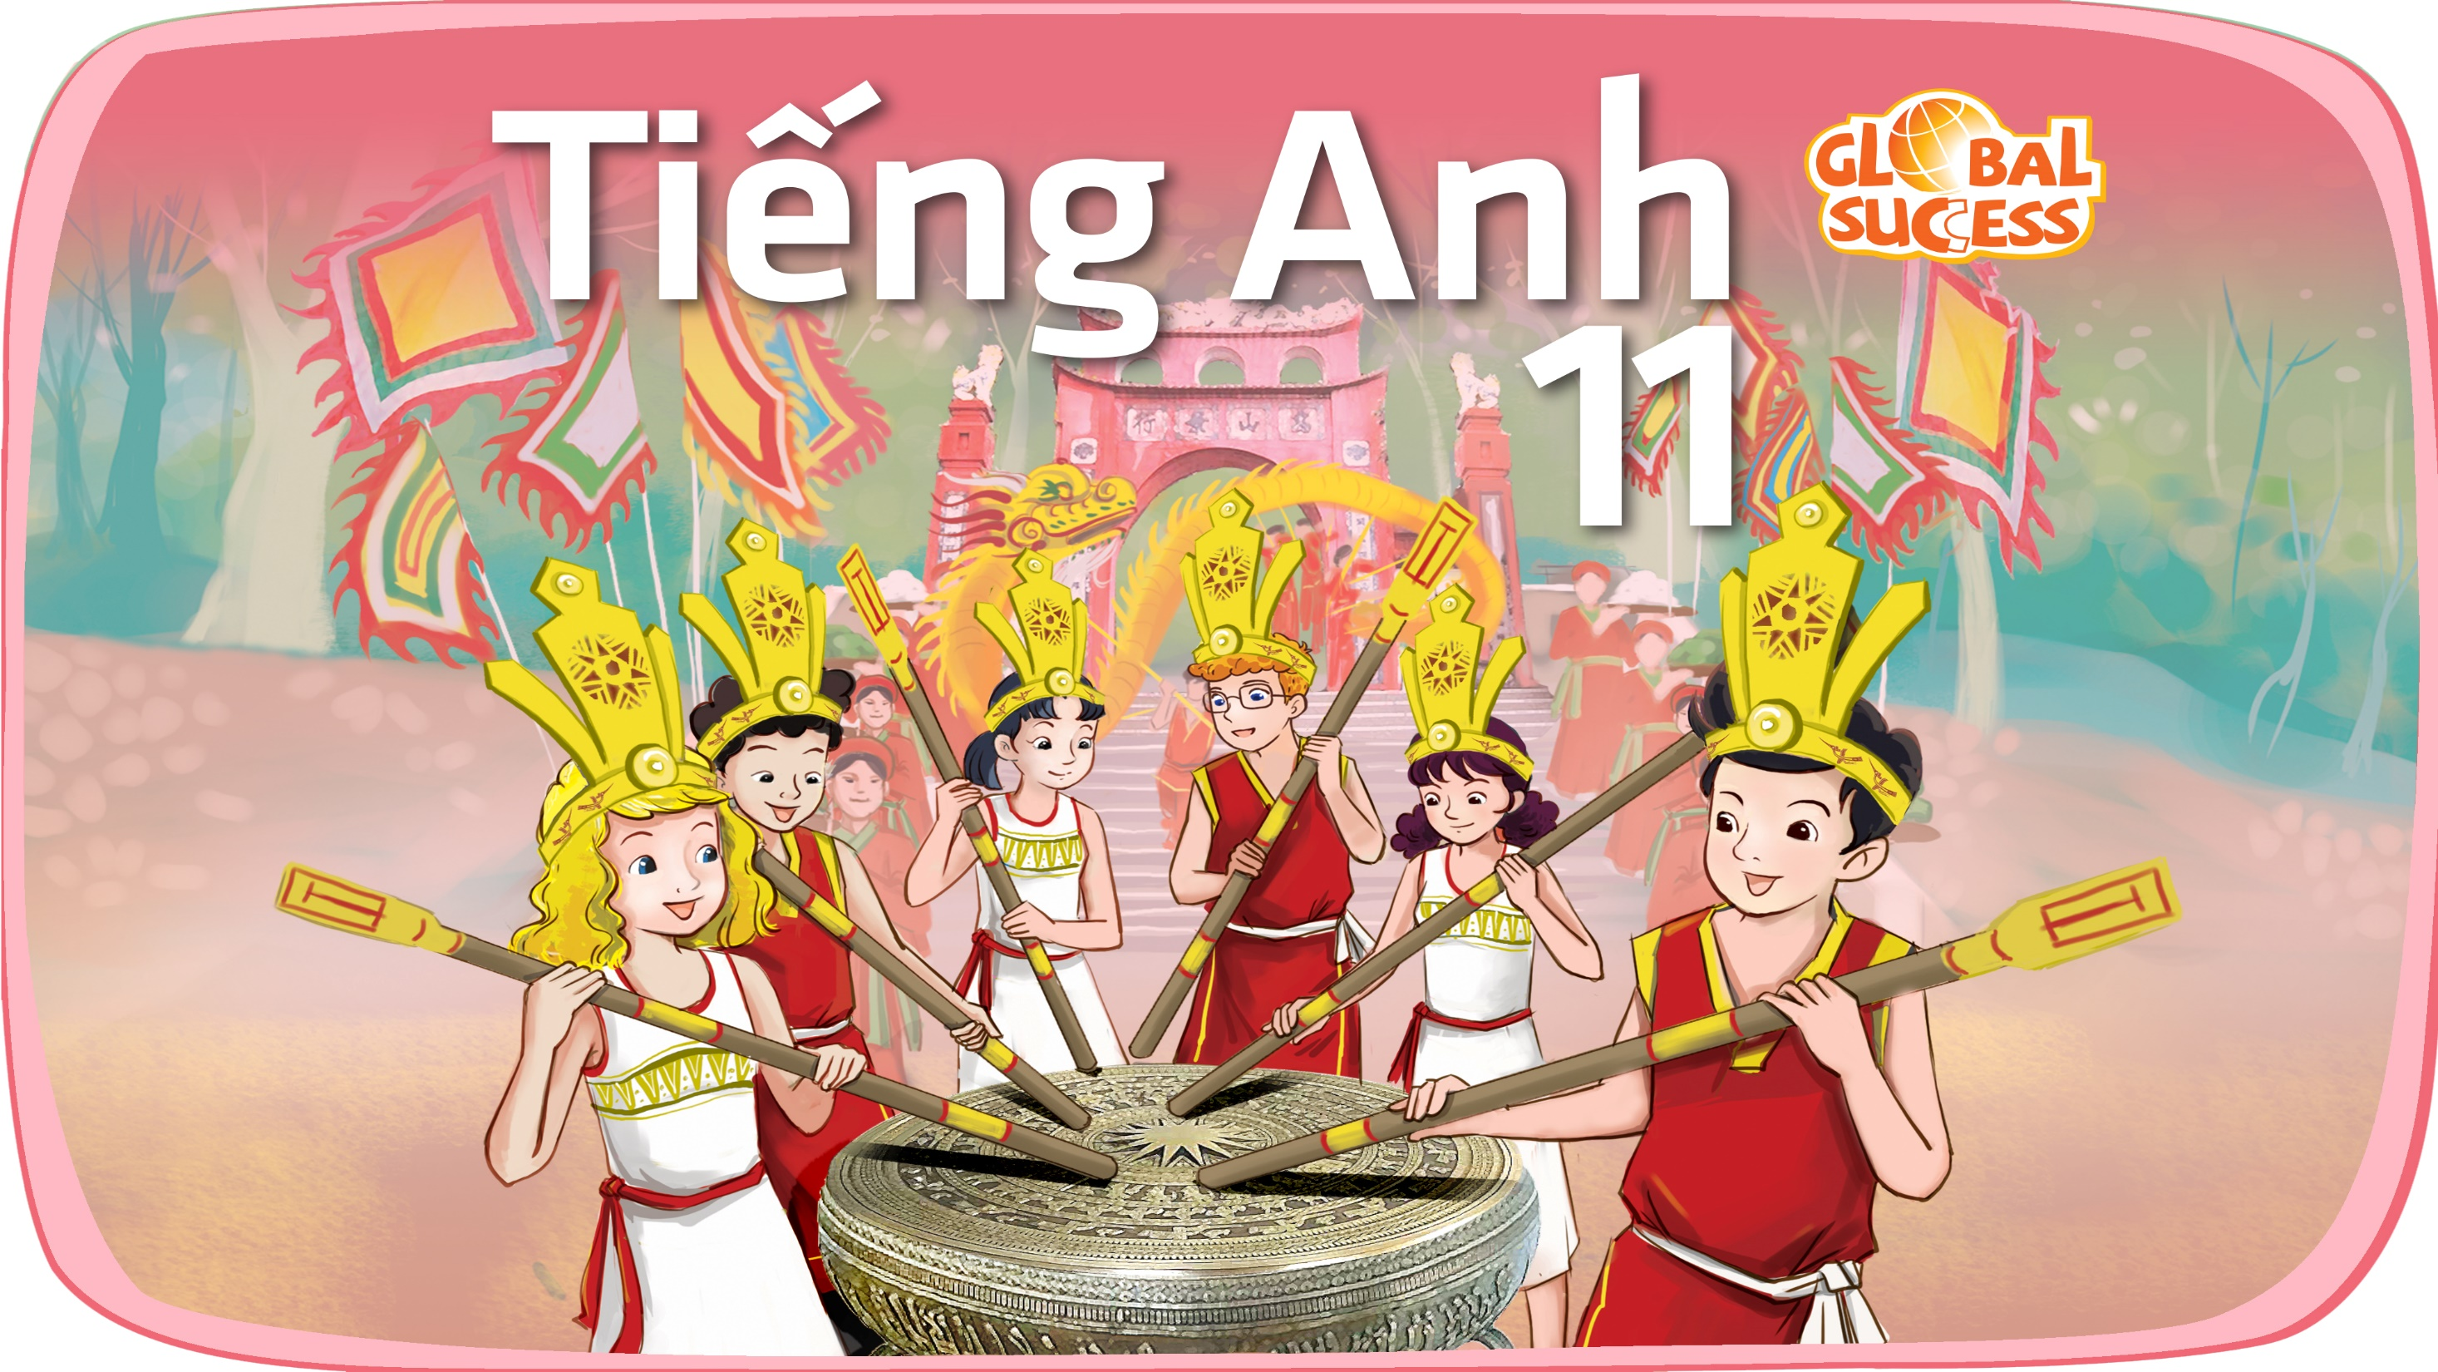

Slide 2
Unit
10
The ecosystem
Unit
FAMILY LIFE
LESSON I
GETTING STARTED
Humans and ecosystems

Slide 3
LESSON I
GETTING STARTED
WARM-UP
GAME: Guess the place
Vocabulary
PRESENTATION
- Task 1. Listen and read
- Task 2. Decide whether these statements are True or False
- Task 3. Complete the diagram
- Task 4. Use the words in the box to form compound nouns mentioned in Task 1. Match them with the meaning below
PRACTICE
PRODUCTION
Role play
Wrap-up
Homework
CONSOLIDATION

Slide 4
WARM-UP
GUESS THE PLACE
- Play in 2 teams
- There are three clues for Ss to guess the place.
- If one team:
+ gets the correct answer after the 1st clue ➔ get 3 points.
+ gets the correct answer after the 2nd clue ➔ get 2 points.
+ gets the correct answer after the 3rd clue ➔ get 1 point.
- The team with the correct answer is the winner.

Slide 5
WARM-UP
CLUE 1
This landscape forms the habitat for some of Asia’s rarest animal and plant species.

Slide 6
WARM-UP
CLUE 2
Visitors in April and May have the chance to see thousands of vibrant butterflies.

Slide 7
WARM-UP
CLUE 3
This place is located 120 km southwest of Hanoi, and nestled between the provinces of Ninh Binh, Thanh Hoa and Hoa Binh.

Slide 8
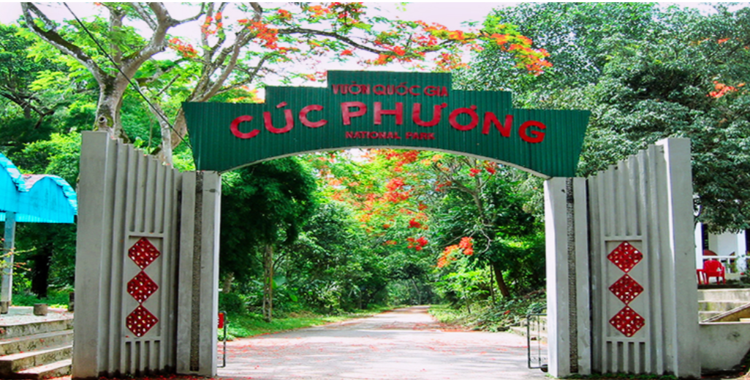
WARM-UP
CUC PHUONG NATIONAL PARK

Slide 9
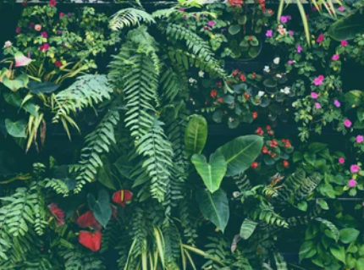

PRESENTATION
flora (n)
/ˈflɔːrə/
the plants of a particular area, type of environment or period of time

Slide 10
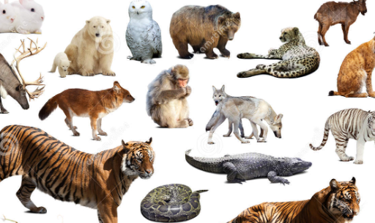
PRESENTATION
fauna (n)
/ˈfɔːnə/
all the animals living in an area or in a particular period of history

Slide 11
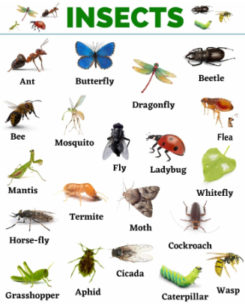
PRESENTATION
insect (n)
/ˈɪnsekt/
any small creature with six legs and a body divided into three parts. Insects usually also have wings. Ants, bees and flies are all insects.

Slide 12
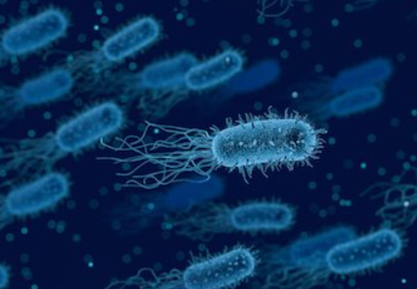
PRESENTATION
organism (n)
/ˈɔːɡənɪzəm/
a living thing, especially one that is extremely small

Slide 13
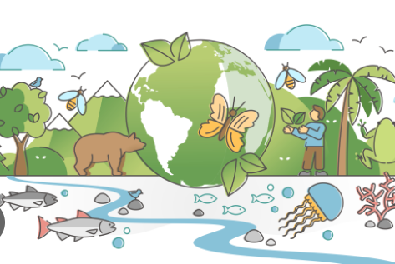
PRESENTATION
biodiversity (n)
/ˌbaɪəʊdaɪˈvɜːsəti/
the existence of a large number of different kinds of animals and plants which make a balanced environment

Slide 14
PRESENTATION
Form | Pronunciation | Meaning | Vietnamese equivalent
1. flora (n) | /ˈflɔːrə/ | the plants of a particular area, type of environment or period of time | Hệ thực vật
2. fauna (n) | /ˈfɔːnə/ | all the animals living in an area or in a particular period of history | Hệ động vật
3. insect (n) | /ˈɪnsekt/ | any small creature with six legs and a body divided into three parts. Insects usually also have wings. Ants, bees and flies are all insects. | Côn trùng
4. organism (n) | /ˈɔːɡənɪzəm/ | a living thing, especially one that is extremely small | Sinh vật
5. biodiversity (n) | /ˌbaɪəʊdaɪˈvɜːsəti/ | the existence of a large number of different kinds of animals and plants which make a balanced environment | Đa dạng sinh học

Slide 15
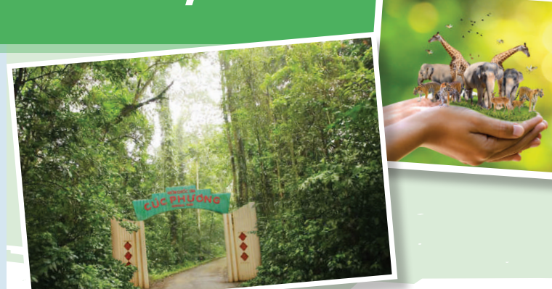
PRESENTATION
1
Listen and read.

Slide 16
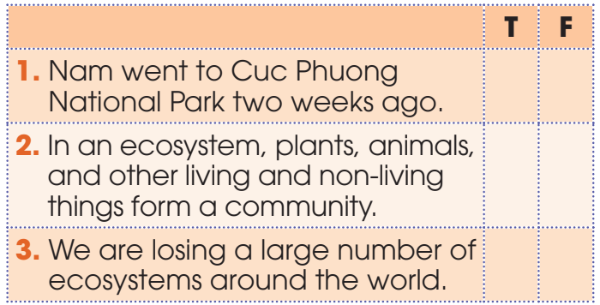
PRACTICE
2
Read the conversation and decide whether these statements are True or False
x
x
x

Slide 17
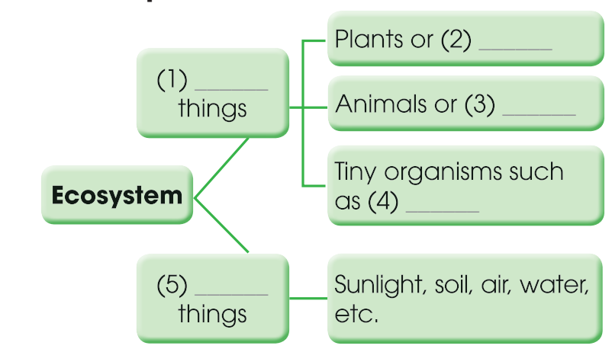
PRACTICE
3
Complete the diagram with words and phrases in Task 1
flora
Living
fauna
bacteria
Non-living

Slide 18
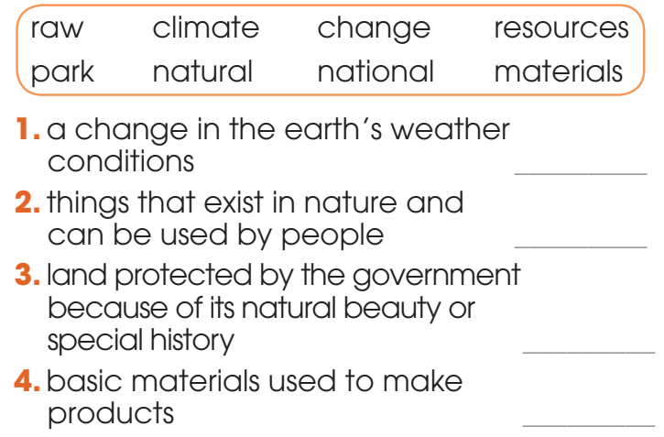
PRACTICE
4
Use the words in the box to form compound nouns mentioned in Task 1. Match them with the meaning below.
climate change
natural resources
national park
raw materials

Slide 19

PRODUCTION
Role play
- 3 groups. In each group, one student will play the role of the teacher and others are students.
- The teacher and the students are going to discuss what an ecosystem is and how important ecosystems are to our planet.
- 3 minutes to prepare for the role play.
- 2 minutes for a presentation.

Slide 20
CONSOLIDATION
1
Wrap-up
What have you learnt today?
Some lexical items about ecosystems;
Reading for specific information;
Compound nouns.

Slide 21
CONSOLIDATION
2
Homework
Do exercises in the workbook.
Prepare for Lesson 2 - Unit 10.
Prepare materials for the project in lesson 8

Slide 22

Website: hoclieu.vn
Fanpage: facebook.com/sachmem.vn/

