Slide 1

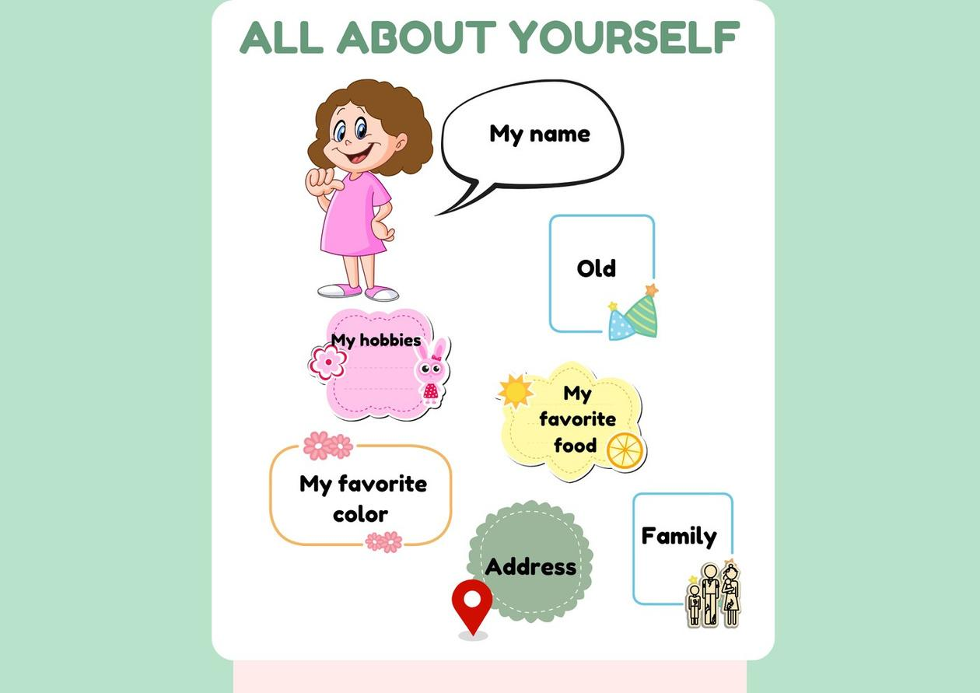

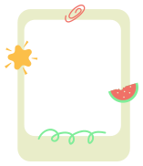
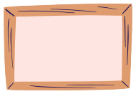

Class
School
Job

Slide 2
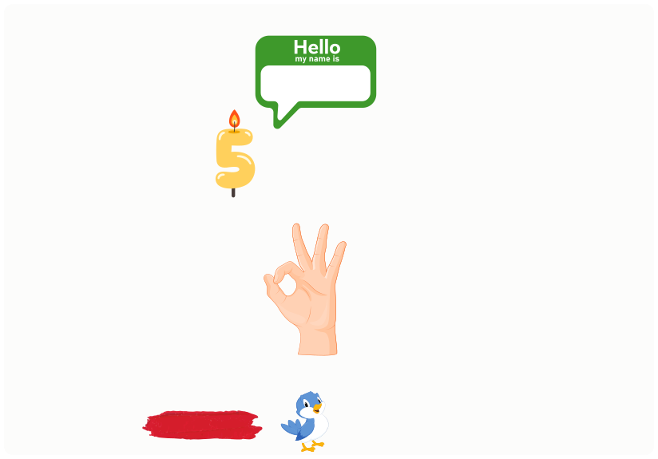


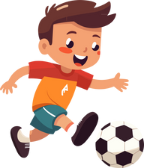
I. QUESTION
1. What’s your name? - I’m ...
2. How old are you?
- I’m ... years old.
3. Where do you live?
- I live in ...
4. How are you today?
- I’m fine.
5. What is your favorite color/animal/sport/ subject/ fruit?
It’s ...

Slide 3
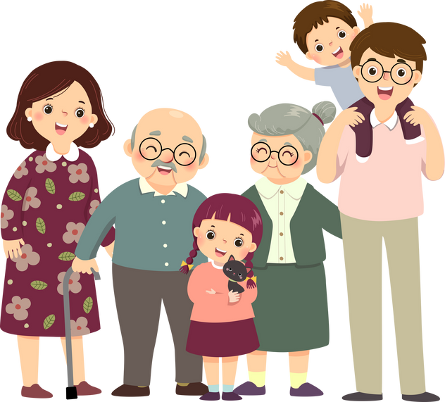
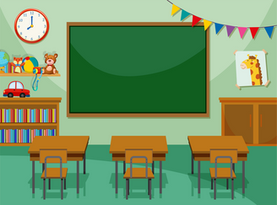
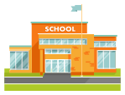

I. QUESTION
6. How many people are there in your family? - There are ... people: ...
7. Which class are you in? - I’m in class ...
8. What is your school name? - It’s ... Primary school.
9. What do you want to be when you grow up? - I want to be a ....

Slide 4
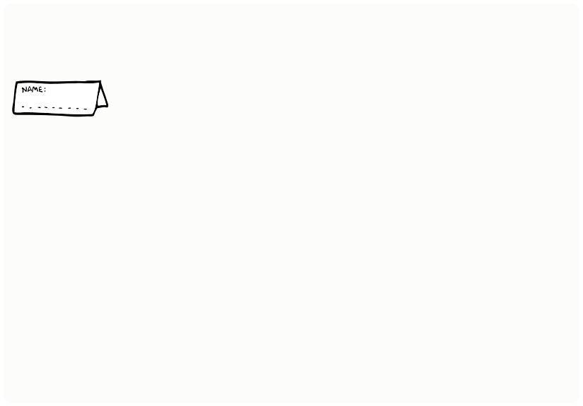
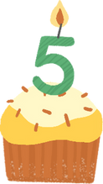
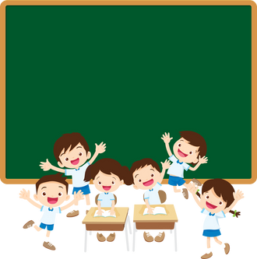
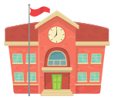
II. VOCABULARY
Name: My name is Sarah
Age: I’m 8 years old
Class: I’m in class 2/1
School: Cam Loc 1 Primary School

Slide 5
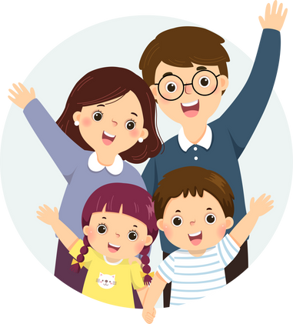

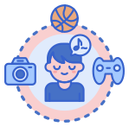
II. VOCABULARY
Family: There are 5 people in my family
.
Job:.........................................................
Hobby: My hobby is playing basketball

Slide 6
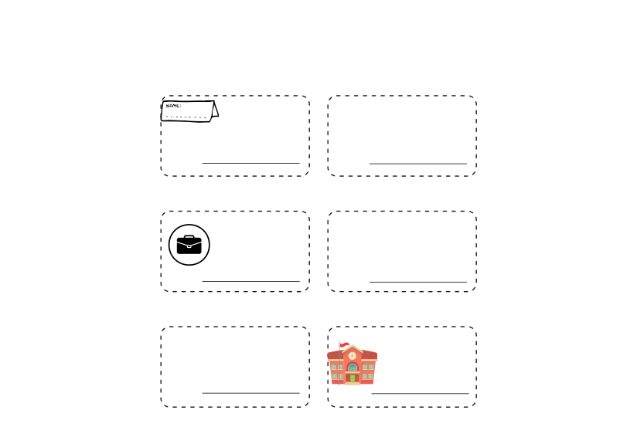

III. EXERCISES:
2. Unscramble the letters and write the name of the body part:
anem
cslsa
ojb
hoybb
gae
scoolh

Slide 7


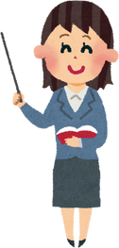
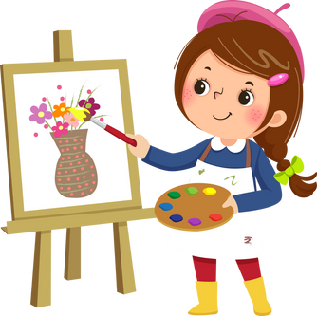
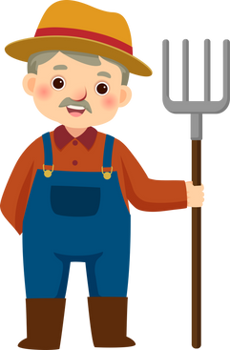

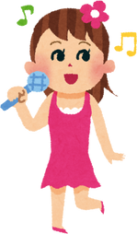


III. EXERCISES:
2. What do you want to be when you grow up? Circle the correct answer:
teacher
.
doctor
singer

Slide 8
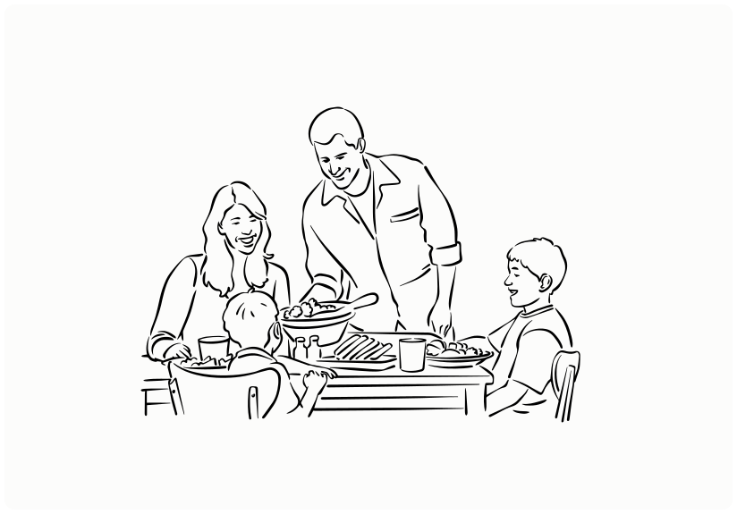
III. EXERCISES:
3. How many people are there in your family? Choose the answer and color it:
.
A. 3 people
A. 4 people
A. 5 people

Slide 9
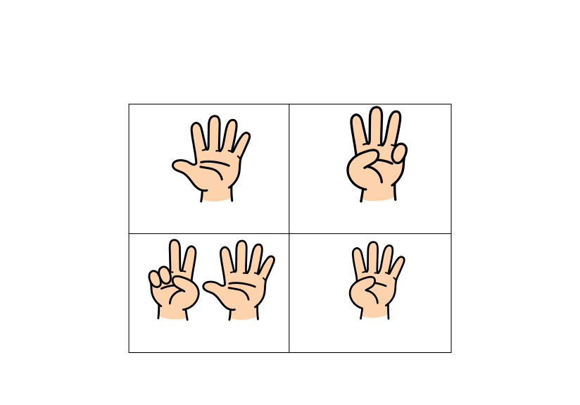
III. EXERCISES:
4. How old are you? Count and circle:
6
5
4
7
1
2
3
4
5
7
8
9
1
2
3
4

Slide 10
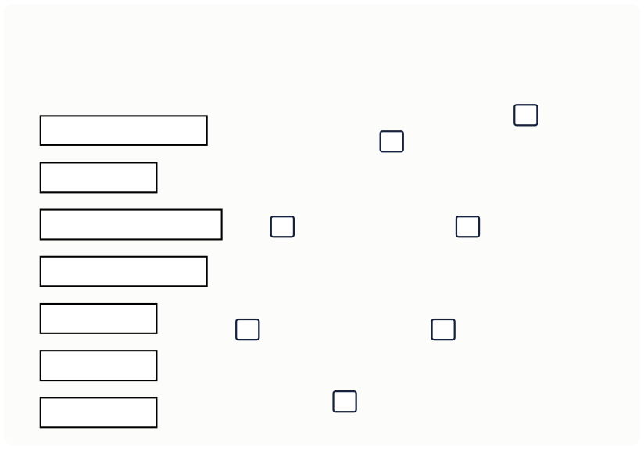
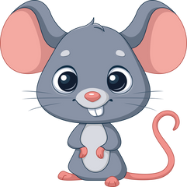
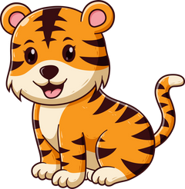
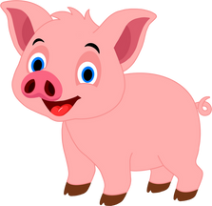
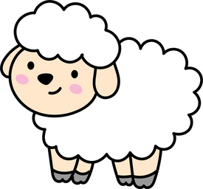



III. EXERCISES:
5. What is your favorite animals? Write number:
1. dog
2. cat
3. bird
4. pig
5. mouse 6. tiger 7. sheep

Slide 11


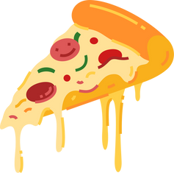
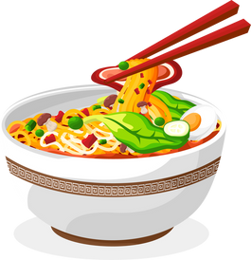
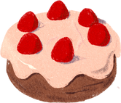
III. EXERCISES:
6. What is your favorite food? Find and line the similar picture:

Slide 12
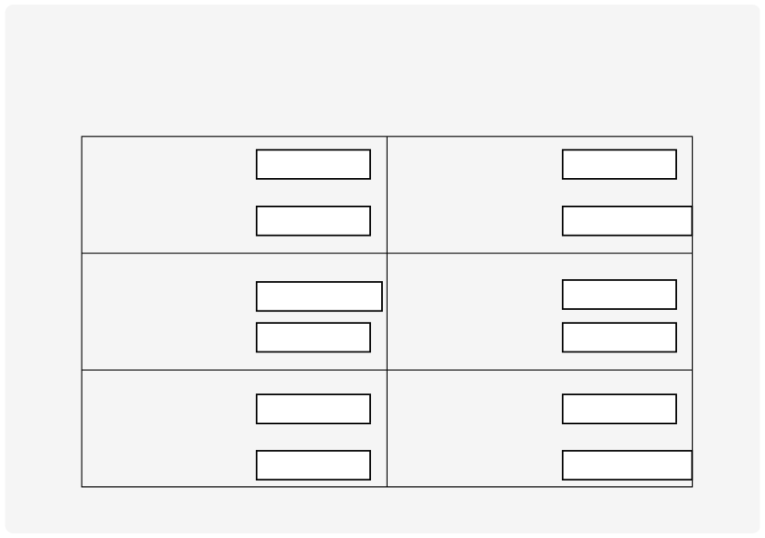
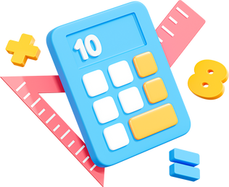
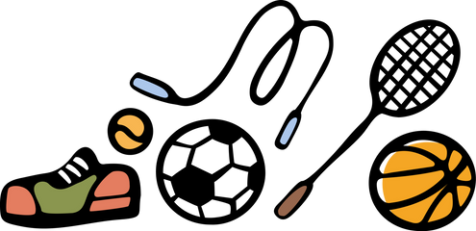




III. EXERCISES:
7. What is your favorite subject? Circle the correct answer:
maths
music
music
PE
english
english IT
history
science
music
geography
vietnamese

Slide 13
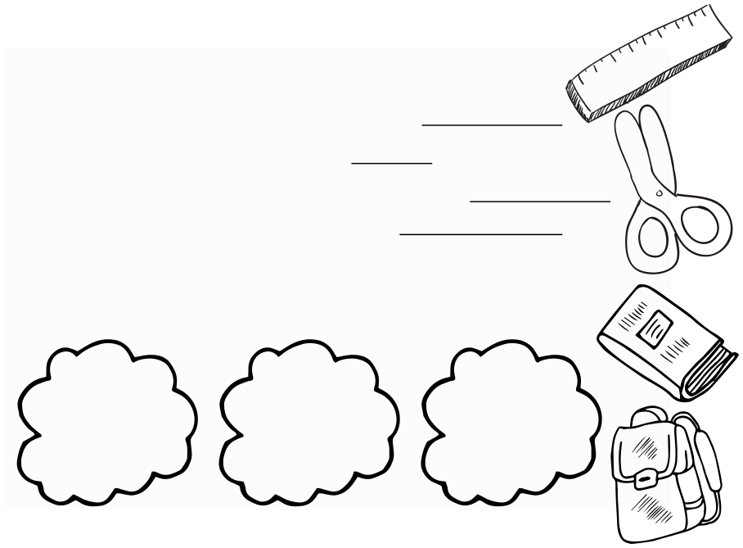
III. EXERCISES:
8. Interview your friend and write down:
His/Her name is
She/He
years old.
The birthday is on
He/She from
.
hobby:
favorite food:
bestfriend:

