Slide 1


Slide 2
A PROPOSAL
AGAINST CYBERBULLYING
Unit
9
SOCIAL ISSUES
Unit
FAMILY LIFE
LESSON 7
COMMUNICATION AND CULTURE / CLIL
@#&!*
EW
YOU CAN'T

Slide 3
LESSON 7
COMMUNICATION AND CULTURE / CLIL
Mini game
WARM-UP
Task 1: Listen and complete the
conversation with the expressions in the box.
Task 2: Use the model in 1 to make similar conversations for these situations. Use the expressions to help you.
EVERYDAY ENGLISH
Task 1: Read the text and match each
percentage in the chart with ONE social problem mentioned in the text.
Task 2: Work in pairs. Discuss the questions.
CLIL
EXTRA ACTIVITY
CONSOLIDATION
Wrap-up
Homework

Slide 4

WARM-UP
Students work in 4 groups.
You will hear and find if 4 speakers below express positivity or negativity.
Raise your hands to get turn and answer.

Slide 5


Listen and find if 4 speakers below express positivity or negativity
1
2
3
4
Negativity
Positivity

Slide 6


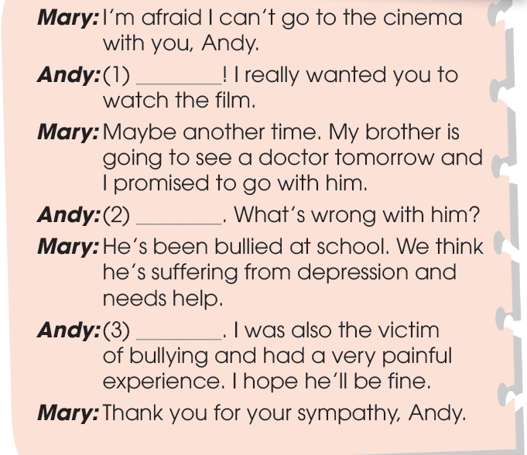
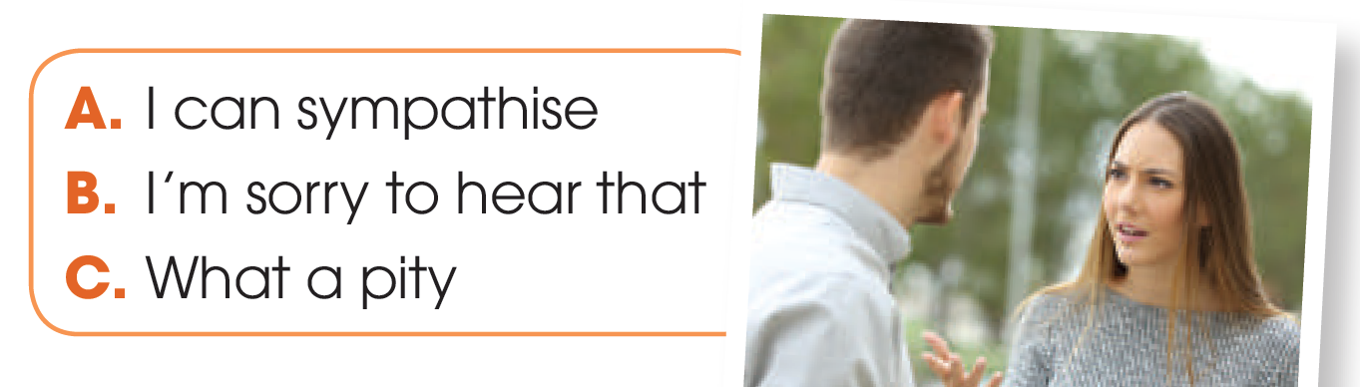

EVERYDAY ENGLISH
1
Listen and complete the conversation with the expressions
C
B
A

Slide 7
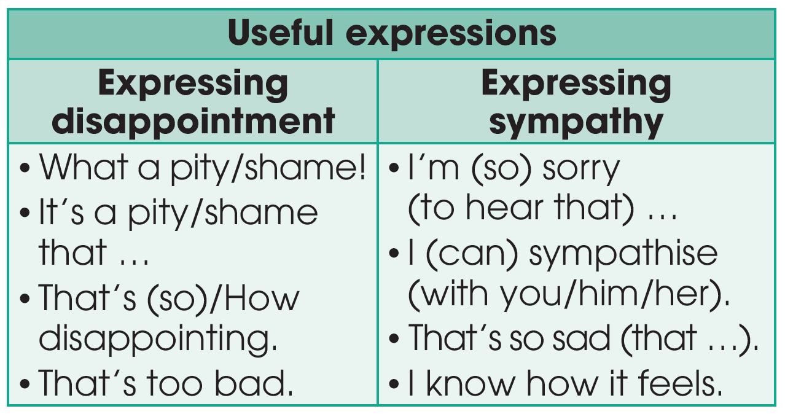
EVERYDAY ENGLISH

Slide 8
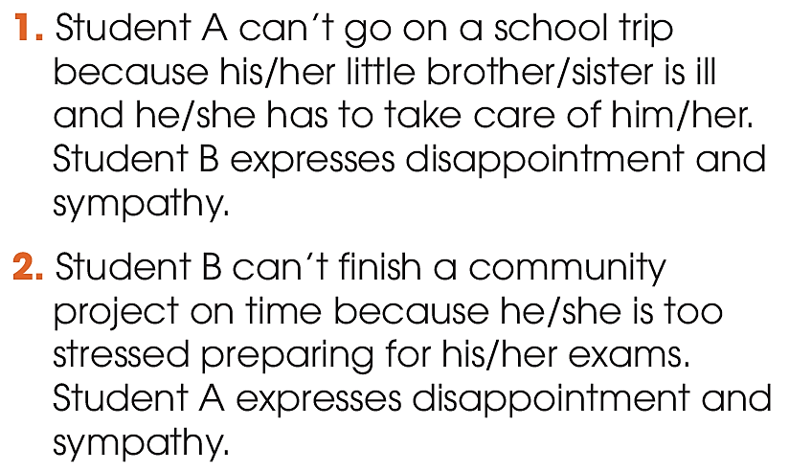

EVERYDAY ENGLISH
2
Work in pairs. Use the model in 1 to make similar conversations for these situations. One of you is Student A, the other is Student B. Use the expressions to help you.

Slide 9
EVERYDAY ENGLISH
SAMPLE CONVERSATIONS
A: I don’t think I’ll be able to finish the community project on time.
B: That’s too bad! And you don’t look so well today. Is everything OK?
A: Not really. I’m so stressed about the exams next week so I don’t have time for the project. I can’t sleep well either.
B: I can sympathize. Exams can be stressful. Try some sports to feel less stressed, and good luck with the exams.
A: Good idea. Thank you.

Slide 10
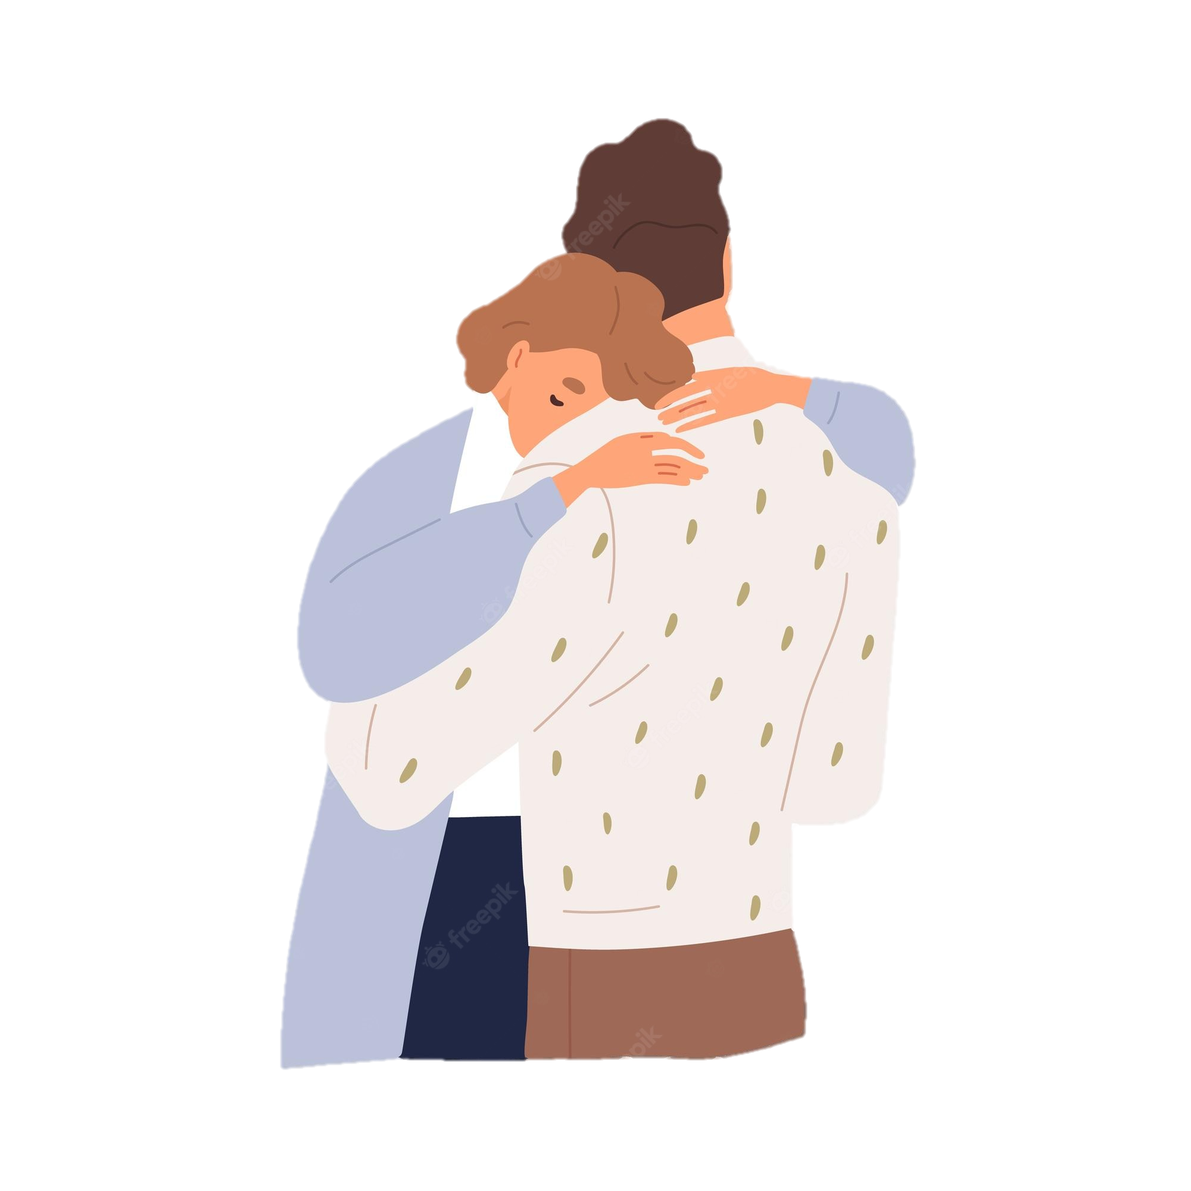
CLIL
Sympathy (n)
/ˈsɪm.pə.θi/
(an expression of) understanding and care for someone else's suffering

Slide 11
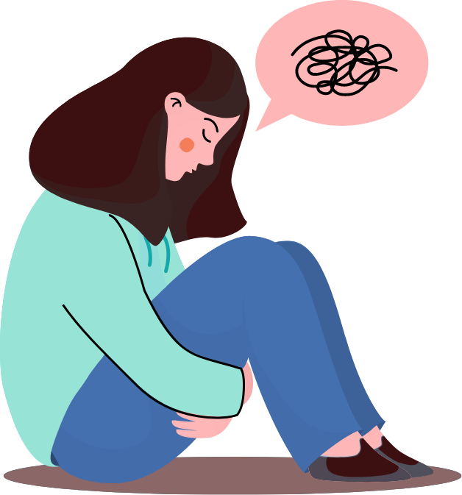
CLIL
Anxiety (n)
/æŋˈzaɪ.ə.ti/
an uncomfortable feeling of nervousness or worry about something that is happening or might happen in the future

Slide 12
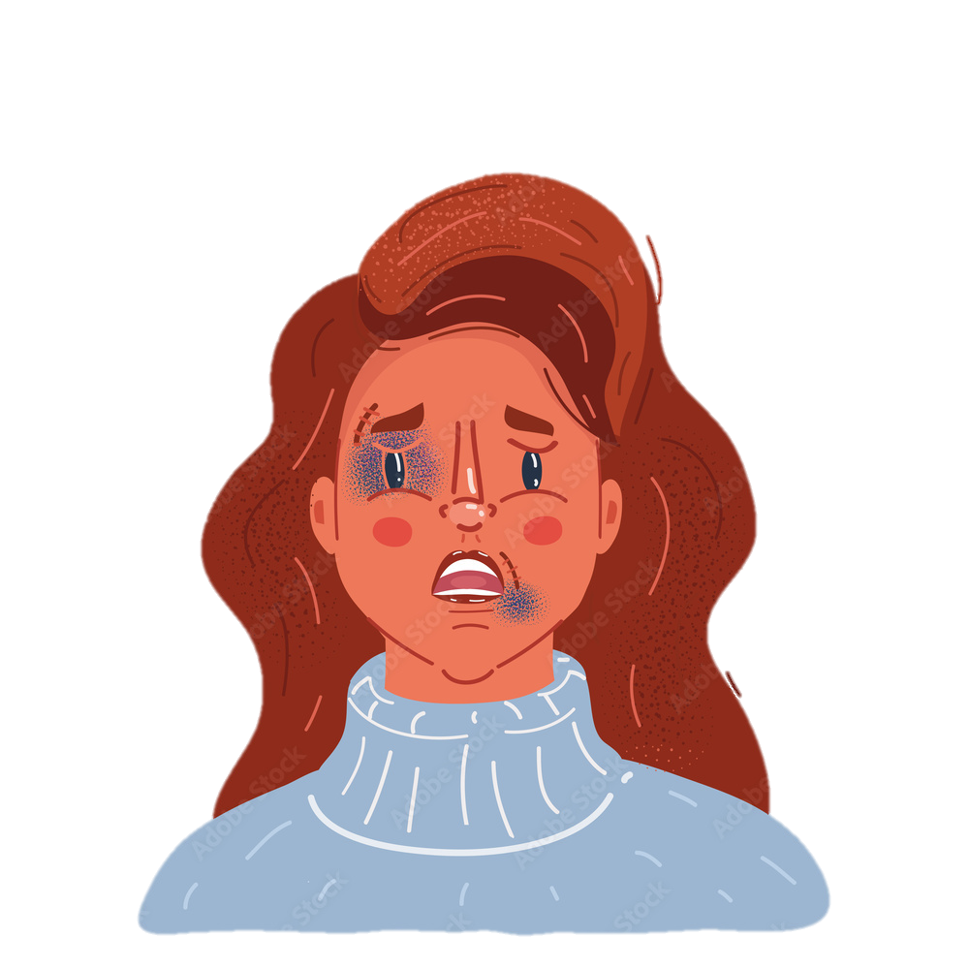
CLIL
Victim (n)
/ˈvɪk.tɪm/
someone or something that has been hurt, damaged, or killed or has suffered, either because of the actions of someone or something else, or because of illness or chance

Slide 13
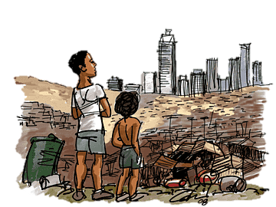
CLIL
The poverty line (n)
/ˈpɒv.ə.ti ˌlaɪn/
the official level of income that is needed to achieve a basic living standard with enough money for things such as food, clothing, and a place to live

Slide 14
CLIL
Form | Pronunciation | Meaning
1. Sympathy (n) | /ˈsɪm.pə.θi/ | (an expression of) understanding and care for someone else's suffering
2. Anxiety (n) | /æŋˈzaɪ.ə.ti/ | an uncomfortable feeling of nervousness or worry about something that is happening or might happen in the future
3. Victim (n) | /ˈvɪk.tɪm/ | someone or something that has been hurt, damaged, or killed or has suffered, either because of the actions of someone or something else, or because of illness or chance
4. The poverty line (n) | /ˈfɑː.mɪŋ/ | the official level of income that is needed to achieve a basic living standard with enough money for things such as food, clothing, and a place to live

Slide 15
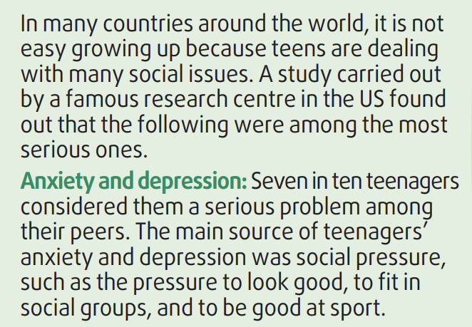
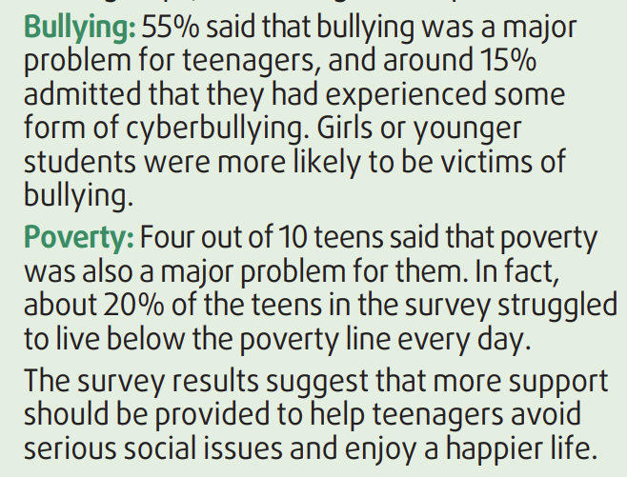
CLIL
1
Read the text and match each percentage in the chart with ONE social problem mentioned in the text.

Slide 16
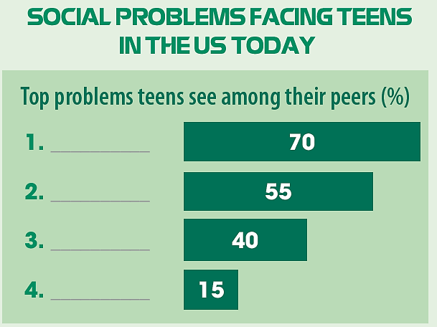
CLIL
1
Read the text and match each percentage in the chart with ONE social problem mentioned in the text.
Anxiety and depression
Bullying
Drug (addiction)
Poverty

Slide 17
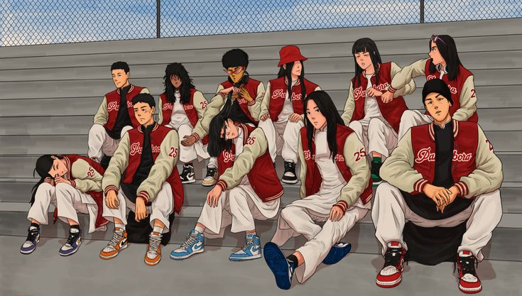
CLIL
2
Work in pairs. Discuss the following questions.
Are the problems mentioned in the text similar to those facing Vietnamese teens? Are there any other problems among teenagers in Viet Nam?

Slide 18
EXTRA ACTIVITY

Slide 19
01
WRAP-UP
CONSOLIDATION
@#&!*
What have you learnt today?
Express disappointment and sympathy.
Understand some of the social problems facing teens in the US today.
New Vocabularies.
YOU CAN'T

Slide 20
02
HOMEWORK
CONSOLIDATION
@#&!*
Do exercises in the workbook.
Prepare for Lesson 8 - Unit 9.
YOU CAN'T

Slide 21

Website: hoclieu.vn
Fanpage: facebook.com/sachmem.vn/

