Slide 1


Slide 2

Unit
9
NATURAL DISASTERS
Unit
ETHNIC GROUPS OF VIET NAM
LESSON 7: Looking back & Project
LESSON 3: A CLOSER LOOK 2
Vocabulary
Grammar
Project
Unit
HOBBIES

Slide 3
LESSON 7: Looking back & Project
WARM-UP
Mind map
Task 1: Write the name of a natural disaster in each blank.
Task 2: Fill in each blank with the correct form of the word in brackets.
VOCABULARY
Task 3: Put the verbs into the correct tense.
Task 4: Complete the sentences about you and your family members.
GRAMMAR
PROJECT
“What do we know about it?”
CONSOLIDATION
Wrap-up
Homework

Slide 4
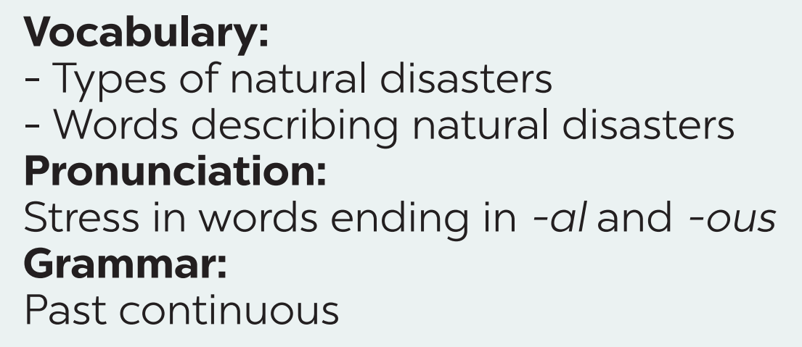

WARM-UP
Unit 9

Slide 5
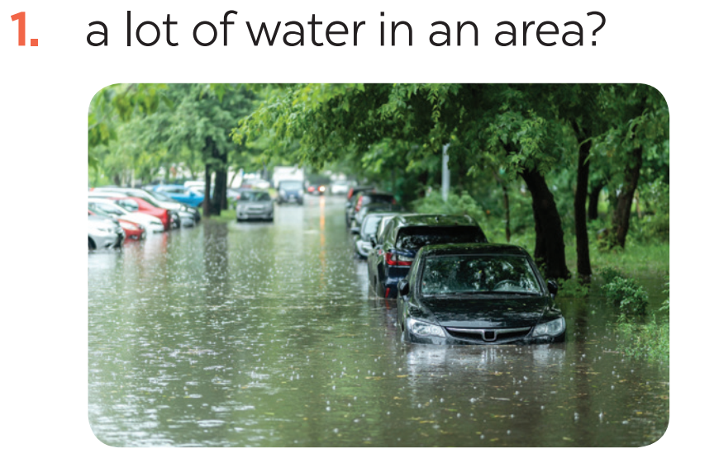
VOCABULARY
1
Write the name of a natural disaster in each blank.
flood

Slide 6
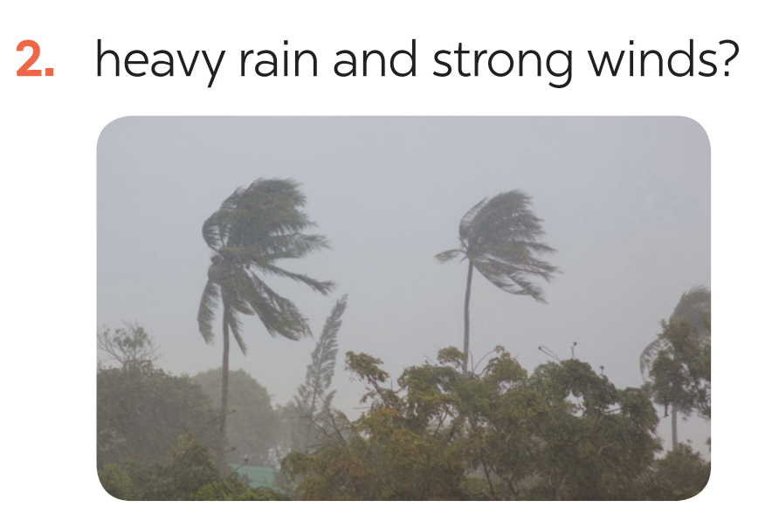
VOCABULARY
1
Write the name of a natural disaster in each blank.
storm

Slide 7
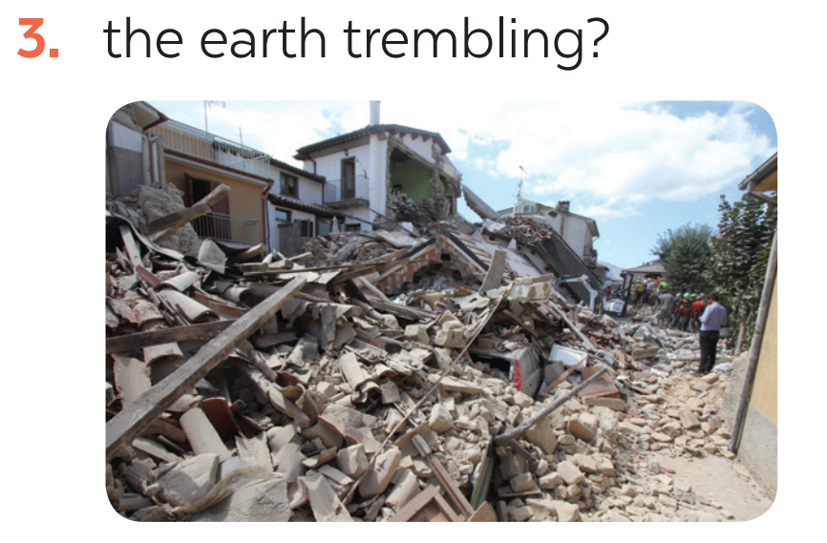
VOCABULARY
1
Write the name of a natural disaster in each blank.
earthquake

Slide 8
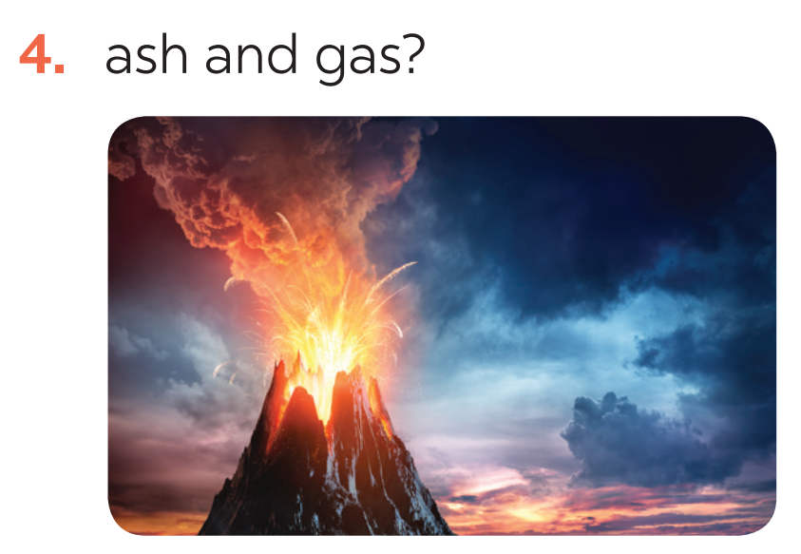
VOCABULARY
1
Write the name of a natural disaster in each blank.
volcanic eruption

Slide 9
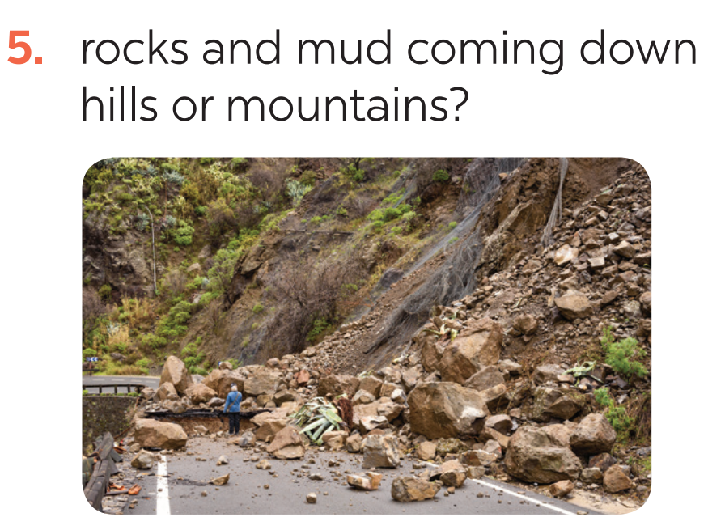
VOCABULARY
1
Write the name of a natural disaster in each blank.
landslide

Slide 10
VOCABULARY
2
Fill in each blank with the correct form of the word in brackets.
1. The tsunami brought __________ to cities and towns near the sea. (destroy)
2. The government has developed some systems to help make __________ about natural disasters. (predict)
3. We are donating money and food to help the ______ of the landslide. (victim)
4. The local authorities _______ the villagers about a landslide yesterday. (warning)
5. Rescue _______ are trying hard to save people in the flooded area. (work)
destruction
predictions
victims
warned
workers

Slide 11
GRAMMAR
3
Put the verbs into the correct tense: the past simple or past continuous.
1. What _____ you (do) _____ at 8 o’clock yesterday morning?
2. Last year, earthquakes (destroy) _________ a lot of houses in Japan.
3. He (water) ____________ the flowers in his garden when the tornado (come) _____.
4. While they (call) __________ for help, the rescue workers (appear) ________.
5. _______ you (listen) ________ to music at 9 o’clock yesterday evening?
were
doing
destroyed
was watering
came
were calling
appeared
Were
listening

Slide 12
GRAMMAR
4
Complete the sentences about you and your family members.
At 7 p.m. yesterday, …
1. I was ________________________________.
2. my grandmother / grandfather ____________.
3. my mother ____________________________.
4. my father _____________________________.
5. my sister / brother ______________________.

Slide 13
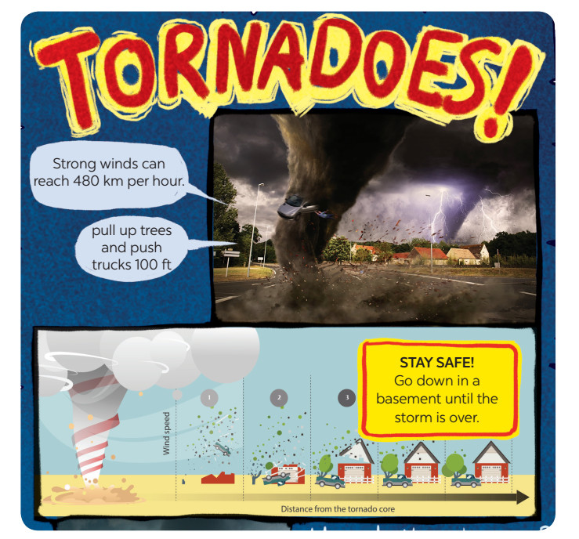
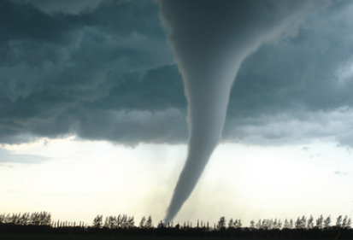
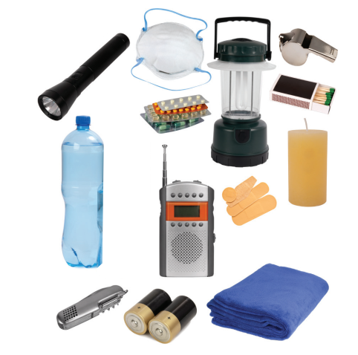
PROJECT

Slide 14

CONSOLIDATION
1
Wrap-up
In this lesson, you have:
revised more vocabulary items you have learnt in the unit.
revised the differences between the past simple and past continuous.
revised the past continuous.
researched more deeply into a natural disaster.

Slide 15

CONSOLIDATION
2
Homework
Do exercises in the workbook.
Prepare for Unit 10 – Getting started

Slide 16

Website: hoclieu.vn
Fanpage: facebook.com/tienganhglobalsuccess.vn/

