Slide 2


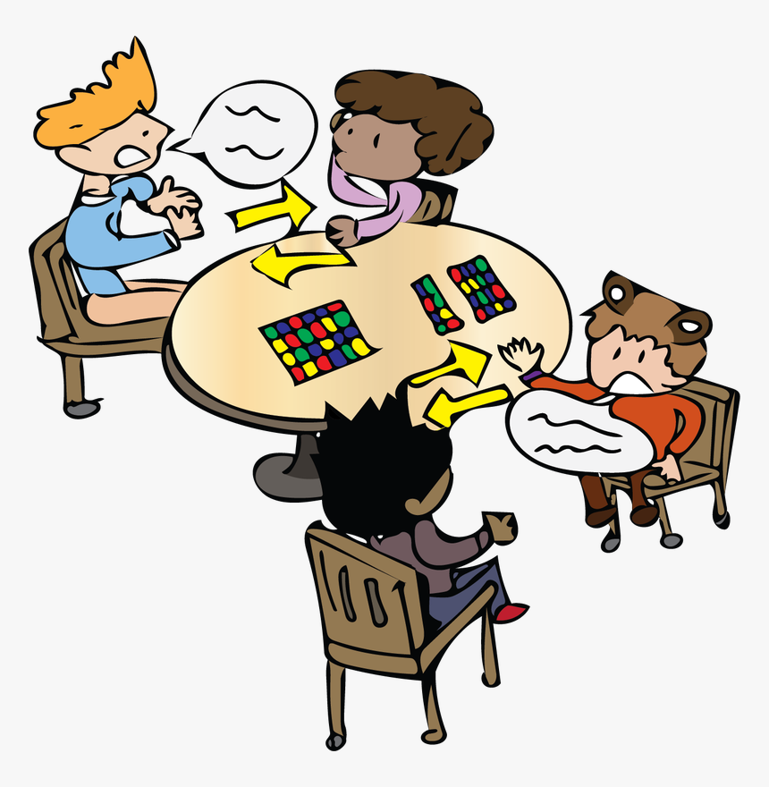
Unit
10
HOUSES IN THE FUTURE
LESSON 4: COMMUNICATION
1

Slide 3
LESSON 4: COMMUNICATION
LESSON 1: GETTING STARTED
WARM-UP
Game: BINGO: Household appliances
EVERYDAY ENGLISH
● How to express surprises
● Task 1: listen and read the conversation. Highlight the expressions.
PRACTICE
● Task 2: Pair work: Practice
→ Contest: The acting queen/ king
● Task 3: Read the survey and tick (Ex. 3 – p. 43)
→Pairwork: Ask and answer (take note)
● Task 4: Mini presentation: tell the class about their partners’ future houses, using the notes that have been written.
SURVEY
CONSOLIDATION
Wrap-up
Homework

Slide 4
WARM-UP
Make a table
Fill out with household appliances.
WASHING
MACHINE
DISH
WASHER
SMART TV
BINGO
…

Slide 5
EVERYDAY ENGLISH
1
1
Listen and read the conversation.
DAVID | John! Hello!
JOHN | Oh, hi, David. Wow! Is that your computer? It looks great.
DAVID | Yes, it’s my new computer. My parents gave it to me for my birthday.
Oh, hi, David. Wow! Is that your computer? It looks great.
Point out the expressing surprise
Wow! Is that + object?
It looks + adjective.

Slide 6



EVERYDAY ENGLISH
2
Work in pair. Express your surprise when you see your partner’s new watch, TV, mobile phone, etc.
Work in pairs.
3 mins
Express your surprise when you see your partner’s new watch, TV, mobile phone, etc.
Student A
Show new things
take turns
Student B
Express surprise

Slide 7
SURVEY
3
Read the questions in the class survey below. Tick (√) Y (Yes) or N (No).
No | Questions | Y | N
1 | Will you live in a hi-tech house?
2 | Will your house be in space?
3 | Will you have a lot of trees and flowers around your house?
4 | Will you have a fridge that can cook your meals?
5 | Will you have a robot that can look after your children?
6 | Will you have a car that can fly

Slide 8

SURVEY
4
Work in pair. Use the questions in Ex 3 to interview your partner.
Example
You | Hi, Nam. Will you live in a hi-tech house in the future?
Nam | Yes, I will.
You | Will your house be in space?
Nam | Oh, no. It won’t.
You | So where will it be?
Nam | I’m not sure. It might be by the sea.

Slide 9
SURVEY
5
Tell the class about your interview.
Hello. I’d like to tell you about Nam’s house and appliances that will help him to do things in his house… His future house will be a UFO. It’ll be in space. He might have a robot to help him with his home. Thank you for listening.
Checking
Is the pronunciation correct?
Is the tense correct?
Is it full of ideas?

Slide 10

CONSOLIDATION
1
Wrap-up
What have we learnt in this lesson?
Everyday English: Express surprise
Make a survey

Slide 11

CONSOLIDATION
2
Homework
Do exercises Part C in your Workbook.

Slide 12






Website: hoclieu.vn
Fanpage: facebook.com/www.tienganhglobalsuccess.vn/

