Slide 1


Slide 2
Unit
8
BECOMING INDEPENDENT
Unit
FAMILY LIFE
LESSON 4
SPEAKING
Learning basic life skills

Slide 3
LESSON 4
SPEAKING
WARM-UP
Watch a video
PRE-SPEAKING
Task 1. Work in pairs. Discuss these questions.
Task 2. Underline the correct answers.
Task 3. Practice giving instructions
Task 4. Take turns demonstrating the skill and giving instructions
WHILE-SPEAKING
POST-SPEAKING
Further practice
Wrap-up
Homework
CONSOLIDATION

Slide 4
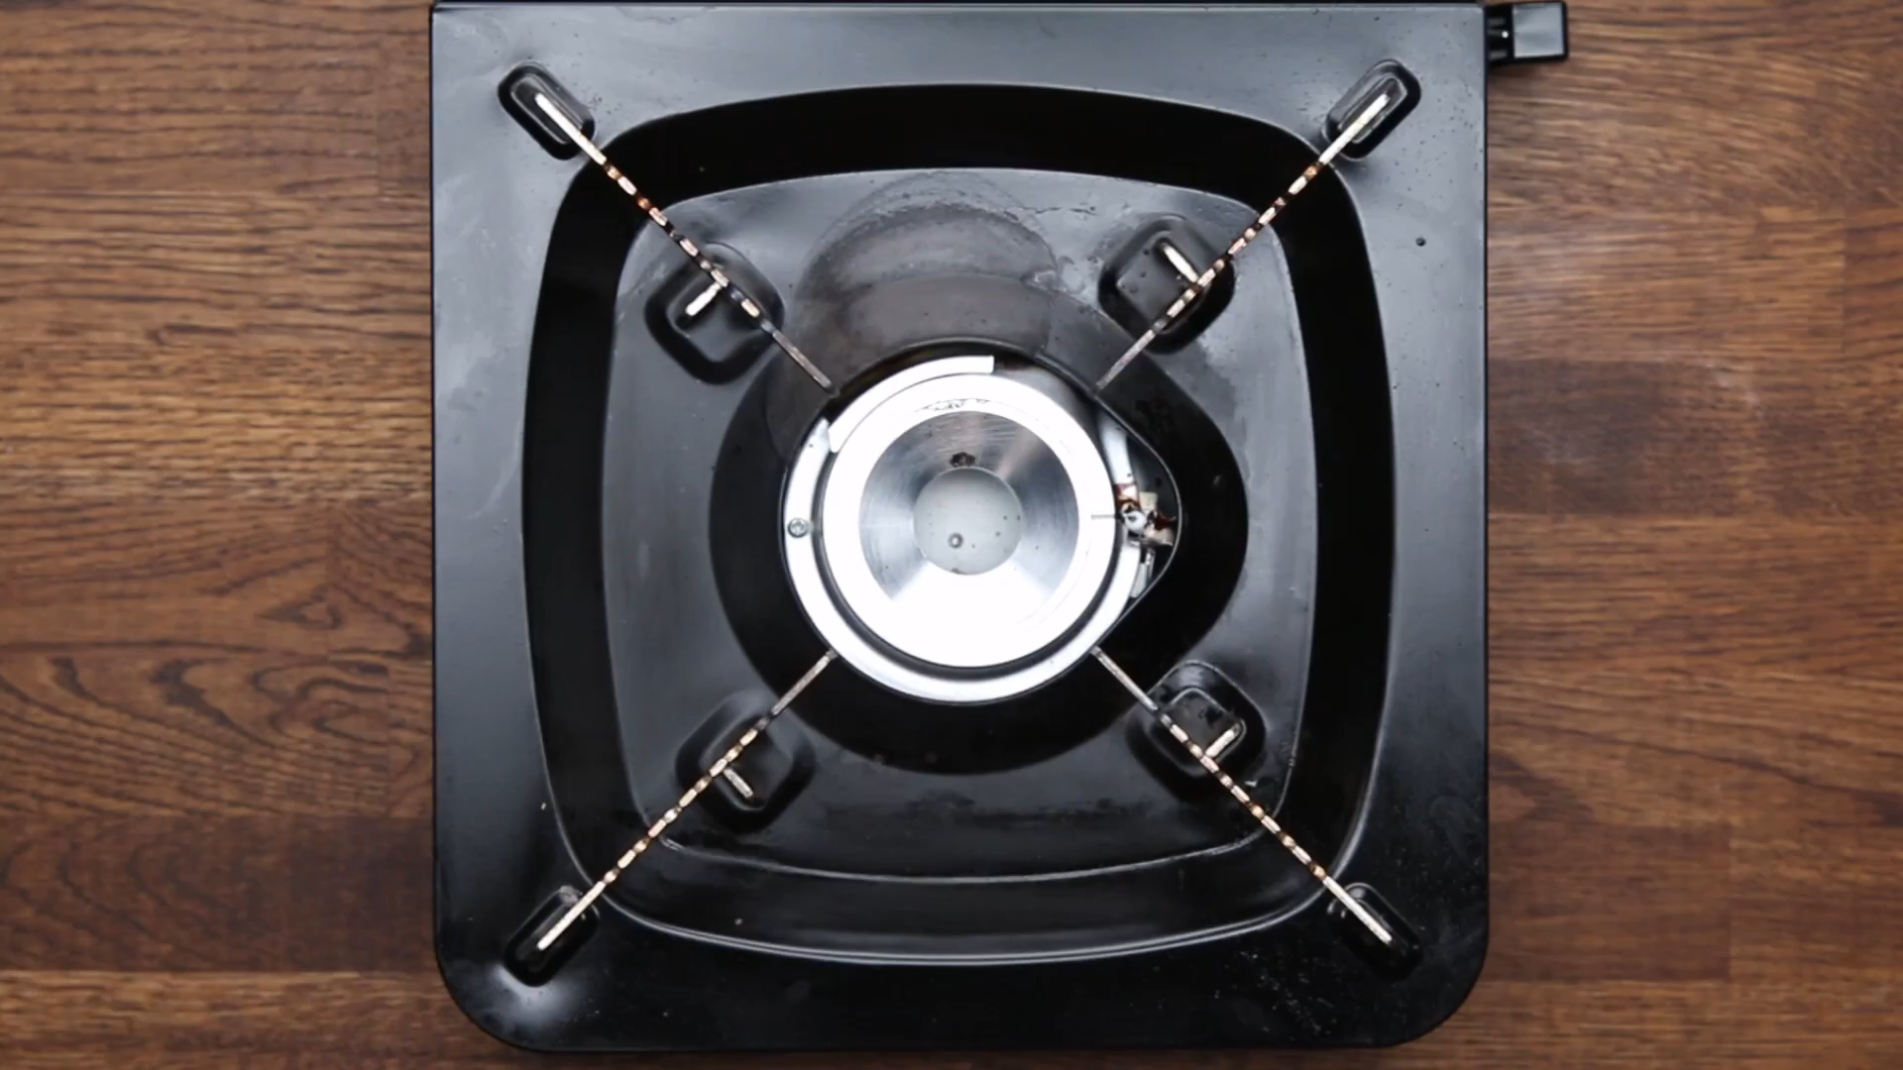
WARM-UP
WATCH A VIDEO

Slide 5
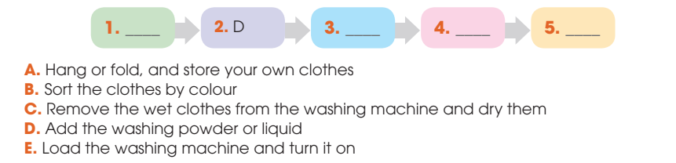
PRE-SPEAKING
1
Work in pairs. Discuss these questions.
B
E
C
A

Slide 6
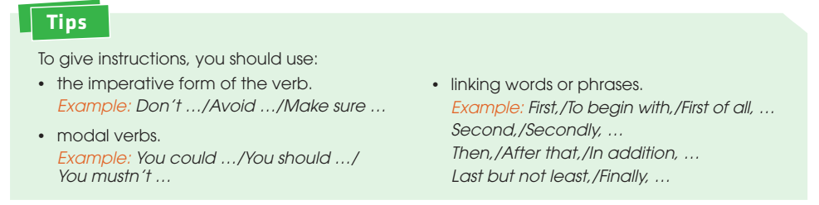
PRE-SPEAKING
Tips to give instructions:

Slide 7
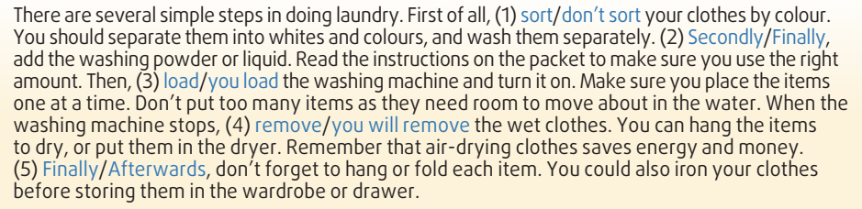
WHILE-SPEAKING
2
Read the following instructions on how to do laundry. Underline the correct answers.

Slide 8
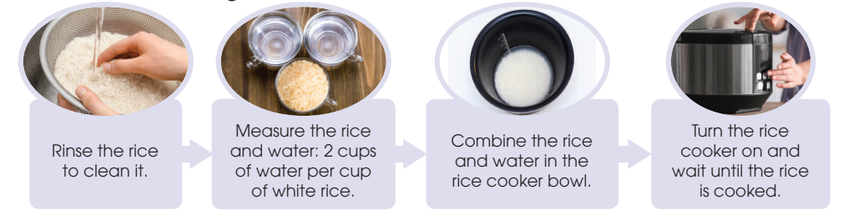
WHILE-SPEAKING
3
Work in pairs. Read the steps in cooking rice in a rice cooker. Use the model in 2 and the tips above to give instructions.

Slide 9
WHILE-SPEAKING
4
Work in groups. Add more steps or tips, and report to the whole class. Vote for the best recipe for cooking rice in a rice cooker.

Slide 10
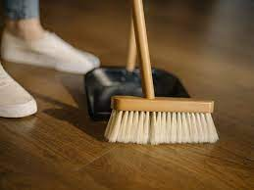

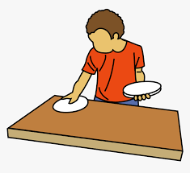
POST-SPEAKING
FURTHER PRACTICE
- Work in pairs and come up with instructions for another life skill.
- Demonstrate your skill in front of the class and give instructions.

Slide 11
CONSOLIDATION
1
Wrap-up
What have you learnt today?
How to give instructions on a basic life skill.

Slide 12
CONSOLIDATION
2
Homework
Do exercises in the workbook.
Prepare for Lesson 5 - Unit 8.

Slide 13

Website: hoclieu.vn
Fanpage: facebook.com/sachmem.vn/

