Slide 1


Slide 2



REVIEW
2
LESSON 2: SKILLS
Reading
UNITS
4-5-6
Speaking
Listening
Unit
HOBBIES
Writing

Slide 3

OBJECTIVES
By the end of the lesson, students will have revised the skills practised in Units 4 – 6.

Slide 4
LESSON 2: SKILLS
WARM-UP
What kind of music?
READING
Task 1: Choose the appropriate option (A, B, or C) to fill in each gap of the paragraph.
Task 2: Work in pairs. Ask and answer the questions, using the suggestions.
SPEAKING
Task 3: Listen and tick the adjectives you hear.
Task 4: Listen again and fill in each gap with ONE word.
LISTENING
WRITING
Task 5: Write a paragraph of about 60 words about a meal you had at a restaurant.
CONSOLIDATION
Wrap-up
Homework

Slide 5

LESSON 2: SKILLS
WARM-UP
What kind of music?
Aims of the stage:
to lead in the lesson

Slide 6


WARM-UP
COUNTRY MUSIC

Slide 7


WARM-UP
CLASSICAL MUSIC

Slide 8

WARM-UP
ROCK MUSIC

Slide 9

WARM-UP
HIP HOP MUSIC

Slide 10

WARM-UP
POP MUSIC

Slide 11
LESSON 2: SKILLS
WARM-UP
What kind of music?
READING
Task 1: Choose the appropriate option (A, B, or C) to fill in each gap of the paragraph.

Slide 12
READING
1
Choose one appropriate option (A, B, or C) to fill in each gap of the paragraph.
What kind of music do you enjoy? Some people like going to (1) ______ concerts or listening to an orchestra. The musicians wear very formal clothes, and the audience is silent until the end of the (2) ______. If you are a fan of rock music, you can dance to the music or sing some rock songs at football stadiums or in parks.
(3) ______ music is often played at weddings and parties in many countries. Nowadays, we can (4) ______ to music in shops and lifts. Teenagers even listen to music when they (5) ______. Music is everywhere!
1. A. classic B. class C. classical
2. A. performance B. orchestra C. band
3. A. Historical B. Traditional C. National
4. A. hear B. have C. listen
5. A. study B. do C. go

Slide 13
LESSON 2: SKILLS
WARM-UP
What kind of music?
READING
Task 1: Choose the appropriate option (A, B, or C) to fill in each gap of the paragraph.
Task 2: Work in pairs. Ask and answer the questions, using the suggestions.
SPEAKING
Task 3: Listen and tick the adjectives you hear.
Task 4: Listen again and fill in each gap with ONE word.
LISTENING

Slide 14

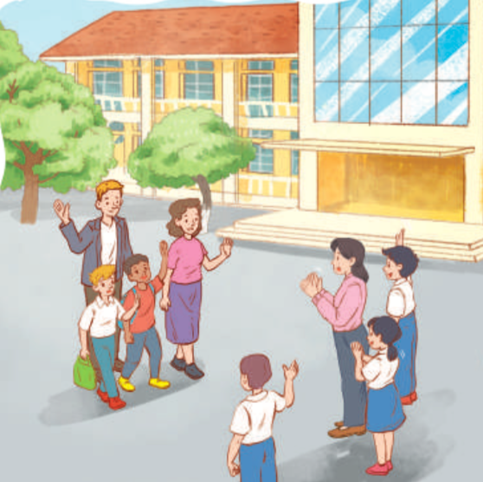
SPEAKING
2
Work in pairs. Imagine you have just visited a lower secondary school. Ask and answer the questions, using the following suggestions.
1. Where the school is.
2. How many teachers and students there are.
3. What school facilities are.
4. What school outdoor activities students do.

Slide 15
LESSON 2: SKILLS
WARM-UP
What kind of music?
READING
Task 1: Choose the appropriate option (A, B, or C) to fill in each gap of the paragraph.
Task 2: Work in pairs. Ask and answer the questions, using the suggestions.
SPEAKING
Task 3: Listen and tick the adjectives you hear.
Task 4: Listen again and fill in each gap with ONE word.
LISTENING

Slide 16

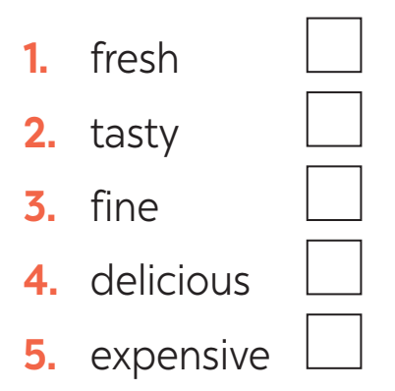
LISTENING
3
Listen to a man talking about his meal at a restaurant and tick the adjectives you hear.

Slide 17
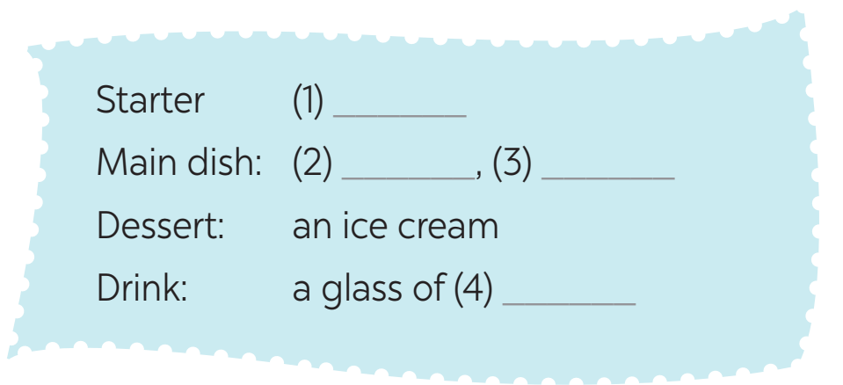
LISTENING
4
Listen again and fill in the gap with ONE word.
salad
fish
vegetables
juice

Slide 18
LESSON 2: SKILLS
WARM-UP
What kind of music?
READING
Task 1: Choose the appropriate option (A, B, or C) to fill in each gap of the paragraph.
Task 2: Work in pairs. Ask and answer the questions, using the suggestions.
SPEAKING
Task 3: Listen and tick the adjectives you hear.
Task 4: Listen again and fill in each gap with ONE word.
LISTENING
WRITING
Task 5: Write a paragraph of about 60 words about a meal you had at a restaurant.

Slide 19
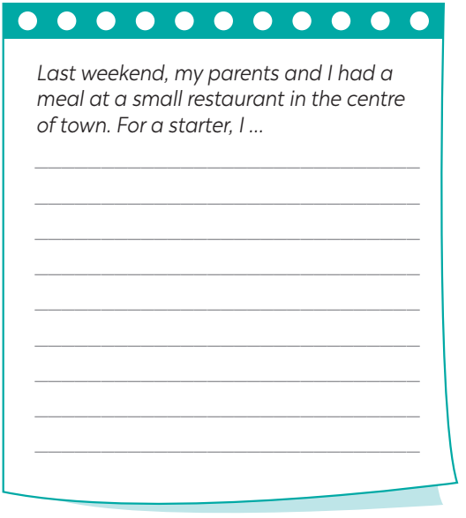
WRITING
5
Write a paragraph of about 60 words about a meal you had at a restaurant.
Suggested paragraph:
… For a starter, I had salad. It was fresh. My main dish was fish. I really enjoyed the spices in it. The vegetables were good, very fresh and tasty. For dessert, I had an ice cream. It’s usually delicious but this time it wasn’t very sweet. So, I didn’t eat much. Then I had a glass of juice. I think the meal was OK.

Slide 20
LESSON 2: SKILLS
WARM-UP
What kind of music?
READING
Task 1: Choose the appropriate option (A, B, or C) to fill in each gap of the paragraph.
Task 2: Work in pairs. Ask and answer the questions, using the suggestions.
SPEAKING
Task 3: Listen and tick the adjectives you hear.
Task 4: Listen again and fill in each gap with ONE word.
LISTENING
WRITING
Task 5: Write a paragraph of about 60 words about a meal you had at a restaurant.
CONSOLIDATION
Wrap-up
Homework

Slide 21
CONSOLIDATION
1
WRAP-UP
Reading
UNITS
4-5-6
Speaking
Listening
Writing

Slide 22

CONSOLIDATION
2
HOMEWORK
Prepare for Unit 7 – Getting started

Slide 23

Website: hoclieu.vn
Fanpage: facebook.com/www.tienganhglobalsuccess.vn/

