Slide 1

UNIT 7: INVENTIONS
Lesson 3.2 – Writing and Speaking
Page 63

Slide 2




Lesson 3.2
LESSON OUTLINE
Consolidation

Slide 3

By the end of this lesson,
students will be able to …
write an opinion essay, using conjunctions to give examples.

Slide 4



Slide 5

Work in pairs.
Talk about advantages and disadvantages of the internet.

Slide 6



Slide 7
a. Read about using conjunctions to give examples, then read Tâm's essay again and answer the questions.
Pre-writing
In Tâm's opinion, in which two ways has the internet changed our lives?
2. What examples did she give to support her opinions in the third paragraph?
the way we communicate and work
working from home and working with people from other countries

Slide 8
Writing skill
Using conjunctions to give examples
To give examples, you should use words like for example and such as.
For example can be used at the beginning of a sentence, followed by a comma:
Computers are used in other inventions. For example, computers are used to make ﬂying easier.

Slide 9
For example can be used in the middle of a sentence, separated by commas:
Computers are used in other inventions, for example, airplanes and cars.
Such as is only used in the middle of a sentence with a comma before such as and a comma after the examples.
Computers are used in other inventions, such as airplanes and cars, to make them better

Slide 10
b. Fill in the blanks with for example or such as
While-writing
1. The invention of cars gave people more freedom. ____________, people didn't need to live close to work anymore.
2. Many inventions, ____________, the light bulb and the computer, changed society.
3. Engines are used in many vehicles, ____________ boats, trains, and cars.
for example
for example
such as

Slide 11
4. The invention of airplanes brought the world closer together. ____________, you can ﬂy to a city half way across the world in less than 24 hours.
5. We can do many things, ____________ making phone calls, sending emails, and taking photos with a smartphone.
For example
such as

Slide 12
Extra Practice
WB, page 43
Fill in the blanks with for example or such as.
1. Social media, _____________ Post Now! and Chatty Cats, helps people keep in touch with friends.
2. Many modern inventions use electricity. _____________, computers, light bulbs, and smartphones all need electricity to work.
3. A vending machine contains food and drinks, _____________, chips, candy, and soda.
such as
For example
such as

Slide 13
4. Thanks to the invention of vaccines, people now can get treatment for many diseases,_____________ measles, rubella, and inﬂuenza.
5. Many people nowadays still prefer using TV for some certain kinds of information._____________, they can watch news broadcasts
and live sports on TV.
for example
For example

Slide 14

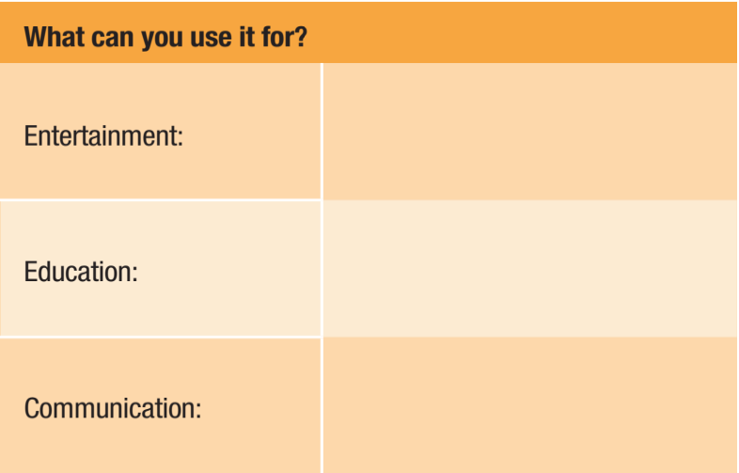
Make notes about why the tablet is an important invention and how you can use it in the following categories.
watching movies, playing games
finding information for homework, looking at history, science videos, reading books
chatting on social media, video calls

Slide 15


Now, use your notes to write an essay about the tablet. Write 120 to 150 words.

Slide 16
Sample answer:
I think the tablet is probably the most important invention of modern times because it has changed our lives in many ways.
I can use my tablet for entertainment purposes, such as watching movies or playing games. It is big enough to watch something with my friends, so we don't need to watch TV at home. We can watch a movie anywhere. It is not heavy, and I can carry it in my bag.

Slide 17
Tablets are great for education as well. For example, I use my tablet when I want to find out information for my homework. I can also look at videos about history or science. I can use my tablet to read books, too.
Tablets are very good for communication purposes, for example, chatting on social media and making video calls. It is very useful to talk to people overseas, such as my cousins in Australia.
Tablets help us in many ways, and that is why I think they are the most important invention.

Slide 18



Slide 19
Work in pairs.
a. You're discussing useful inventions. Talk about the inventions that you use every day.
I often use my laptop to do exercises, and surf the internet.
I use my smart phone to study online, and call my grandpa.

Slide 20

Consolidation

Slide 21
Work in pairs.
b. Choose an invention and think of examples of how it helps make your life easier or more interesting. Ask and answer the questions below and fill in the table.

Slide 22


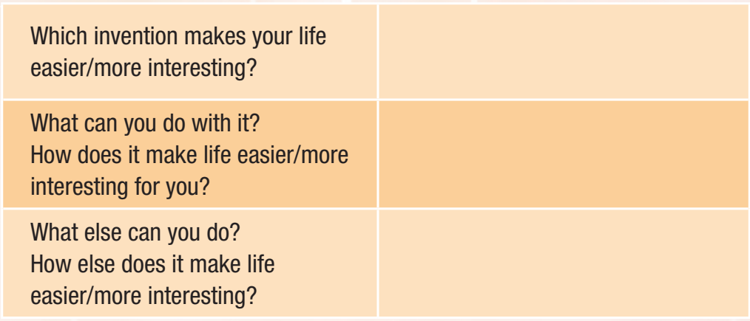
Work in pairs.
A smartphone
Listen to music, surf the internet
Connect to my relatives
It makes our relationship be closer

Slide 23

WRAP-UP

Slide 24
Today’s lesson
Writing: write an opinion essay, using conjunctions to give examples
Speaking: talk about useful inventions, and how they help our lives easier and more interesting

Slide 25


Write an essay in on page 63.
Complete the writing notes in Tiếng Anh 10 i-Learn Smart World Notebook on page 43.
Prepare the next lesson – Unit 8 in SB.
Play the consolidation games in Tiếng Anh 10 i-Learn Smart World DHA App on www.eduhome.com.vn

