Slide 1
Unit 8: Traditions of
Ethnic Groups in Vietnam
Lesson 2.1: Vocab & Listening
Pages 78 & 79

Slide 2
Lesson Outline
Warm-up
Vocabulary
Listening
Consolidation
Wrap-up

Slide 3
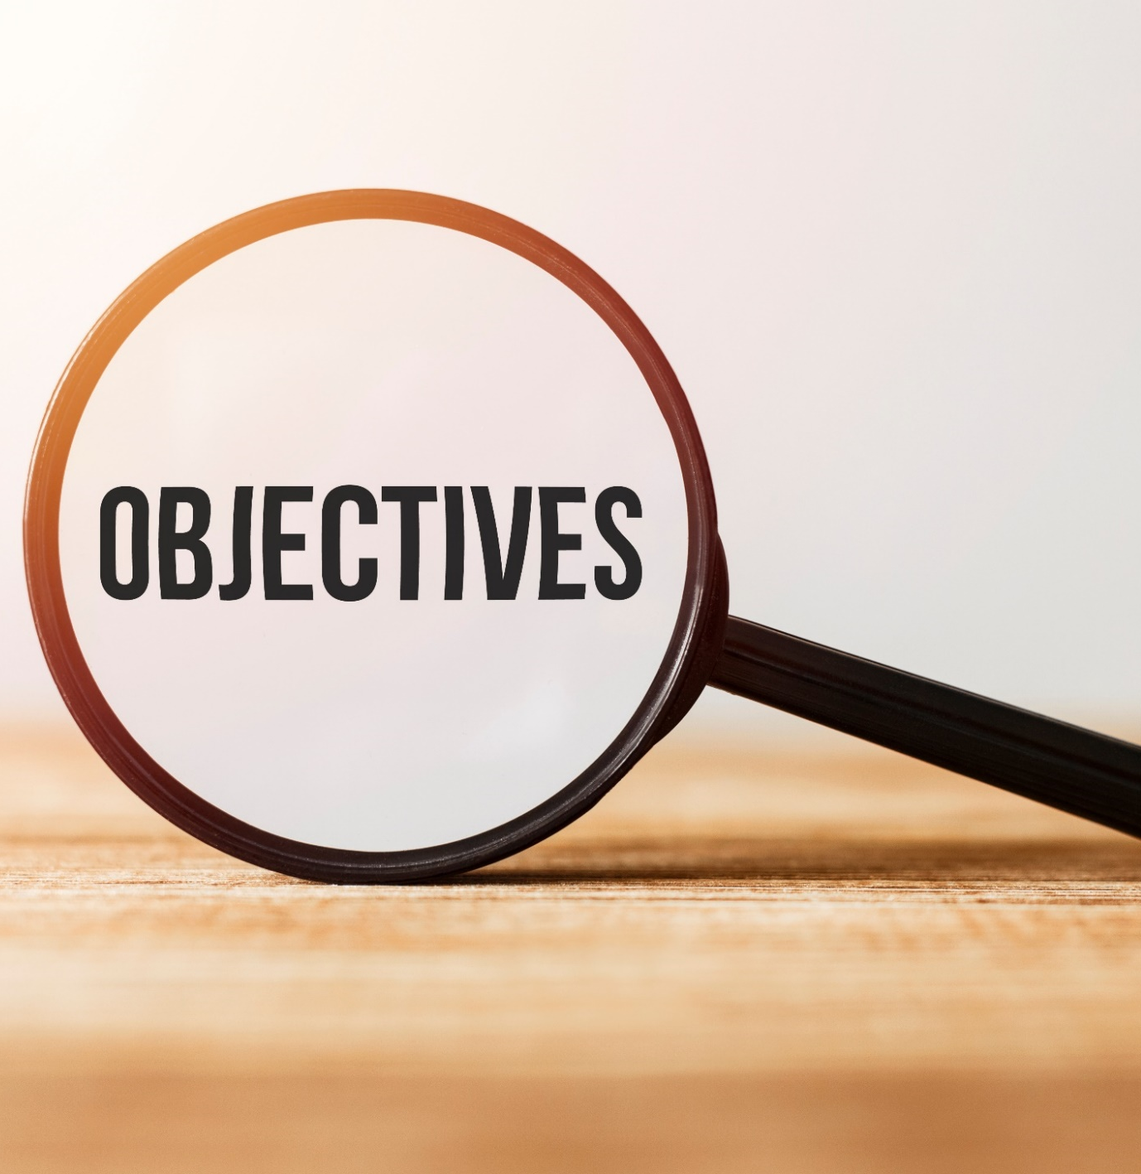
By the end of this lesson, students will be able to…
- learn and use vocabulary related to the topic
- practice listening for specific information
- practice functional English – showing interest to get more information

Slide 4
New words
blouse
apron
sticky rice
steamed
utensils
corn

Slide 5
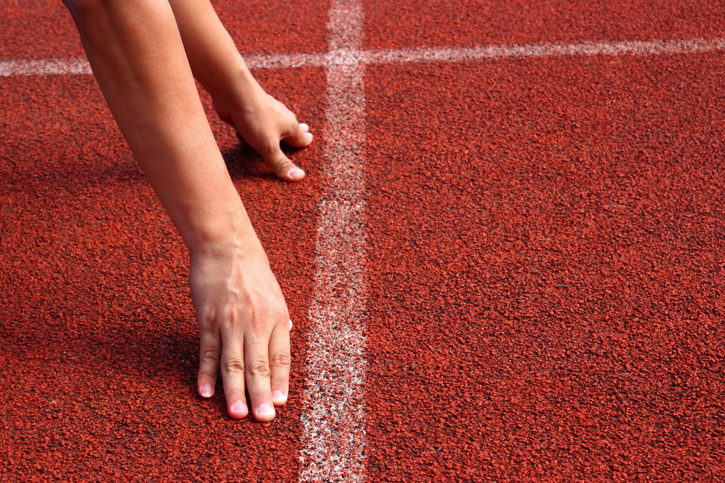
WARM UP

Slide 6
Work in pairs.
Let’s talk: Look at the picture
+ What kinds of food and crafts can you see?
+ Do you know which ethnic groups eat each food or make each craft?
+ What are some traditional kinds of food and crafts of your ethnic group?

Slide 7
Pre-listening

Slide 9
What can you see in each picture?

Slide 10
Match the words with the pictures.
1
2
3
New words
blouse
apron
sticky rice
steamed
utensils
corn
steamed
apron
sticky rice
4
5
6
corn
utensils
blouse

Slide 11
a. Look at the pictures and fill in the blanks. Listen and repeat.
utensils
sticy rice
apron
blouse
Corn

Slide 12
Practice saying these words with a partner.
Listen and repeat. Click on each word to hear the sound.
apron (n) /ˈeɪprən/ tạp dề
blouse (n) /blaʊs/ áo cánh, áo kiểu nữ
corn (n) /kɔːrn/ ngô, bắp
utensil (n) /juːˈtensl/ đồ dùng, dụng cụ dùng trong gia đình
sticky rice (n) /ˌstɪki ˈraɪs/ gạo nếp, xôi
steamed (adj) /stiːmd/ hấp

Slide 13
b. In pairs: Use the new words to talk about things you have or people do in your house.

Slide 14
Listening

Slide 15
Task a
Pre-listening
Read the instruction and the answers quickly:
Underline the key words.
What are we going to do?
Listen and choose the correct answer.
Listen to Sarah telling John about her vacation.
What does John think about her trip?
boring
interesting
scary

Slide 16
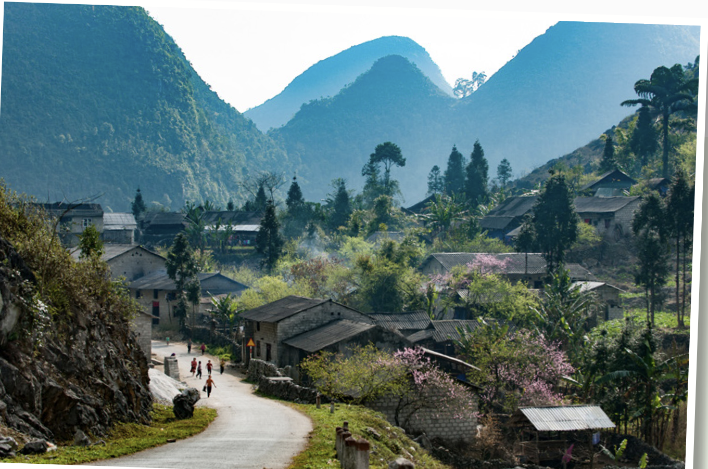
Task a
Listen and circle.
boring
interesting
scary

Slide 17
Task b
Pre-listening
Read the instruction and the answers quickly:
Underline the key words.
What are we going to do?
Listen circle the correct answer.
Listen and circle the correct answer
+ Scan and underline the key words in the question and in each option.

Slide 18
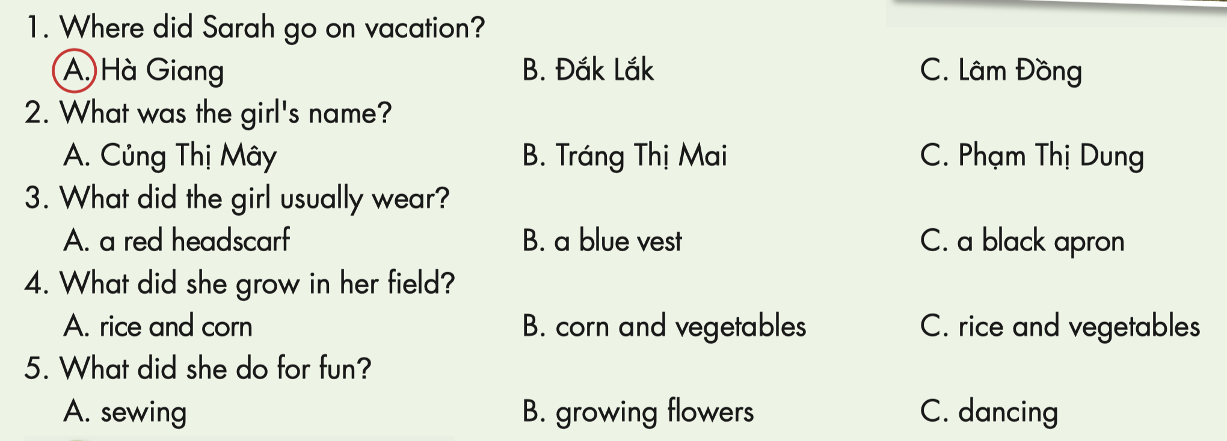
Task b
Now, listen and circle the correct answer.

Slide 19
Listen and fill in the blanks. Role-play the conversation
Sarah : Hey, John.
John : Hi, Sarah. Did you have a good 1)………………………………………………..?
Sarah : It was great. I went to Hà Giang in Vietnam.
John : Wow.
Sarah : Yeah. I met a really interesting
Pu Péo girl.
John : Pu Péo
Sarah : It’s a small 2) ………………………in Vietnam.
John : Oh, cool.
Sarah : I asked her what her name was. She said it was Tráng Thị Mai.
John : 3) ………………………………………………………….?
Sarah : I asked her what she usually wore
John : And?
Sarah : She said she usually wore Pu Péo
4) …………………..clothes. She was wearing a long blue skirt, a black vest, black 5) ……………….., and a purple 6) …………………………… .
John : That sounds pretty.
Sarah : Yeah. I also asked her what her family did and she told me what they 7 ) ……... in their field.
John : Oh?
Sarah : She said they grew 8) ………., ……….., and bean.
John : Interesting.
Sarah : Last, I asked her what she did for fun.
John : What did she say?
Sarah : She said she liked 9) ………………… .
John: I like sewing, too.
Sarah : I didn’t know that.
traditional
summer vacation
apron
headscarf
grew
corn
rice
ethnic group
What else did you ask her?
sewing

Slide 20
Post-listening

Slide 21
Task c
Read the Conversation Skill box. Then, listen and repeat.

Slide 22
Task d
Now, listen to the conversation again and number the phrases in the order you hear them.
2
1

Slide 23
Task e
Work in pairs
What was the most interesting you learned about the girl? What else would you like to learn about her? Why?
The most interesting thing was her clothes. I’d like to learn more about what she does every day because I think her life is very different.

Slide 24
CONSOLIDATION

Slide 25
Talk to your friend about your summer vacation last year. Answer the questions below.
+ Where did you go?
+ Who did you go with?
+ What did you see in the trip? (People, things, etc.)
+ Who did you meet on the trip?
+ How did you feel about the trip?

Slide 26
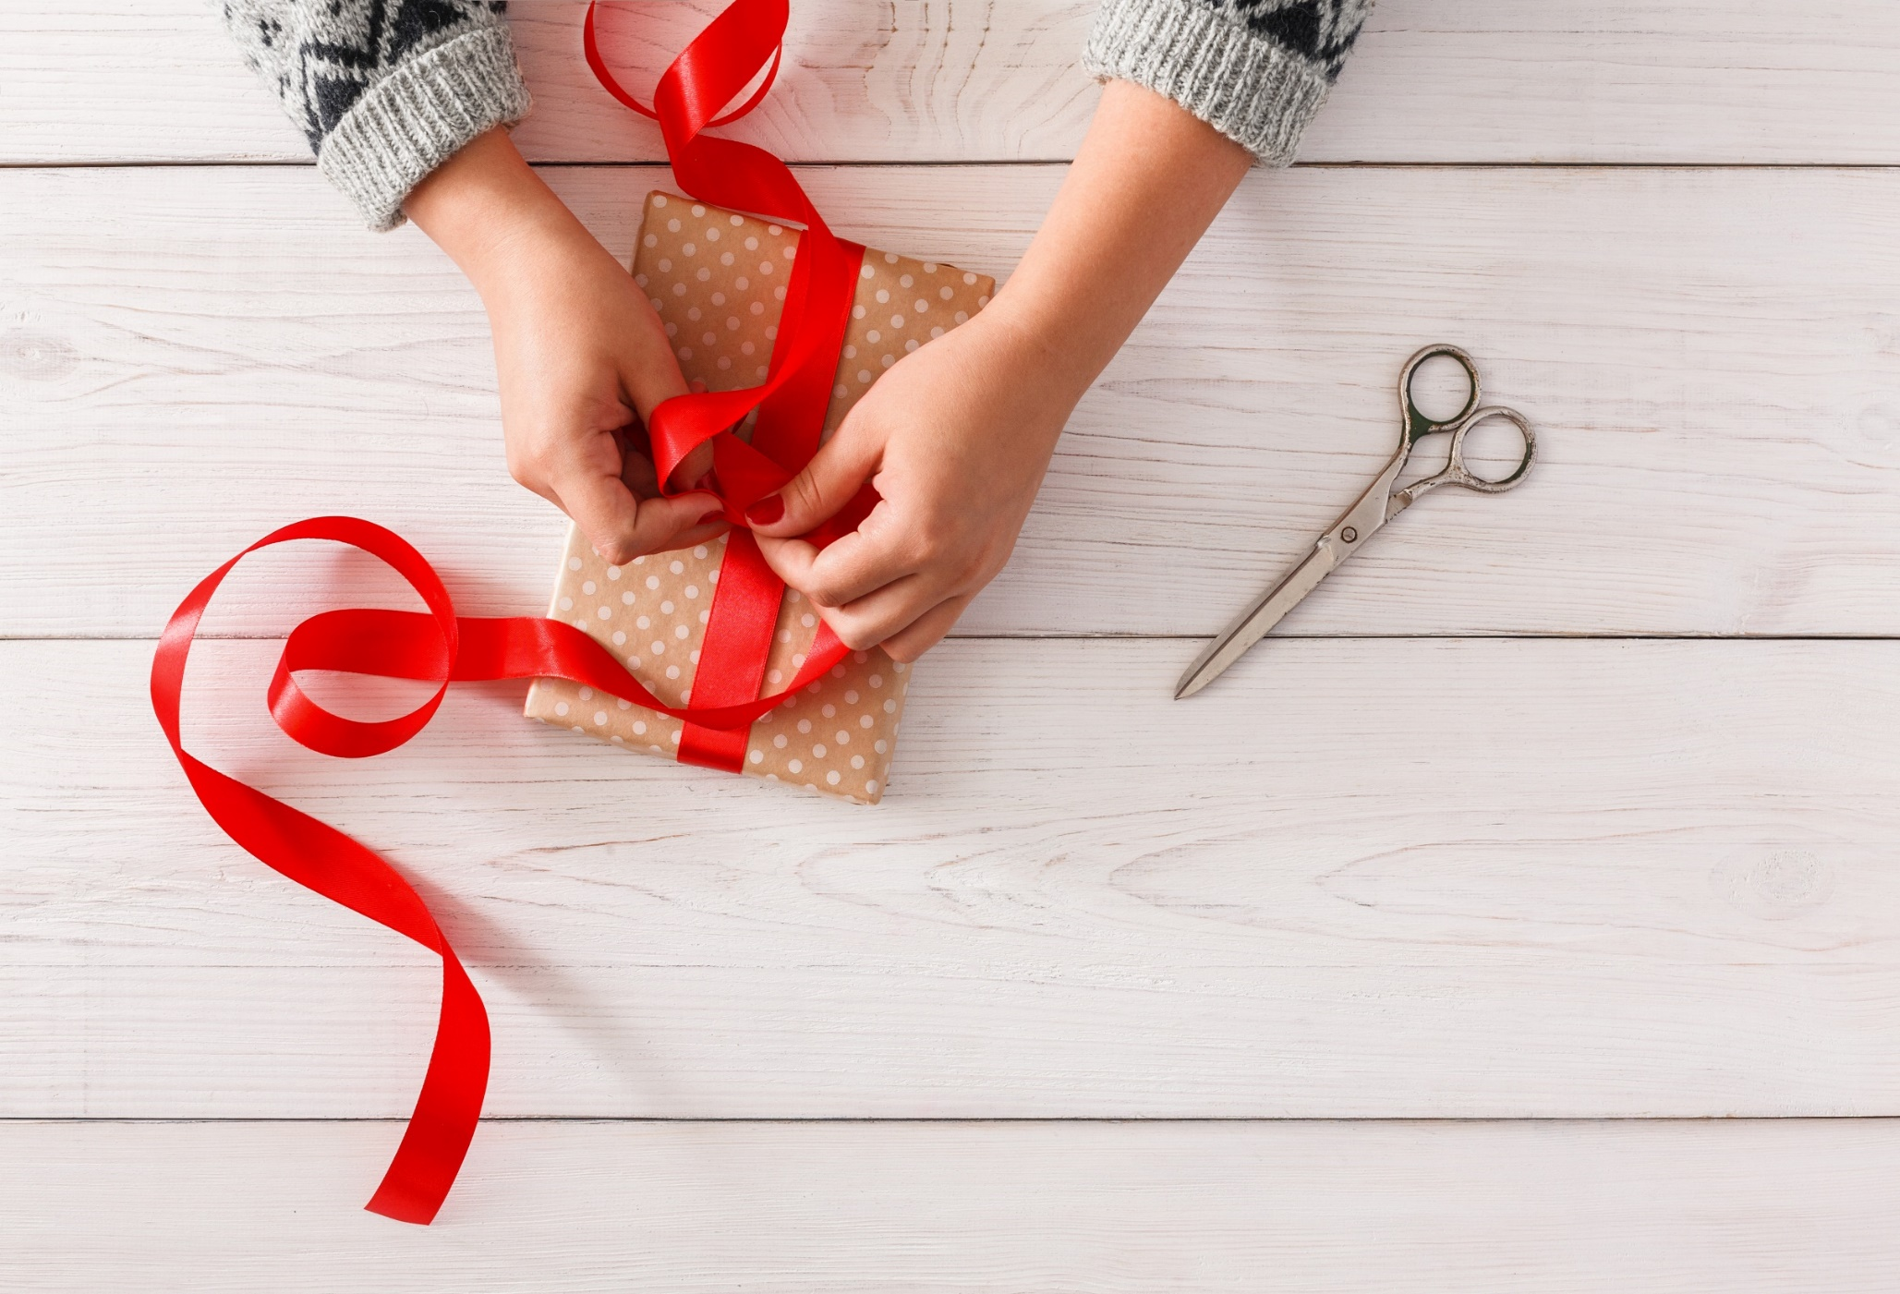
WRAP-UP

Slide 27
Today’s lesson
Vocabularies
steamed, apron, blouse, utensil, corn, sticky rice
Listening
Listening to a conversation and circle the correct answer
Speaking
Talking about a summer vacation

Slide 28
Homework
Learn by heart the new words and practice making sentences with them.
Do exercises on page 46 WB.
Do the exercises in Tiếng Anh 8 i-Learn Smart World Notebook on pages 65 & 66.
Prepare the next lesson (pages 79 & 80 SB)
Play the consolidation games on www.eduhome.com.vn

Slide 29
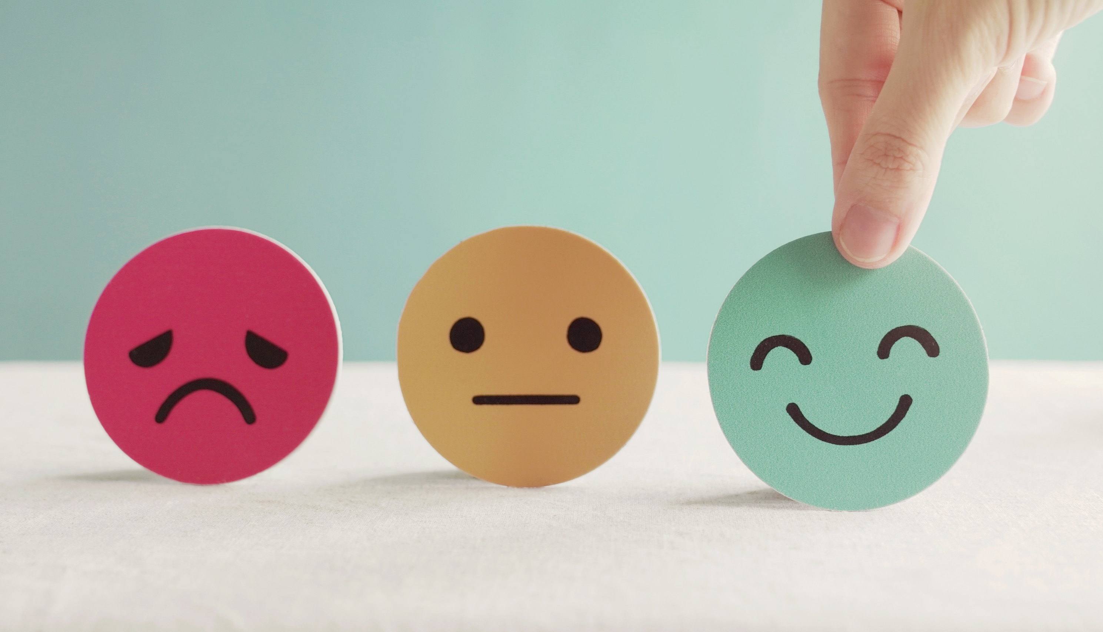
Lesson 3
Stay positive and have a nice day!

