Slide 1


Slide 2



Review
4
Units 10-11-12
LESSON 1: LANGUAGE
Pronunciation review
Vocabulary review
Grammar review
Unit

Slide 3

OBJECTIVES
By the end of the lesson, students will be able to review pronunciation, vocabulary and the grammar points they have learnt in units 10, 11, 12.

Slide 4
LESSON 1: LANGUAGE
WARM-UP
Mind map
PRONUNCIATION REVIEW
Task 1: Mark (') the stressed syllables in the underlined words. Then listen, check and repeat.
Task 2: Write the words in the box next to their definitions.
Task 3: Complete the sentences with the words below.
VOCABULARY REVIEW
Task 4: Use the correct tense and form of each verb in brackets to complete the sentence.
Task 5: Find and cross (––) ONE incorrect article in each sentence and write the correct one.
GRAMMAR
REVIEW
CONSOLIDATION
Wrap-up
Homework

Slide 5
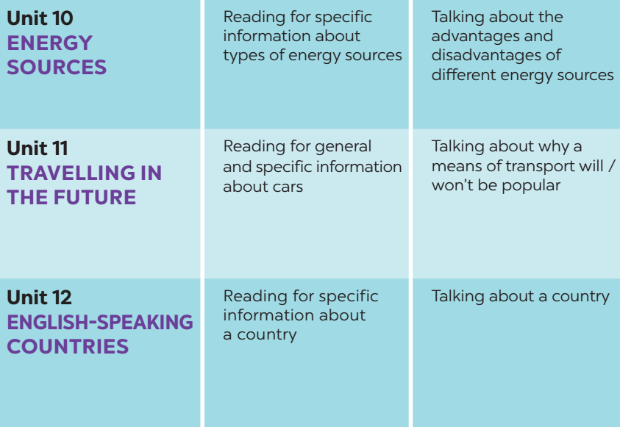
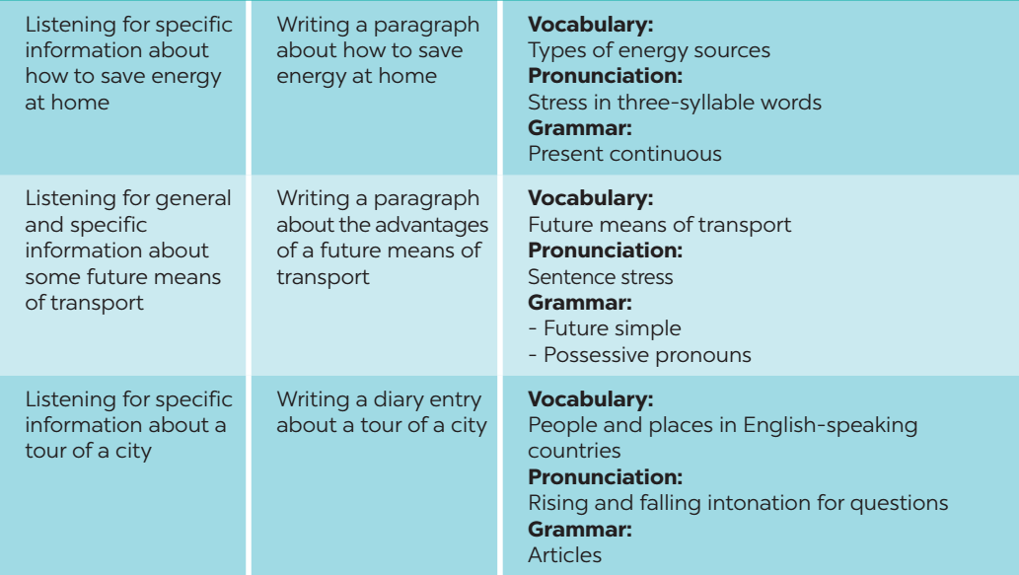
WARM-UP

Slide 6

PRONUNCIATION REVIEW
1
Mark (') the stressed syllables in the underlined words. Then listen, check, and repeat.
1. 'Driverless trains will be 'popular.
2. Niagara Falls is Canada’s most famous ‘natural at’traction.
3. We can save 'energy by re'cycling.
4. All plants and ‘animals need ‘energy
5. He’s reading Guidance for ‘Visitors to Scotland.

Slide 7
VOCABULARY REVIEW
2
Write the words in the box next to their definitions.
source symbol coal attraction bamboo-copter
1. ﻿It is a place or thing that you get something from.
2. ﻿This means of transport is eco-friendly.
3. ﻿It is a person or an object that represents a place.
4. ﻿It is a non-renewable source of energy.
5. ﻿An object or a place many visitors want to see.
→ source
→ bamboo-copter
→ symbol
→ coal
→ attraction

Slide 8
VOCABULARY REVIEW
3
Complete the sentences with the words below.
national native renewable electrical public natural
1. SkyTrans and driverless buses will be popular ___________ means of transport.
2. Niagara Falls is a ___________ wonder of both the USA and Canada.
3. The colours of the UK’s ____________ flag are red, white, and blue.
4. Solar energy and hydro energy are _____________sources.
5. The kangaroo is ______________ to Australia.
6. We can save electricity by using fewer _____________ appliances.
public
natural
national
renewable
native
electrical

Slide 9
GRAMMAR REVIEW
4
Use the correct tense and form of each verb in brackets to complete the sentence.
is doing
1. At present, our class (do) ____________ a big project on how to save energy in our school.
2. My biggest dream is that I (visit) ____________ Edinburgh one day.
3. At present, my city (build) ______________ stations for skyTrans.
4. In the future, we (use) _______________ more renewable energy in our daily life.
5. I hope that we (have) _____________ flying cars for faster travel. soon.
will visit
is building
will use
will have

Slide 10
GRAMMAR REVIEW
5
Find and cross (––) ONE incorrect article in each sentence and write the correct one.
1. ﻿A Roadster is the automatic electric car.
2. ﻿What is the meaning of a word ‘eco-friendly’?
3. ﻿A Statue of Liberty is in the USA.
4. ﻿The Maori are a native people of New Zealand.
5. ﻿Can you give me a example of an electrical appliance?
6. ﻿The teacher is talking about means of transport in a future.
the → an
a → the
A → The
a → the
a → an
a → the

Slide 11
CONSOLIDATION
1
WRAP-UP
Pronunciation review
Vocabulary review
Grammar review

Slide 12

CONSOLIDATION
2
HOMEWORK
Prepare for the next lesson: Review 4 - Skills

Slide 13

Website: hoclieu.vn
Fanpage: facebook.com/www.tienganhglobalsuccess.vn

