Slide 1


Slide 2


Unit
10
COMMUNICATION IN THE FUTURE
LESSON 6: SKILLS 2
1

Slide 3
LESSON 6: SKILLS 2
WARM-UP
Game: Hot seat
Task 1: Look at the pictures. Complete the word / phrase for each picture.
Task 2: Listen to an announcement about an exhibition. Complete each gap in the agenda with ONE word or a number.
Task 3: Listen again. Circle the correct answer A, B, or C.
LISTENING
Task 4:. Match the ideas with parts of an outline for a paragraph about a video call.
Task 5: Write a paragraph to describe a way of modern communication. You can use the ideas in 4 or your own ideas.
WRITING
CONSOLIDATION
Wrap-up
Homework

Slide 4
WARM-UP
How to play:
One student comes to the board and mime a way of communication.
This student acts without saying.
The rest of class guess the words.
HOT SEAT

Slide 5

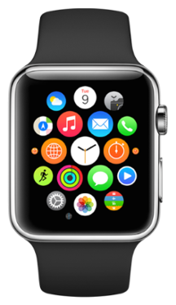
LISTENING
1
Look at the pictures. Complete the word / phrase for each picture.
1. c_____ pigeon
carrier
2. s____________
smartwatch

Slide 6
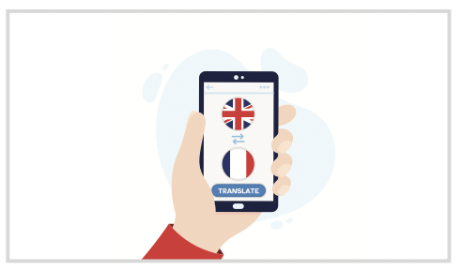

LISTENING
1
Look at the pictures. Complete the word / phrase for each picture.
3. t_______ machine
4. h_________
telepathy
holographs

Slide 7

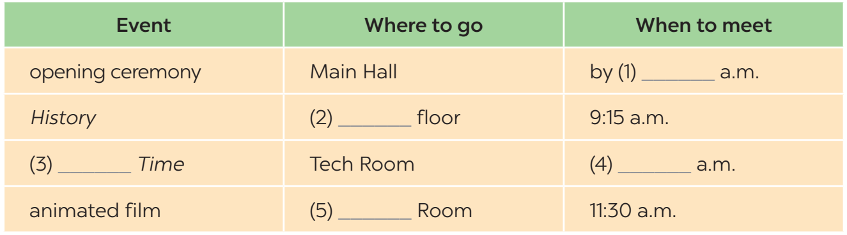


LISTENING
2
Listen to an announcement about an exhibition. Complete each gap in the agenda with ONE word or a number.
8:20
First
Modern
10:15
Cinema

Slide 8
LISTENING
3
Listen again. Circle the correct answer A, B, or C.
1. Who is making the announcement?
A. A teacher. B. A student C. Dr Lam.
2. What is in the History section?
A. An introductory talk. B. A documentary. C. Many pictures.
3. What is NOT true about the Modern Time section?
A. Students won’t like this section.
B. It shows smart devices.
C. They will be there for one hour.

Slide 9
LISTENING
3
Listen again. Circle the correct answer A, B, or C.
4. What will the film in the Cinema Room be about?
A. Super smartwatches.
B. Translation devices for personal use.
C. Telepathy machines.
5. In general, what does the exhibition show?
A. Problems of modern technology.
B. History of smartphones.
C. Means of communication.

Slide 10
WRITING
4
Work in pairs. Match the ideas (a - h) with parts of an outline (1 - 4) for a paragraph about a video call.
a phone call using Internet connection
needs a high-speed Internet access
saves time because people needn’t travel to meet
transmits live images of the speakers with a webcam or camera on smart devices
may spend too much time chatting with each other
can be useful for family members and business partners
will still be a common tool of communication
can see and hear each other in real time
1. What is it?
2. What are its advantages?
3. What are its disadvantages?
4. Will people use it in the future?
a, d
c, f ,h
b, e
g

Slide 11

WRITING
5
Write a paragraph (80 – 100 words) to describe a way of modern communication. You can use the ideas in 4 or your own ideas.

Slide 12
WRITING
5
Write a paragraph (80 – 100 words) to describe a way of modern communication. You can use the ideas in 4 or your own ideas.
Suggested answer:
Making a video call is a modern way of communication. A video call is a phone call via the Internet. It transmits live images of the speakers with a webcam or camera on smart devices. Video calls are time-saving because people do not need to travel to meet and still see and hear each other in real time. They help both family members and business partners keep contact with each other regardless of geographic distances. However, video calls require high-speed Internet access, so not all the time people can make one. I believe that when the Internet becomes better in the future, video calls will be an even more common tool of communication.

Slide 13
CONSOLIDATION
1
Wrap-up
What have we learnt in this lesson?
Listen to an announcement for an exhibition
Write a paragraph to describe a way of communication

Slide 14

CONSOLIDATION
2
Homework
- Rewrite the email on the notebook.
- Prepare for Lesson 7 – Looking back & Project.

Slide 15

Website: hoclieu.vn
Fanpage: facebook.com/tienganhglobalsuccess.vn/

