Slide 2


Unit
1
MY NEW SCHOOL
LESSON 2: A CLOSER LOOK 1
VOCABULARY
PRONUNCIATION
to study, to have, to do, to play + N
/ɑː/ and /ʌ/
1

Slide 3
LESSON 2: A CLOSER LOOK 1
LESSON 1: GETTING STARTED
WARM-UP
Game: Hot seat
Vocabulary
Task 1: Listen and repeat the words.
Task 2: Work in pairs. Put the words in Task 1 in the correct columns.
Task 3: Put the words in the blanks.
VOCABULARY
Task 4: Listen and repeat. Pay attention to the sounds /ɑː/ and /ʌ/.
Task 5: Listen and repeat. Underline the words with the sounds /ɑː/ and /ʌ/.
PRONUNCIATION
CONSOLIDATION
Wrap-up
Homework

Slide 4

WARM-UP
HOT SEAT
Instructions
1 member stands against the board.
Winner: team with the most correct answers in the fastest time
2 teams
Other members use body language to describe the pictures.

Slide 5
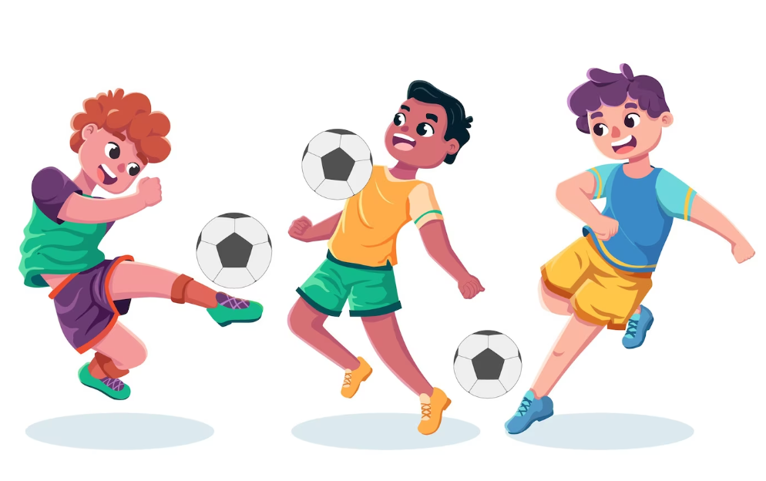
WARM-UP
PLAY
FOOTBALL

Slide 6

WARM-UP
LISTEN TO MUSIC

Slide 7
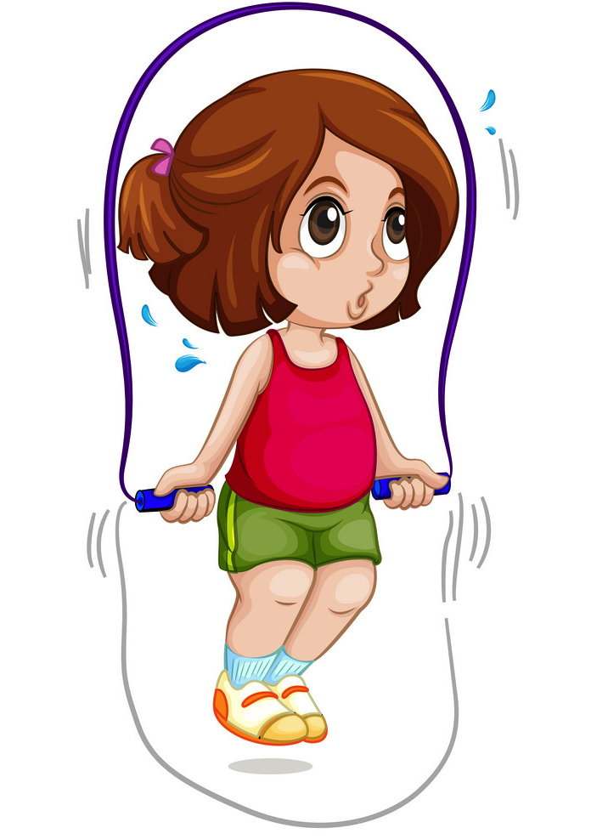
WARM-UP
SKIP ROPE

Slide 8
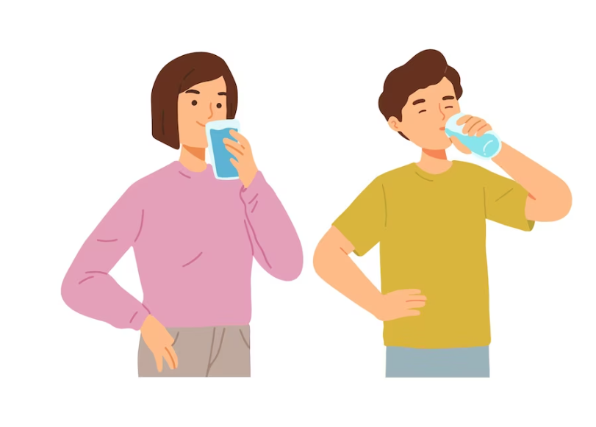
WARM-UP
DRINK WATER

Slide 9
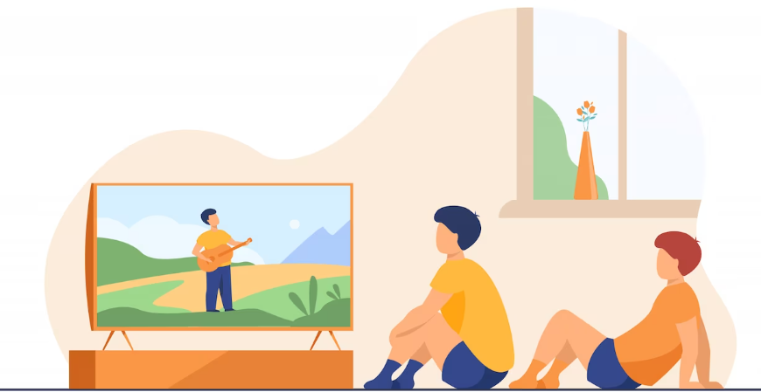
WARM-UP
WATCH TV

Slide 10

WARM-UP
PLAY VIDEO GAMES

Slide 11


VOCABULARY
science (n)
/ˈsaɪəns/
khoa học

Slide 12
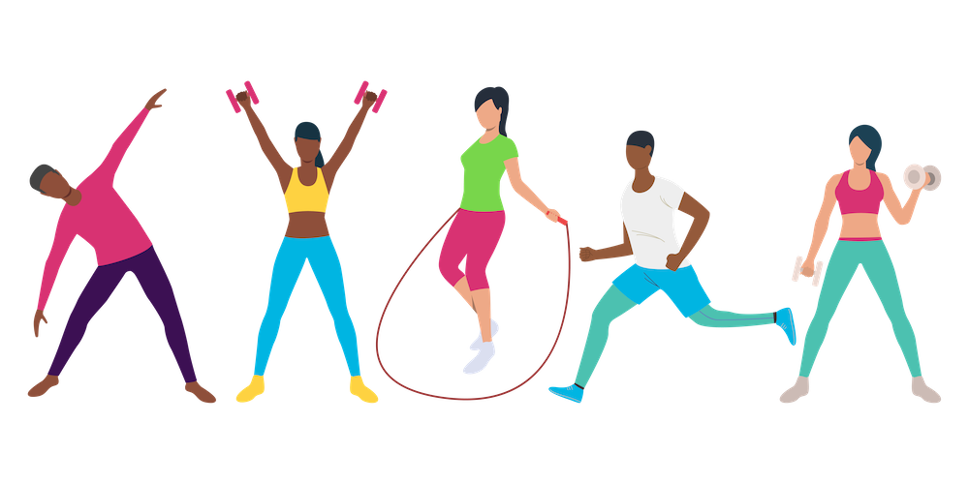
VOCABULARY
exercise (n /v)
/ˈeksəsaɪz/
bài tập /
tập thể dục

Slide 13
VOCABULARY
New words | Pronunciation | Meaning
1. science (n) | /ˈsaɪ.əns/ | khoa học
2. exercise (n / v) | /ˈek.sə.saɪz/ | bài tập / tập thể dục

Slide 14

VOCABULARY
1
Listen and repeat the words.
school lunch
English
history
homework
exercise
science
football
lessons
music

Slide 15
VOCABULARY
2
Work in pairs. Put the words in Task 1 in the correct columns.
school lunch English history homework
exercise science football lessons music
play | do | have | study

Slide 16

VOCABULARY
2
Work in pairs. Put the words in Task 1 in the correct columns.
school lunch English history homework
exercise science football lessons music
play | do | have | study
football
homework
school lunch
English
music
exercise
lessons
history
science
music
Can you add more words to each column?

Slide 17
VOCABULARY
3
Put one of these words in each blank.
1. Vy and I often do our ____________ after school.
2. Nick plays __________ for the school team.
3. Mrs Nguyen teaches all my history _________.
4. They are healthy. They do __________ every day.
5. I study maths, English and _________ on Mondays.
homework
football
lessons
exercise
science

Slide 18

PRONUNCIATION
/ɑː/ and /ʌ/

Slide 19
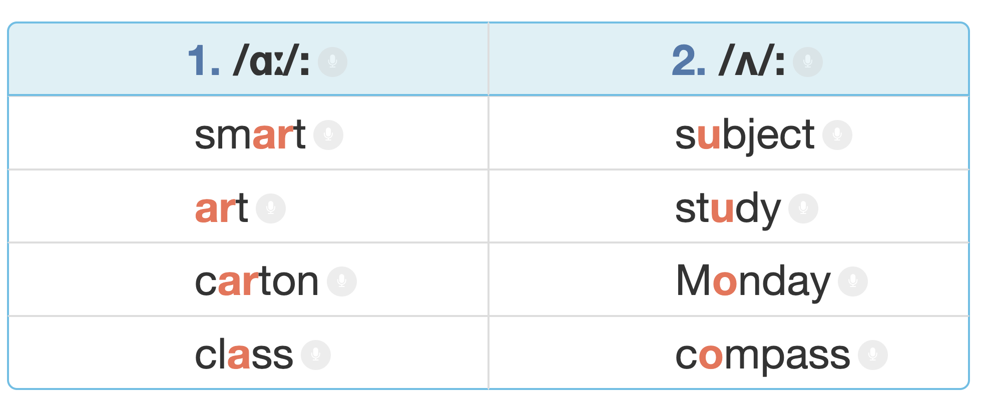

PRONUNCIATION
4
Listen and repeat. Pay attention to the sounds /ɑː/ and /ʌ/.

Slide 20
PRONUNCIATION
5
Listen and repeat. Then listen again and underline the words with the sounds /ɑː/ and /ʌ/.
1. My brother has a new compass.
2. Our classroom is large.
3. They look smart on their first day at school.
4. The art lesson starts at nine o’clock.
5. He goes out to have lunch every Sunday.

Slide 21

CONSOLIDATION
1
Wrap-up
What have we learnt in this lesson?
Vocabulary: The lexical items related to school
Pronunciation: /ɑ:/ and /ʌ/

Slide 22

CONSOLIDATION
2
Homework
- Do exercises in the workbook.
- Find 3 more school activities that have the sound /ɑː/ or /ʌ/.

Slide 23






Website: hoclieu.vn
Fanpage: facebook.com/www.tienganhglobalsuccess.vn/

