Slide 1
Unit 3: PROTECTING THE ENVIRONMENT
Lesson 1.1
--- Pages 24 & 25 ---

Slide 2
Lesson Outline
Warm-up
Vocabulary
Reading
Consolidation
Wrap-up

Slide 3
By the end of this lesson, students will be able to…
- learn and use vocabulary, related to pollution.
- practice reading for gist and specific information about some effects of pollution.

Slide 4
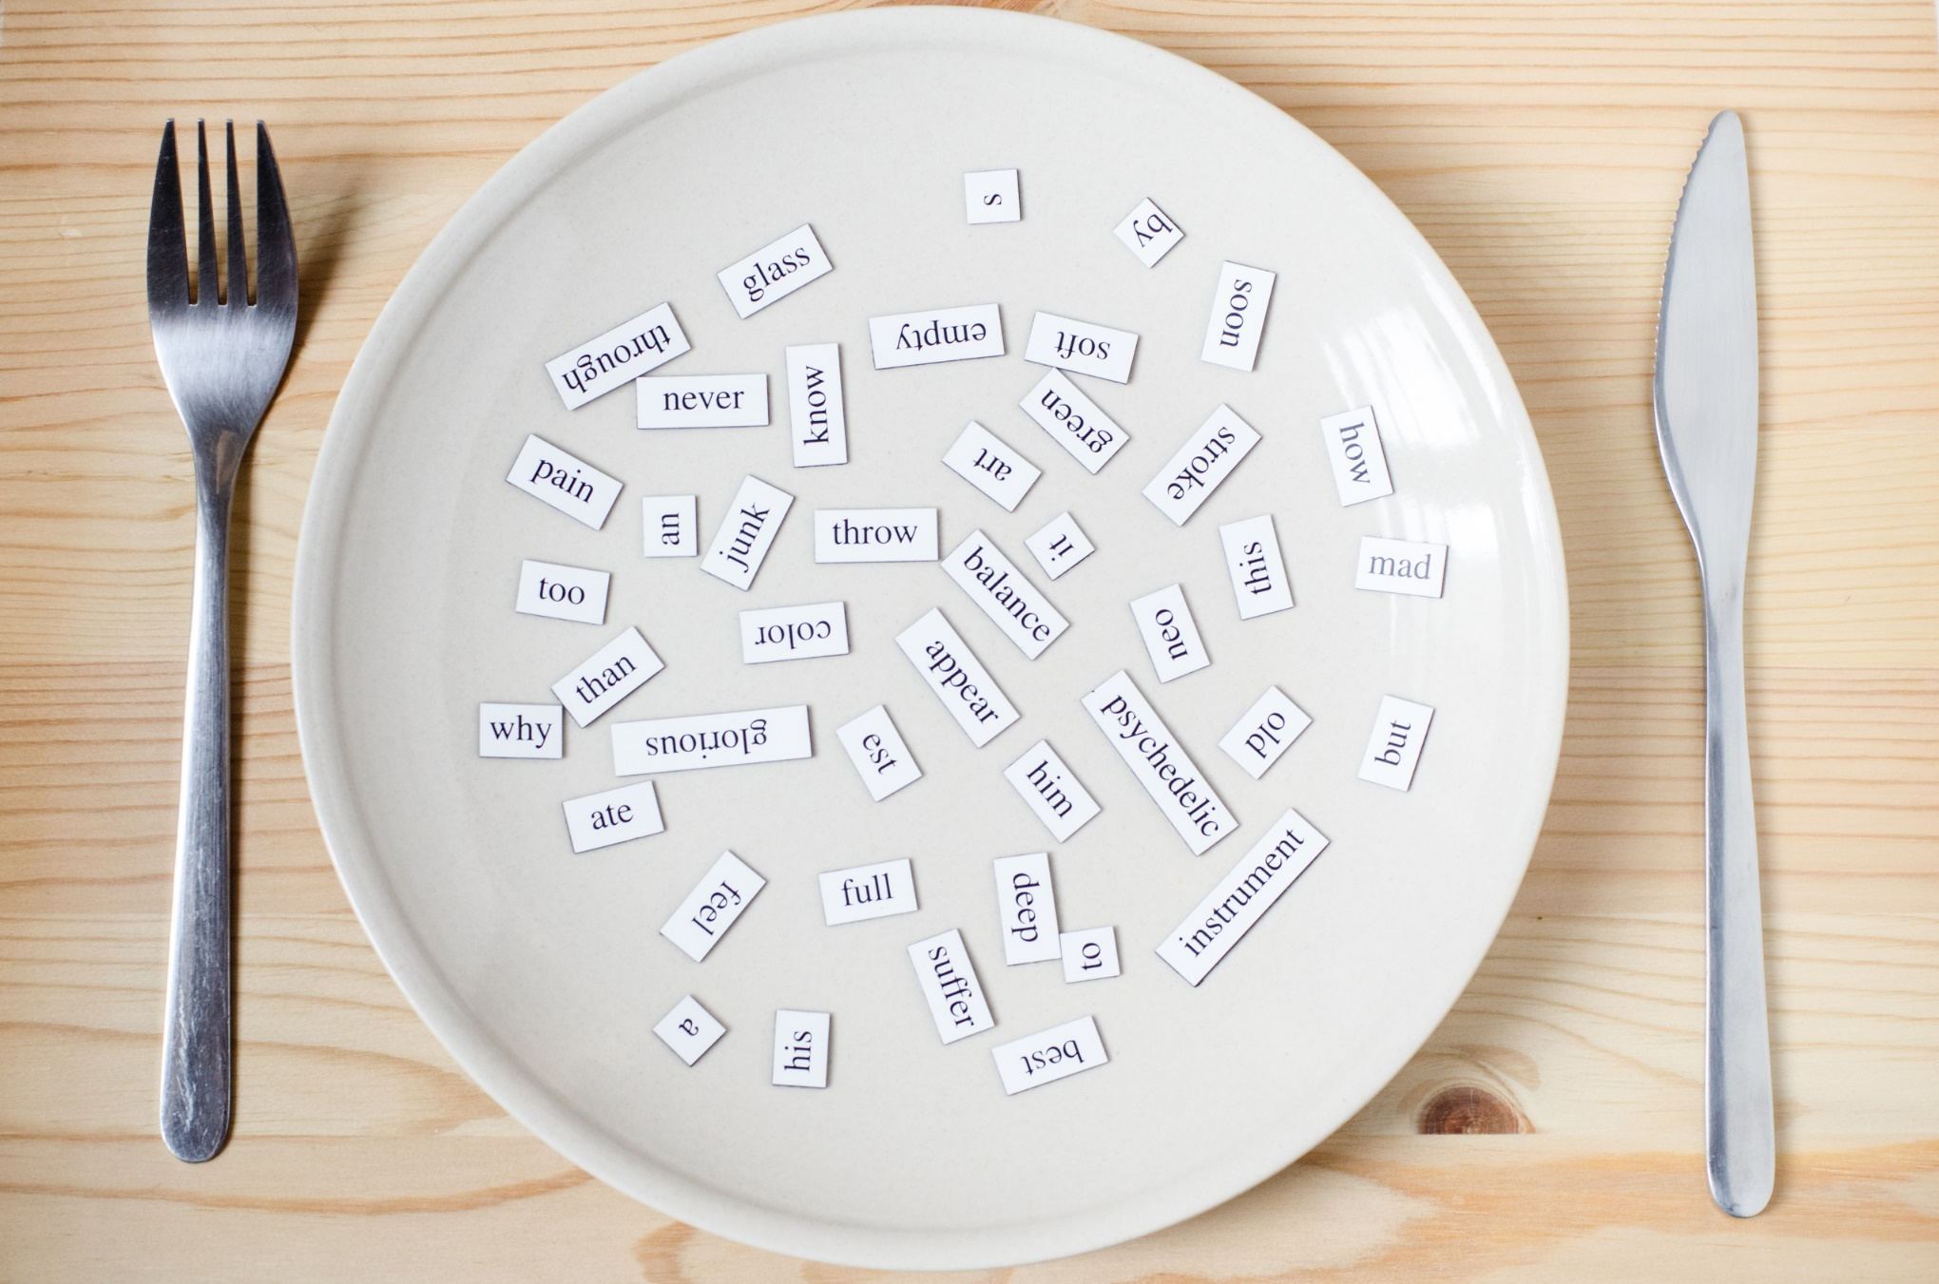
New words
affect
cause
pollute
disease
wildlife
tourism
environment
damage

Slide 5
Lesson 1
WARM UP

Slide 6
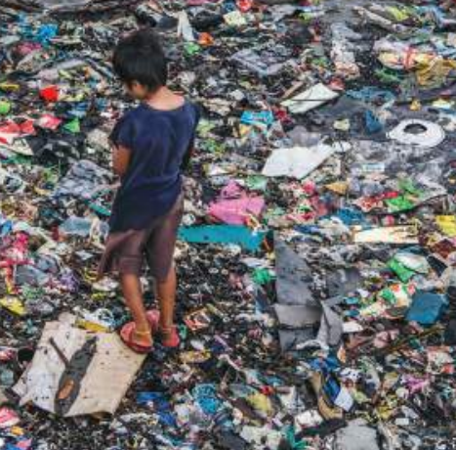
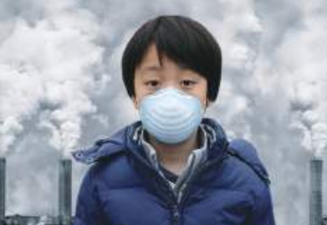
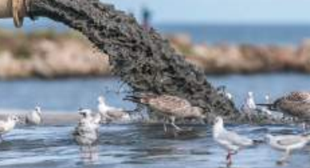
Let’s talk
Work in pairs. Look at the pictures. What kinds of pollution can you see? Is pollution a big problem in your country? Why does pollution happen?
Water pollution
Air pollution
Land pollution

Slide 7
NEW LESSON

Slide 8
Pre-reading
Vocabulary

Slide 9
New words
affect
cause
pollute
disease
wildlife
tourism
environment
damage

Slide 10
Listen and repeat. Practise saying these words with a partner.
affect /əˈfekt/ (v): tác động, ảnh hưởng.
cause /kɔːz/ (v): gây ra.
pollute / pəˈluːt / (v): gây ô nhiễm.
disease / dɪˈziːz / (n): bệnh.
wildlife / ˈwaɪldlaɪf / (n): đời sống hoang dã.
tourism / ˈtʊrɪzəm / (n): du lịch.
environment /ɪnˈvaɪrənmənt/ (n): môi trường.
damage /ˈdæmɪdʒ/ (v): tàn phá, phá hủy.

Slide 11
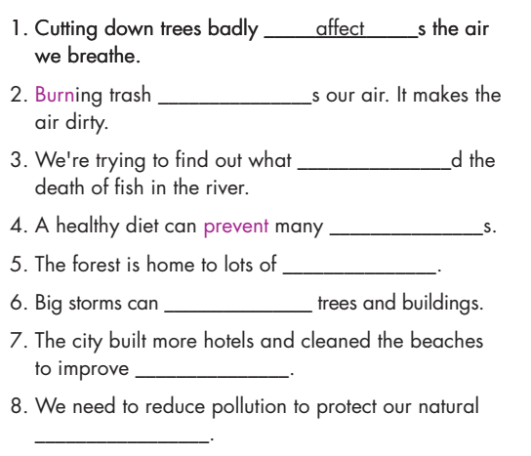
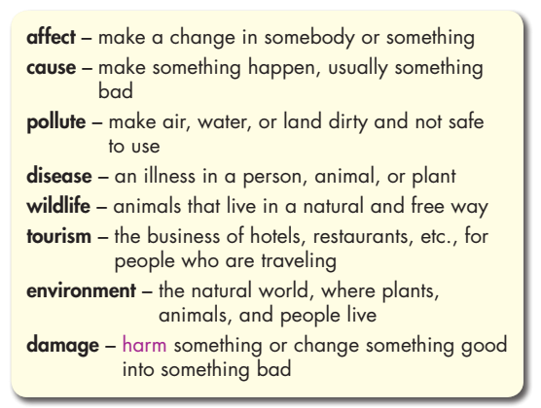
Pre - reading
Read the words and definitions, then fill in the blanks with new words.
pollute
cause
disease
wildlife
damage
tourism
environment

Slide 12
Work in pairs
Which kinds of pollution affect tourism and cause diseases?
I think land pollution badly affects tourism.

Slide 13
While-
reading

Slide 14
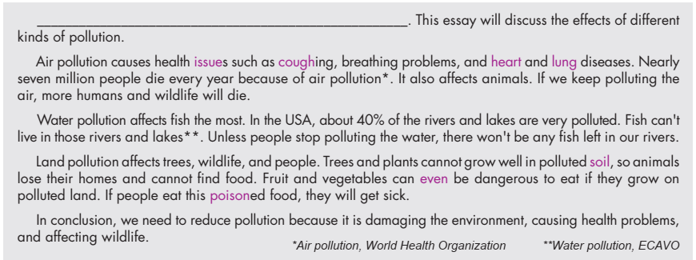
Read the essay about some effects of pollution and choose the best introduction sentence.
1. Air, water, light, and noise are four main types of pollution affecting our world.
2. There are many types of pollution, and each type can affect people, wildlife, and the environment.

Slide 15
Now, listen, read and write True, False, or Doesn’t say.
False
True
False
True

Slide 16
Post-
reading

Slide 17
Post - reading
Work in pairs
There’s land pollution in my area. People throw trash everywhere.
What kinds of pollution are there in your area?
It makes street very dirty. It also causes air pollution.
What are their effects

Slide 18
CONSOLIDATION

Slide 19
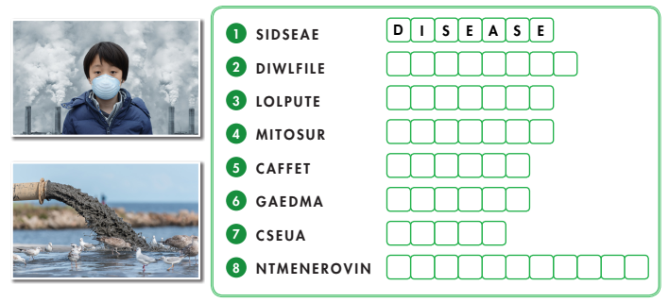
Unscramble words. (WB page 14)
W I L D L I F E
P O L L U T E
T O U R I S M
A F F E C T
D A M A G E
C A U S E
E N V I R O N M E N T

Slide 20
WRAP-UP

Slide 21
Today’s lesson
Vocabularies
affect
cause
pollute
disease
wildlife
tourism
environment
damage

Slide 22
Today’s lesson
* Vocabulary: affect, cause, pollute, disease, wildlife, tourism, environment, damage.
* Reading: Skimming and scanning for general and specific information
* Speaking:
- Talking about kinds of pollution.

Slide 23
Homework
Learn by hearts vocabularies and make sentences using them.
Do the exercises on pages 14 & 15 WB.
Do the exercises in TA 8 Notebook (pages 20 & 21)
Prepare the next lesson (pages 25 & 26 - SB)
Play the consolidation games on www.eduhome.com.vn

Slide 24
Lesson 3
Stay positive and have a nice day!

