Slide 1

Unit 4: All things high-tech
Lesson 4d: Everyday English
Pages 69

Slide 2
Lesson Outline
Warm-up
Everyday Eng.
Pronunciation
Consolidation
Wrap-up

Slide 3
Objectives
By the end of this lesson, students will be able to…
- act out a dialogue giving instructions.
- learn and practise intonation in questions.

Slide 4

WARM-UP

Slide 5
Choose the word whose main stress is placed differently
from the others.
Extra Practice
1. A. connection B. internet C. computer D. importance
2. A. portal B. headset C. tablet D. display
3. A. alien B. designer C. musician D. technician
/kəˈnekʃən/
/ˈɪntənet/
/kəmˈpjuːtər/
/ɪmˈpɔːtəns/
/ˈpɔːtəl/
/ˈhedset/
/ˈtæblət/
/dɪˈspleɪ/
/ˈeɪliən/
/dɪˈzaɪnər/
/mjuːˈzɪʃən/
/tekˈnɪʃən/

Slide 6
Choose the word whose underlined part is pronounced differently
from that of the other words.
1. A. photo B. portal C. console D. robot
2. A. behave B. program C. delay D. create
3. A. character B. mechanic C. paragraph D. dialogue
/ˈpɔːtəl/
/ˈkɒnsəʊl/
/ˈrəʊbɒt/
/ˈfəʊtəʊ/
/bɪˈheɪv/
/ˈprəʊɡræm/
/dɪˈleɪ/
/kriˈeɪt/
/ˈkærəktər/
/məˈkænɪk/
/ˈpærɡrɑːf/
/ˈdaɪəlɒɡ/

Slide 7

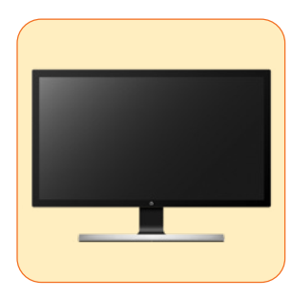
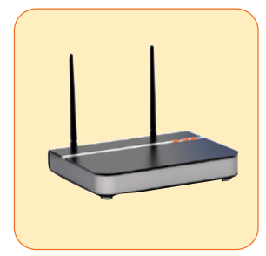

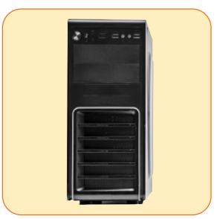


Work in pairs.
Name the pictures
1
2
3
screen
router
mouse
4
5
6
tower
USB flash drive
speakers

Slide 8

It’s time to learn …

Slide 9

Speaking

Slide 10
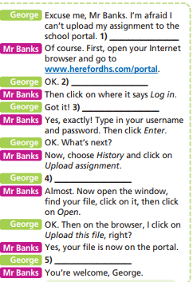
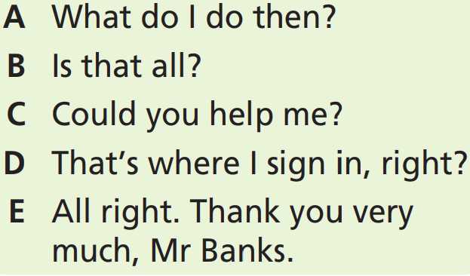
Pre - Speaking
Who are there in the dialogue?
→ George and Mr. Banks.
What are you going to do?
Complete the dialogue, use the sentences A-E.

Slide 11
George: Excuse me, Mr Banks. I’m afraid I can’t upload my assignment to the school portal. (1) _________________
Mr Banks: Of course. First, open your Internet browser and go to www.herefordhs.com/portal.
George: OK. (2) __________________________
Mr Banks: Then click on where it says Log in.
George: Got it! (3) _______________________
Mr Banks: Yes, exactly! Type in your username and password. Then click Enter.
George: OK. What’s next?
C Could you help me?
A What do I do then?
D That’s where I sign in, right?

Slide 12
Mr Banks: Now, choose History and click on Upload assignment.
George: (4) ____________________
Mr Banks: Almost. Now open the window, find your file, click on it, then click on Open.
George: OK. Then on the browser, I click on Upload this file, right?
Mr Banks: Yes, your file is now on the portal.
George: (5) __________________________________
Mr Banks: You’re welcome, George.
B Is that all?
E All right. Thank you very much, Mr Banks.

Slide 13
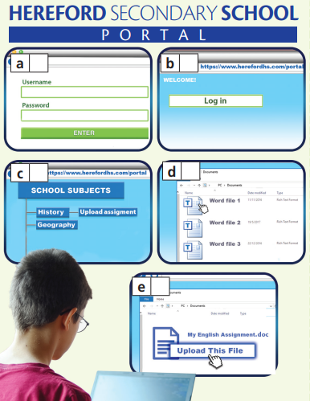
Pre - Speaking
2 Listen and check. Then put pictures (a-e) in the correct order. Compare with your partner.
How many pictures are there?
→ There are five.
What are you going to do?
→ Listen, check, put pictures (a-e) in the correct order and compare.

Slide 14

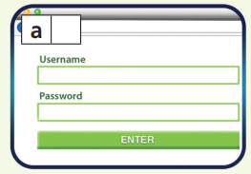
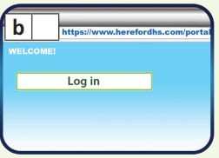
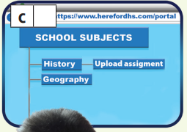
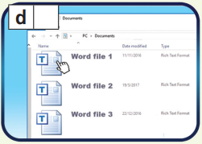
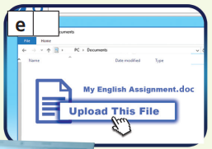
Pre - Speaking
2 Listen and check. Then put pictures (a-e) in the correct order. Compare with your partner.
2
1
3
4
5

Slide 15

While - Speaking
Take roles and read the dialogue aloud.
Mind your intonation and rhythm.
George: Excuse me, Mr Banks. I’m afraid I can’t upload my assignment to the school portal. Could you help me?
Mr Banks: Of course. First, open your Internet browser and go to www.herefordhs.com/portal.
George: OK. What do I do then?
Mr Banks: Then click on where it says Log in.
George: Got it! That’s where I sign in, right?
Mr Banks: Yes, exactly! Type in your username and password. Then click Enter.

Slide 16
George: OK. What’s next?
Mr Banks: Now, choose History and click on Upload assignment.
George: Is that all?
Mr Banks: Almost. Now open the window, find your file, click on it, then click on Open.
George: OK. Then on the browser, I click on Upload this file, right?
Mr Banks: Yes, your file is now on the portal.
George: All right. Thank you very much, Mr Banks.
Mr Banks: You’re welcome, George.

Slide 17
Post - Speaking
With a partner, act out a similar conversation.
Mind your intonation and rhythm.

Slide 18

Pronunciation

Slide 19

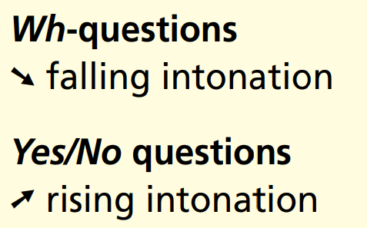

Slide 20
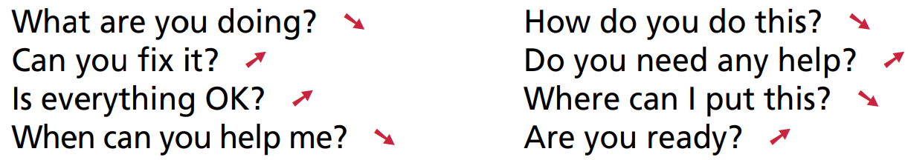
Listen and repeat. Then practise saying them with a partner.
Mind the intonation.

Slide 21

CONSOLIDATION

Slide 22
Practice saying these questions.
What do I do then?
Is it on King Street?
How can I help you?
Is that for the 2:30 p.m. performance or the 7:30 p.m.?
What about the one at 2:30 p.m.?
Can I have the ones next to the aisle, please?
How much are the tickets?

Slide 23

WRAP-UP

Slide 24
Today’s lesson
- Act out a dialogue giving instructions.
- Learn and practise intonation in questions.

Slide 25
Homework
Practise intonation in questions.
Do the exercises in TA 7 Right on WB (page 35).
Prepare the next lesson (page 70 SB)

Slide 26

Lesson 3
Stay positive and have a nice day!

