Slide 1
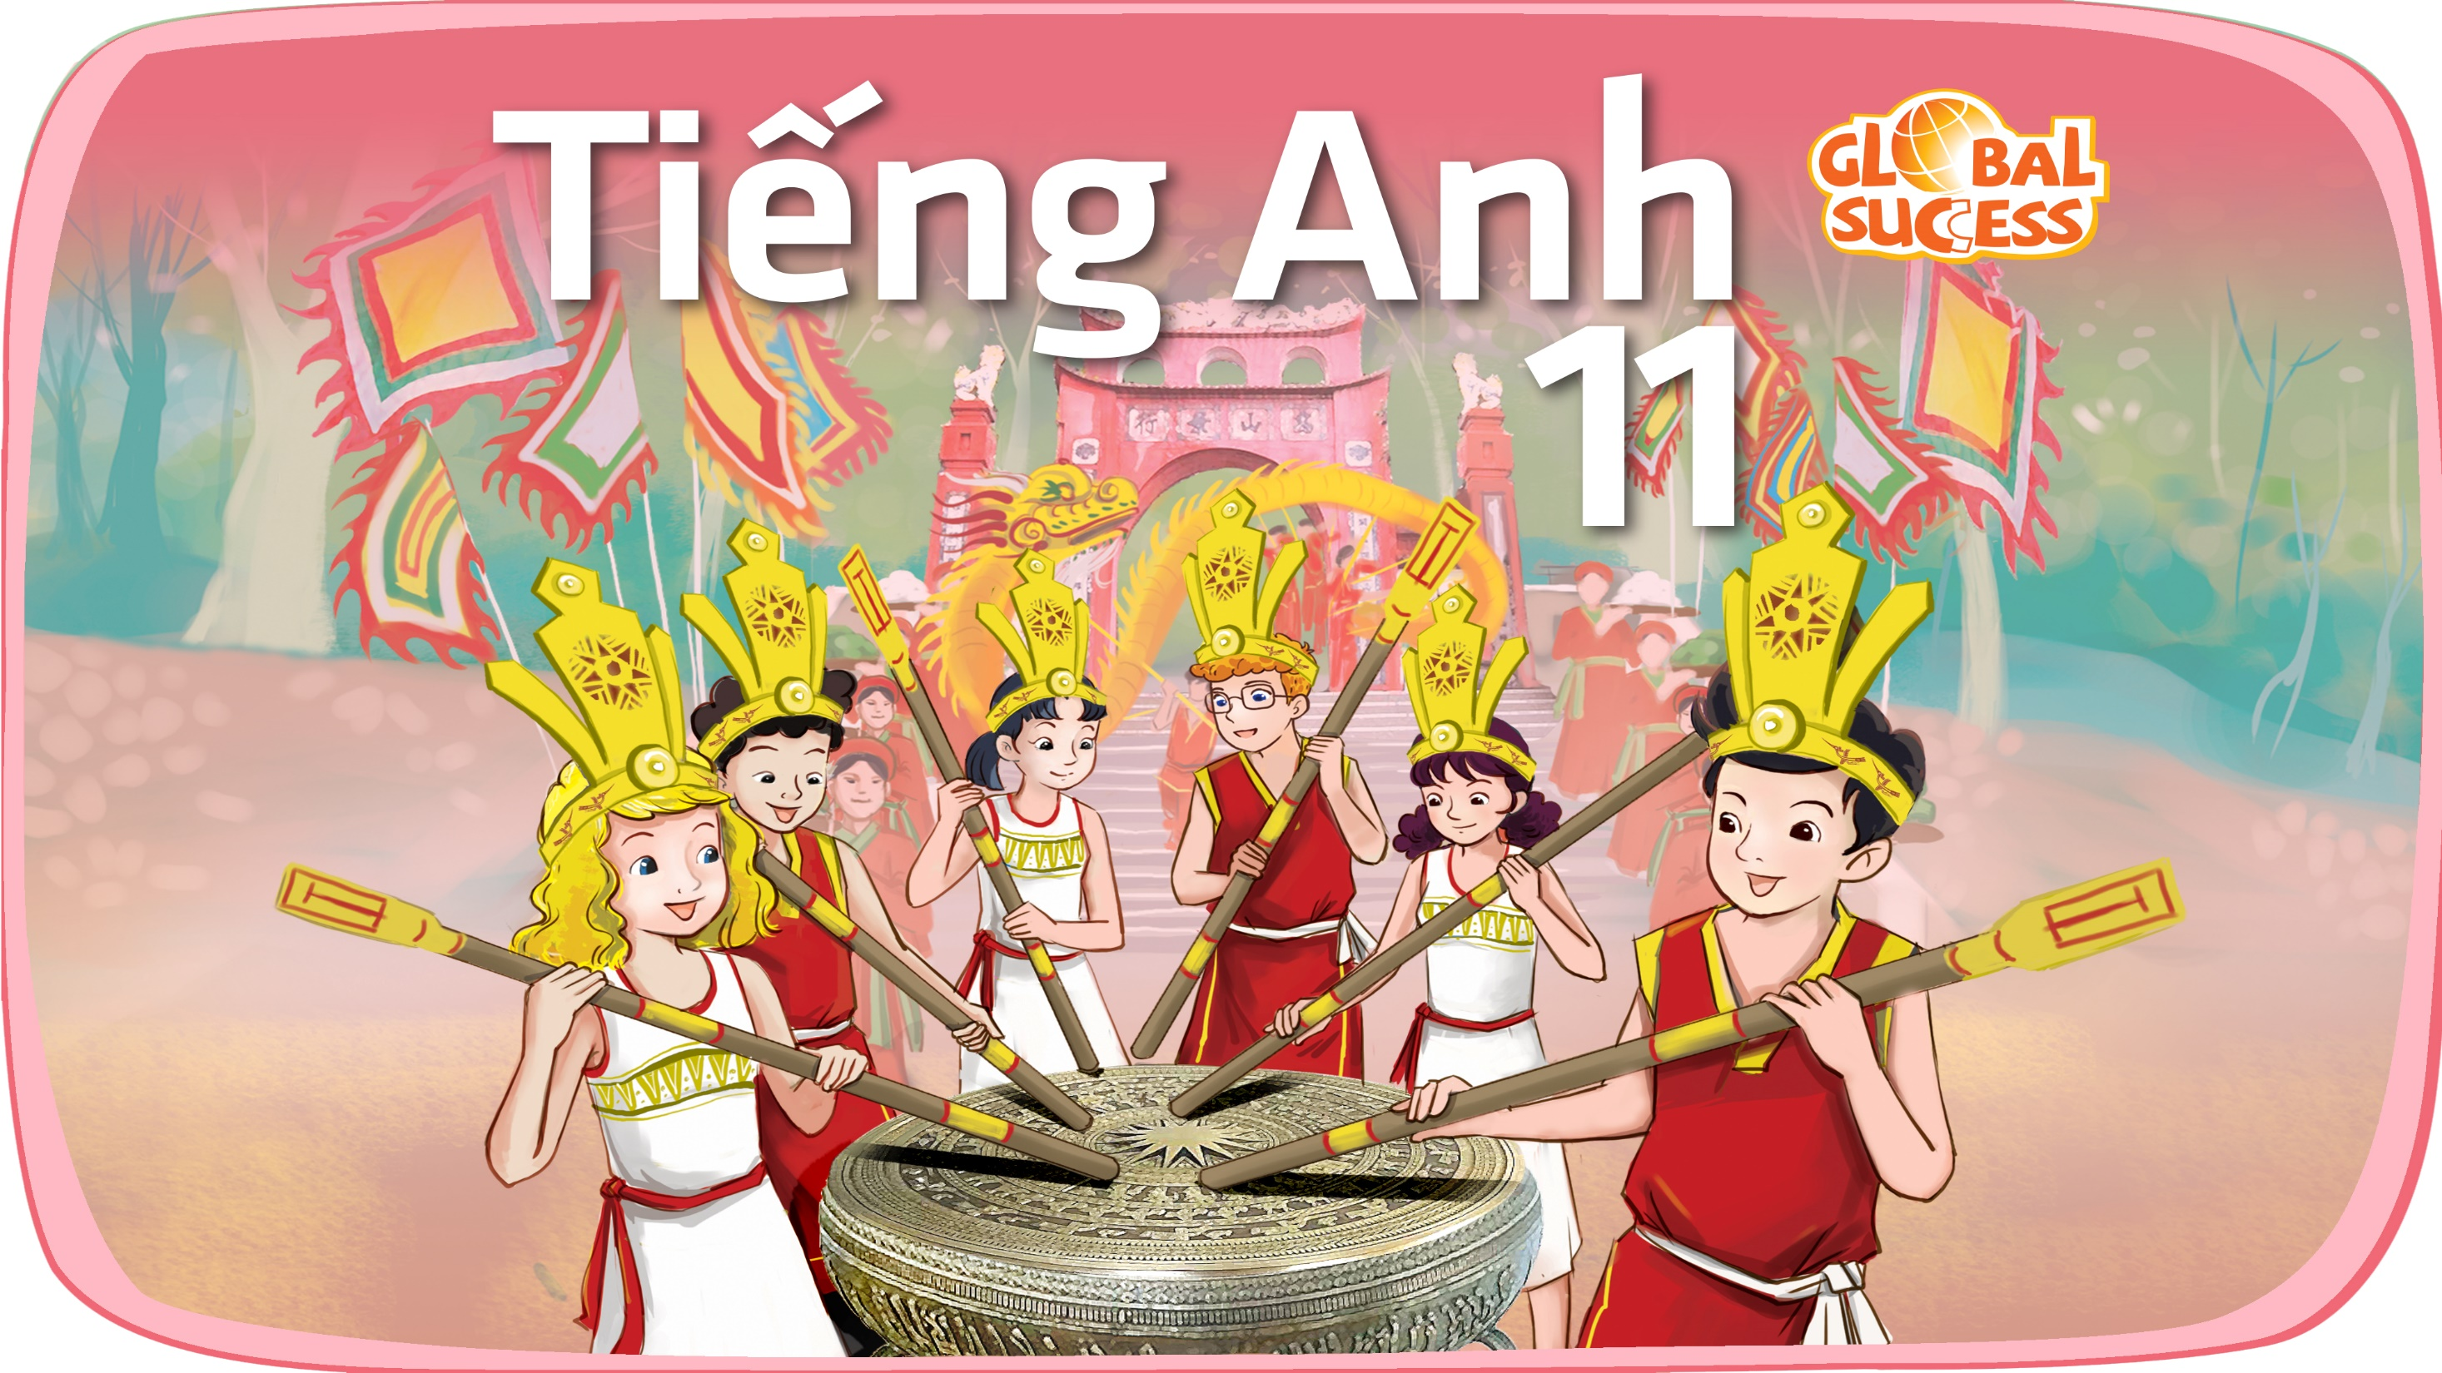

Slide 2
Unit
6
Preserving our heritage
Unit
FAMILY LIFE
COMMUNICATION AND CULTURE / CLIL
LESSON 7

Slide 3
LESSON 7
COMMUNICATION AND CULTURE / CLIL
WARM-UP
Lucky number
- Task 1: Listen and complete the conversation with the expressions in the box.
- Task 2: Work in pairs. Use the model in Task 1 to make similar conversation for these situations.
COMMUNICATION
CLIL
- Task 1: Read the text and answer the questions.
- Task 2. Work in groups. Discuss the following questions.
CONSOLIDATION
Wrap-up
Homework

Slide 4
WARM-UP
LUCKY NUMBER
- Ss work in 4 groups.
- There are 8 numbers, including 3 lucky numbers and 5 numbers are corresponding to 5 questions.
- Pick a lucky number ➔ get one point without having to answer the question.
- Pick a question ➔ answer “Where is it?”
- One point for a correct answer.

Slide 5
WARM-UP
Answer the question in each number
1
2
3
4
5
6
7
8

Slide 6
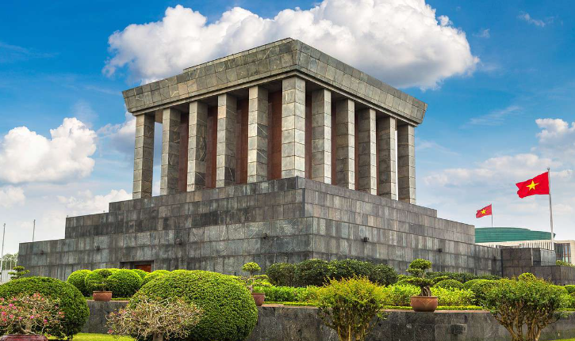
WARM-UP
Question 1
➔ HO CHI MINH MAUSOLEUM
BACK

Slide 7
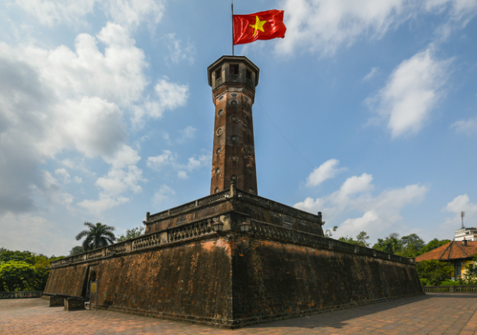
WARM-UP
Question 2
➔ HANOI FLAG TOWER
BACK

Slide 8
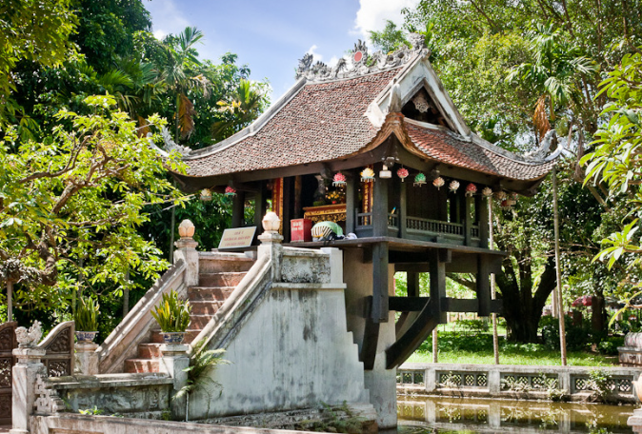
WARM-UP
Question 3
➔ ONE-PILLAR PAGODA
BACK

Slide 9
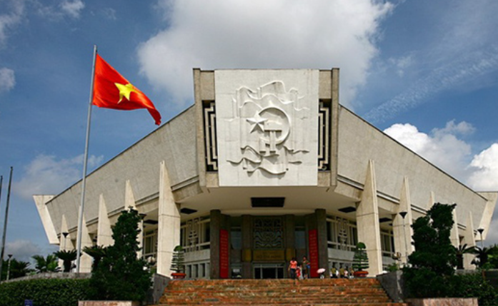
WARM-UP
Question 4
➔ HO CHI MINH MUSEUM
BACK

Slide 10
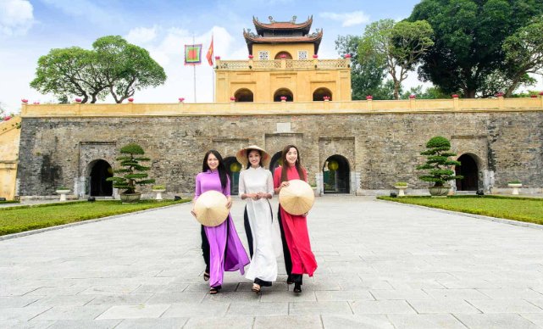
WARM-UP
Question 5
➔ IMPERIAL CITADEL OF THANG LONG
BACK

Slide 11

WARM-UP
BACK

Slide 12
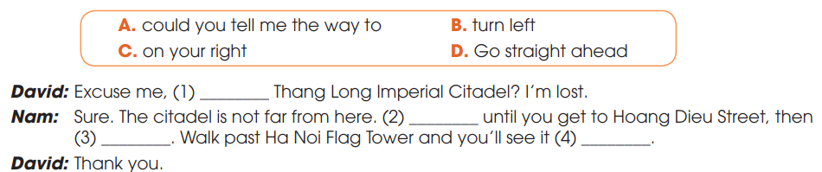
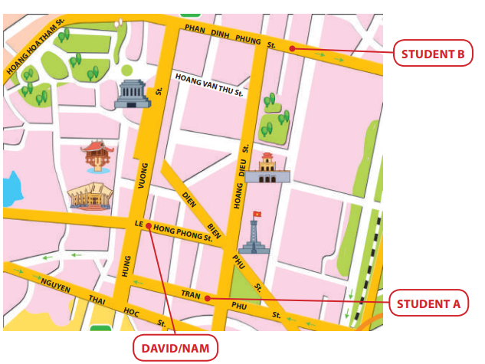
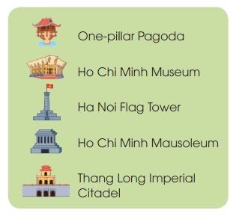
EVERYDAY ENGLISH
1
Listen and complete the conversation with the expressions in the box. Then practice it in pairs
A
D
C
B

Slide 13
EVERYDAY ENGLISH
Useful expressions
Asking for directions | Give directions
+ Can you tell me the way to …? + Excuse me, is … near here? + How do/can I get to …? + What is the best/easiest way to …? + Could you show me how to get to …? | + Go straight ahead/on. + Walk along … street/road. + Walk past the (post office/bank). + Turn left/right at the traffic lights/into Star Street. +Take the first/second road/turning on the left. + It’s on your left/right. + It’s next to/opposite/between/at the end of/behind/in front of… + It’s (just) around the corner.

Slide 14
EVERYDAY ENGLISH
2
Work in pairs. Make similar conversation for these situations.
1. Student A asking for directions to Ho Chi Minh Mausoleum.
2. Student B asking for directions to Ha Noi Flag Tower.

Slide 15
EVERYDAY ENGLISH
2
Work in pairs. Make similar conversation for these situations.
Situation 1.
A: Excuse me. Can you show me the way to Ho Chi Minh Mausoleum?
B: Sure, it’s not far from here. Go straight ahead and turn right into Hung Vuong Street. Then walk along Hung Vuong Street and you can see it on the left.
B: Thank you so much.

Slide 16
EVERYDAY ENGLISH
2
Work in pairs. Make similar conversation for these situations.
Situation 2
B: Excuse me. How can I get to Hanoi Flag Tower?
A: Sure. Walk along Phan Dinh Phung Street and take the second turn on the left into Hoang Dieu Street. Walk past the Thang Long Imperial Citadel. Hanoi Flag Tower is just behind it.
B: Thank you very much.

Slide 17


CLIL
crowdfunding (n)
/ˈkraʊdfʌndɪŋ/
the practice of funding a project or an activity by raising many small amounts of money from a large number of people, usually using the internet

Slide 18

CLIL
non-profit (adj)
/ˌnɒn ˈprɒfɪt/
without the aim of making a profit

Slide 19

CLIL
regardless of (prep)
/rɪˈɡɑːdləs əv/
paying no attention to something/somebody; treating something/somebody as not being important

Slide 20
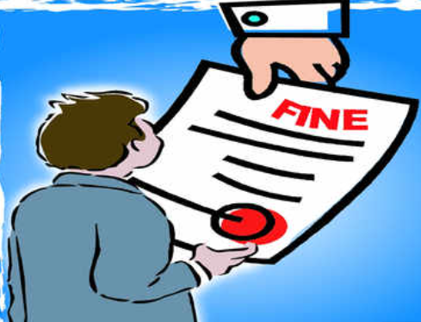
CLIL
fine (n)
/faɪn/
a sum of money that must be paid as punishment for breaking a law or rule

Slide 21

CLIL
unique (adj)
/juˈniːk/
being the only one of its kind

Slide 22
CLIL
Form | Pronunciation | Meaning | Vietnamese equivalent
1. crowdfunding (n) | /ˈkraʊdfʌndɪŋ/ | the practice of funding a project or an activity by raising many small amounts of money from a large number of people, usually using the internet | gây quỹ
2. non-profit (adj) | /ˌnɒn ˈprɒfɪt/ | without the aim of making a profit | phi lợi nhuận
3. regardless of (prep) | /rɪˈɡɑːdləs əv/ | paying no attention to something/somebody; treating something/somebody as not being important | bất kể
4. fine (n) | /faɪn/ | a sum of money that must be paid as punishment for breaking a law or rule | tiền phạt
5. unique (adj) | /juˈniːk/ | being the only one of its kind | độc nhất vô nhị

Slide 23
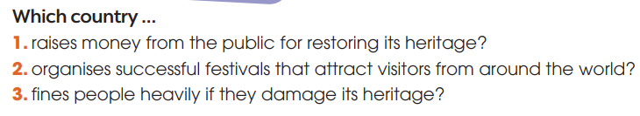



CLIL
1
Read the text and answer the questions
1
2
3
Italy
Spain
Australia

Slide 24
CLIL
2
Work in groups. Discuss the following questions
Are the methods of preserving heritage in the text used in Vietnam? Which one do you think works best in Vietnam?

Slide 25
CONSOLIDATION
1
Wrap-up
What have you learnt today?
Some methods for preserving heritage sites in the world;
Review expressions for asking for and giving directions.

Slide 26
CONSOLIDATION
2
Homework
Do exercises in the workbook.
Prepare for Lesson 8 - Unit 6.

Slide 27

Website: hoclieu.vn
Fanpage: facebook.com/sachmem.vn/

