Slide 1

Unit 6: Entertainment
Lesson 6e: Grammar (cont.)
Page 111

Slide 2
Lesson Outline
Warm-up
Presentation
Practice
Consolidation
Wrap-up

Slide 3
Objectives
By the end of this lesson, students will be able to…
- learn the Conditional (type 1).
- write sentences to continue a story.

Slide 4

WARM-UP

Slide 5
Rewrite the sentences. Use should, shouldn’t or might.
1 It’s possible they will go to the cinema tonight.
They ___________________________________ .
2 I advise you to book tickets online.
You ____________________________________ .
3 I advise you not to be late.
You ____________________________________ .
4 I advise them to arrive on time at the meeting.
They ___________________________________ .
5 It’s possible he will buy a new camera.
He _____________________________________ .
6 I advise her not to be rude to others.
She ____________________________________ .
might go to the cinema tonight
should book tickets online
shouldn’t be late
should arrive on time at the meeting
might buy a new camera
shouldn’t be rude to others

Slide 6

It’s time to learn …

Slide 7
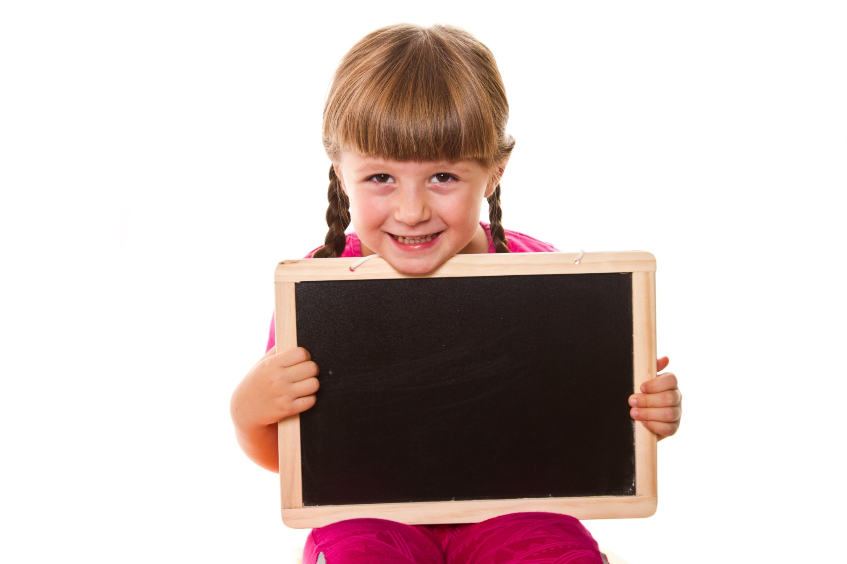
Presentation

Slide 8
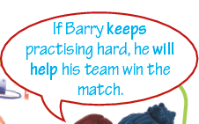
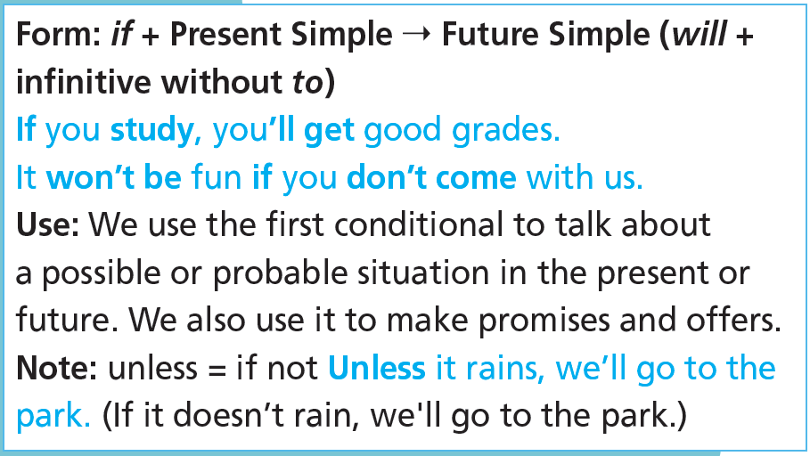
Conditional (Type 1)
4 Read the theory box. How do we form the First Conditional?
if + Present Simple ➞ Future Simple (will + infinitive without to)

Slide 9
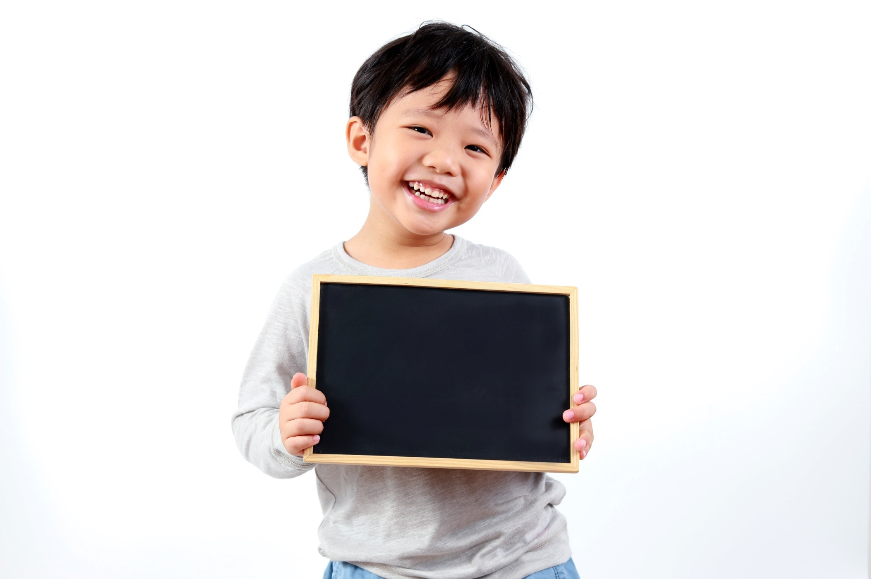
Practice

Slide 10
5 Put the verbs in brackets into the Present Simple or Future Simple. Put commas where necessary.
go
will see
1 If we _________________ (go) to the stadium, we _________________ (see) our favourite band perform live.
2 The teacher _________________ (explain) the exercise to you if you _________________ (ask) him.
3 I _________________ (not/lend) you my camera unless you ________________ (be) careful with it.
4 I ___________________ (come) to your party if my parents _________________ (let) me.
5 If I _________________ (meet) Joe tonight, I _________________ (tell) him the good news.
6 If Kathy _________________ (visit) us, we _________________ (order) pizza for dinner.
will explain
ask
won‘t lend
are
will come
let
meet
will tell
visits
will order

Slide 11
6 Put the verbs in brackets into the correct tense.
1 If Joe isn't busy, he ______________ (help) you.
2 If it rains, we ______________ (not/go) to the exhibition centre tomorrow.
3 My parents won't let me come to the circus unless I _____________ (do) my homework first.
4 If you’re hot, I _______________ (open) the window.
5 If the tickets _____________ (not/be) expensive, we’ll go to the theatre.
will help
won’t go
do
will open
aren't

Slide 12
More Practice
WB p. 58
3 ★ Underline the correct tense.
1 If we book/will book our tickets now, we will pay less.
2 If you water plants, they ’ll keep/keep growing.
3 Dan and Estelle will go for a swim later if the water is/will be warm.
4 They will become/become tired soon if they keep running that fast.
5 Unless Liam can find his football boots, he is not/won’t be able to play.
6 If I miss the 10 o’clock bus, I have/’ll have to call a taxi.

Slide 13
More Practice
WB p. 58
4 ★★ Complete the sentences with the verbs in brackets.
1 If we play well, we _________ (win).
2 I ___________ (let) you borrow my laptop if you promise to give it back.
3 We’ll leave if the show _____________ (not/begin) in the next five minutes.
4 If you go to Paris, you __________ (see) the Eiffel Tower.
5 If Sam doesn’t find his favourite film on DVD, he _____________ (not/buy)
anything.
6 I __________ (eat) pizza if I’m hungry later.
will win
will let
doesn’t begin
will see
won‘t buy
will eat

Slide 14
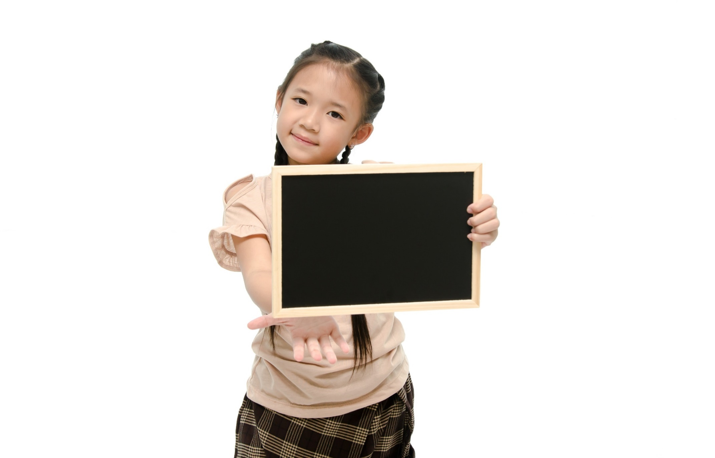
Production

Slide 15

Continue the story.
S1: If it’s hot tomorrow, I will go to the beach.
S2: If I go to the beach, … etc.

Slide 16

CONSOLIDATION

Slide 17
Make 5 sentences using Conditional (type 1) to predict what may happen next week.

Slide 18

WRAP-UP

Slide 19
Today’s lesson
Grammar
Conditional (type 1)
Form: if + Present Simple ➝ Future Simple (will + infinitive without to)
Note: unless = if not

Slide 20
Homework
Practise grammar and make sentences using them.
Do the exercises in TA 6 Right on WB (p. 58).
Complete grammar notes in TA 6 Right on Notebook (p. 58).
Prepare the next lesson (p. 112 SB).

Slide 21
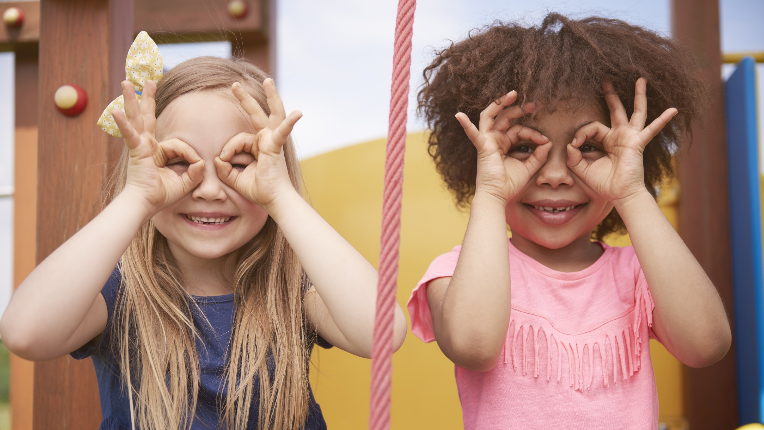
Enjoy your day!

