Slide 1

Unit 8: Traditions of
Ethnic Group in Vietnam
Lesson 3.1: Reading & Writing
Pages 82 & 83

Slide 2
Lesson Outline
Warm-up
Reading
Writing
Consolidation
Wrap-up

Slide 3

By the end of this lesson, students will be able to…
- practice reading for gist and for detail
- learn how to give supporting information in writing

Slide 4

WARM UP

Slide 5

Pre-reading

Slide 6

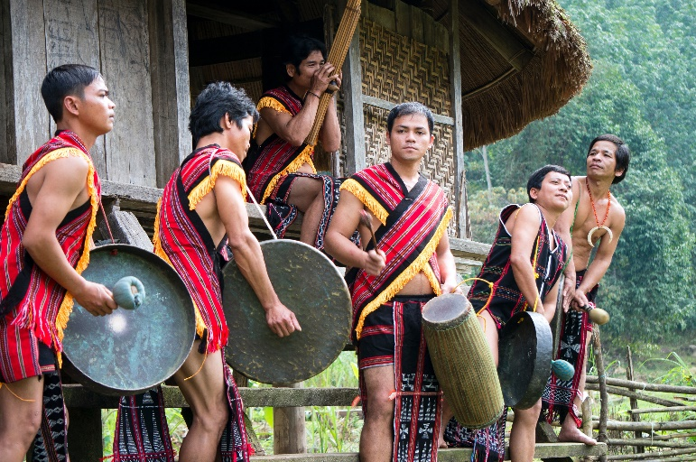
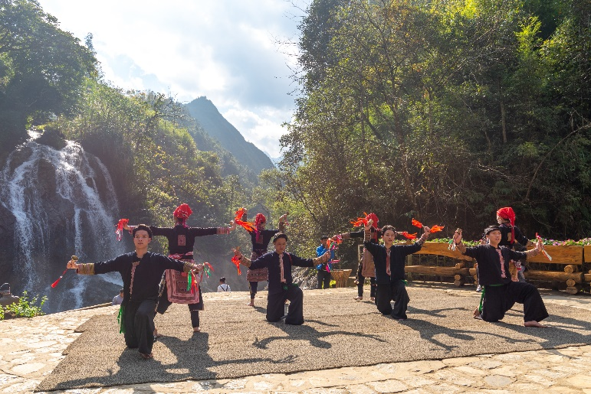
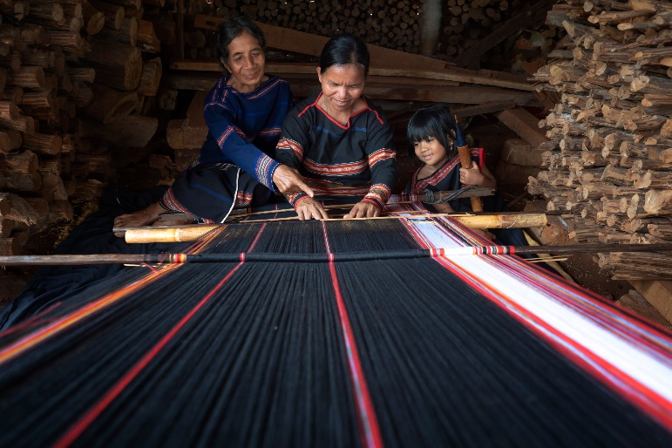
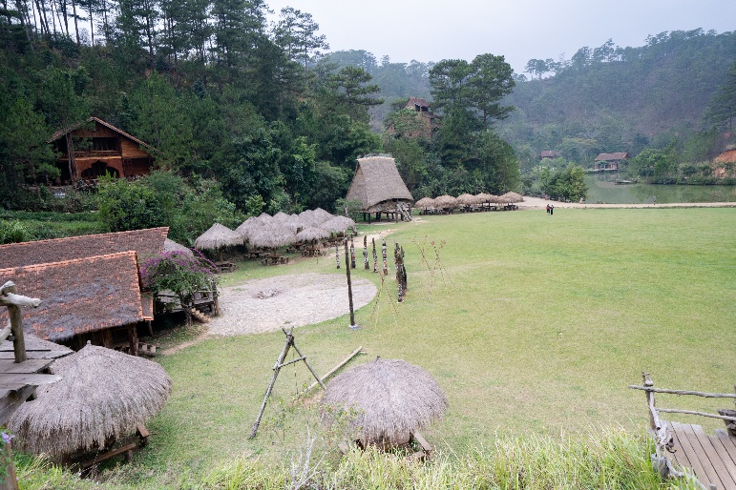
Work in pairs
Let’s talk
What activities are they doing?
What other activities do people often do when they visit ethnic villages?

Slide 7
Vocabulary
Listen and repeat.
stilt house (n) /stɪlt haʊs/ nhà sàn
gong (n) /ɡɑːŋ/ cồng, chiêng
decide (v) /dɪˈsaɪd/ quyết định
delicious (adj) /dɪˈlɪʃəs/ ngon

Slide 8
Task a
Pre-reading
Read the instruction and the answers quickly:
Underline the key words.
What are we going to do?
Read and choose the best topic sentence
Read Lan’s passage and choose the best topic sentence.
Jun Village is one of the most beautiful places in Vietnam.
I had an exciting trip to Jun Village.

Slide 9
Task b
Pre-reading
Read the instruction and the answers quickly:
- Identify the Wh-word in each question
- Underline the key words in each question
- Skim then scan the passage
- What are we going to do?
Read and answer the questions.

Slide 10
b. Now, read and answer the questions.
1. Where’s Jun Village? _______________________________
2. Where did Lan stay on her trip? _______________________________
3. What does Lan think about Lắk Lake? _______________________________
4. What food did she try? _______________________________
5. What did Lan learn on the trip to Jun Village?
____________________________________________________________

Slide 11

While-Reading

Slide 12
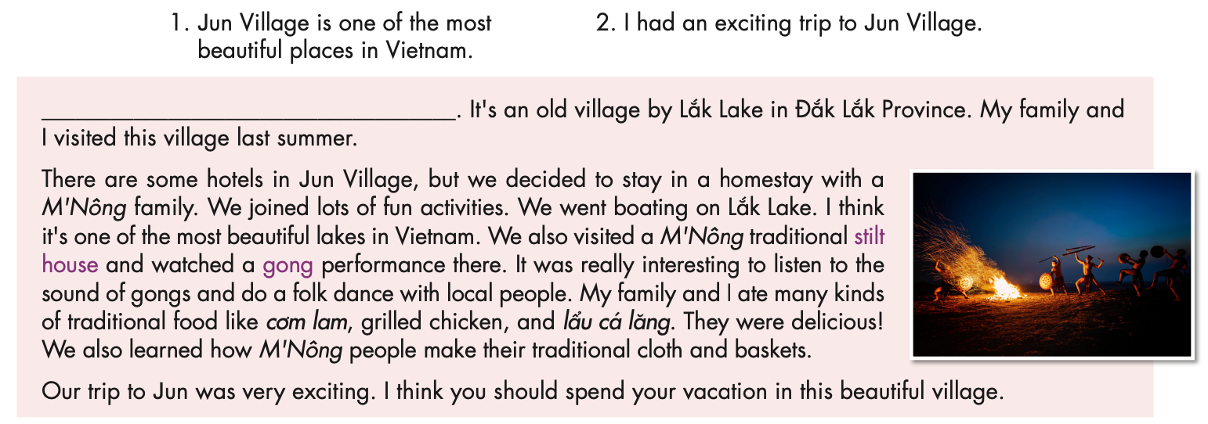
a. Read Lan’s passage and choose the best topic sentence.

Slide 13
b. Now, read and answer the questions.
1. Where’s Jun Village? _______________________________
by Lắk Lake in Đắk Lắk Province
2. Where did Lan stay on her trip? _______________________________
in a homestay with a M’Nông family
It’s one of the most beautiful lakes in Vietnam.
3. What does Lan think about Lắk Lake? _______________________________
4. What food did she try? _______________________________
cơm lam, grilled chicken, lẩu cá lăng
5. What did Lan learn on the trip to Jun Village?
____________________________________________________________
how M’Nông people make their traditional cloth and baskets.

Slide 14

Task c
Listen and read.
I had an exciting trip to Jun Village. It's an old village by Lắk Lake in Đắk Lắk Province. My family and I visited this village last summer.
There are some hotels in Jun Village, but we decided to stay in a homestay with a M'Nông family. We joined lots of fun activities. We went boating on Lắk Lake. I think it's one of the most beautiful lakes in Vietnam. We also visited a M'Nông traditional stilt house and watched a gong performance there. It was really interesting to listen to the sound of gongs and do a folk dance with local people. My family and I ate many kinds of traditional food like cơm lam, grilled chicken, and lẩu cá lăng. They were delicious! We also learned how M'Nông people make their traditional cloth and baskets.
Our trip to Jun was very exciting. I think you should spend your vacation in this beautiful village.

Slide 15
Post-reading

Slide 16

Work in pairs
What do you think about the activities Lan did on her trip? Would you like to try any of them?
I think the activities sound interesting.
I would like to watch a gong performance.

Slide 17

Writing

Slide 18
Task a
Read about giving supporting information.
Giving supporting information
To write a good passage, you should give supporting information for each point you make. Here are three common types of supporting information.
1. Facts – give true information to support the main point. The information answers questions like
I had a fun trip to Quỳnh Sơn. It's a village in Lạng Sơn, Vietnam. I went there last summer.
2. Examples – give specific examples to support the main point
I learned a lot about their culture. We learned how to fish on a lake. We also saw a traditional
who, what, when,...?
Tày folk music and dance show.
3. Opinions – give your personal opinions to help support the main point
I had a fun trip to Quỳnh Sơn. I think you should visit this village.

Slide 19
Read Lan’s passage again and underline the facts, examples, and opinions.
I had an exciting trip to Jun Village. It's an old village by Lắk Lake in Đắk Lắk Province. My family and I visited this village last summer.
There are some hotels in Jun Village, but we decided to stay in a homestay with a M'Nông family. We joined lots of fun activities. We went boating on Lắk Lake. I think it's one of the most beautiful lakes in Vietnam. We also visited a M'Nông traditional stilt house and watched a gong performance there. It was really interesting to listen to the sound of gongs and do a folk dance with local people. My family and I ate many kinds of traditional food like cơm lam, grilled chicken, and lẩu cá lăng. They were delicious! We also learned how M'Nông people make their traditional cloth and baskets.
Our trip to Jun was very exciting. I think you should spend your vacation in this beautiful village.

Slide 20
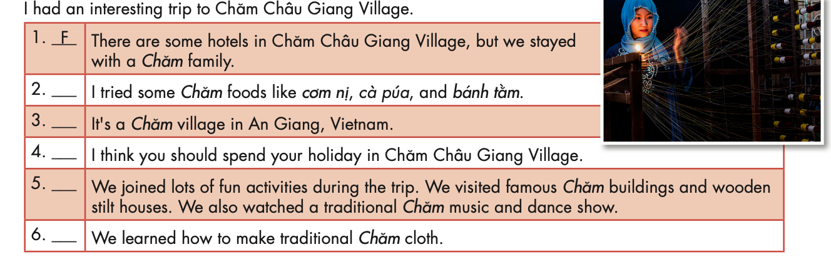
Task b
Read the topic sentence and the supporting information. Then, write “F” for facts, “E” for examples, and “O” for opinions.
E
F
O
E
E

Slide 21

CONSOLIDATION

Slide 22
Arrange the sentences in task b in the correct order of giving supporting information to make a meaningful paragraph.
I had an interesting trip to Chăm Châu Giang Village. It’s a Chăm Village in An Giang, Vietnam. There are some hotels in Chăm Châu Giang Village, but we stayed with a Chăm family. We joined lots of fun activities during the trip. We visited famous Chăm buildings and wooden stilt houses. We also watched a traditional Chăm music and dance show. I tried some Chăm foods like cơm nị, cà púa, and bánh tằm. We learned how to make traditional Chăm cloth. I think you should spend your holiday in Chăm Châu Giang Village.

Slide 23

WRAP-UP

Slide 24
Today’s lesson
Reading
Read a passage about a trip to an ethnic village in Vietnam
Writing
Understand the three common types of supporting information

Slide 25
Homework
Do the reading exercises on page 48 WB.
Do the reading exercise in Tiếng Anh 8 i-Learn Smart World Notebook on page 68.
Prepare the next lesson (page 83 SB).
Play the consolidation games on www.eduhome.com.vn

Slide 26

Lesson 3
Stay positive and have a nice day!

