Slide 1


Slide 2



Unit
3
COMMUNITY SERVICE
Vocabulary
Use words related to community activities
Pronunciation
/t/, /d/, /ɪd/
LESSON 2: A CLOSER LOOK 1
Unit
HOBBIES

Slide 3

OBJECTIVES
By the end of the lesson, students will be able to:
use the lexical items related to community activities
correctly pronounce the sounds: /t/ , /d/ , /ɪd/

Slide 4
LESSON 2: A CLOSER LOOK 1
WARM-UP
Matching game
Task 1: Match a verb in A with a word or phrase in B.
Task 2: Complete each of the sentences with a suitable word or phrase from the box.
Task 3: Use the phrases from the box to write full sentences under the correct picture.
VOCABULARY
Task 4: Listen and repeat. Pay attention to the sounds /t/, /d/ and /ɪd/.
Task 5: Listen to the sentences and pay attention to the underlined parts. Tick the appropriate sounds. Practise the sentences.
PRONUNCIATION
PRODUCTION
Game: Broken telephone
CONSOLIDATION
Wrap-up
Homework

Slide 5
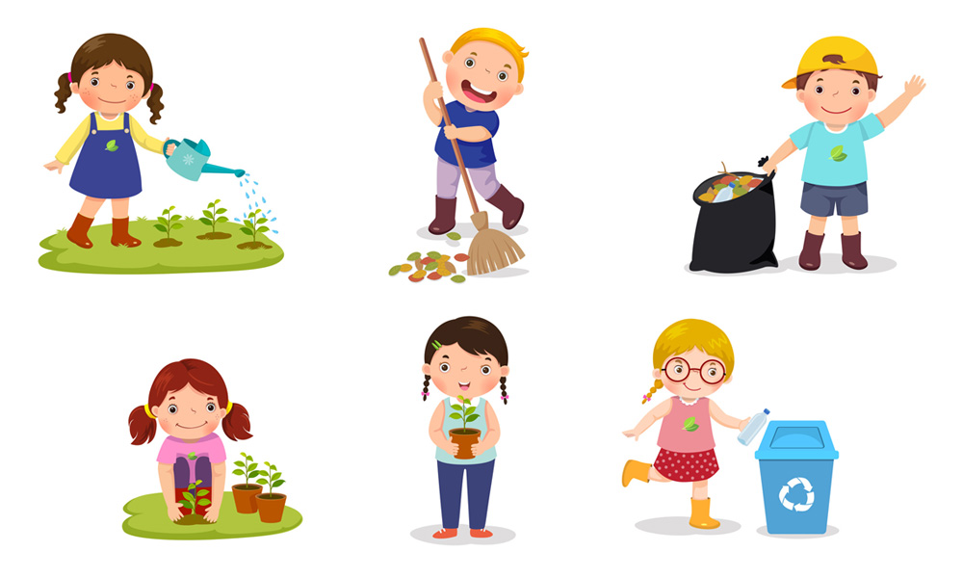
LESSON 2: A CLOSER LOOK 1
WARM-UP
Matching game
Aims of the stage:
to recall students’ vocabulary on community activities

Slide 6
WARM-UP
Match the verbs with the suitable nouns.
recycle | help | plant
trees | vegetables | small children | old people
books | bottles | cans | homeless children

Slide 7
WARM-UP
Match the verbs with the suitable nouns.
recycle
books
bottles
cans
help
small children
homeless children
old people
plant
trees
vegetables

Slide 8

LESSON 2: A CLOSER LOOK 1
WARM-UP
Matching game
Task 1: Match a verb in A with a word or phrase in B.
Task 2: Complete each of the sentences with a suitable word or phrase from the box.
Task 3: Use the phrases from the box to write full sentences under the correct picture.
VOCABULARY

Slide 9


VOCABULARY
exchange (v)
/ɪksˈʧeɪnʤ/
trao đổi

Slide 10

VOCABULARY
pick up (phr. v.)
/pɪk ʌp/
nhặt lên

Slide 11

VOCABULARY
tutor (v)
/ˈtjuːtə/
dạy kèm

Slide 12
PRESENTATION
New words | Pronunciation | Meaning
1. exchange (v) | /ɪksˈʧeɪnʤ/ | trao đổi
2. pick up (phr. v.) | /pɪk ʌp/ | nhặt lên, hái (hoa)
3. tutor (v) | /ˈtjuːtə/ | dạy kèm

Slide 13
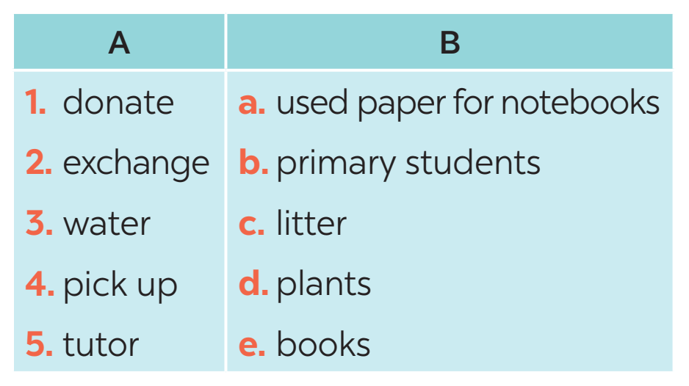
VOCABULARY
1
Match a verb in a with a word or phrase in B.
1. e
2. a
3. d
4. c
5. b
Notes:
Wordwall game: https://wordwall.net/resource/27241481

Slide 14
VOCABULARY
2
Complete each of the sentences with a suitable word or phrase from the box.
tutor litter water donate used paper for notebooks
1. We pick up ____________ at the local park every Sunday.
2. Children in our village exchange ____________________________ every school year.
3. Tom and his friends ____________ the plants in their neighbourhood every weekend.
4. We ____________ old textbooks to children in rural areas.
5. Minh and his friends often ____________ small children in their village.
litter
used paper for notebooks
water
donate
tutor

Slide 15
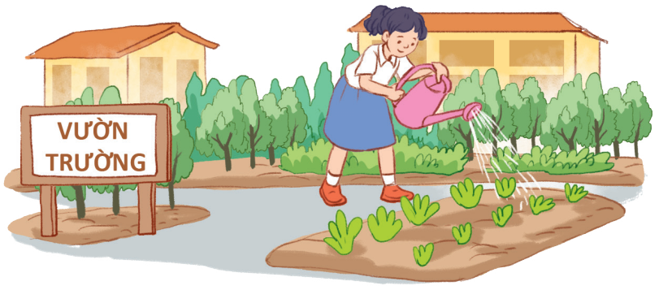
VOCABULARY
3
Use the phrases from the box to write full sentences under the correct pictures.
0. watering vegetables in the school garden
1. giving gifts to old people
2. exchanging used paper for notebooks
3. planting trees in the park
4. reading books to the elderly
5. donating clothes to poor children
Example:
0. Lan is watering vegetables in the school garden.

Slide 16

VOCABULARY
3
Use the phrases from the box to write full sentences under the correct pictures.
0. watering vegetables in the school garden
1. giving gifts to old people
2. exchanging used paper for notebooks
3. planting trees in the park
4. reading books to the elderly
5. donating clothes to poor children
1.
1. She’s reading books to the elderly.

Slide 17
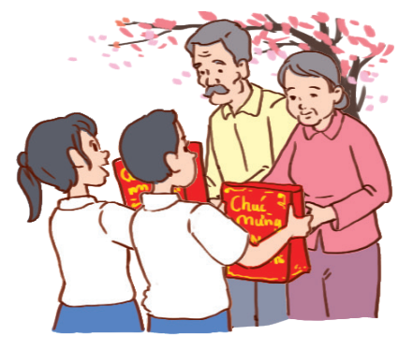
VOCABULARY
3
Use the phrases from the box to write full sentences under the correct pictures.
0. watering vegetables in the school garden
1. giving gifts to old people
2. exchanging used paper for notebooks
3. planting trees in the park
4. reading books to the elderly
5. donating clothes to poor children
2.
2. They’re giving gifts to old people.

Slide 18

VOCABULARY
3
Use the phrases from the box to write full sentences under the correct pictures.
0. watering vegetables in the school garden
1. giving gifts to old people
2. exchanging used paper for notebooks
3. planting trees in the park
4. reading books to the elderly
5. donating clothes to poor children
3.
3. They are exchanging used paper
for notebooks.

Slide 19
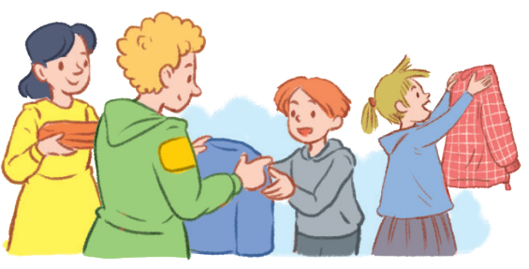
VOCABULARY
3
Use the phrases from the box to write full sentences under the correct pictures.
0. watering vegetables in the school garden
1. giving gifts to old people
2. exchanging used paper for notebooks
3. planting trees in the park
4. reading books to the elderly
5. donating clothes to poor children
4.
4. They’re donating clothes to poor children.

Slide 20
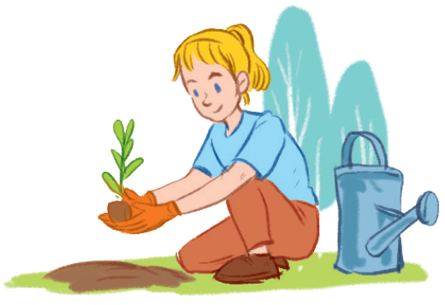
VOCABULARY
3
Use the phrases from the box to write full sentences under the correct pictures.
0. watering vegetables in the school garden
1. giving gifts to old people
2. exchanging used paper for notebooks
3. planting trees in the park
4. reading books to the elderly
5. donating clothes to poor children
5.
5. She’s planting trees in the park.

Slide 21
LESSON 2: A CLOSER LOOK 1
WARM-UP
Matching game
Task 1: Match a verb in A with a word or phrase in B.
Task 2: Complete each of the sentences with a suitable word or phrase from the box.
Task 3: Use the phrases from the box to write full sentences under the correct picture.
VOCABULARY
Task 4: Listen and repeat. Pay attention to the sounds /t/, /d/ and /ɪd/.
Task 5: Listen to the sentences and pay attention to the underlined parts. Tick the appropriate sounds. Practise the sentences.
PRONUNCIATION

Slide 22
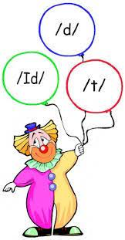

PRONUNCIATION

Slide 23
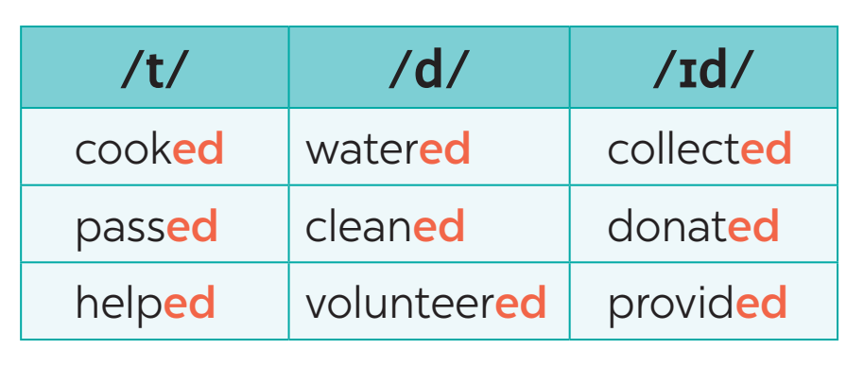
PRONUNCIATION
4
Listen and repeat. Pay attention to the sounds /t/, /d/, and /ɪd/.

Slide 24
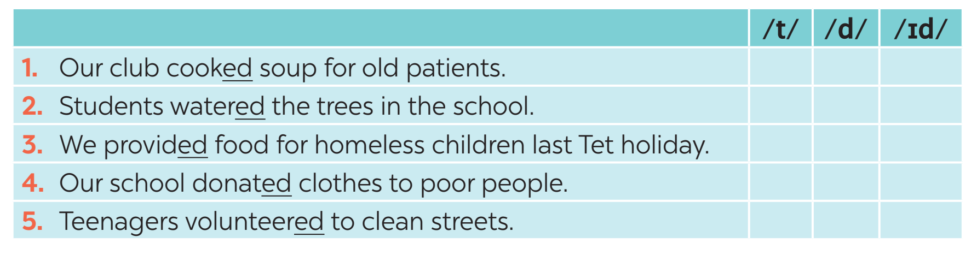

PRODUCIATION
5
Listen to the sentences and pay attention to the underlined parts. Tick the appropriate sounds. Practise the sentences.

Slide 25
LESSON 2: A CLOSER LOOK 1
WARM-UP
Matching game
Task 1: Match a verb in A with a word or phrase in B.
Task 2: Complete each of the sentences with a suitable word or phrase from the box.
Task 3: Use the phrases from the box to write full sentences under the correct picture.
VOCABULARY
Task 4: Listen and repeat. Pay attention to the sounds /t/, /d/ and /ɪd/.
Task 5: Listen to the sentences and pay attention to the underlined parts. Tick the appropriate sounds. Practise the sentences.
PRONUNCIATION
PRODUCTION
Game: Broken telephone

Slide 26

PRODUCIATION
Game: Broken telephone
/t/ | /d/ | /ɪd/
picked, booked, helped | tutored, watered, exchanged | donated, planted

Slide 27
LESSON 2: A CLOSER LOOK 1
WARM-UP
Matching game
Task 1: Match a verb in A with a word or phrase in B.
Task 2: Complete each of the sentences with a suitable word or phrase from the box.
Task 3: Use the phrases from the box to write full sentences under the correct picture.
VOCABULARY
Task 4: Listen and repeat. Pay attention to the sounds /t/, /d/ and /ɪd/.
Task 5: Listen to the sentences and pay attention to the underlined parts. Tick the appropriate sounds. Practise the sentences.
PRONUNCIATION
PRODUCTION
Game: Broken telephone
CONSOLIDATION
Wrap-up
Homework

Slide 28
CONSOLIDATION
Vocabulary
Use words related to community activities
Pronunciation
/t/, /d/, /ɪd/
1
WRAP-UP

Slide 29

CONSOLIDATION
2
HOMEWORK
What can you do to make your neighbourhood to be a greener place? Write at least 3 activities.

Slide 30

Website: hoclieu.vn
Fanpage: facebook.com/www.tienganhglobalsuccess.vn/

