Slide 1

Unit 3: Arts and Music
Lesson 3b: Grammar (Cont.)
Page 49

Slide 2
Lesson Outline
Warm-up
Grammar
Consolidation
Wrap-up

Slide 3
Objectives
By the end of this lesson, students will be able to…
- use be going to, Present Continuous, and Present Simple correctly.
- ask and answer about future predictions, future plans, intentions, future arrangements, timetables, and schedules.

Slide 4

WARM-UP

Slide 5

Work in pairs.
MATCHING
Match the words in column A and words in column B to make complete phrases.
A | B
1. ride | a. a film
2. watch | b. a bike
3. travel | c. tickets
4. buy | d. to Hanoi

Slide 6

It’s time to learn …

Slide 7
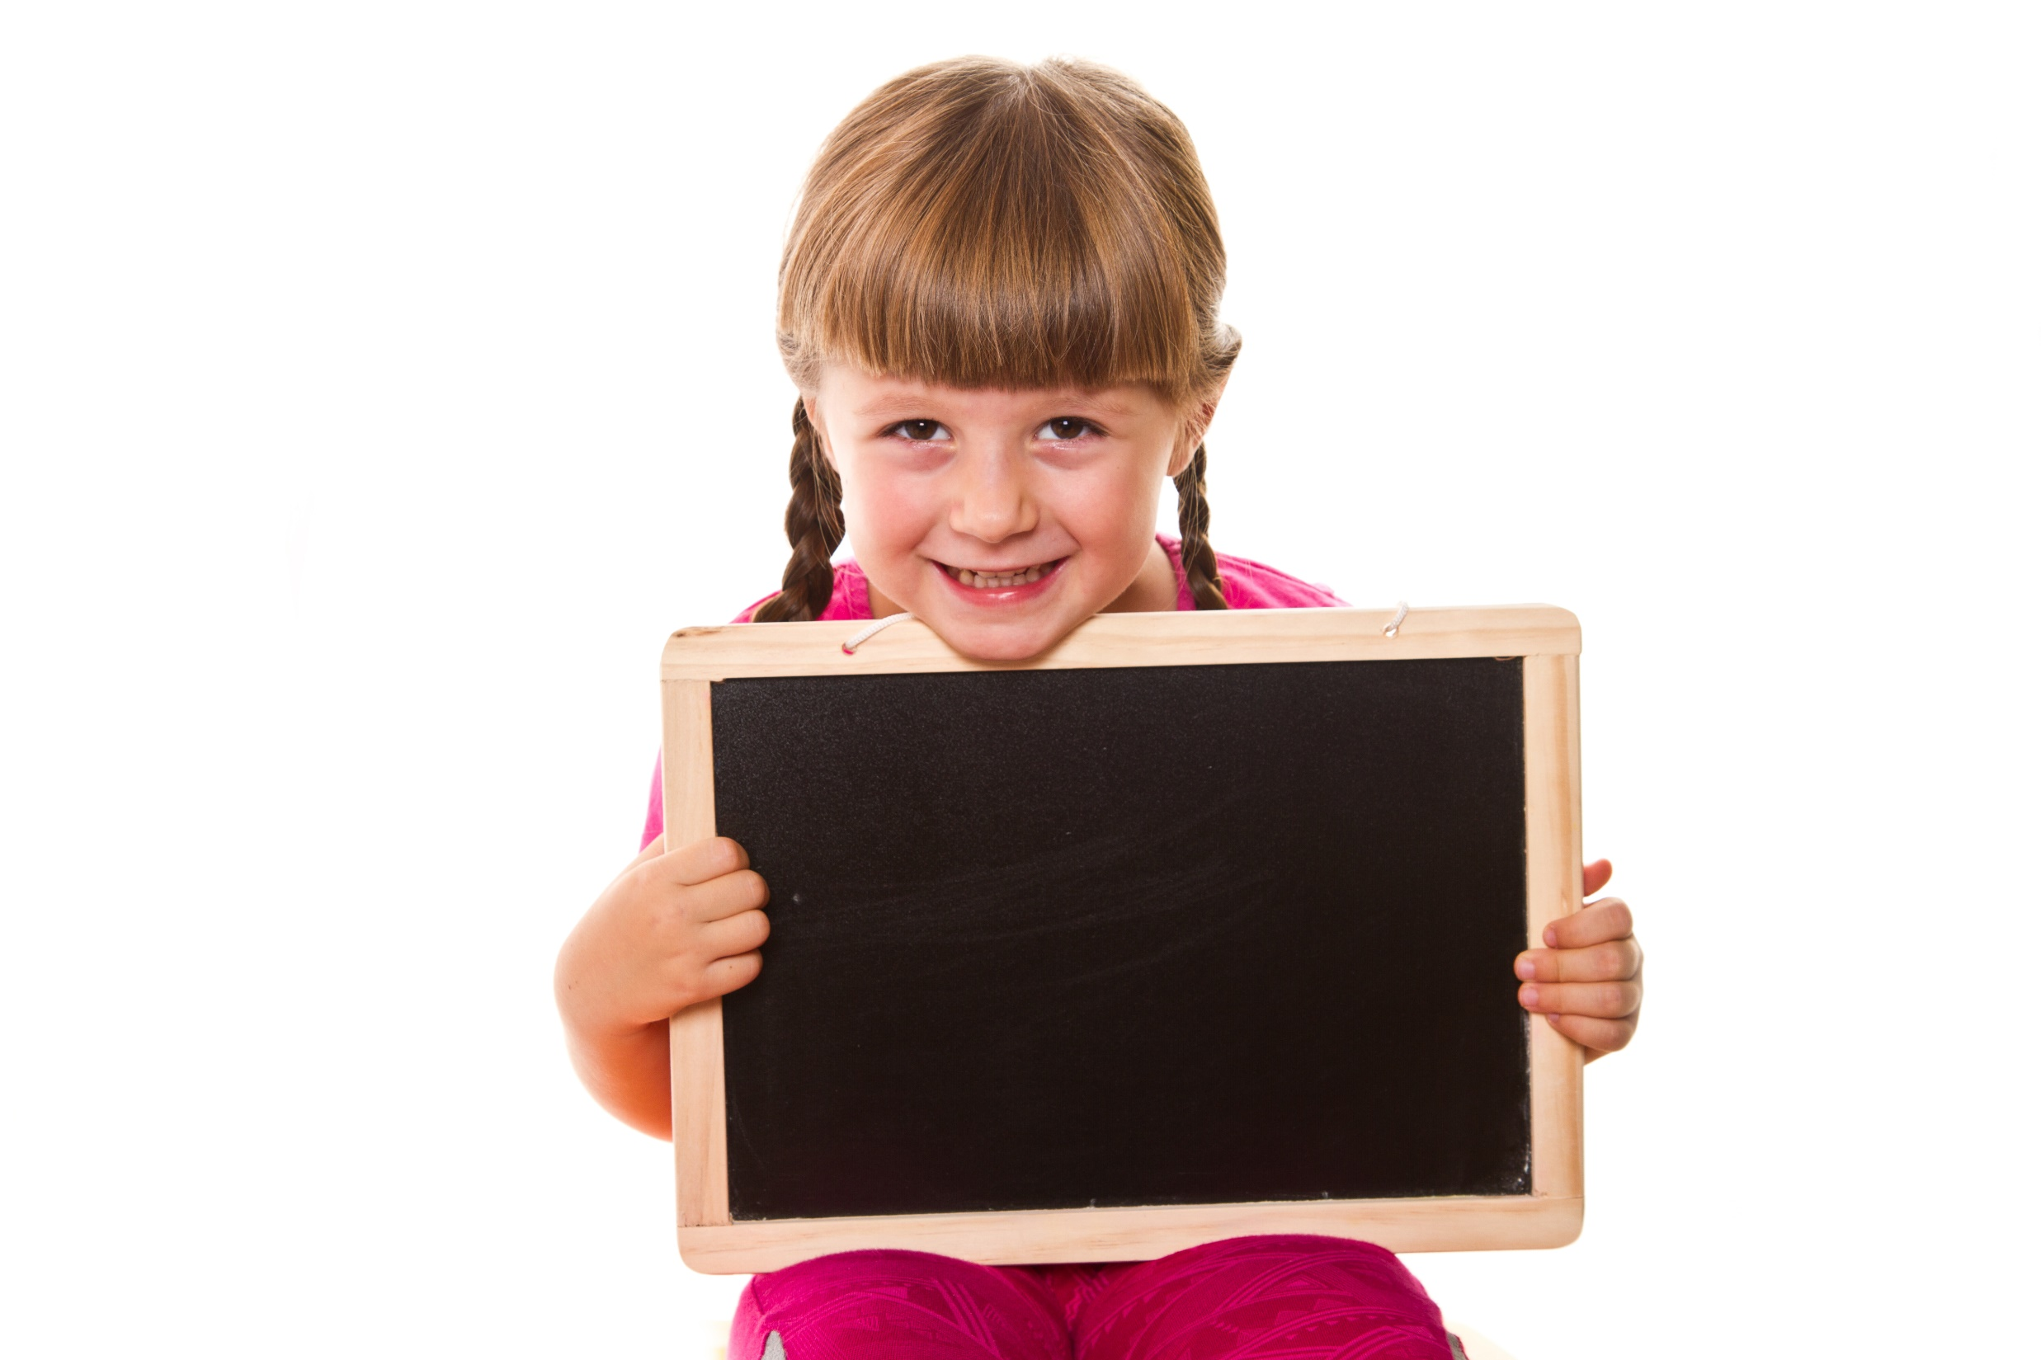
Presentation

Slide 8
Examples
1. Sorry, I can’t. I’m going to take part in the school play. The girls are coming, too.
2. The school play starts at 7:00.

Slide 9
Lead in
1. What tense do we use in sentence 1?
be going to and Present Continuous.
2. What do we use be going to and Present Continuous for?
→ be going to is used for future predictions based on what we know or see; future plans & intentions.
Present Continuous is used for fixed future arrangements.

Slide 10
Lead in
3. How about sentence 2?
→ Present Simple.
4. What do we use Present Simple for?
→ For timetables and schedules.

Slide 11
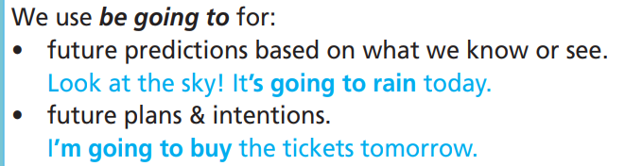
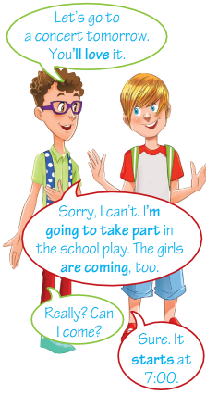
S + am/is/are going to + bare-inf. + …
+
It’s going to rain today.
Structure:
S + am/is/are + not + going to + bare-inf. + …
-
It isn’t going to rain today.
Am/Is/Are + S + going to + bare-inf. + …?
?
Is it going to rain today?

Slide 12
S + am/is/are + V-ing + …
+
We are seeing a film tonight.
Structure:
S + am/is/are + not + V-ing + …
-
We aren’t seeing a film tonight.
?
Am/Is/Are + S + V-ing + …?
Are we seeing a film tonight?

Slide 13
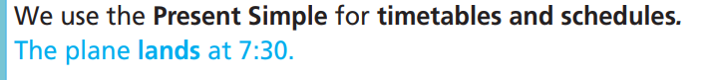
S + V-inf/V(s/es) + …
+
The plane lands at 7:30.
Structure:
S + don’t/doesn’t + V-inf + …
-
The plane doesn’t land at 7:30.
Do/Does + S + V-inf + …?
?
Does the plane land at 7:30?

Slide 14
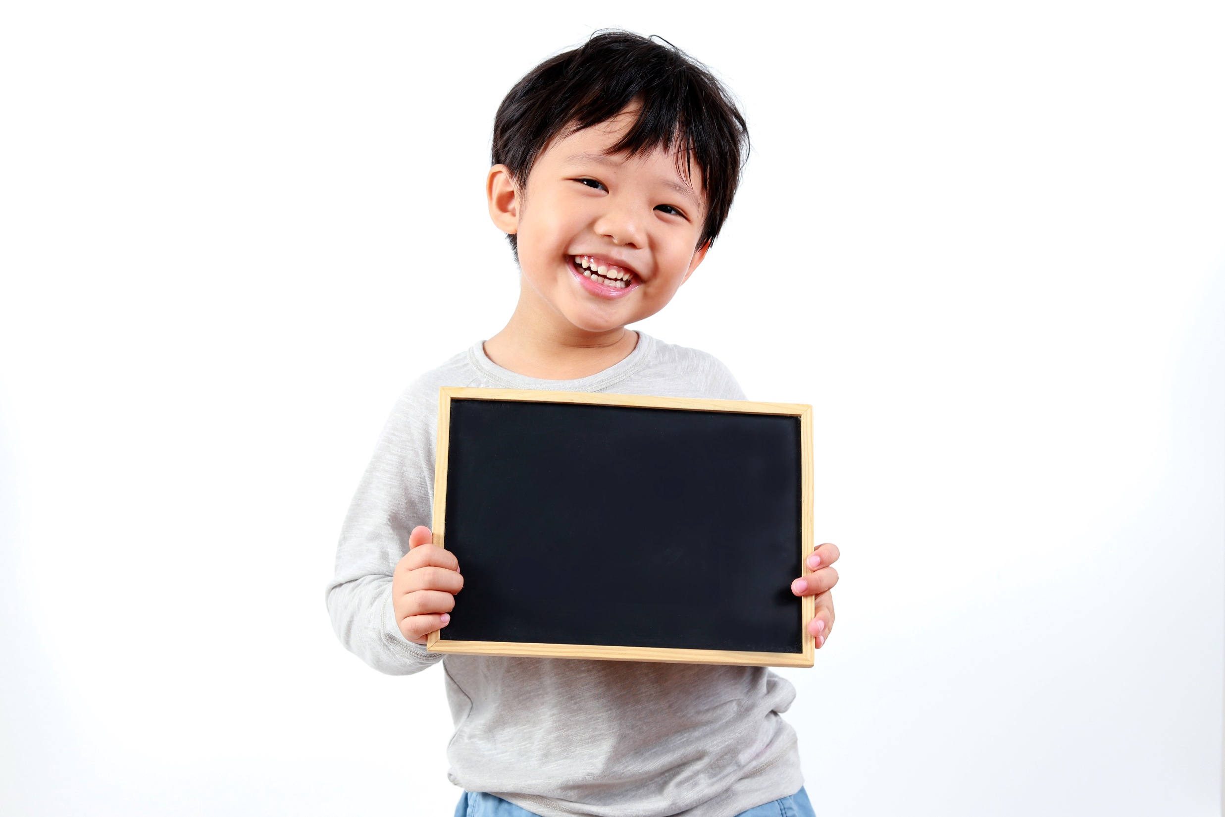
Practice

Slide 15
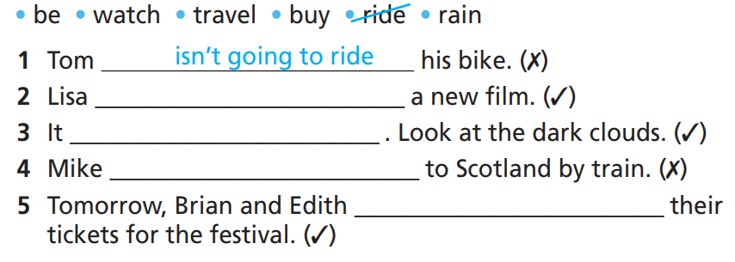
Practice
3 Complete the sentences. Use the affirmative or negative form of
be going to and the verbs in the list.
How many sentences are there?
→ There are 5.
What are you going to do?
Use the affirmative or negative form of be going to and the verbs to complete the sentences.

Slide 16
Practice
Pay attention to underlined parts in each sentence.
• be • watch • travel • buy • ride • rain
1. Tom _________________his bike. (✗)
2. Lisa ___________________ a new film. (✓)
3. It __________________ . Look at the dark clouds. (✓)
4. Mike ___________________ to Scotland by train. (✗)
5. Tomorrow, Brian and Edith _________________ their tickets for the festival. (✓)
isn’t going to ride
is going to watch
is going to rain
isn’t going to travel
are going to buy

Slide 17
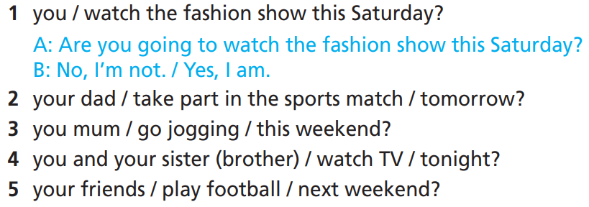
Practice
4 Ask and answer using be going to and the prompts below.
How many sentences questions and
answer will you make?
→ 4 questions and 4 answers.
What will you use?
Use be going to.

Slide 18
Practice
Ask and answer using be going to and the prompts below.
1. you / watch the fashion show this Saturday?
A: Are you going to watch the fashion show this Saturday?
B: No, I’m not. / Yes, I am.
2. your dad / take part in the sports match / tomorrow?
A: Is your dad going to take part in the sports match tomorrow?
B: Yes, he is. / No, he isn’t.

Slide 19
Practice
Ask and answer using be going to and the prompts below.
3. you mum / go jogging / this weekend?
4. you and your sister (brother) / watch TV / tonight?
5. your friends / play football / next weekend?
A: Is your mum going to go jogging this weekend?
B: Yes, she is. / No, she isn’t.
A: Are you and your sister (brother) going to watch TV tonight?
B: Yes, we are. / No, we aren’t.
A: Are your friends going to play football next weekend?
B: Yes, they are. / No, they aren’t.

Slide 20
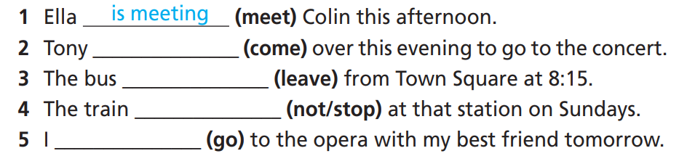
Practice
5 Put the verbs in brackets into the Present Simple or the Present
Continuous.
How many sentences are there?
→ Five.
What tenses will you use?
Present Simple or Present Continuous.

Slide 21
Practice
Pay attention to underlined parts in each sentence.
1. Ella ___________ (meet) Colin this afternoon.
2. Tony ___________ (come) over this evening to go to the concert.
3. The bus ___________ (leave) from Town Square at 8:15.
4. The train __________ (not/stop) at that station on Sundays.
5. I ________ (go) to the opera with my best friend tomorrow.
is meeting
is coming
leaves
doesn’t stop
am going

Slide 22
Practice
6 Choose the correct option.
1. My parents buy/are going to buy a new piano next month.
2. The performance starts/will start at 9:30.
3. Ben won’t/isn’t going to study Drama. He doesn’t want to work as an actor.
4. Some people believe we will/are going to have ﬂying cars
in the future.
5. Ann and Jane aren’t going/don’t go to the fashion show tonight.

Slide 23
Extra Practice
WB, page 27
Choose the correct option.
1 You are finding/find/will find your card on the desk!
2 Luke thinks he is going to win/wins/will win the song competition.
3 Look at the sky! It is going to rain/will rain/rains today.
4 I will meet/meet/am meeting Frank at noon, so I can’t go to the shop with you now.

Slide 24
Extra Practice
WB, page 27
Choose the correct option.
5. I promise I am going to be/will be/am careful with your tablet.
6. Are you playing/Do you play/Will you play football tonight?
7. What time does/will/is the show start?
8. I am saving money because I am going to buy/buy/will buy tickets for the concert.

Slide 25
Extra Practice
WB, page 27
Put the verbs in brackets in the correct form of will, be going to, the Present Continuous or the Present Simple.
1. Tom _________________(work) at a theatre next summer. He signed his contract yesterday.
2. Oh, no! It’s raining! I __________________ (not/play) football outside.
3. They _________________ (spend) a week in Ho Chi Minh City next December. They booked the tickets last week.
4. Our ﬂight ________________ (leave) at 5:30 a.m.
is going to work
won’t play
are going to spend
leaves

Slide 26
Extra Practice
WB, page 27
Put the verbs in brackets in the correct form of will, be going to, the Present Continuous or the Present Simple.
5. I think Julie ________________ (become) a great fashion designer.
6. We ________________ (attend) a dance performance tomorrow. Come with us.
7. I _____________________ (not/study) history at university.
I’m more interested in technology.
8. The theatre club ________________ (not/close) until
9:00 p.m. on weekdays.
will become
are attending
am not going to study
doesn’t close

Slide 27

Production

Slide 28

Tell your partner two things you are/aren’t doing this weekend, you are/aren’t going to do this month.

Slide 29
STUDENT A
STUDENT B
What are you doing this weekend?
I’m going to the theatre.
What aren’t you doing this weekend?
I’m not going to the cinema.
What are you doing this month?
I’m going to go to the stadium with my brother.
What aren’t you doing this month?
I’m not going to go to a fashion show.

Slide 30

CONSOLIDATION

Slide 31

Work in pairs.
Now, practise the conversation with your partner.
1 A: Are you going to watch the fashion show this Saturday?
B: No, I’m not. / Yes, I am.
2 A: Is your dad going to take part in the sports match
tomorrow?
B: Yes, he is. / No, he isn’t.

Slide 32

Work in pairs.
Now, practise the conversation with your partner.
3 A: Is your mum going to go jogging this weekend?
B: Yes, she is. / No, she isn’t.
4 A: Are you and your sister (brother) going to watch TV tonight?
B: Yes, we are. / No, we aren’t.
5 A: Are your friends going to play football next weekend?
B: Yes, they are. / No, they aren’t.

Slide 33

WRAP-UP

Slide 34
Today’s lesson
Grammar: Practise and use be going to, Present Continuous, and Present Simple correctly.
Speaking: Ask and answer about future predictions, future plans, intentions, future arrangements, timetables, and schedules.

Slide 35
Homework
Practise the grammar point and make sentences using them.
Do the exercises in TA 7 Right on WB (page 27).
Prepare the next lesson (page 50 SB).
Complete the grammar notes in TA 7 Right on Notebook (page 22).

Slide 36
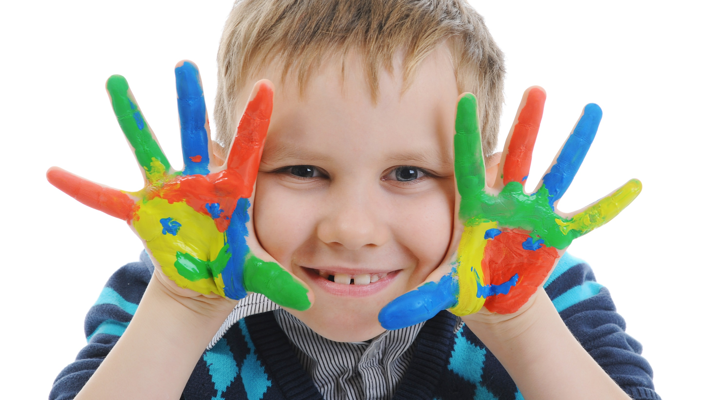
Enjoy your day!

