Slide 1

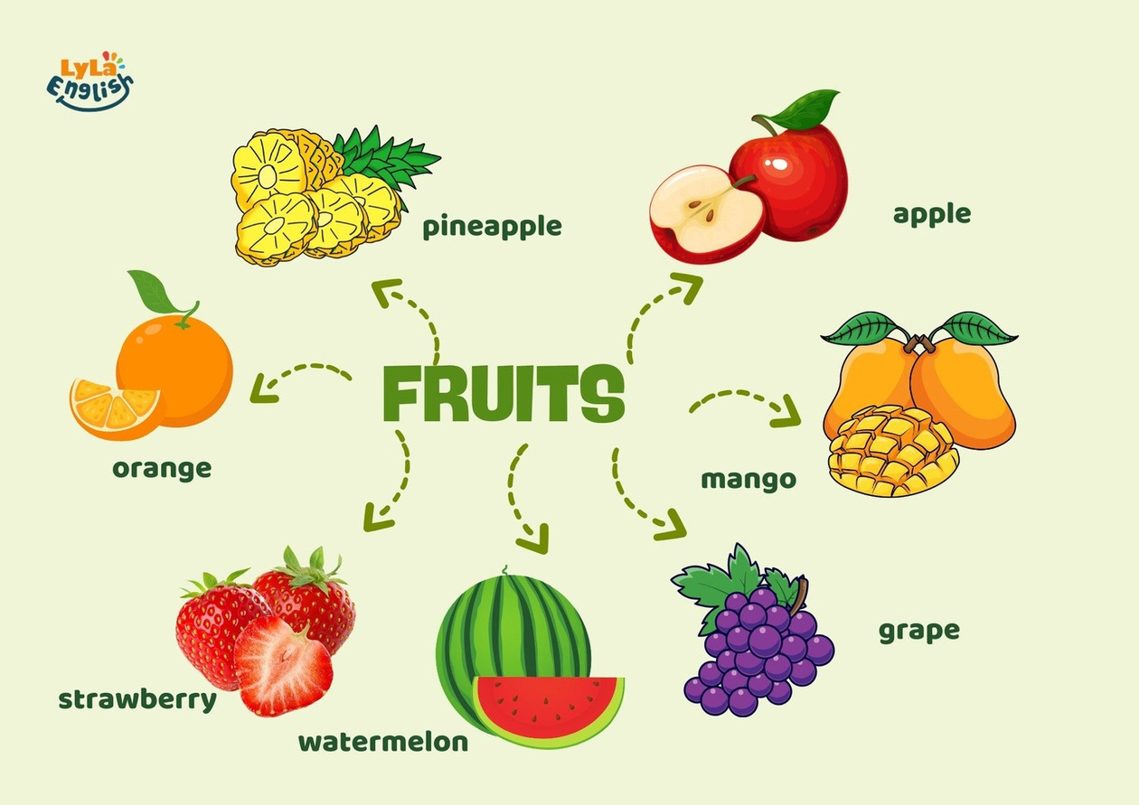


Slide 2

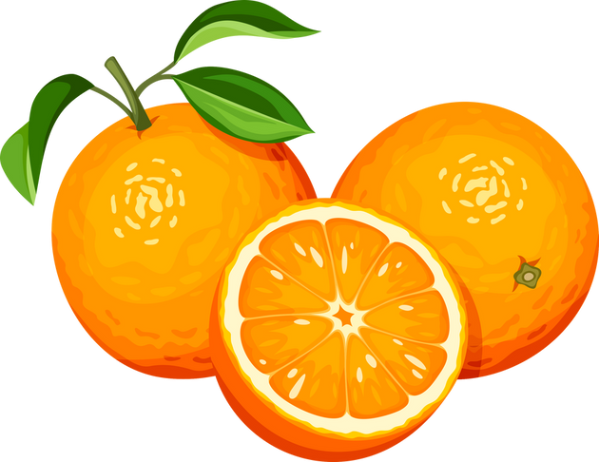
I. QUESTION
What fruit is this?
- It’s an ….
2. What color is this orange?
- It’s ….
3. What shape is this orange?
- It’s ….
4. What fruit do you like?
- I like ….
5. What color is an apple?
- It’s ...

Slide 3
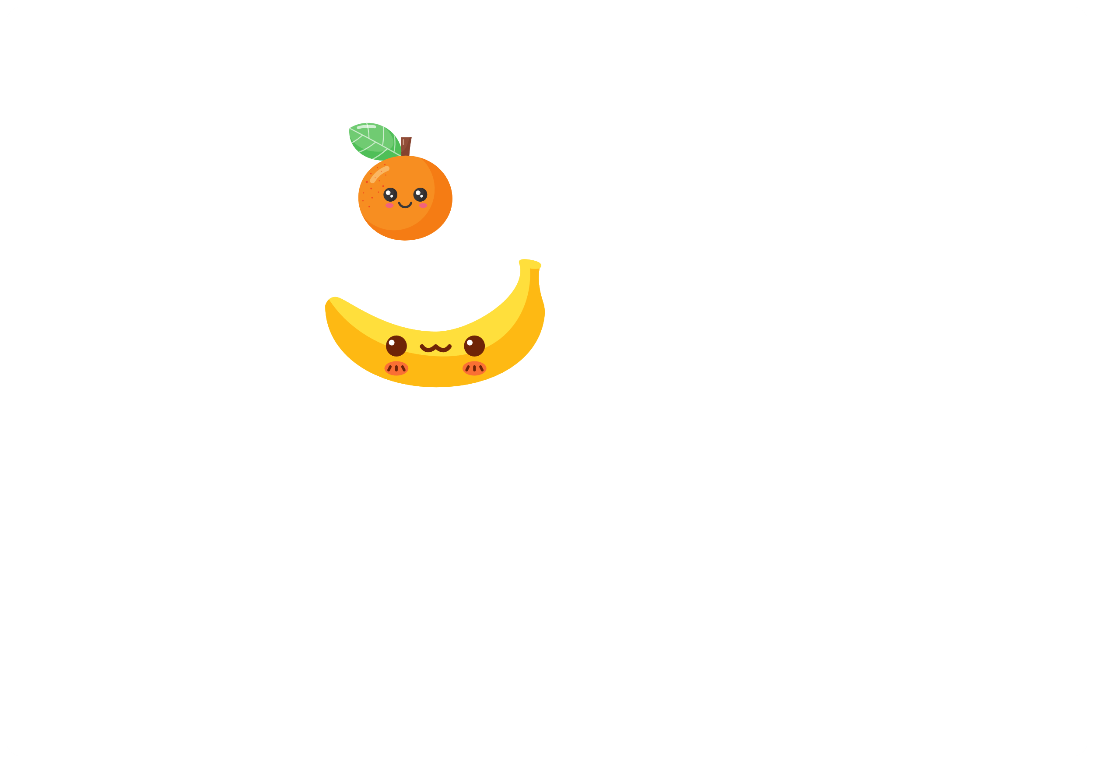
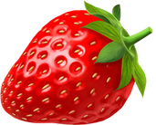
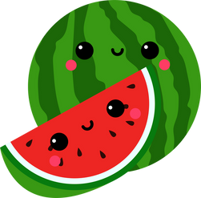
I. QUESTION
1. I’m a fruit. I am the same color as my name. Who am I? -...
2. I’m a fruit. Monkey like to eat me. Who am I? - ...
3. I’m a fruit. I am red. My seeds are on my skin. Who am I? - ...
4. I’m a fruit. I am big, my skin is green. My fresh is red. My seeds is black. Who am I? - ...

Slide 4
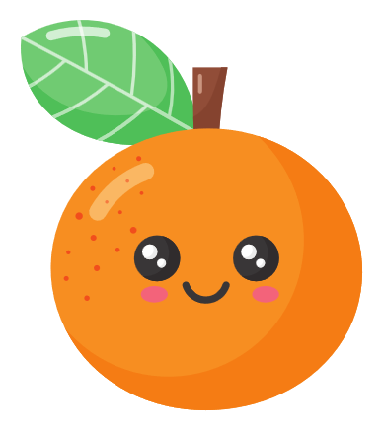
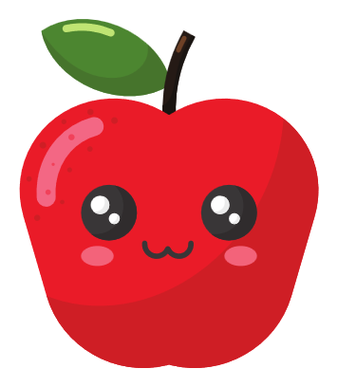


II. VOCABULARY
Orange:.....................................................
Apple:.....................................................
Strawberry:.....................................................
Pineapple:.....................................................

Slide 5
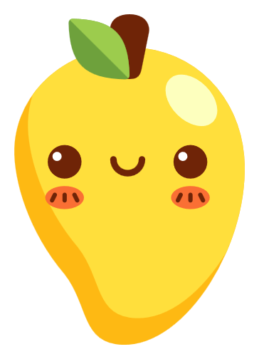
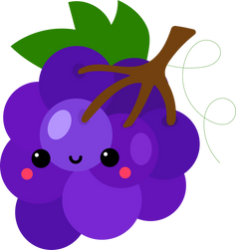
II. VOCABULARY
Mango:.........................................................
Grape:...........................................................
Watermelon:...................................................

Slide 6
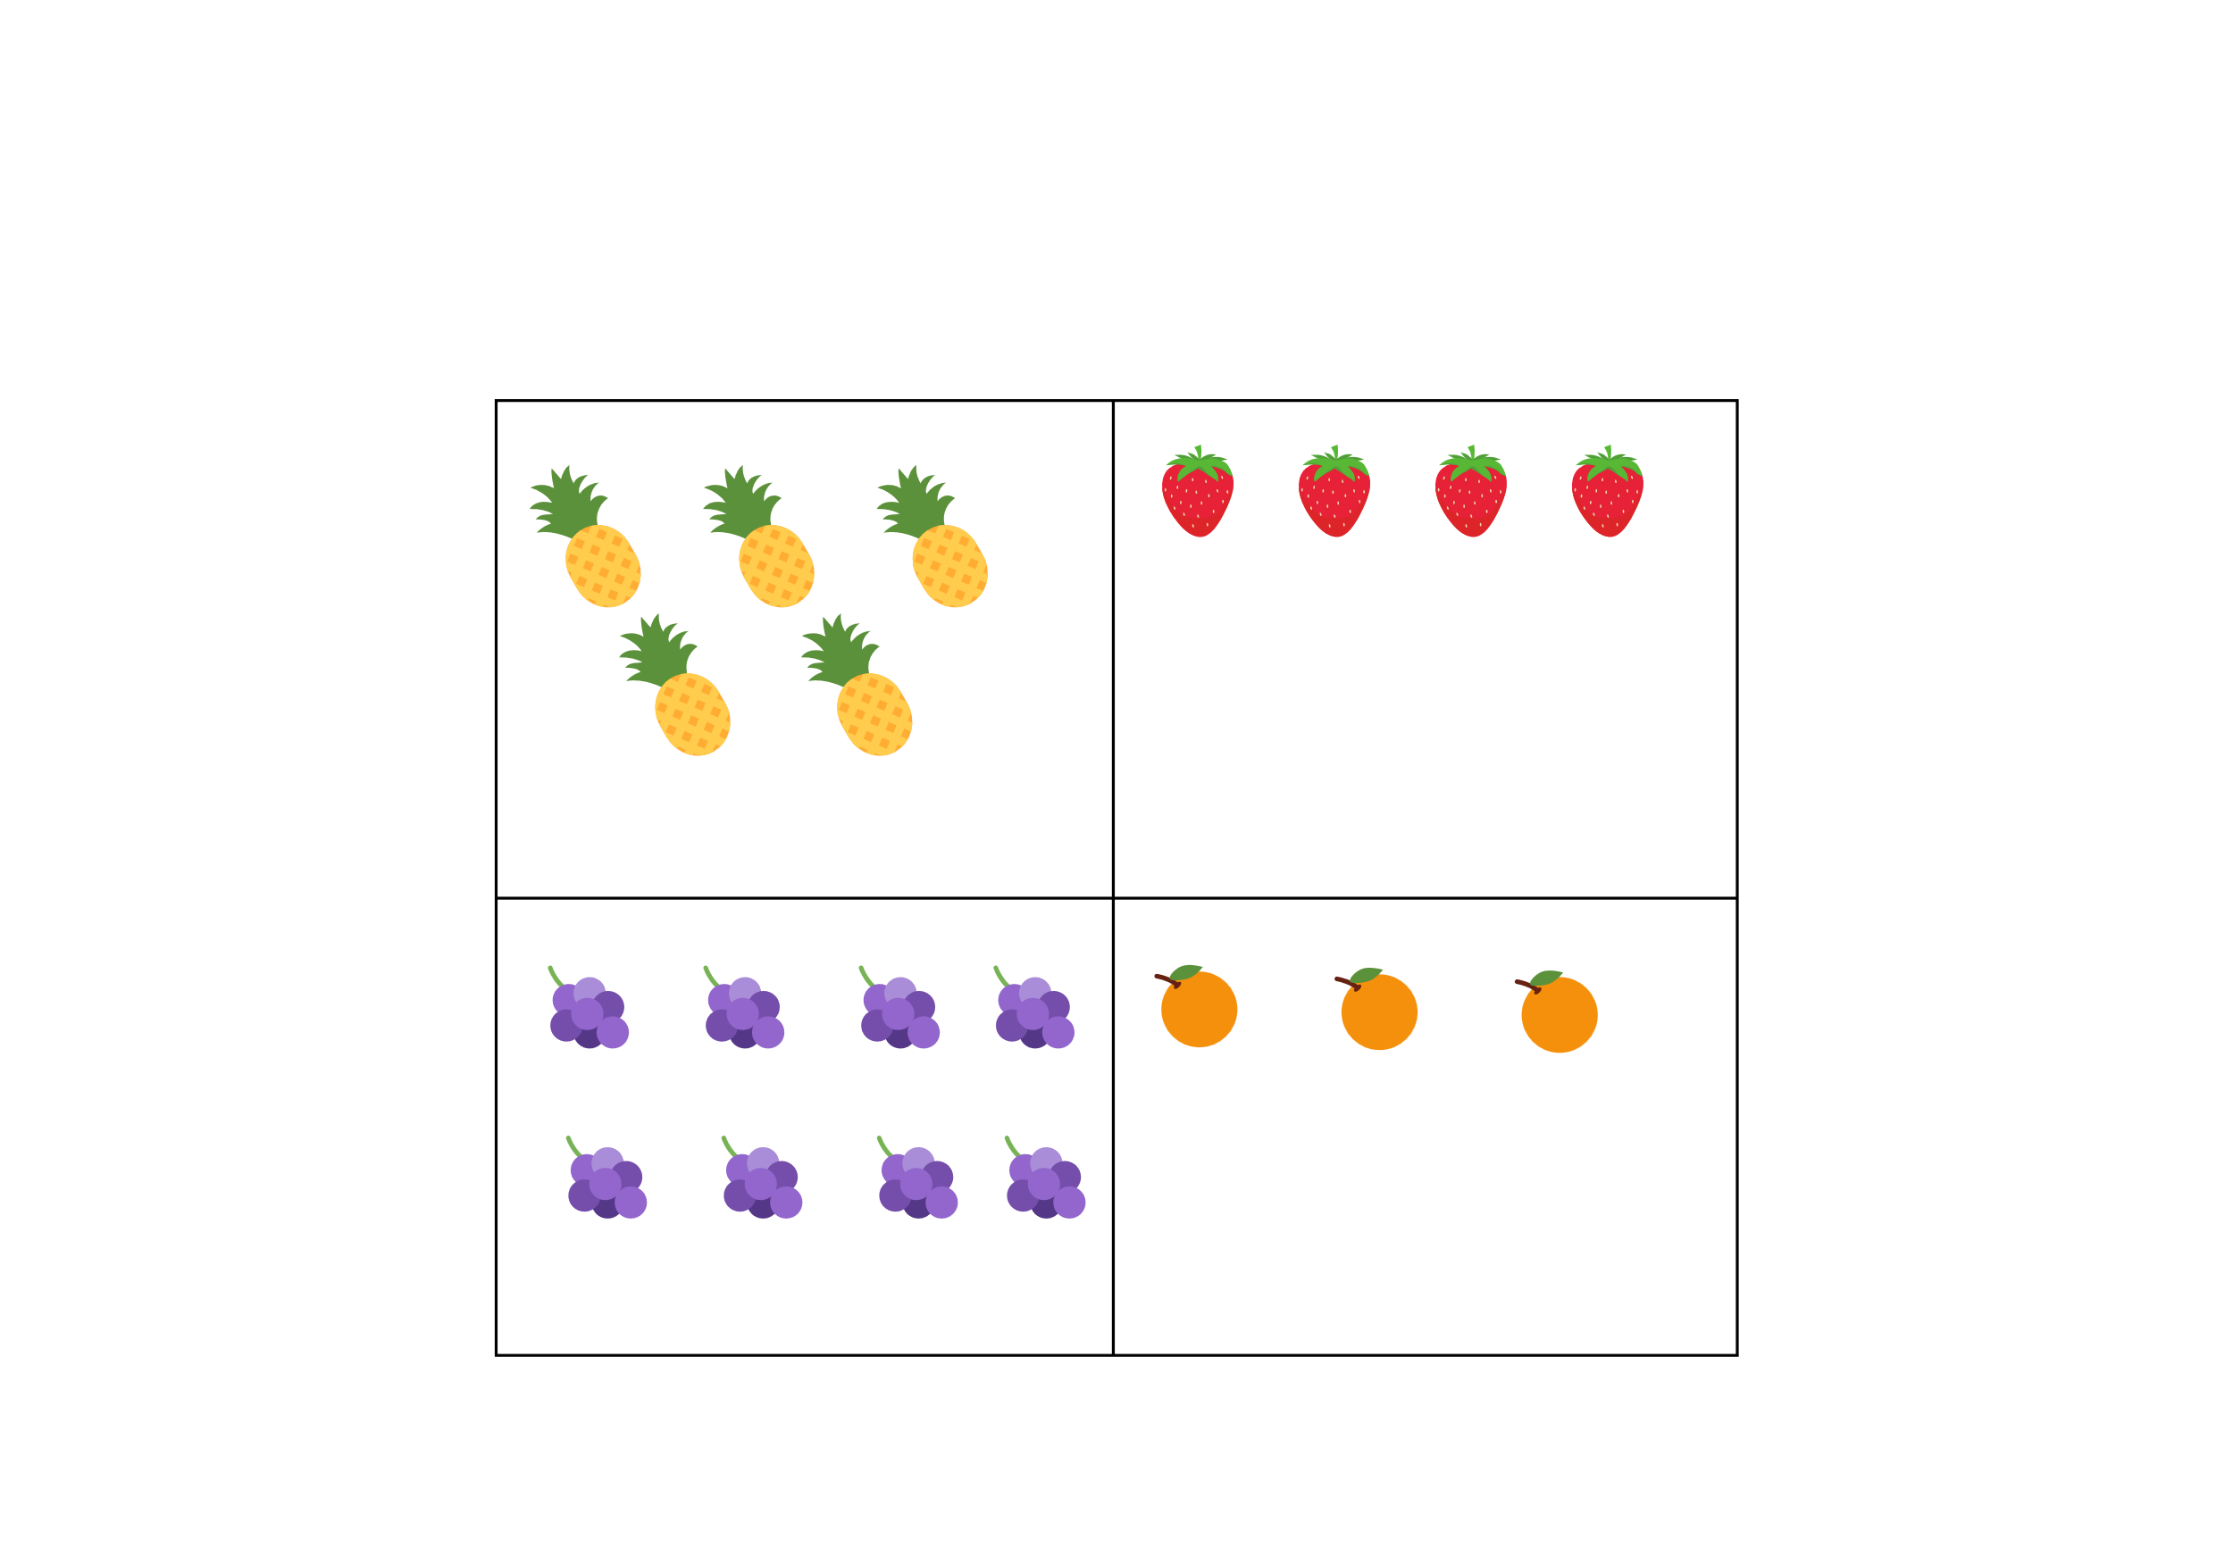
III. EXERCISES:
1.Count and circle the number of fruits in each box:
6
5
4
7
1
2
3
4
5
7
8
9
1
2
3
4

Slide 7
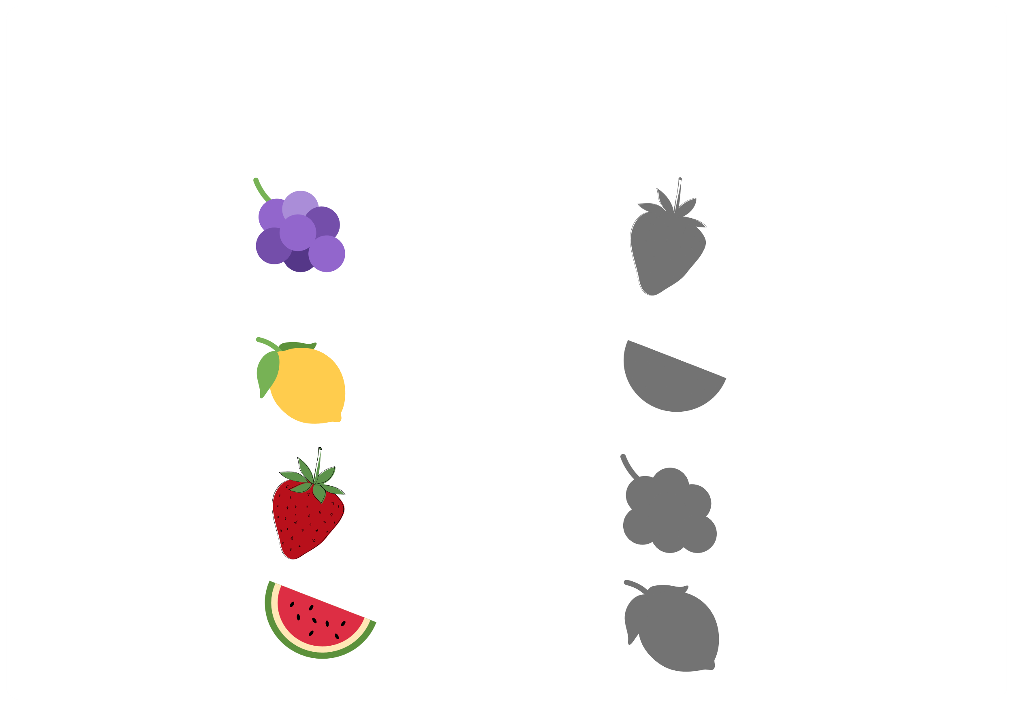
III. EXERCISES:
2. Draw a line from each fruits to its matching shadow:

Slide 8
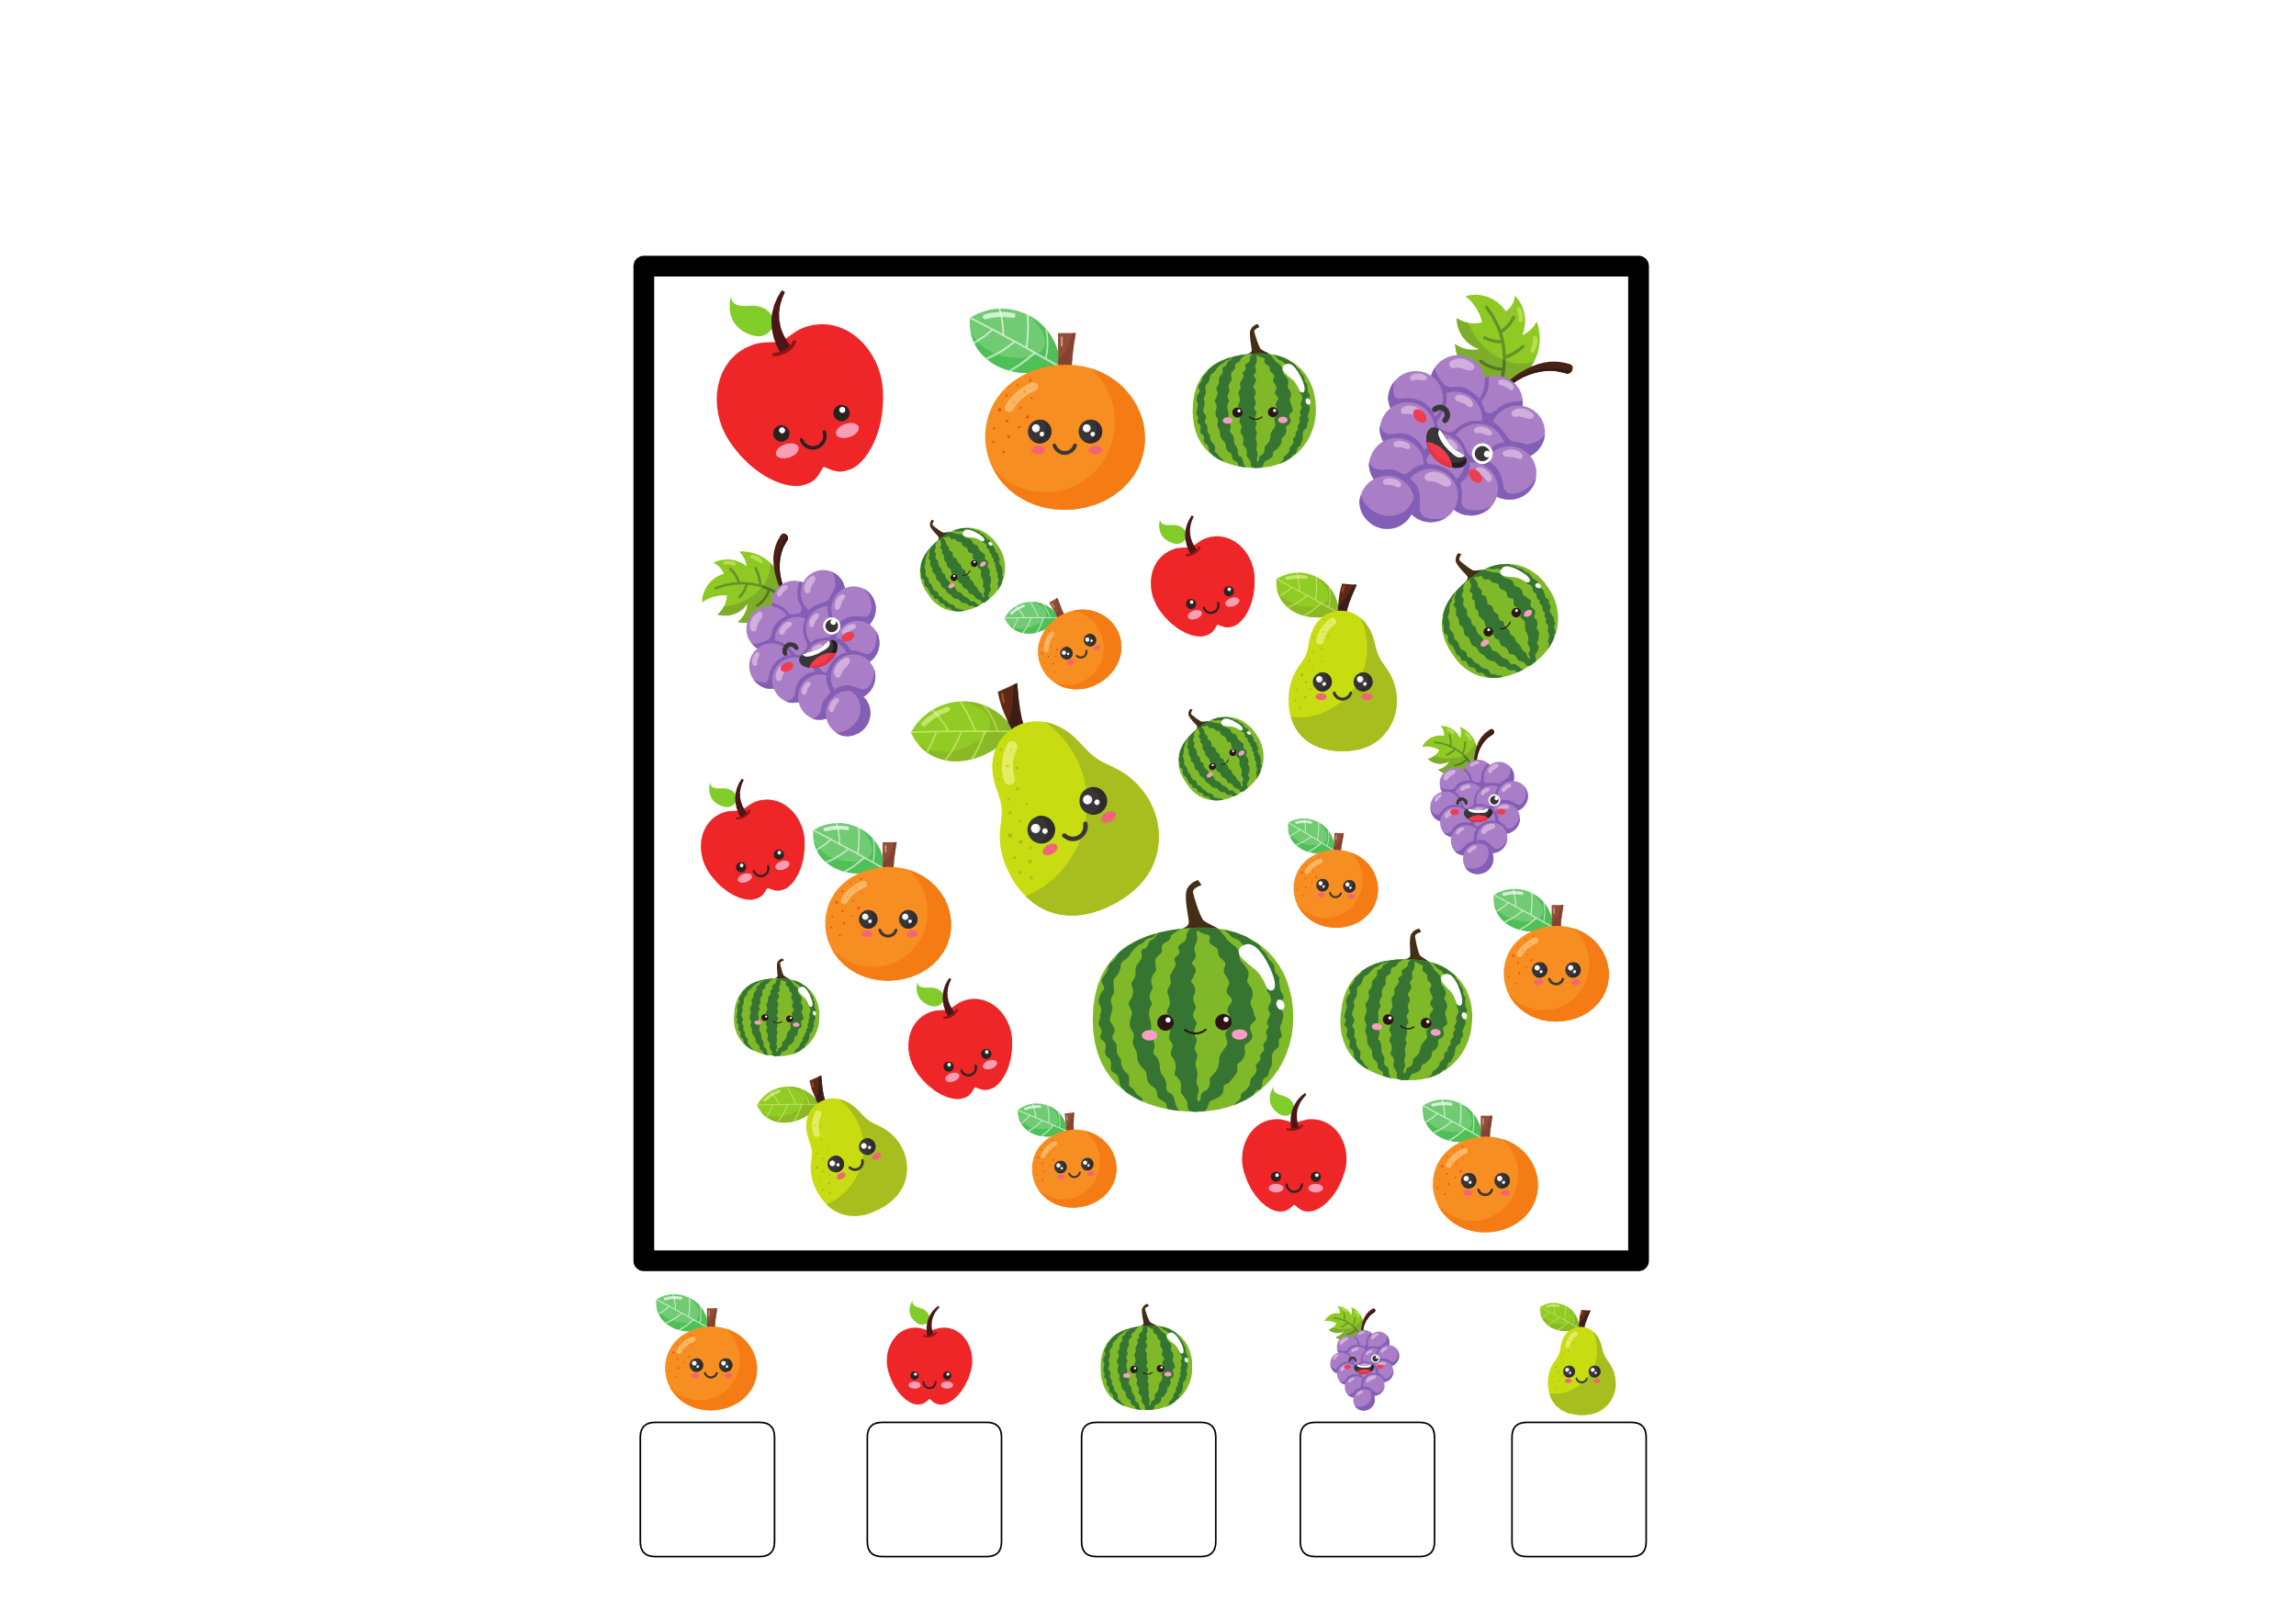
III. EXERCISES:
3. Write in each box the count of the fruits:

Slide 9
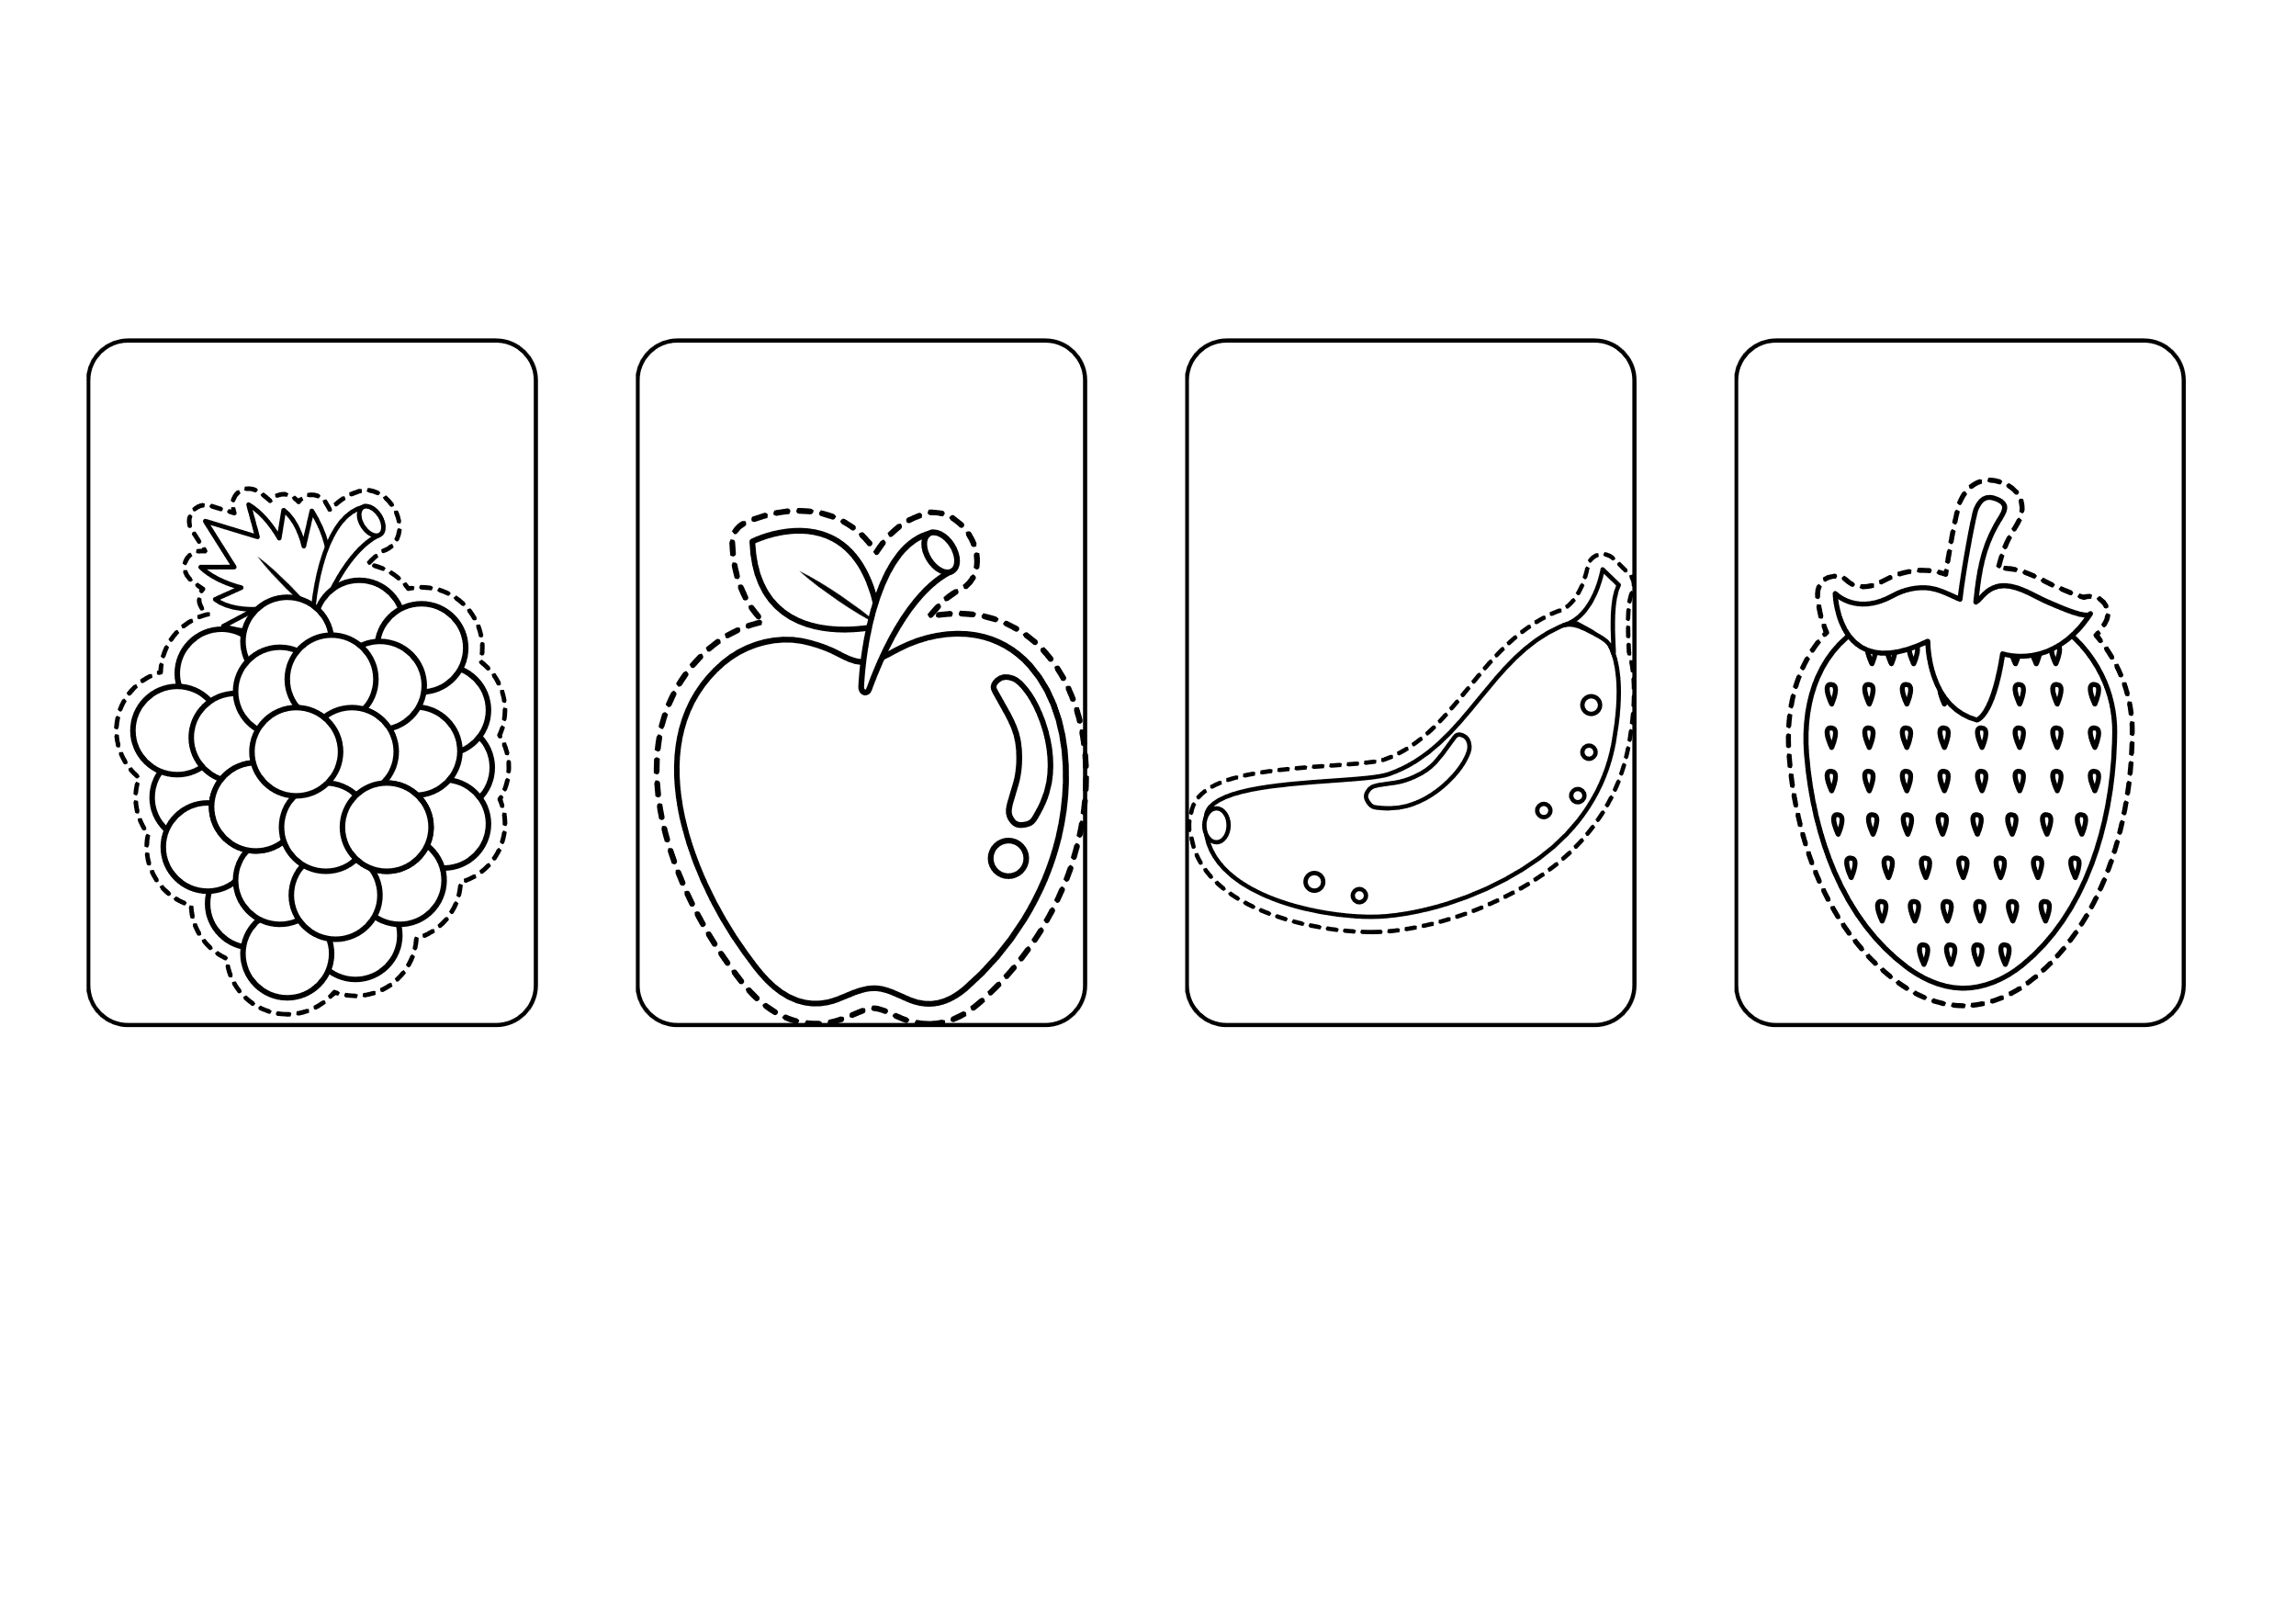
III. EXERCISES:
4. Trace and color:
grapes
apple
banana
strawberry

Slide 10


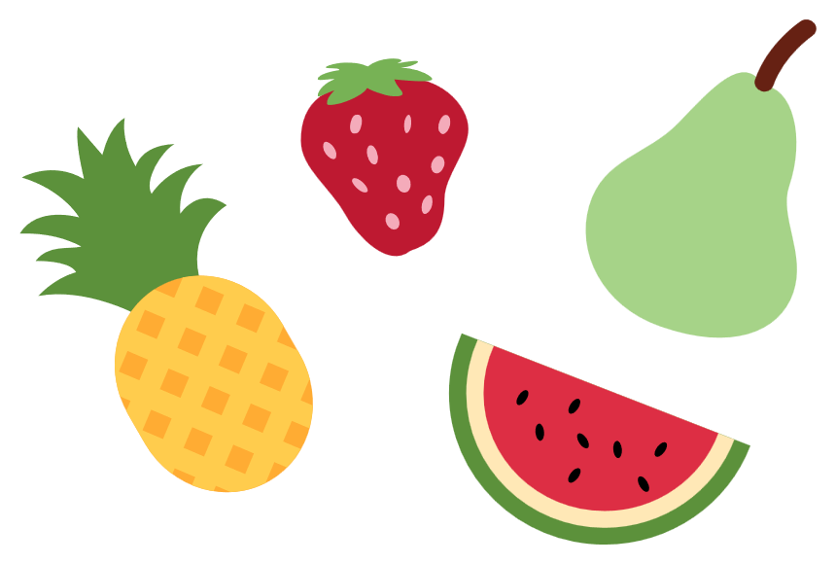
III. EXERCISES:
5. Match the fruits in the bracket below:

Slide 11
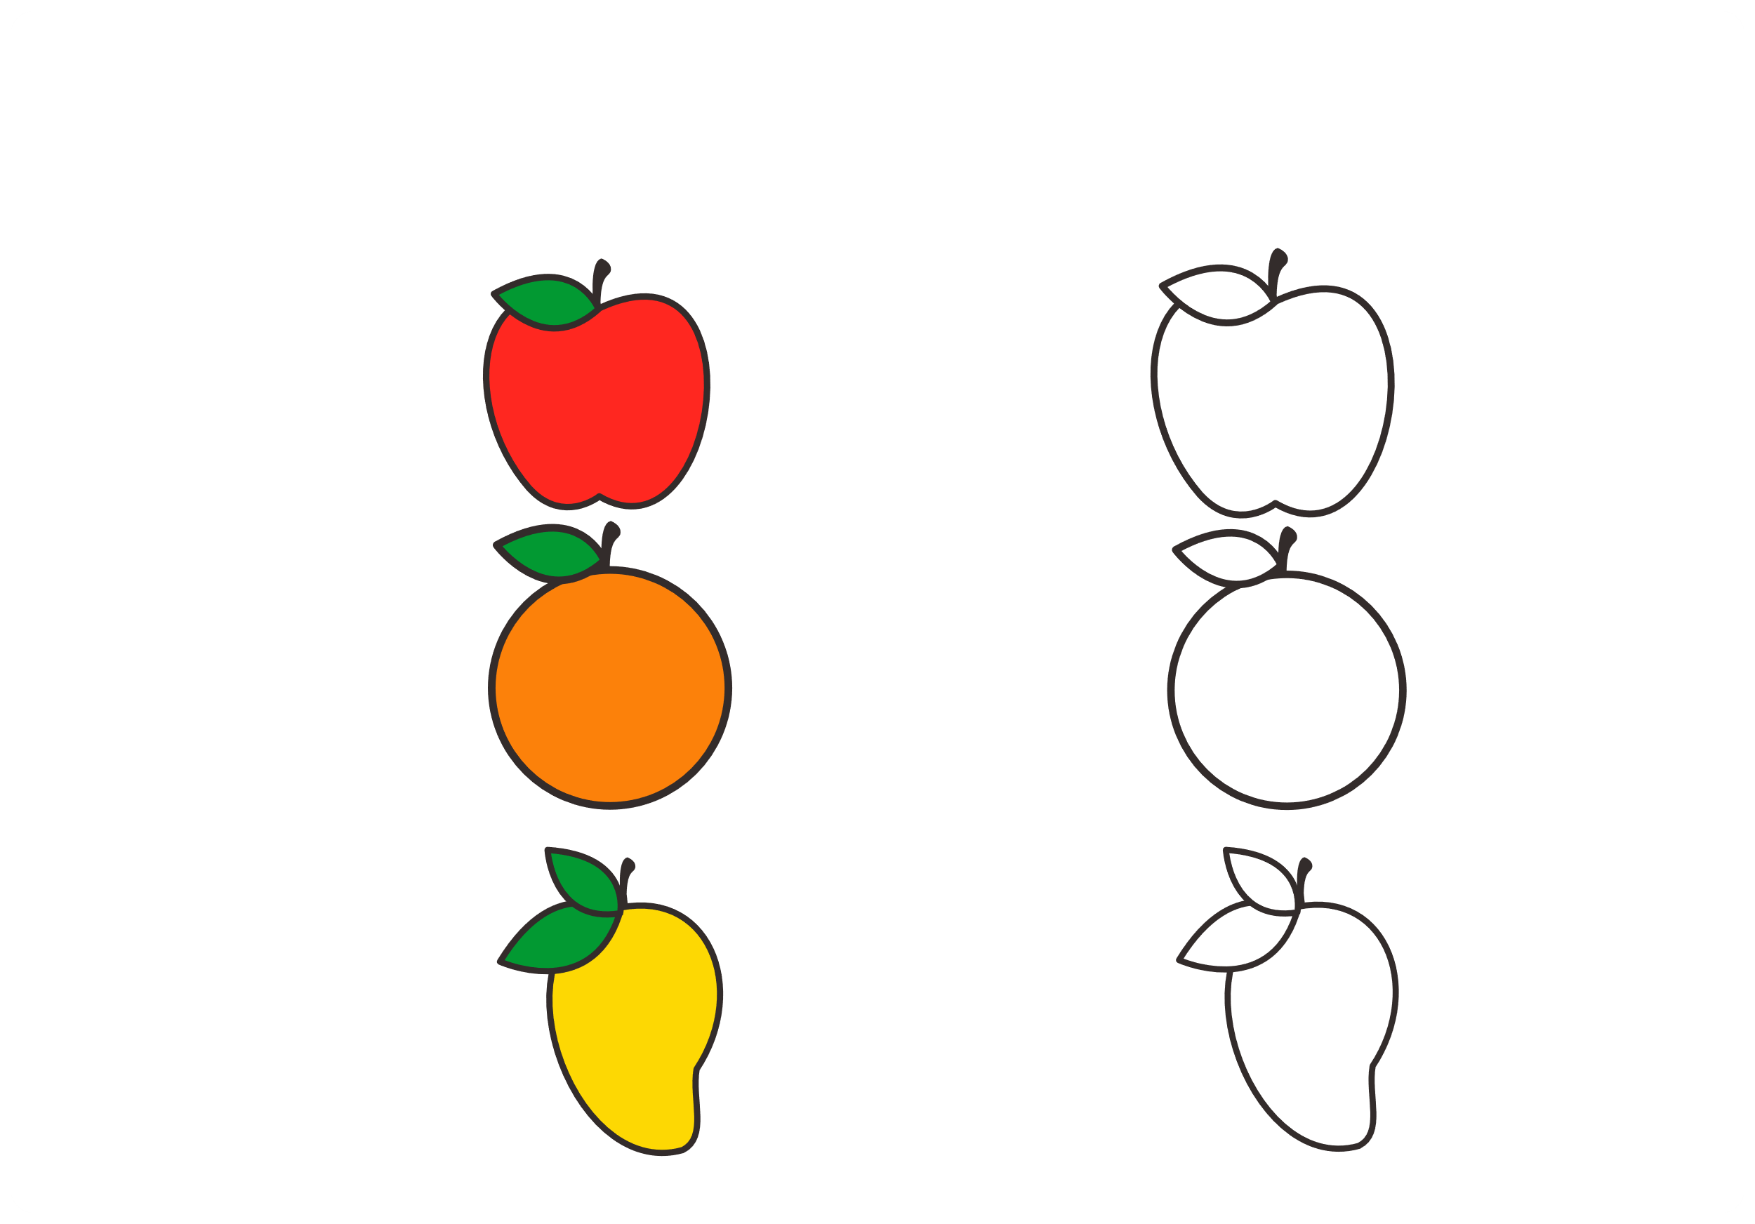
III. EXERCISES:
6.Color the fruits like the picture below:

Slide 12

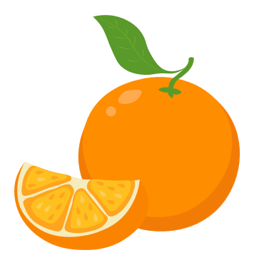
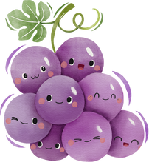
III. EXERCISES:
7. Match the name of the fruits to the correct picture:
apple
grape orange pear mango

Slide 13
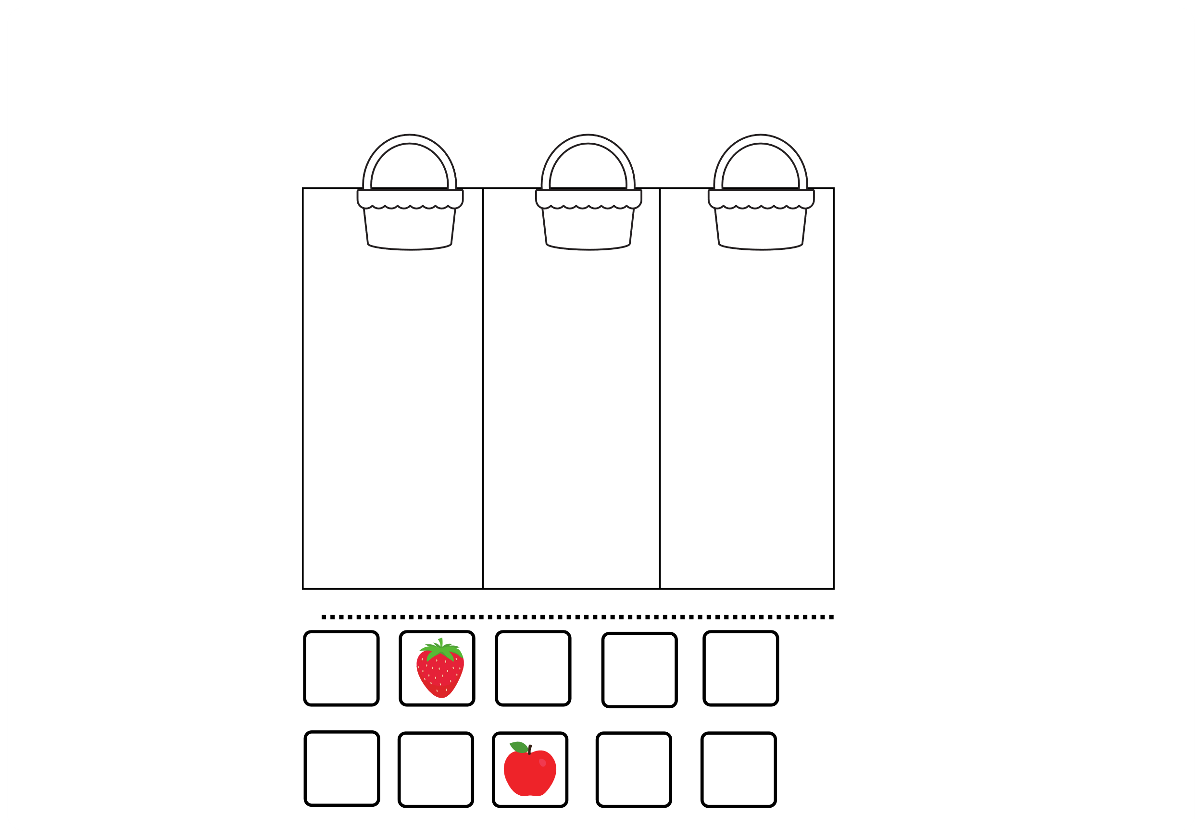
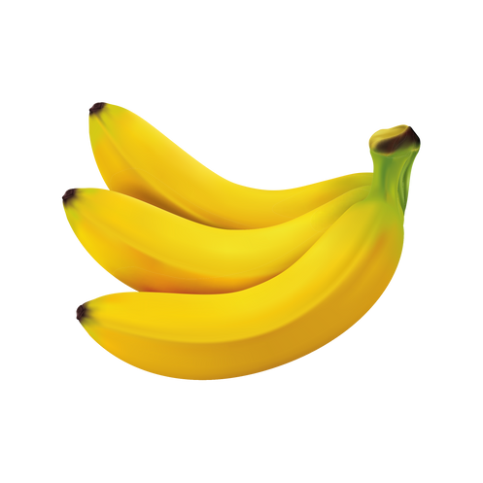
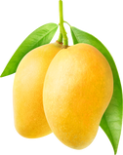
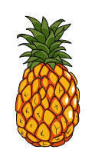
III. EXERCISES:
8. Classify the fruits according to color in 3 boxes:
red
yellow
green

