Slide 1

Unit 1: My World
Lesson 1a: Reading (cont.)
Page 15

Slide 2
Lesson Outline
Warm-up
Vocabulary
Speaking
Writing
Consolidation
Wrap-up

Slide 3
Objectives
By the end of this lesson, students will be able to…
- learn and use vocabularies for and talk about free-time activities & hobbies.
- revise and practise Prepositions of movements.
- talk about survey results and write a survey report (optional).

Slide 4

WARM-UP

Slide 5
Tell some activities/hobbies people usually do in their free time.

Slide 6

It’s time to learn …

Slide 7
Vocabulary

Slide 8

Presentation

Slide 9





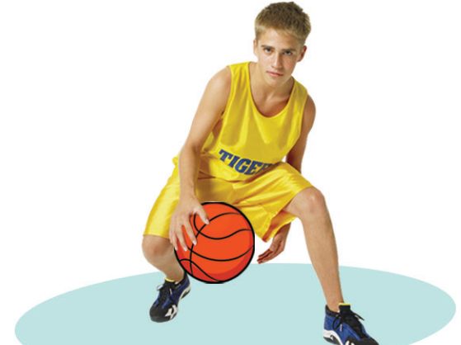




Label the pictures with the words in the list.
1
2
3
5
6
4

Slide 10

b) Listen and check.
1
2
3
5
6
4

Slide 11
More Practice:
Listen and repeat.
Click on each phrase to hear the sound.
1
2
3
5
6
4

Slide 12

Practice

Slide 13

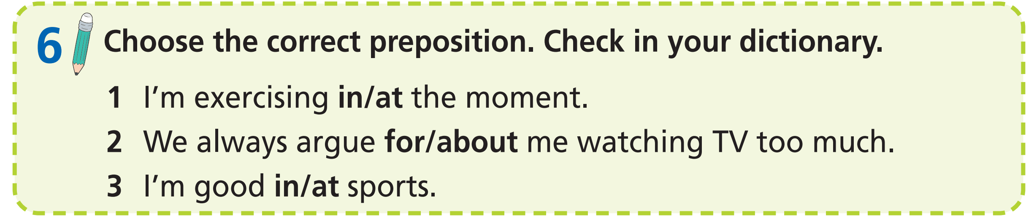

Slide 14
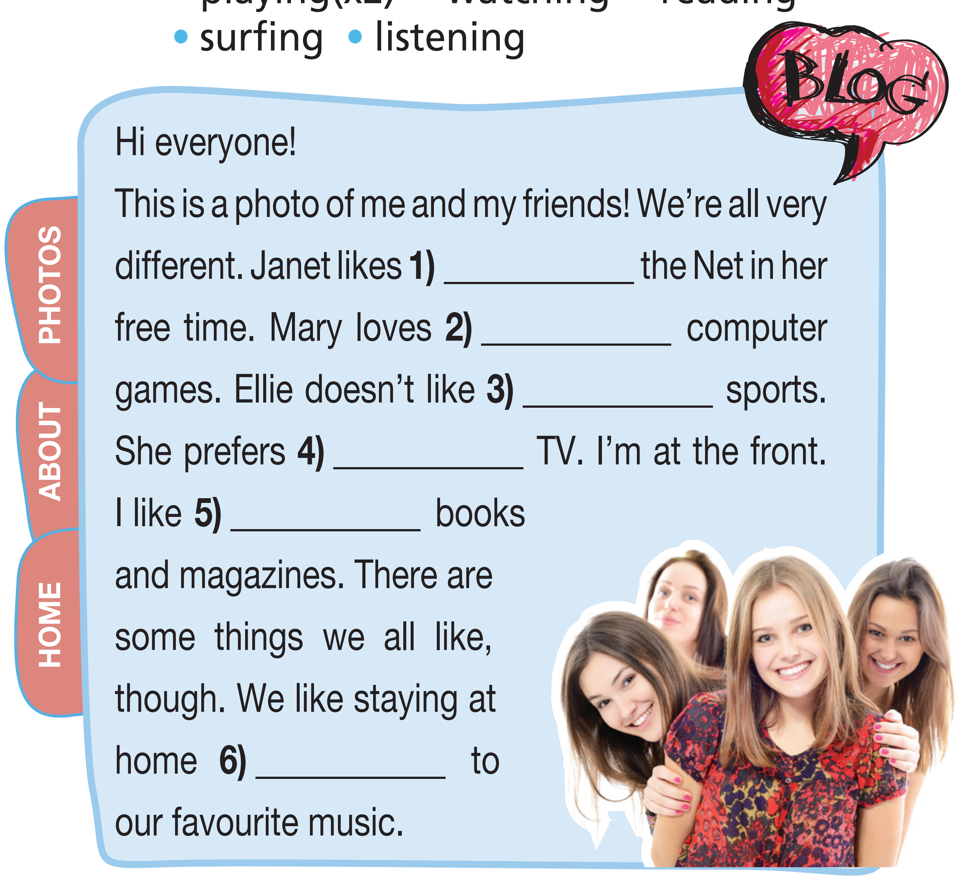
Extra Practice
WB, page 10
Complete the blog with the
correct verb from the list below.
playing
watching
reading
surfing
listening
playing

Slide 15

Production

Slide 16
Make five sentences with the phrases in Exercise 5.
• play sports
• watch TV series/videos
• read books/magazines
• surf the Net
• listen to music
• play video/computer games

Slide 17

Speaking

Slide 18
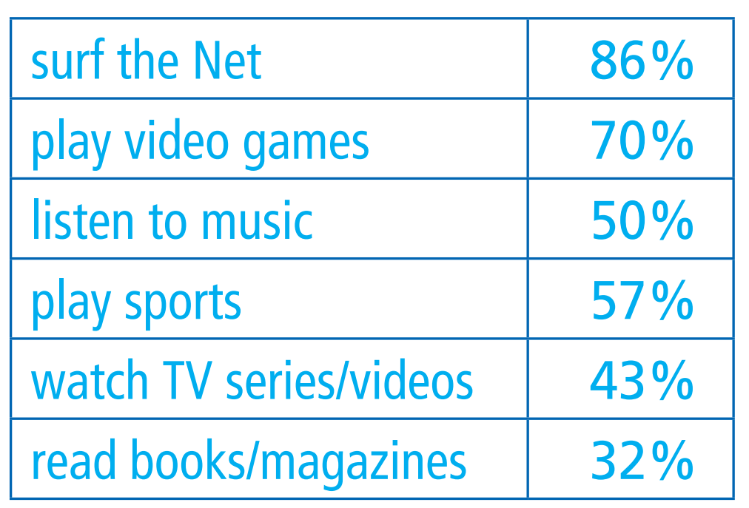
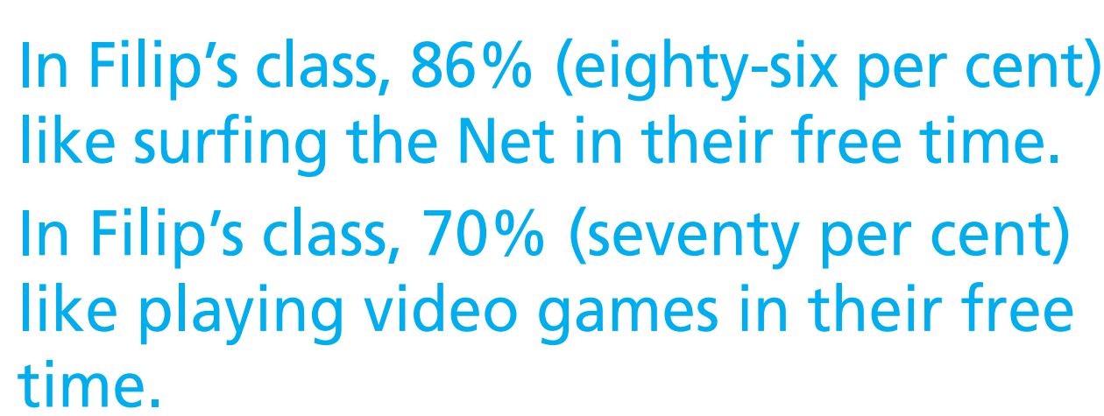
Pre-speaking
Example

Slide 19
While-speaking
Example
Make sentences as in the examples.

Slide 20
Post-speaking
Write a paragraph (60-80) about activities/hobbies students in Filip’s class like doing in their free time.

Slide 21

Writing

Slide 22

Give the list to your classmates and each will tick (✓) the activities they do in their free time.
Pre-writing
Name: ________
Age: __________
What are your favourite free-time activities/hobbies? Tick (✓).
1. surf the Net
2. play video games
3. listen to music
4. play sports
5. watch TV series/videos
6. read books/magazines

Slide 23
Suggested paragraph
Opening statement
The most popular free-time activities are
playing sports and surfing the Net. 80% of the
class play sports in their free time and 75%
surf the Net. 44% play video/computer games
in their free time. 25% watch TV series or
videos in their free time. Only 12% listen to
music and 10% read books in their free time.
Relevant sentences: percentages of the activities/hobbies

Slide 24
While-writing
In groups of four, study all the answers and write a short paragraph (about 60-80 words) about your findings. Use the sentences in Exercise 7 to help you.

Slide 25
Post-writing
Peer correction
Guideline
Criteria | Yes | No
Opening sentence
Percentage of surfing the Net
Percentage of playing video games
Percentage of listening to music
Percentage of playing sports
Percentage of watching TV series/videos
Percentage of reading books/magazines
Spelling mistakes | circle
Grammar mistakes | underline
Exchange your papers. Tick (✓) in the column “Yes” or “No“ if your friends’ paragraphs meet the criteria.

Slide 26

CONSOLIDATION

Slide 27
Work in groups of four. Talk about what you usually do in your free time.

Slide 28

WRAP-UP

Slide 29
Today’s lesson
Vocabularies
Free-time activities/hobbies
Prepositions of movement
Structures/ Sentence patterns
Sentences to talk about survey results.

Slide 30
Homework
Practise the vocabularies and structure and make sentences using them.
Do the exercises in TA 7 Right on WB (page 10)
Prepare the next lesson (page 16 SB)
Do the exercises in TA 7 Right on Notebook (pages 4 & 5)

Slide 31
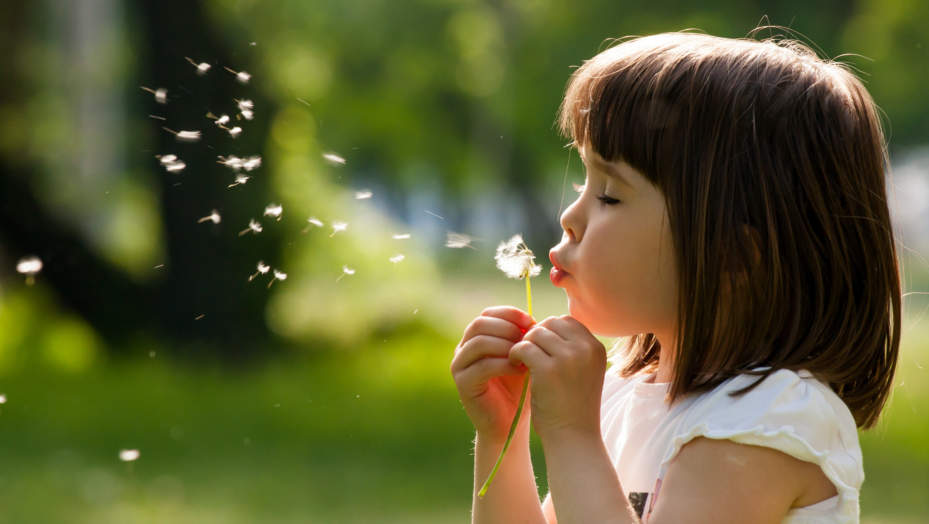
Enjoy your day!

