Slide 1

UNIT 7: TEENS
Lesson 3.2 – Speaking & Writing
Page 73

Slide 2
Lesson Outline
Warm-up
Speaking
Writing
Consolidation
Wrap-up

Slide 3

By the end of this lesson, students will be able to…
Talk about problems teens have where they live
Practice writing a passage about
a problem teenagers have

Slide 4

WARM UP

Slide 5
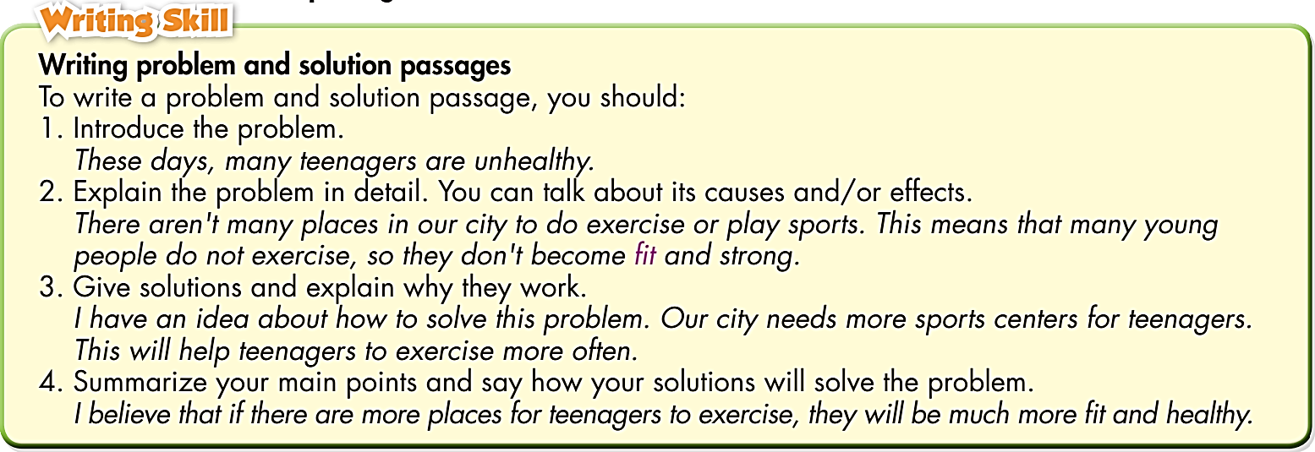
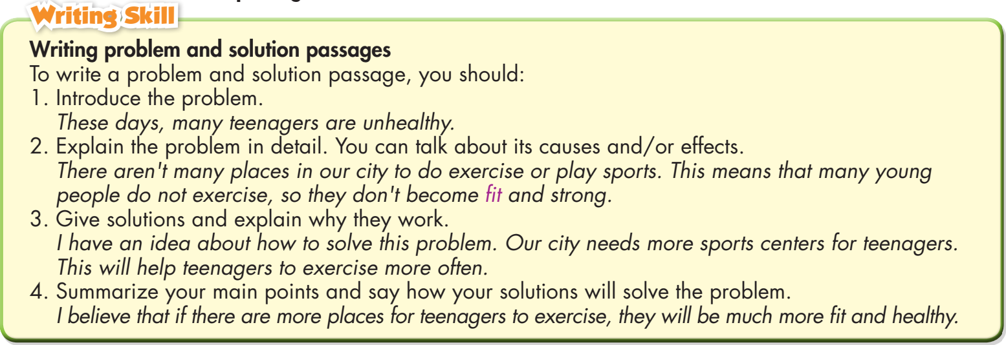
Read the Writing Skill box. Number the sentences (a–d) to match
them with the parts of a problem and solution passage.
I believe that if teenagers do yoga and go to bed earlier, they will be less stressed 
Teenagers are too stressed. 
This means that teenagers don't study very well 
Teenagers should do yoga. They should also go to bed earlier 
4
1
2
3

Slide 6

Speaking

Slide 7

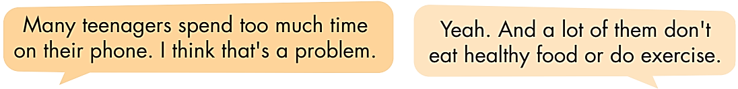
a. In pairs: Discuss and list three to four problems teenagers have.

Slide 8
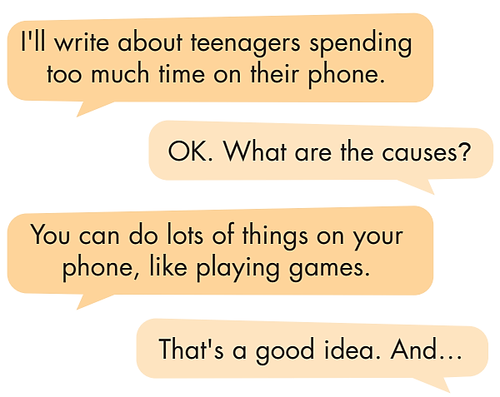
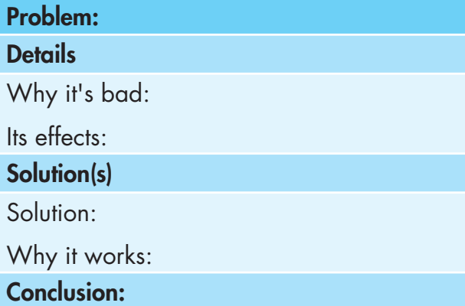
b. Now, choose the biggest problem you discussed. In pairs: Discuss the points on the table below and write in your own ideas.

Slide 9
Writing

Slide 10


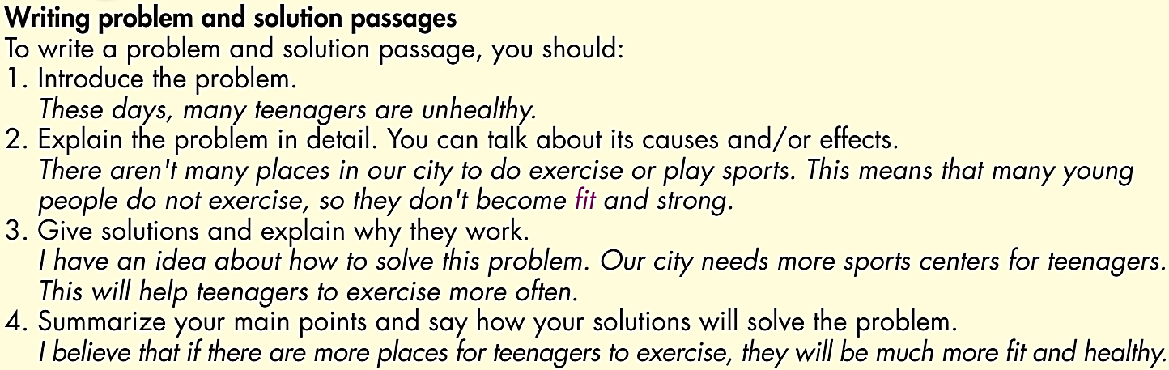
While - writing
Now, write a problem and solution passage about the problem you discussed in Speaking. Use the Writing Skill box and your speaking notes to help you. Write 80 to 100 words.

Slide 11
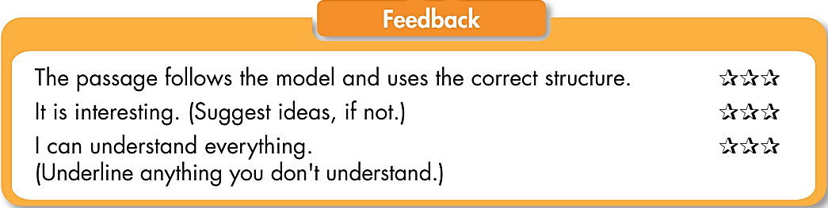
In pairs. Swap your writing. Read your partner’s passage.
Give feedback on it using the Writing Skill and Feedback box.
Post - writing

Slide 12
Suggested answer
These days, many teens in my town spend too much time using smartphones. They play games online and they don't go outside to meet their friends. This means that they don't do enough exercise, so they become unhealthy. I have an idea about how to solve this problem. They should spend more time playing sports with their friends. I believe that if teens play sports with their friends more, they'll become healthier.

Slide 13

CONSOLIDATION

Slide 14

Read the problem and solution passage. Complete each gap with ONE WORD. Then, listen and check.

Many teenagers feel _______ during the summer holidays.
They don't have _______ things to do. It makes it _______ to study
and feel happy. This means they won't do as well at school the next year.
I have a _______ to the problem. I think teenagers should go to a summer camp in the holidays. They will have fun and relax.
I really believe that going to summer camp will help teenagers be _______ .
bored
enough
harder
solution
active

Slide 15

WRAP-UP

Slide 16
Today’s lesson
Speaking:
Talk about problems teens have where they live
Writing:
Practice writing a passage about a problem teenagers have

Slide 17
Homework
Do the exercises on page 43, WB.
Do the exercises in Tiếng Anh 8 i-Learn Smart World Notebook, Page 61.
Prepare the next lesson (page 102, SB)
Play the consolidation games on www.eduhome.com.vn

Slide 18

Lesson 3
Stay positive and have a nice day!

