Slide 1


Hello every one !!!
love

Slide 2


WARM-UP
Alphabet game

Slide 3

* WARM-UP
ALPHABET GAME
A: He asked me my name.
1
2
3
4
A
D
P
T
5
7
C
E
G
F
6
8
H
S
11
12
9
10
L
B

Slide 4


Unit
3
COMMUNITY SERVICE
LESSON 4: COMMUNICATION
EVERYDAY ENGLISH

Slide 5


1
Listen and read the dialogue between Lan and Mark. Pay attention to the highlighted parts.
Lan: What did you do to help your community last summer, Mark?
Mark: We planted some trees in the schoolyard and picked up a lot of rubbish along the nearby roads.
Lan: Sounds like great work! We collected books and warm clothes for our friends in the mountainous areas.
Mark: Wonderful!
2 ways to give compliments:
Sounds like great work!
Wonderful!

Slide 6

2
Work in pairs. Make similar conversations.
1. Mi helped lonely elderly people.
2. Tom and his friends cleaned and decorated parts of their neighbourhood.

Slide 7

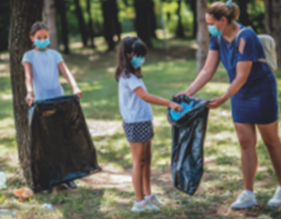

2
Work in pairs. Make similar conversations.
Mi: What did you do to help your community last summer, Tom?
Tom: My friends and I cleaned and decorated parts of our neighbourhood.
Mi: Sounds like great work! I helped lonely elderly people in the area.
Tom: Wonderful!

Slide 8
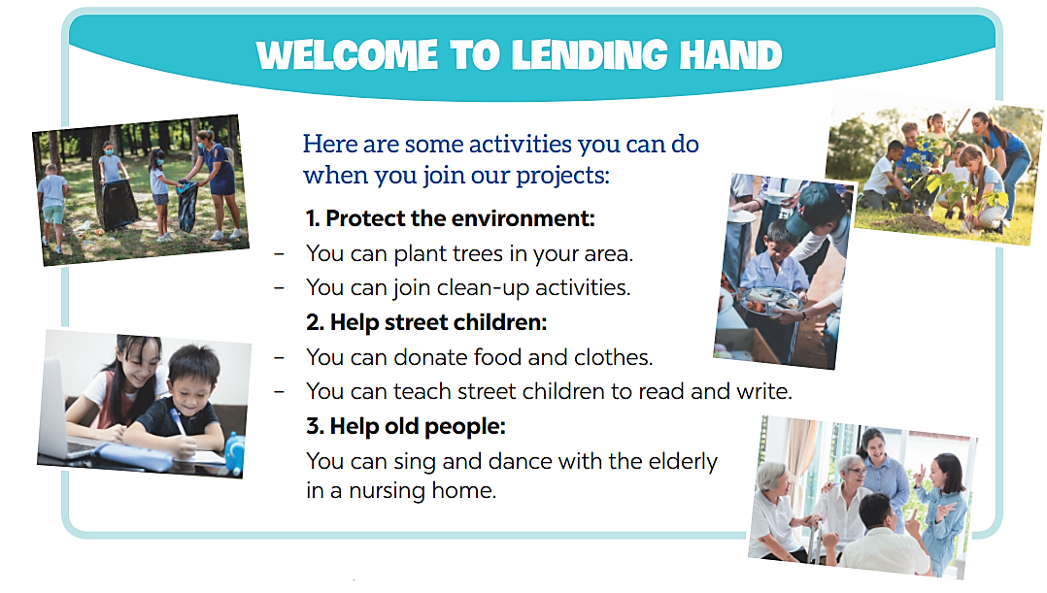
* CHANGING OUR NEIGHBOURHOOD
3
Work in pairs. Read the poster about the volunteer activities for teenagers at Lending Hand.

Slide 9
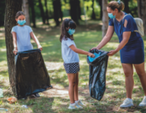


* CHANGING OUR NEIGHBOURHOOD
3
Write the project number (1 – 3) next to its benefit (A – E)
Benefits
______ A. making the elderly less lonely
______ B. making the neighbourhood greener
______ C. helping feed children
______ D. helping children have a better future
______ E. making the neighbourhood cleaner
3
1
2
2
1

Slide 10
* CHANGING OUR NEIGHBOURHOOD
4
Ask and answer which activities in Task 3 you want to join. Give reasons.
Example:
Minh: Which activity do you want to join?
Lan: I want to join some clean-up activities.
Minh: Why do you want to join these activities?
Lan: because they make the neighbourhood cleaner

Slide 11
* CHANGING OUR NEIGHBOURHOOD
5
Discuss which activity each member of your group chooses and the benefit(s) of the activity.
4
Example:
Mai wants to donate food to street children because this helps feed them. Lan wants to join clean-up activities because these activities make our neighbourhood cleaner …

Slide 12
* CHANGING OUR NEIGHBOURHOOD
5
Discuss which activity each member of your group chooses and the benefit(s) of the activity.
4
Nga wants to donate food to street children and teach them English because this helps feed them and helps them have a better future.

Slide 13


* CONSOLIDATION
1
WRAP-UP
In this lesson, we have learn to:
know how to give compliments
discuss and present the benefits of
community activities

Slide 14


homework
Redo all the exercises.
Prepare SKILLS 1.

Slide 15


Thank you!
Goodbye!

