Slide 1


Slide 2



Review
3
LESSON 1: LANGUAGE
Pronunciation review
Vocabulary review
Grammar review
Unit

Slide 3

OBJECTIVES
By the end of the lesson, students will have revised pronunciation, vocabulary and the grammar points they have learnt in units 7, 8, 9.

Slide 4
LESSON 1: LANGUAGE
WARM-UP
Mindmap
Task 1a: Choose the word in which the underlined part is pronounced differently.
Task 1b: Choose the word which has a different stress pattern from that of the others.
PRONUNCIATION REVIEW
VOCABULARY REVIEW
Task 2: Write the phrases from the box under the road signs.
Task 3: Fill in each blank with a suitable word from the box.
Task 4: Which of the underlined parts in each question is incorrect? Find and correct it.
Task 5: Rewrite the sentences so that they have the same meanings as the original ones. Use the words given in brackets.
GRAMMAR
REVIEW
CONSOLIDATION
Wrap-up
Homework

Slide 5
LESSON 1: LANGUAGE
WARM-UP
Mindmap
Aims of the stage:
To remind students the knowledge that they have learnt in Units 7-8-9.

Slide 6
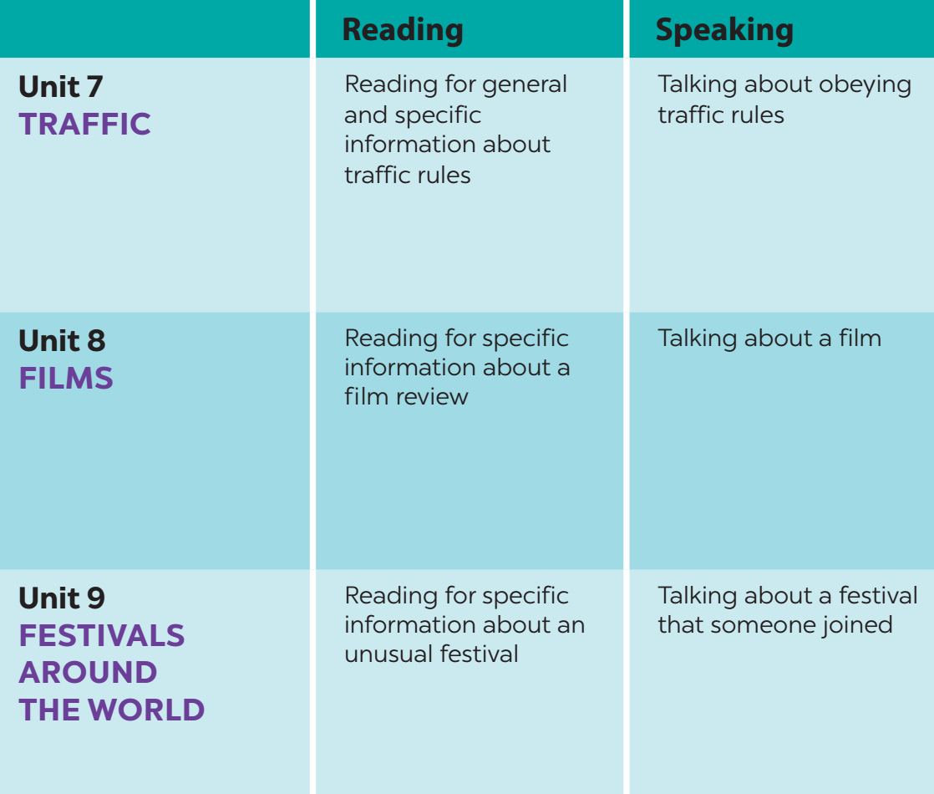
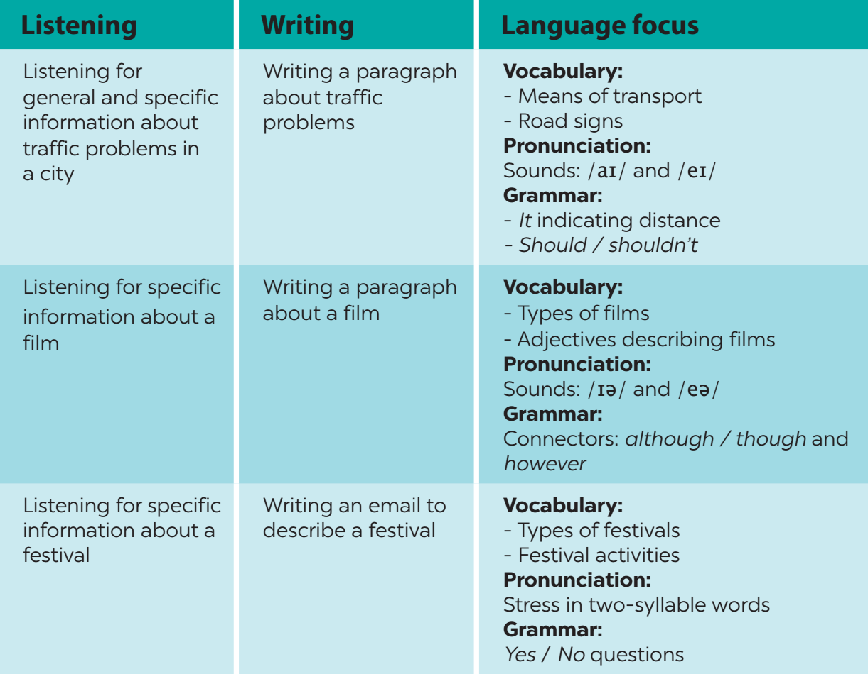
WARM-UP

Slide 7
LESSON 1: LANGUAGE
WARM-UP
Mindmap
Task 1a: Choose the word in which the underlined part is pronounced differently.
Task 1b: Choose the word which has a different stress pattern from that of the others.
PRONUNCIATION REVIEW

Slide 8
PRONUNCIATION REVIEW
1
a. Choose the word in which the underlined part is pronounced differently.
1. A. careful B. patient C. parade
2. A. tonight B. time C. favourite
3. A. feature B. clear C. appear

Slide 9
PRONUNCIATION REVIEW
1
b. Choose the word which has a different stress pattern from that of the others.
4. A. helmet B. transport C. believe
5. A. enjoy B. boring C. arrive

Slide 10
LESSON 1: LANGUAGE
WARM-UP
Mindmap
Task 1a: Choose the word in which the underlined part is pronounced differently.
Task 1b: Choose the word which has a different stress pattern from that of the others.
PRONUNCIATION REVIEW
VOCABULARY REVIEW
Task 2: Write the phrases from the box under the road signs.
Task 3: Fill in each blank with a suitable word from the box.

Slide 11


VOCABULARY REVIEW
2
Write the phrases from the box under the road signs.
Walking only Road work School ahead
No left turn Turn right ahead
No left turn
Walking only
Turn right ahead
1. ______________
2. ______________
3. ________________
School ahead
Road work
School ahead
4. ___________
5. ______________

Slide 12
VOCABULARY REVIEW
3
Fill in each blank with a suitable word from the box.
shocking feast Easter fantasy violent
1. A _________ is a special meal with very good food.
2. This documentary has some _______________ facts about a poor country. I was sad when I watched it last night.
3. Many children like _______ because they can paint and search for chocolate eggs.
4. In a _________, you can see fairies, dragons, ghosts, and other unreal characters.
5. You shouldn’t watch this film because it’s __________. There are many fighting scenes.
feast
shocking
Easter
fantasy
violent

Slide 13
LESSON 1: LANGUAGE
WARM-UP
Mindmap
Task 1a: Choose the word in which the underlined part is pronounced differently.
Task 1b: Choose the word which has a different stress pattern from that of the others.
PRONUNCIATION REVIEW
VOCABULARY REVIEW
Task 2: Write the phrases from the box under the road signs.
Task 3: Fill in each blank with a suitable word from the box.
Task 4: Which of the underlined parts in each question is incorrect? Find and correct it.
Task 5: Rewrite the sentences so that they have the same meanings as the original ones. Use the words given in brackets.
GRAMMAR
REVIEW

Slide 14
GRAMMAR REVIEW
4
Which of the underlined parts in each question is incorrect? Find and correct it.
1. Did you walk to the supermarket? Yes, I do.
2. Though he rode a motorcycle, but he didn’t wear a helmet.
3. There is a red light, so you should cross the road. It’s dangerous.
4. Will Lan to attend the music festival this Sunday?
5. The film was boring. However she watched it to the end.
A
B
C
→ did
A
B
→ Ø
C
A
B
→ shouldn’t
C
A
B
→ Ø
C
A
B
C
→ However,

Slide 15
GRAMMAR REVIEW
5
Rewrite the sentences so that they have the same meanings as the original ones. Use the words given in brackets.
1. The distance from my house to my school is about five kilometres. (IT)
→ __________________________________________________
2. What is the distance between Ha Noi and Hai Phong? (HOW)
→ __________________________________________________
3. He was tired, but he still performed the lion dance. (ALTHOUGH)
→ __________________________________________________
→ __________________________________________________
It’s / It is about five kilometres from my house to my school.
How far is it from Ha Noi to Hai Phong?
Although he was tired, he still performed the lion dance.
He still performed the lion dance although he was tired.

Slide 16
GRAMMAR REVIEW
5
Rewrite the sentences so that they have the same meanings as the original ones. Use the words given in brackets.
4. Walking here is dangerous because this lane is for cycling only. (SHOULDN’T)
→ ___________________________________________________________
5. My sister lives far away, but she comes back home every Tet. (THOUGH)
→ ___________________________________________________________
→ ___________________________________________________________
We / You / They shouldn’t walk here because this lane is for cycling only.
Though my sister lives far away, she comes back home every Tet.
My sister comes back home every Tet though she lives far away.

Slide 17
LESSON 1: LANGUAGE
WARM-UP
Mindmap
Task 1a: Choose the word in which the underlined part is pronounced differently.
Task 1b: Choose the word which has a different stress pattern from that of the others.
PRONUNCIATION REVIEW
VOCABULARY REVIEW
Task 2: Write the phrases from the box under the road signs.
Task 3: Fill in each blank with a suitable word from the box.
Task 4: Which of the underlined parts in each question is incorrect? Find and correct it.
Task 5: Rewrite the sentences so that they have the same meanings as the original ones. Use the words given in brackets.
GRAMMAR
REVIEW
CONSOLIDATION
Wrap-up
Homework

Slide 18
CONSOLIDATION
1
WRAP-UP
Pronunciation review
Vocabulary review
Grammar review

Slide 19

CONSOLIDATION
2
HOMEWORK
Prepare for the next lesson: Review 3 - Skills

Slide 20

Website: hoclieu.vn
Fanpage: facebook.com/www.tienganhglobalsuccess.vn/

