Slide 1


Slide 2
Unit
8
BECOMING INDEPENDENT
Unit
FAMILY LIFE
LESSON 3
READING
How to become independent

Slide 3
LESSON 3
READING
WARM-UP
Guessing
PRE-READING
Leading
- Task 2. Read the article. Match the paragraphs with their headings.
- Task 3. Match the highlighted phrase with the heading.
- Task 4. Complete the diagrams with information from the text.
WHILE-READING
POST-READING
Discussion
Wrap-up
Homework
CONSOLIDATION

Slide 4
WARM-UP
GUESSING
Work in groups.
Use body language to explain the words.
If you get the correct answer ➔ 1 point.
- If the answer is wrong or you don’t have the answer ➔ the chance is for other groups.
The group with more correct answers will be the winner.

Slide 5
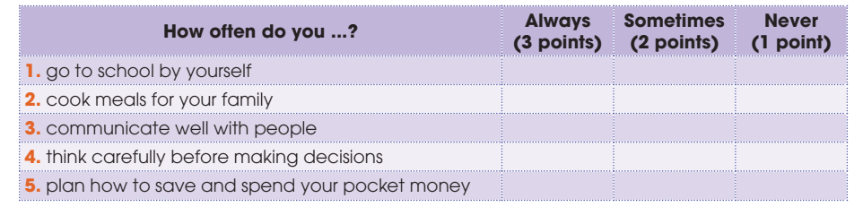
PRE-READING
1
Tick the appropriate box to see how independent you are. Add up your points. If your total score is nine or above, you are independent. Compare with a partner.

Slide 6
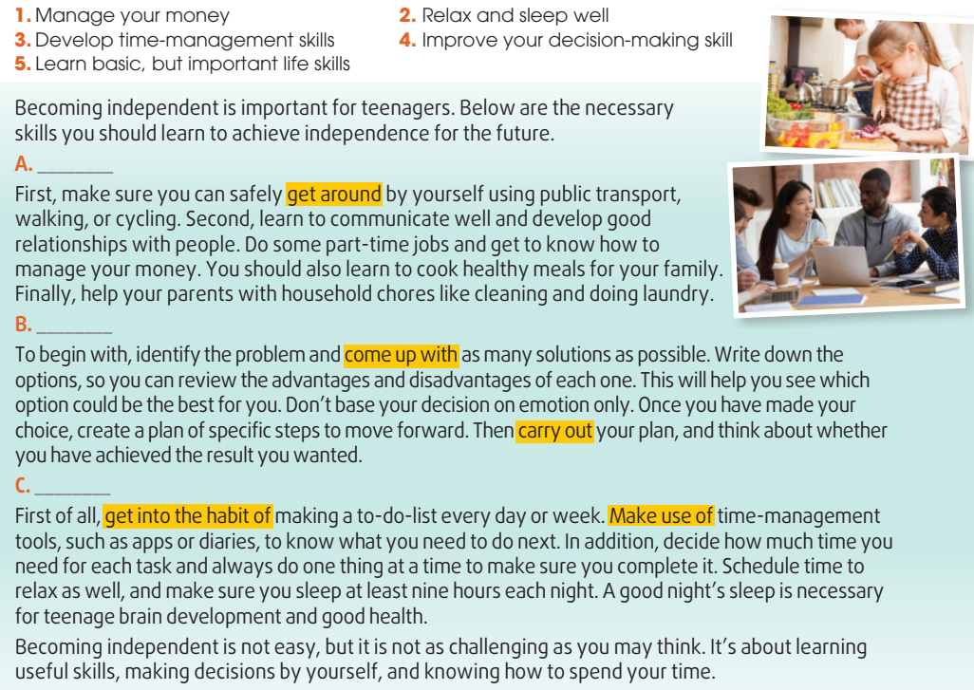
WHILE-READING
2
Read the text. Match the paragraphs (A-C) with their headings (1-5). There are TWO extra headings.
A - 5
B - 4
C - 3

Slide 7
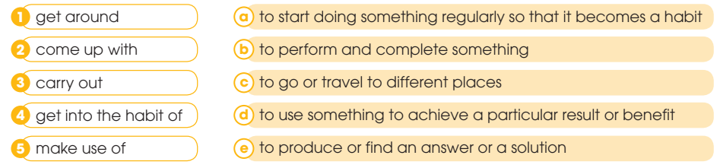
WHILE-READING
3
Read the text again and match the highlighted phrases in the text with their meanings.

Slide 8
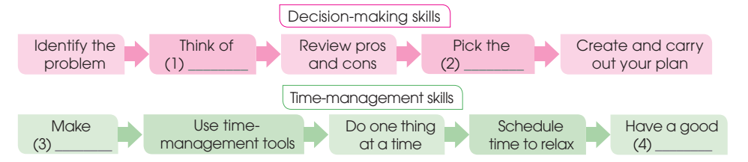
WHILE-READING
4
Read the article again. Complete the diagrams with information from the text. Use no more than two words for each gap
best option
choice
a to-do-list
night’s sleep

Slide 9


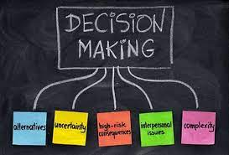
POST-READING
5
Discussion
Which of the skills mentioned in the text do you have?
What other skills do you think teenagers need to become independent?

Slide 10
CONSOLIDATION
1
Wrap-up
What have you learnt today?
Some skills to become independent
Reading for main ideas and specific information

Slide 11
CONSOLIDATION
2
Homework
Do exercises in the workbook.
Prepare for Lesson 4 - Unit 8.

Slide 12

Website: hoclieu.vn
Fanpage: facebook.com/sachmem.vn/

