Slide 1
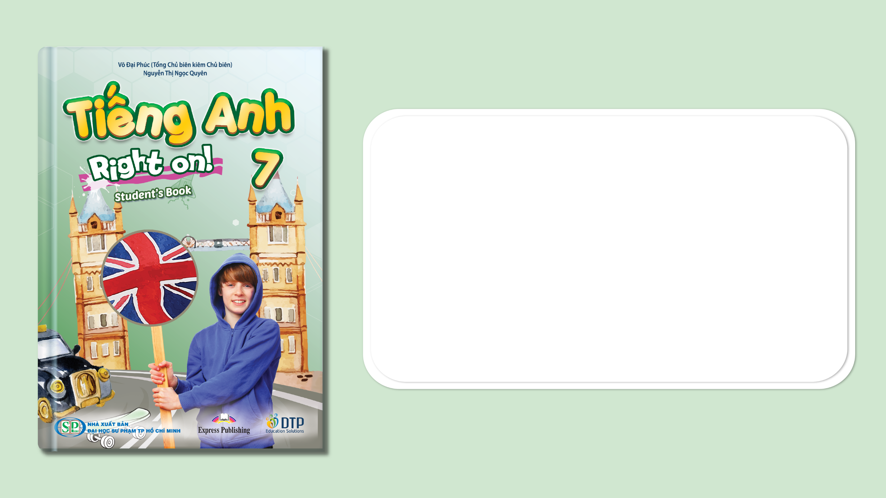
Unit 5: Travel & Transportation
CLIL (Citizenship)
Page 90

Slide 2
Lesson Outline
Warm-up
Vocabulary
Reading
Speaking
Consolidation
Wrap-up

Slide 3
Objectives
By the end of this lesson, students will be able to…
learn and use some vocabulary about wonders or the world: ancient, preserve, display, damage, support, path, soil.
read for key information.
talk about national heritage, make a presentation about how to protect wonders (optional).

Slide 4

WARM-UP

Slide 5

Work in pairs.
Choose the word whose main stress is placed
differently from the others.
1. A. holiday B. scientist C. condition D. monument
2. A. amazing B. favorite C. important D. historic
3. A. listen B. remove C. prepare D. protect
/ˈhɒlədeɪ/
/ˈsaɪəntɪst/
/kənˈdɪʃn/
/ˈmɒnjumənt/
/əˈmeɪzɪŋ/
/ˈfeɪvərɪt/
/ɪmˈpɔːtnt/
/hɪˈstɒrɪk/
/ˈlɪsn/
/rɪˈmuːv/
/prɪˈper/
/prəˈtekt/

Slide 6
Work in pairs.
Discuss the following questions:
Is it important to protect historic sites, such as Trấn Quốc Temple, Cu Chi Tunnel, etc.? Why?
What can you do to protect historic sites?
E.g.
It’s important to protect historic sites because they let the young generations know about the history and culture of the country.
We can make more people know the importance of historic sites, so we can protect those sites together. We should throw rubbish in the bin when visiting those places.

Slide 7

It’s time to learn …

Slide 8
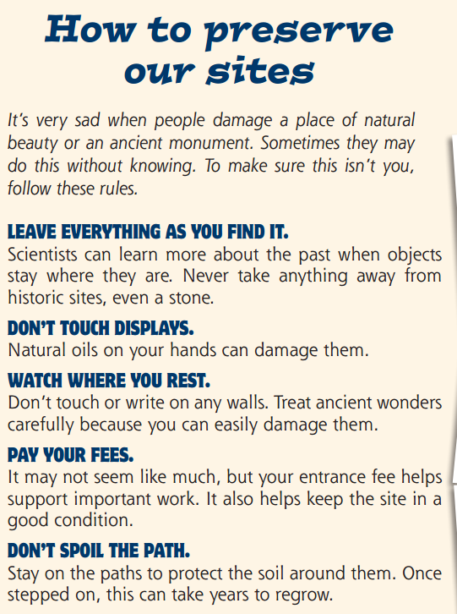
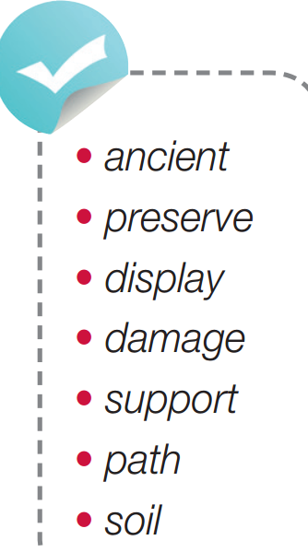
Pre-reading
Find these words in the text, try to guess their meanings.

Slide 9

Vocabulary
Listen and repeat.
ancient /ˈeɪnʃənt/ (adj) cổ xưa
preserve /prɪˈzɜːv/ (v) bảo tồn
display /dɪˈspleɪ/ (n) vật trưng bày, buổi trưng bày
damage /ˈdæmɪdʒ/ (v) gây tổn hại, phá hủy
support /səˈpɔːt/ (v) hỗ trợ, ủng hộ
path /pæθ/ (n) đường nhỏ, đường mòn, lối đi
soil /sɔɪl/ (n) đất

Slide 10
Choose the suitable word for each gap
ancient * preserved * display * damaged * support * path * soil
soil
The farmer prepared the ………………. for planting trees.
Many people in the town strongly ………………. the plans to build a new school.
Many buildings were badly ………………… during the war.
Rome is a/an ………………. city with many old buildings.
They walked along the ………………. until they came to a village.
Historic buildings should be …….…………….. .
There is a/an ………………. of photographs of the war in the museum.
support
damaged
ancient
path
preserved
display

Slide 11

Pre-Reading
Read the instruction quickly. Underline the key words. What are we going to do?

Slide 12
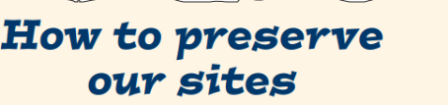
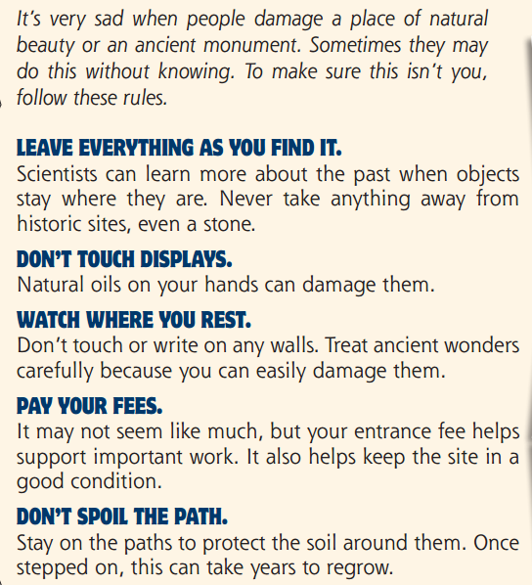
While-reading
How can we preserve ancient wonders?
=> We can preserve ancient wonders by leaving them as we find them, not touching them or writing on any walls. We can also pay the entrance fees and always stay on paths when you visit them.

Slide 13
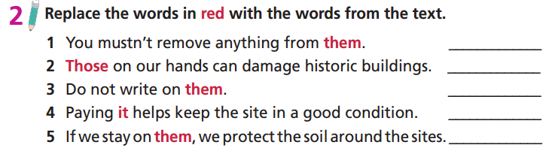
Read the instruction quickly. Underline the key words. What are we going to do?

Slide 14
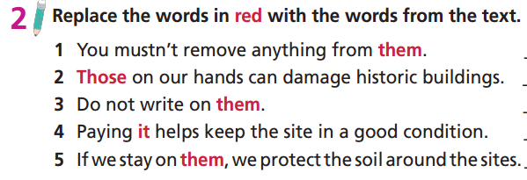
While-reading
historic sites
natural oils
walls
entrance fee
paths

Slide 15
Read the text again, then choose suitable words to complete the things we should do to preserve ancient wonders.
Extra Practice
condition * hold * paths * position * walls
position
Try not to change the ………………….. of things.
Never ………………….. the things on display.
Try not to touch the ………………….. of ancient wonders.
Pay for tickets to visit the sites to help keep them in good …………………..
Do not walk out of the ………………….. to protect the soil.
hold
walls
condition
paths

Slide 16
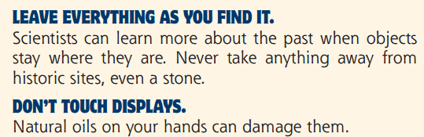
Now, read again to check the answers.
position
Try not to change the …………………..of things.
Never ………………….. the things on display.
hold

Slide 17
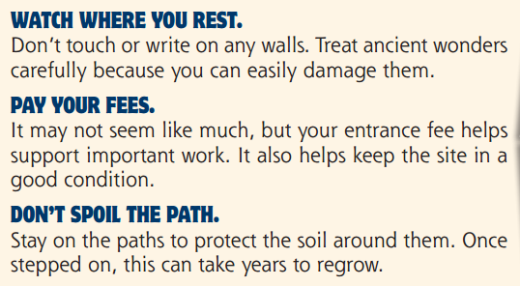
Now, read again to check the answers.
walls
Try not to touch the ………………….. of ancient wonders.
Pay for tickets to visit the sites to help keep them in good …………………..
Do not walk out of the ………………….. to protect the soil.
condition
paths

Slide 18
Post-reading
Work in pairs.
We can preserve our sites by ……..

Slide 19
Post-reading
Work in pairs.
Example
We can preserve our sites by paying the entrance fee while visiting a monument. This way we can help to keep the monument in a good condition. We should never touch
anything with our hands because natural oils in our hands can damage a monument. We should never touch or write on any walls. Finally, we should stay on paths around a
monument.

Slide 20

Work in groups.
Hi everyone!
Our world is full of wonders and it’s important to protect them. You can follow these simple rules. ……………………………..
Thank you!
Use ideas in the reading text (Task 1) and find more ways to protect wonders.
e.g.
pay entrance fee => keep the site in good condition
natural oils in our hands can damage the monuments => never touch them, etc.

Slide 21
Work in groups.
e.g.
Hi everyone!
Our world is full of wonders and it’s important to protect them. You can follow these simple rules.
We all love to visit a historic site or ancient monument, but remember to always pay your entrance fee. This will help to keep the site/monument in a good condition. Natural oils in our hands can damage the monuments, so just take a look at them but never touch, write or carve on them. Next time, when you visit a historical site or an ancient monument, have these simple rules in mind. In this way, they will survive for many generations to come!
Thank you.

Slide 22

CONSOLIDATION

Slide 23
Write a paragraph (60-80 words) to describe the importance of ancient wonders and what you can do to preserve them.
E.g.
Ancient wonders brings us the beautiful sights and help us understand more about the past. Therefore, it is very important to preserve them. There are many small actions we can do to protect those places. For example, we can pay entrance fees to help keep the ancient wonders in good condition. We can also avoid touching things there because the natural oil in our hands can damage them.

Slide 24

WRAP-UP

Slide 25
Today’s lesson
Vocabularies
ancient
preserve
display
damage
support
path
soil
Reading
Read for key information
Speaking
- Talk about national heritage.
- Make a presentation about how to protect wonders (optional).

Slide 26
Homework
Practise the vocabularies and make sentences using them.
Do the exercises in TA 7 Right on WB (page 47)
Prepare the next lesson (page 91 SB)

Slide 27

Enjoy your day!

